Slide 1

NETFLIX BIG DATA ANALYTICS
Presentation Slides Content

Slide 2
Netflix Movies & TV Shows Big Data Analytics Project
Using Python | SQL | Power BI
vipin gautam
Big Data Analytics Course
December 2025

Slide 3
📋 Today's Presentation
AGENDA
01
02
03
Project Overview & Objectives
Dataset Introduction
Methodology & Tools
04
05
06
Data Cleaning Process
Key Findings & Insights
SQL Analysis Highlights
07
08
09
Power BI Dashboard Demo
Business Recommendations
Conclusion & Q&A

Slide 4
🎯 Objective
PROJECT OVERVIEW
Perform end-to-end analysis of Netflix's content library to:
Understand content distribution patterns
Identify geographic and temporal trends
Analyze audience targeting strategies
Provide data-driven business recommendations
Deliverables
✅ Python Analysis (Data Cleaning + EDA)
✅ SQL Queries (40+ business queries)
✅ Power BI Dashboard (Interactive visualizations)
✅ Comprehensive Report

Slide 5

📊 Dataset Specifications
DATASET OVERVIEW
Source: Kaggle - Netflix Movies & TV Shows
Size: 8,807 titles
Time Period: Content as of 2021
Attributes: 12 columns
Key Columns:
Title, Type, Director, Cast
Country, Date Added, Release Year
Rating, Duration, Genres
Challenge: Missing values, inconsistent formats, multi-value fields

Slide 6

🔧 Technology Stack
TOOLS & TECHNOLOGIES
Python 3.x
SQL
pandas, numpy (Data manipulation)
SQLite Database
matplotlib, seaborn (Visualization)
Complex queries for insights
Jupyter Notebook (Development)
Power BI
GitHub
Interactive dashboards
Version control
Business intelligence
Project documentation

Slide 7

📈 Analysis Workflow
METHODOLOGY
Data Acquisition
Data Loading & Exploration
Data Cleaning & Preprocessing
Exploratory Data Analysis
SQL Database Analysis
Power BI Dashboard Creation
Insights & Recommendations
Approach: Systematic, reproducible, business-focused

Slide 8

🧹 Data Quality Issues
DATA CLEANING CHALLENGES
Issue
Impact
Solution
Missing Directors (30%)
Analysis gaps
Fill with "Unknown"
Missing Cast (9%)
Limited insights
Fill with "No Info"
Inconsistent Dates
Temporal analysis errors
Standardize format
Multi-value Fields
Complex parsing
Split & analyze
Duplicates
Skewed results
Remove
Result: Clean dataset with 95%+ completeness

Slide 9
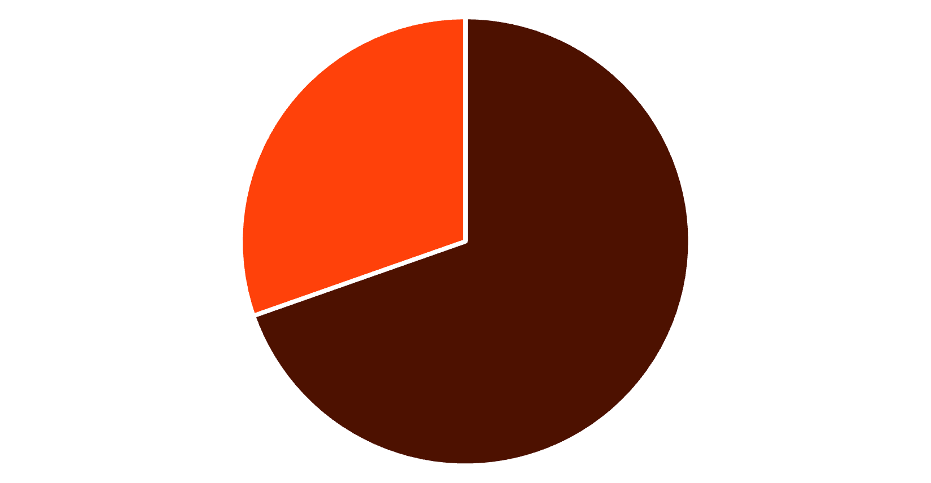

🎬 Movies vs TV Shows
KEY FINDING #1 - CONTENT TYPE
Distribution:
Movies: 69.6% (6,131 titles)
TV Shows: 30.4% (2,676 titles)
Trend Analysis:
TV shows growing 5% YoY
Shift from 80/20 (2015) to 70/30 (2021)
Insight: Netflix responding to binge-watching culture
Movies
TV Shows

Slide 10
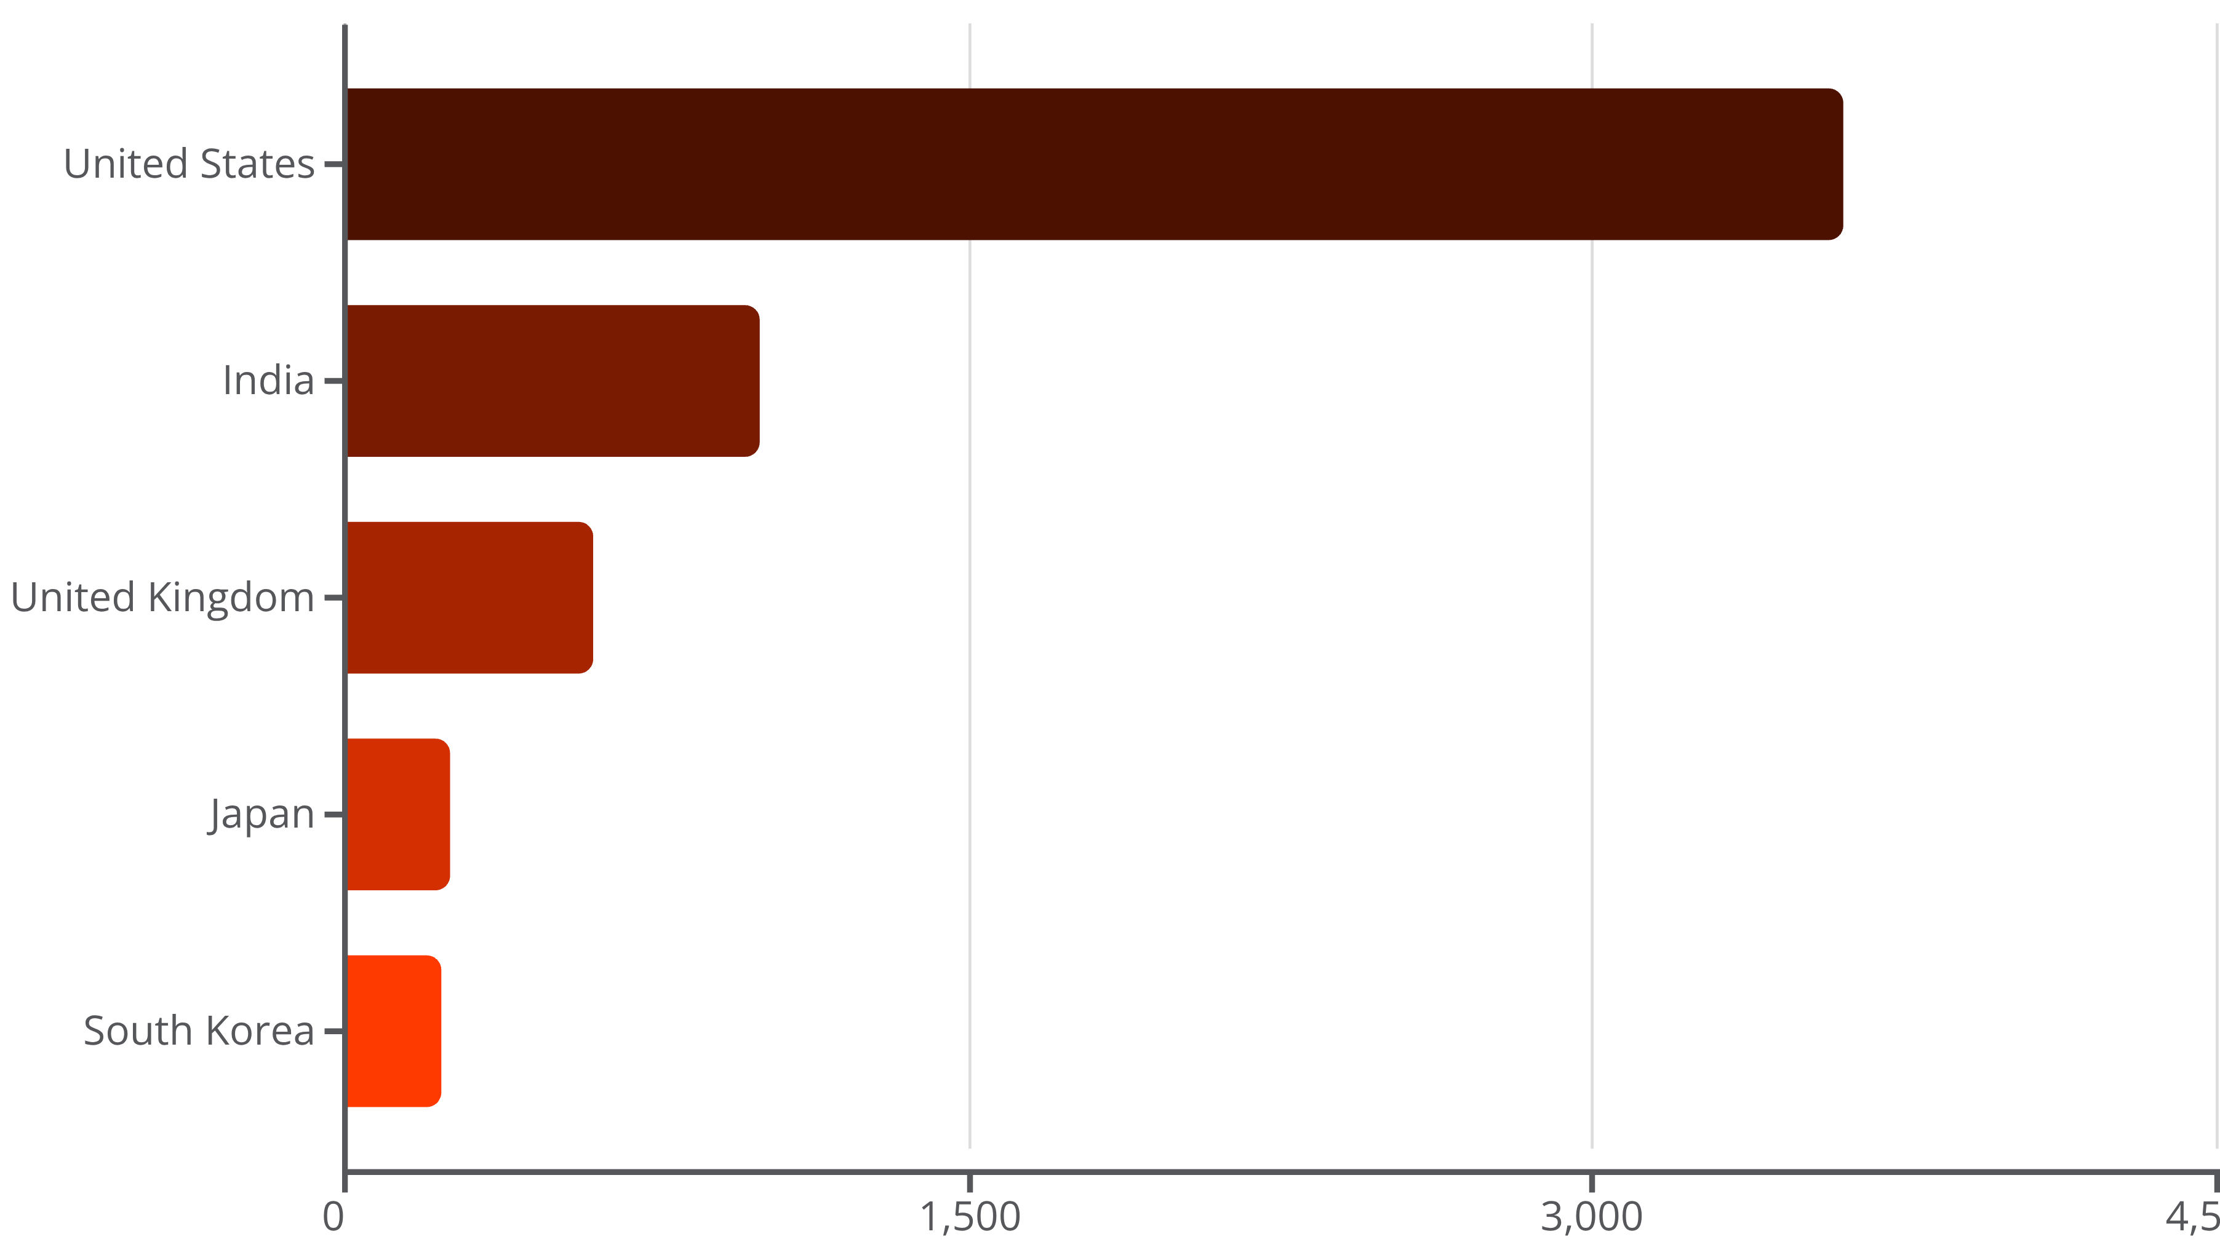
🌍 Top Content Producing Countries
KEY FINDING #2 - GEOGRAPHIC DISTRIBUTION
Insight:
US dominance clear
Emerging markets (India, South Korea) strong
100+ countries with <20 titles (long tail)

