Slide 1


Netflix Content Analytics Dashboard
A comprehensive big data analysis exploring content patterns, geographic distribution, and viewing trends across Netflix's vast entertainment library
PYTHON
SQL
DATA VISUALIZATION

Slide 2
PROJECT OVERVIEW
Understanding Netflix's Content Universe
This interactive dashboard transforms raw Netflix data into actionable insights, revealing patterns in content strategy, production trends, and audience targeting across 120+ countries and nearly 9,000 titles.
Technologies Used
Python for data processing and analysis
pandas for data manipulation
By analyzing temporal trends, geographic distribution, and genre preferences, we uncover the strategic decisions driving one of the world's leading streaming platforms.
matplotlib for visualization
SQL for database queries
HTML/CSS/JavaScript for dashboard
Analysis Period: Multi-year dataset spanning Netflix's expansion phase (2015-2020+)

Slide 3
Content Library at a Glance
8,807
6,131
2,676
120+
Total Titles
Movies
TV Shows
Countries
Complete content catalog analyzed across all categories and regions
Feature films spanning multiple genres, languages, and production countries
Series content including originals, licensed shows, and international productions
Global reach with content from diverse markets and cultures worldwide
These metrics represent Netflix's transformation from a DVD rental service to a global streaming giant, with strategic investments in diverse content portfolios.

Slide 4

Movies Dominate the Content Mix
Strategic Content Balance
Movies represent 69.6% of Netflix's library, reflecting the platform's emphasis on film content for immediate viewing satisfaction.
TV shows, while fewer in number, drive sustained engagement through episodic storytelling and binge-watching behavior, accounting for 30.4% of the catalog.
Movies
TV Shows
This distribution aligns with consumption patterns where movies offer quick entertainment while series build long-term subscriber retention.

Slide 5

GLOBAL DISTRIBUTION
Top Content Producing Countries
The United States dominates with 45% of total content, but Netflix's investment in international markets—particularly India, UK, and Asian markets—demonstrates a clear globalization strategy to capture diverse audiences worldwide.

Slide 6

Content Expansion Timeline
1
Pre-2015: Foundation
Limited content library focused primarily on licensed US productions
2
2015-2017: Acceleration
Rapid content acquisition and initial Netflix Originals launch phase
3
2018-2019: Peak Growth
Massive expansion with thousands of titles added annually across all categories
4
2020+: Maturation
Strategic curation balancing quantity with quality and audience preferences
The 2015-2020 period marked Netflix's most aggressive content expansion, with year-over-year increases exceeding 50% as the company invested billions in securing global streaming dominance.

Slide 7




Genre Preferences and Content Ratings
Top 10 Genre Categories
Content Rating Distribution
International Movies
Global cinema from diverse cultures
Dramas
37%
Character-driven storytelling
Comedies
Humor across cultures and styles
TV-MA
Action & Adventure
Mature audiences
High-energy entertainment
Documentaries
Real-world stories and education
22%
TV-14
Teen-appropriate
18%
R-Rated
Adult content
23%
Other Ratings
Family & general
TV-MA content leads the platform, reflecting Netflix's positioning as an adult-focused entertainment service, though family-friendly options remain strategically important for household retention.

Slide 8
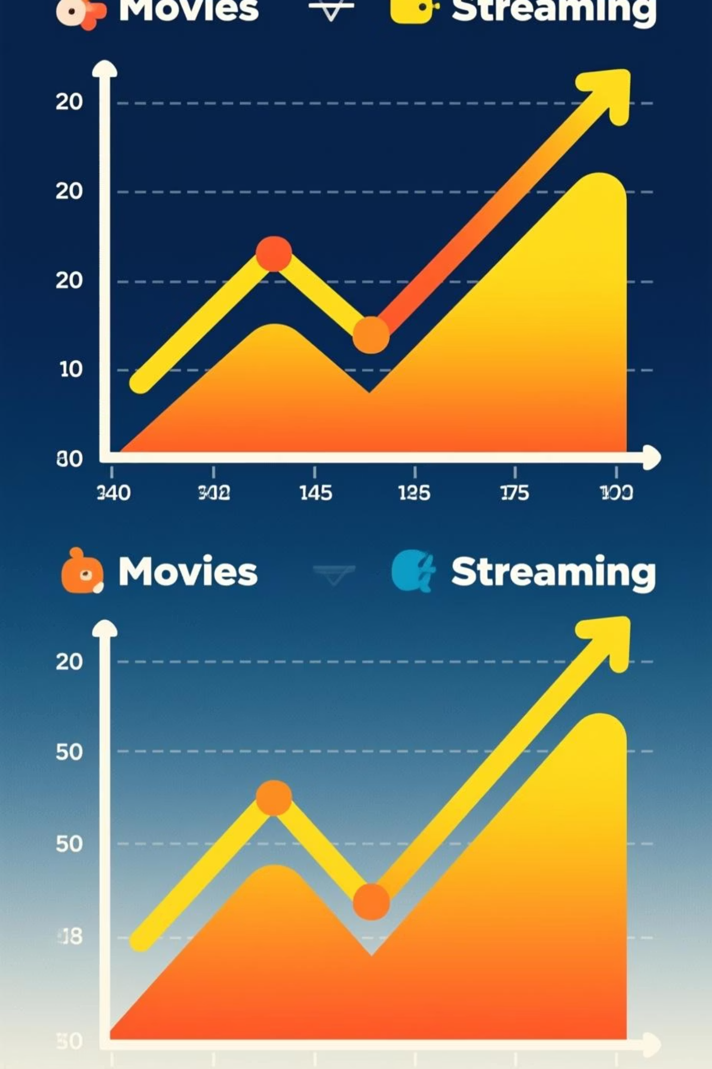



GROWTH ANALYSIS
Movies vs TV Shows: Evolution Over Time
Movie Growth Pattern
Steady accumulation with emphasis on international acquisitions and varied genres for broad appeal
TV Show Strategy
Strategic investment in original series and licensed content to drive subscription retention
Portfolio Balance
Maintaining optimal mix to serve different viewing habits and maximize platform engagement
While movies provide catalog depth, TV shows create viewing habits. Netflix's dual strategy ensures both immediate satisfaction and long-term engagement across subscriber segments.

Slide 9
Key Strategic Insights
Content Mix Optimization
Globalization Success
The 70-30 movie-to-TV ratio provides catalog breadth while TV originals drive subscriber loyalty and reduce churn
45% US content balanced with strong international presence positions Netflix for sustained global growth
Aggressive Expansion Phase
Mature Audience Focus
2015-2020 growth trajectory established Netflix as the dominant streaming platform through massive content investment
TV-MA dominance reflects strategic positioning toward adult demographics with higher spending power
These insights reveal a sophisticated content strategy balancing global reach, genre diversity, and audience targeting to maintain market leadership in the competitive streaming landscape.

Slide 10


Project Methodology & Technical Implementation
Data Processing Pipeline
01
Data Extraction
Collected and cleaned 8,807 Netflix records using Python pandas
02
SQL Analysis
Performed complex queries to identify patterns and trends
03
Visualization
Created interactive charts using matplotlib and web technologies
04
Dashboard Design
Built responsive interface with HTML/CSS/JavaScript
Created by Vipin GautamDecember 2025
This project demonstrates advanced big data analytics capabilities, transforming raw streaming data into actionable business intelligence.

