Slide 1
An Exploration of Translanguaging on Social Media by Hispanic International Students in the United States
Cristina Reguera-Gómez, Utrecht University
TACOS Conference 2023

Slide 2
Introduction
Translanguaging can be defined as “the act performed by bilinguals of accessing different linguistic features or various modes of what are described as autonomous languages, in order to maximize communicative potential” (García, 2009, p. 140).
It was first coined by Cen Williams in the 1980s, and it referenced the way Welsh-English bilingual students communicated in the classroom, in comparison to their monolingual peers (as cited in Lewis et al., 2012). Later research in the subject has often continued on the same field of education. Far too little attention has been paid to translanguaging in real-life situations, especially translanguaging in daily communication through social networks.
Much less is known about the way Spanish-English bilingual international students translanguage in English-speaking countries. This specific demographic engages in translanguaging in a different way from bilingual individuals who have resided in only one country for an extended period of time. After all, international students are introduced into a new environment with a different culture, so the effects of this situation may be noticeable in the way they translanguage.

Slide 3
Literature Review
Language & Identity
While speaking we are constantly negotiating and renegotiating ourselves within a social context, and characteristics like gender, ethnicity or class are an implicit part of this negotiation (Norton, 2010).
A study by Fuller (2007) focused on the language choices preferred for constructing social identities by a group of fourth-graders who were bilingual in Spanish and English. The results showed that these children used one language or another depending mainly on the environment and person they were speaking to. However, some children also showed signs of translanguaging between Spanish and English depending on the situation.

Slide 4
Literature Review
Language & Emotions
The Facilitating Words Hypothesis: “the integration of speech and emotional expression was expected to occur with the children’s earlier learned and most frequent words since these are the words they presumably know best” (Bloom & Beckwith, 1989, p. 318).
Some studies suggest the predilection of bilinguals for expressing certain emotions in their L1 (Ferré et al., 2018), while others show a greater response in the L2 when it had become the dominant tongue (Sutton et al., 2007).

Slide 5
Literature Review
Translanguaging & Creativity
Creativity can be defined as:
“The ability to choose between following and flouting the rules and norms of behaviour, including the use of language, and to push and break boundaries between the old and the new, the conventional and the original, and the acceptable and the challenging” (Wei, 2011, p. 94).
An example of creativity:
I put the forks en las mesas: ‘I put the forks on the tables’ (McClure, 1977)
El hombre who saw the accident es cubano: ‘The man who saw the accident is
Cuban’ (Gingras, 1974)
Estaba training para pelear: ‘He was training to fight’ (Pfaff, 1979)
(As cited in Woolford, 1983, p. 2)

Slide 6
Literature Review
Translanguaging in the Social Networks
In a study conducted by Schreiber (2015), it was shown how a Serbian university student translanguaged on Facebook as a way to showcase his local and global identity. More specifically, the participant was a hip-hop artist who translanguaged in English and Serbian in order to share his music. While his lyrics were admired by online users, his writing was not equally praised in his EFL writing classes.
Dumrukcic (2020) performed a similar study with 360 participants from various socio-cultural backgrounds in order to find the reasons why multilingual individuals translanguaged and their attitudes towards it:
“Given that around one quarter of the respondents agreed with the statement that mixing languages is an indication of poor language skills, the results show that there are still preconceived notions that translanguaging occurs due to language incompetence. However…over half of the respondents said they find it easier to express themselves when they are allowed to use multiple languages within the same sentence or social media post” (p. 129).

Slide 7
Methodology
This study analysed the data of five international students from Spanish-speaking countries, attending American universities at the time of the study. All of these participants were in their 20s and used social networks on a daily basis. There were four women and one man, and they were from Spain, Colombia and Ecuador.
The data set comprises messages and posts the participants shared on their social networks. The total number of messages and posts was 273, of which 227 are from WhatsApp, 38 from Instagram and 8 from Twitter. The messages were analysed according to two types of discourse analysis: Critical Discourse Analysis and Multilingual Discourse Analysis.
As the first step of the analytical procedure in this study, the data segments with translanguaging occurrences were categorised according to the level at which translanguaging was performed: within the word level, at the sentential level and at the suprasentential level. After categorising the data based on linguistic patterns, the second step of the procedure was to identify for what social purposes the participants performed translanguaging. The analysis was focused on three social functions: expressing an identity, expressing emotions, and accommodating different types of audience.

Slide 8
How is Translanguaging Performed?
Translanguaging At the Word Level
Participant’s word use | English and Spanish Spelling | GenAm IPA transcription
Wolman | Walmart | [ˈwɔːl mɑːrt]
andergraun | underground | [ˈʌnd ᵊr ɡraʊnd]
iuembisi | UMBC | [ˈjuː em biː siː]
Washintong | Washington | [ˈwɑʃ ɪŋ tən]
Table 1: Examples of pronunciation respelling

Slide 9
How is Translanguaging Performed?
Translanguaging at the Sentential Level
Participant’s word use | English | Spanish
Terminé el midterm. | I finished the midterm. | Terminé el examen.
¿Recuerdas si tuviste que subir la welcome letter? | Do you remember if you had to upload the welcome letter? | ¿Recuerdas si tuviste que subir la carta de bienvenida?
Si tienes un hueco nos tomamos un coffee. | If you are free, let’s get a coffee. | Si tienes un hueco nos tomamos un café.
Table 2: Examples of gender agreement

Slide 10
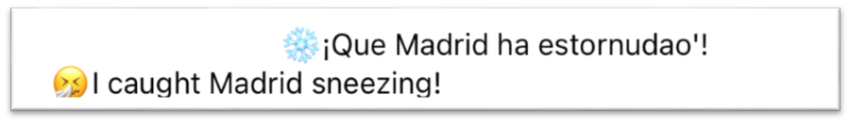

How is Translanguaging Performed?
Translanguaging at the Suprasentential Level
Figure 1: Example in translation
Figure 2: Example in hashtags

Slide 11
What Social Functions does Translanguaging Have?
Construction of Identity
Participant’s word use | English | Spanish
Estuve en fall 2019 y spring 2020. | I was in Fall 2019 and Spring 2020. | Estuve en el primer y el segundo cuatrimestre.
Te van a poner la A. | You will get an A. | Te van a poner el sobresaliente.
Quedamos a las 6 PM. | Let’s meet at 6 PM. | Quedamos a las 18h.
Table 3: Examples of country-specific conventions

Slide 12

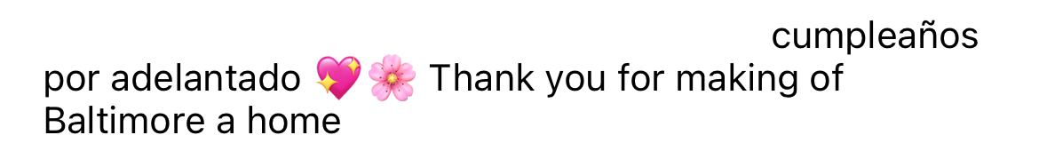
What Social Functions does Translanguaging Have?
Expression of Emotions
Figure 3: Example of expression of emotions in Spanish
Figure 4: Example of expression of emotions in English

Slide 13
What Social Functions does Translanguaging Have?
Adaptation to the Audience
The participants engaged in different kinds of translanguaging practices depending on the audience of the messages and posts. Firstly, this fact can be explained in the framework of Howard Gile’s Communication Accommodation Theory, which states that speakers modify their way of speaking and interacting with others depending on the context (as cited in Gasiorek, 2016). Secondly, Duggan and Brenner (2013) affirm that different social media platforms concentrate audience that belongs to different demographics.
In public posts in Instagram and Twitter with a bigger audience of bilingual and monolingual followers, participants generally restrained themselves from translanguaging or did it at the sentential level. In private conversations with other Spanish-English bilingual international students on WhatsApp, translanguaging occured more frequently and at the word/sentential level.

Slide 14
Conclusion
The results show that participants engage in three kinds of translanguaging: at the word level, at the sentential level and at the suprasentential level. During their communicative exchanges, it was noticeable to see how they manifest translanguaging through many creative forms.
The data analysed also evidences that translanguaging fulfils social functions as a way of constructing identities, expressing emotions, and adapting to the audience. They display plenty of forms of translanguaging when speaking with fellow bilingual international students. However, they feel more self-conscious with a bigger and mixed audience of bilingual and monolingual speakers.

Slide 15
Bibliography
Bloom, L. & Beckwith, R. (1989). Talking with Feeling: Integrating Affective and Linguistic Expression in Early Language Development. Cognition & Emotion, 3(4), 313–342. doi:10.1080/02699938908412711
Duggan, M., & Brenner, J. (2013). The demographics of social media users, 2012. Pew Research Center’s Internet & American Life Project, 14, 1–14.
Dumrukcic, N. (2020). Translanguaging in social media: Output for FLT didactics. heiEDUCATION, 5, 109–137. doi:10.17885/heiup.heied.2020.5.24159
Ferré, P., Anglada-Tort, M., & Guasch, M. (2018). Processing of emotional words in bilinguals: Testing the effects of word concreteness, task type and language status. Second Language Research, 34(3), 371–394. doi:10.1177/0267658317744008
Fuller, J. M. (2007). Language Choice as a Means of Shaping Identity. Journal of Linguistic Anthropology, 17(1), 105–129. doi:10.1525/jlin.2007.17.1.105
García, O. (2009). Education, multilingualism and translanguaging in the 21st century. In T. Skutnabb-Kangas, R. Phillipson, A. K. Mohanty & M. Panda (Eds.), Social Justice Through Multilingual Education (pp. 140–158). Multilingual Matters.
Gasiorek, J. (2016). Theoretical Perspectives on Interpersonal Adjustments in Language and Communication. In Giles, H. (Ed.), Communication Accommodation Theory: Negotiating Personal Relationships and Social Identities across Contexts (pp. 13-35). Cambridge University Press. doi:10.1017/CBO9781316226537.002
Lewis, G., Jones, B., & Baker, C. (2012). Translanguaging: origins and development from school to street and beyond. Educational Research and Evaluation, 18(7), 641–654. doi:10.1080/13803611.2012.718488
Norton, B. (2010). Language and Identity. In N. Hornberger & S. McKay (Eds.), Sociolinguistics and language education (pp. 349–369). Multilingual Matters.
Schreiber, B. R. (2015). “I am what I am”: Multilingual identity and digital translanguaging. Language Learning & Technology, 19(3), 69–87. http://llt.msu.edu/issues/october2015/schreiber.pdf
Sutton, T. M., Altarriba, J., Gianico, J. L., & Basnight-Brown, D. M. (2007). The automatic access of emotion: Emotional Stroop effects in Spanish–English bilingual speakers. Cognition & Emotion, 21(5), 1077–1090. doi:10.1080/02699930601054133
Wei, L. (2011). Moment Analysis and translanguaging space: Discursive construction of identities by multilingual Chinese youth in Britain. Journal of Pragmatics, 43(5), 1222–1235. doi:10.1016/j.pragma.2010.07.035
Woolford, E. (1983). Bilingual Code-Switching and Syntactic Theory. Linguistic Inquiry, 14(3), 520–536. http://www.jstor.org/stable/4178342

Slide 16
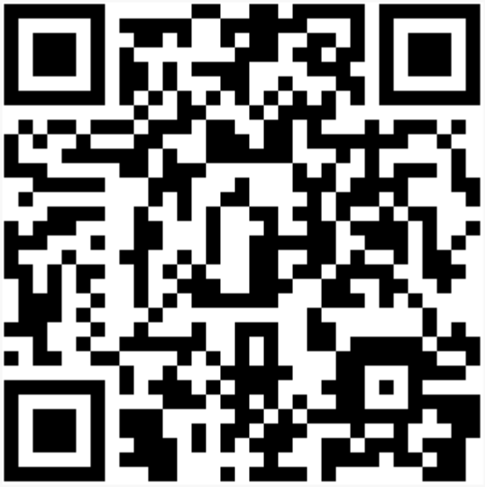
Thank you for your attention. Any questions? ☺
Contact Info

