Slide 1

Prediction of Customer’s Intention to Purchase
Group 4
x21168580 – Amruta Venkatesh
x21155054 – raj sonawane x21164274 – VIPLav gadewar
x21123292 – Kapil lalwani
x19214413 – rohan kore

Slide 2

Objective
• Predicting a customer’s buying intention using Web session dataset. • Thorough examination of historical data and forecasting of future patterns that will aid in creating positive income.

Slide 3

Dataset Overview:
The dataset is obtained through UCI machine learning repository ”Online Shoppers Purchasing Intention” (https://archive.ics.uci.edu/ml/datasets/Online+Shoppers+Purchasing+Intention+Dataset)consists of feature vectors from 12,330 web sessions with 18 attributes

Slide 4

CHOSEN TECHNIQUE
Extreme Gradient Boosting (XGb) Classifier

Slide 5

CRISP-DM Methodology

Slide 6
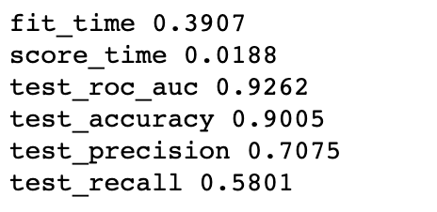
Extreme Gradient Boosting (XGB) Classifier Results

Slide 7
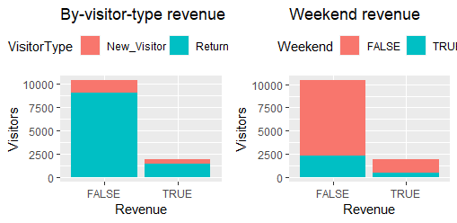
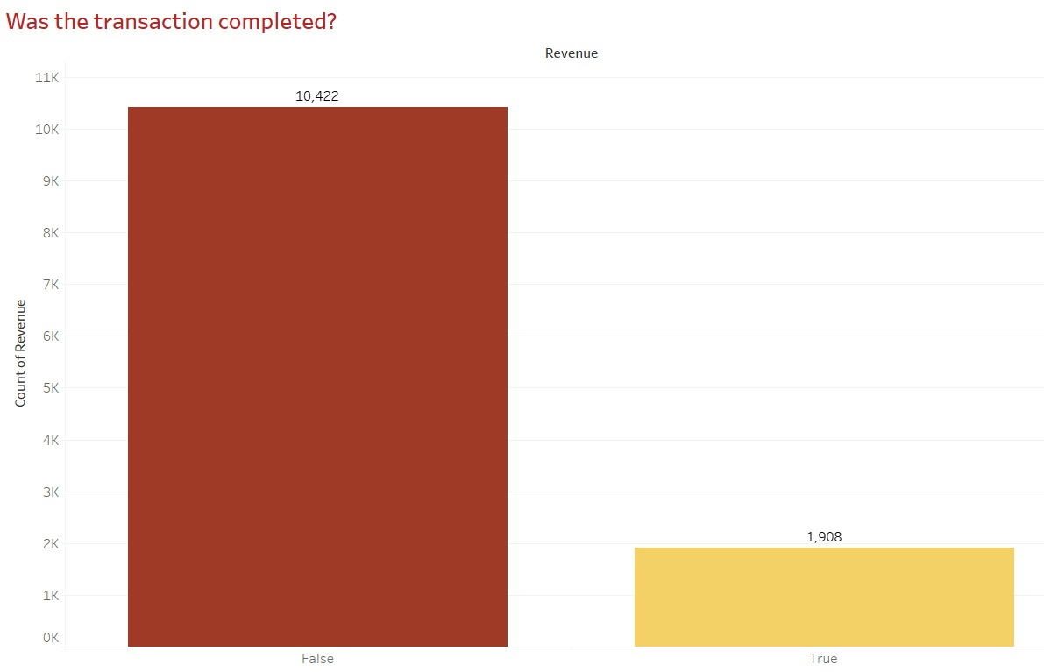
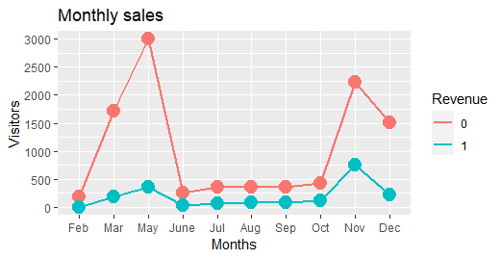
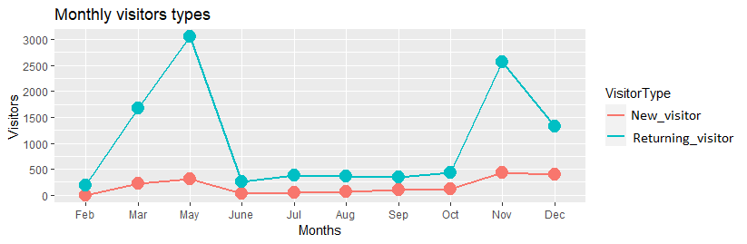
QUANTITATIVE AND QUALITATIVE INTERPRETATION

Slide 8

CONCLUSION

Slide 9

THANK YOU

