Slide 1



Slide 2
Contents:
Concept of inheritance
Types of Inheritance in java
Abstract Class
Interfaces
Final Class
Packages

Slide 3


Slide 4

Inheritance is the mechanism through which we can derived classes from other classes.
The derived class is called as child class or the subclass and the class from which we are deriving the subclass is called the base class or the parent class.
To derive a class in java the keyword extends is used.

Slide 5
Terminology
Inheritance is a fundamental Object Oriented concept
A class can be defined as a "subclass" of another class.
The subclass inherits all data attributes of its superclass
The subclass inherits all methods of its superclass
The subclass inherits all associations of its superclass
The subclass can:
Add new functionality
Use inherited functionality
Override inherited functionality
Person
- name: String
- dob: Date
superclass:
Employee
- employeeID: int
- salary: int
- startDate: Date
subclass:

Slide 6
Inheritance
When an object is created using new, the system must allocate enough memory to hold all its instance variables.
This includes any inherited instance variables
In this example, we can say that an Employee "is a kind of" Person.
An Employee object inherits all of the attributes, methods and associations of Person
Person
- name: String
- dob: Date
Person
name = "John Smith"
dob = Jan 13, 1954
Employee
name = "Sally Halls"
dob = Mar 15, 1968
employeeID = 37518
salary = 65000
startDate = Dec 15, 2000
is a kind of
Employee
- employeeID: int
- salary: int
- startDate: Date

Slide 7
Inheritance in Java
Inheritance is declared using the "extends" keyword
public class Person
{ private String name;
private Date dob;
[...]
Person
- name: String
- dob: Date
public class Employee extends Person
{ private int employeID;
private int salary;
private Date startDate;
[...]
Employee
- employeeID: int
- salary: int
- startDate: Date
Employee anEmployee = new Employee();

Slide 8
Inheritance Hierarchy
Each Java class has one (and only one) superclass.
C++ allows for multiple inheritance
Java does not support multiple inheritance
Inheritance creates a class hierarchy
Classes higher in the hierarchy are more general and more abstract
Classes lower in the hierarchy are more specific and concrete
Class
Class
Class
Class
Class
Class
Class
Class

Slide 9
The class called Object
At the very top of the inheritance tree is a class called Object
All Java classes inherit from Object.
The Object class is defined in the java.lang package
Object

Slide 10

Single Inheritance
Multilevel Inheritance
Java does not support multiple inheritance .

Slide 11
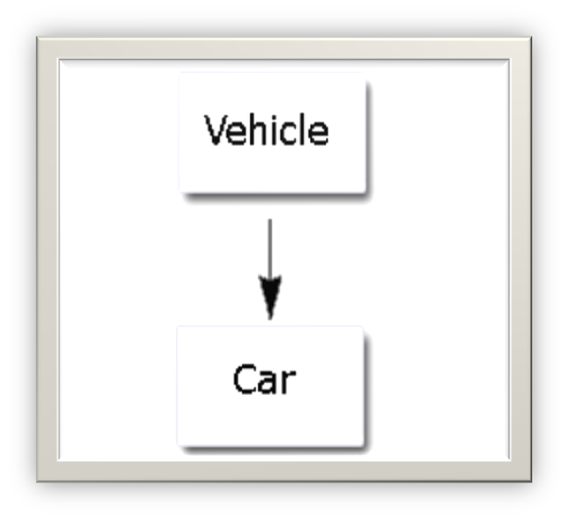
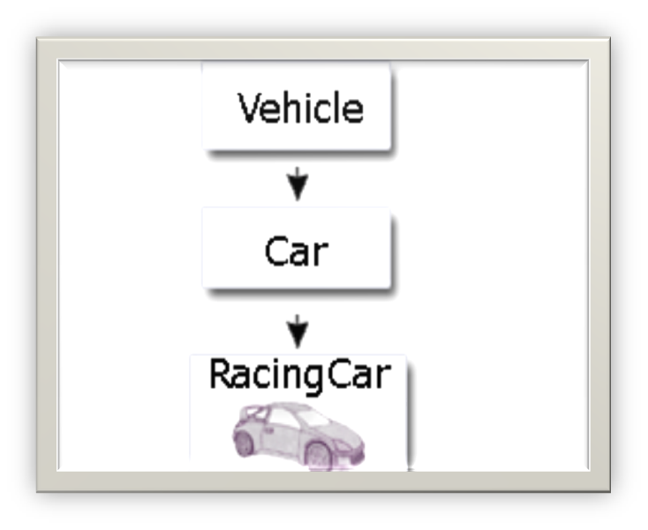
Single Inheritance
Multilevel Inheritance

Slide 12
Constructors in inheritance
Classes use constructors to initialize instance variables
When a subclass object is created, its constructor is called.
The subclass constructor to invoke the appropriate superclass constructors so that the instance variables defined in the superclass are properly initialized
Superclass constructors can be called using the "super" keyword It must be the first line of code in the constructor
If a call to super is not made, the system will automatically attempt to invoke the no-argument constructor of the superclass.

Slide 13
Constructors - Example
public class Bank
{
private String Name;
private int acno;
public Bank(int ano, String Name)
{
acno = ano;
Name = Name;
} }
public class Saving extends Bank
{
private float amount;
public Saving(int no, String name, float amt)
{
super(no, name);
amount=amt
}}

Slide 14

A method is overloaded if it has multiple definitions that are distinguished from one another by having different numbers or types of arguments
A method is overridden when a subclass gives a different definition of the method with the same number and types of arguments

Slide 15
Method Overriding
Subclasses inherit all methods from their superclass
But sometimes, the implementation of the method in the superclass does not provide the functionality required by the subclass.
In these cases, the method must be overridden.
To override a method, provide an implementation in the subclass.
The method in the subclass MUST have the exact same signature as the method it is overriding.

Slide 16
Method overriding - Example
public class Bank
{
private String Name;
private int acno;
protected float bal;
public void deposit(float amt)
{
if (amt>0.0)
bal = bal + amt;
}
public void withdraw(float amt)
{
if ((amt>0.0) && (bal>amt))
bal = bal - amt;
}
public float getBalance()
{ return bal; }
}

Slide 17
Method overriding - Example
public class OverdraftAccount extends Bank
{
private float limit;
public void withdraw(float amt)
{
if ((amt>0.0) && (getBalance()+ limit > amt))
bal = bal - amt;
}

Slide 18

Private variables and methods are not visible to subclasses or clients
Public variables and methods are visible to all subclasses and clients
Default Variables and methods with package are only visible to classes and subclasses defined in the same package as the class
Protected variable or method declared are visible to subclasses of the class and no other classes

Slide 19
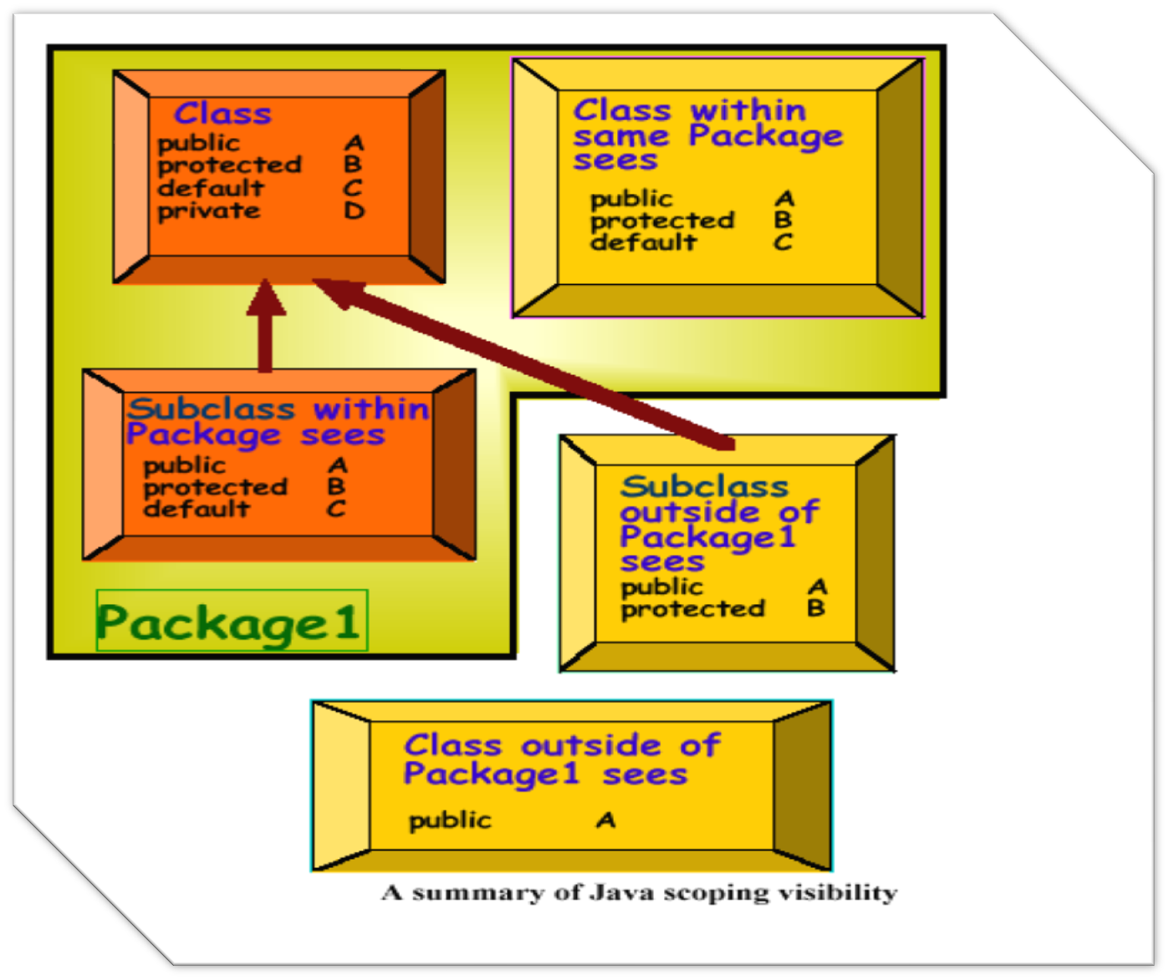

Slide 20

The call to super must be the first statement in the subclass constructor
Example:
class C extends B {
…
public C ( … ) {
super( B’s constructor arguments );
…
}
…

Slide 21

Static Binding
Determining which method will be invoked to respond to a message at compile time
Dynamic Binding
Determining which method will be invoked to respond to a message at run time
Required when method definitions are overridden in subclasses, since type of the receiver class may not be known until run time

Slide 22

Abstract classes are only used as super classes
Abstract classes contain abstract methods as well as non abstract methods .

Slide 23

Abstract methods have no body .
Abstract methods must be overridden in the derived classes , if derived class is not an abstract class.
Overridden abstract methods must have same signature as of super class method.

Slide 24

public abstract class Mouse implements Direction
{
abstract void makeMove( );
void show()
{ System.out.println(“hello”);
}
}

Slide 25

Java does not support multiple inheritance
Interface support multiple inheritance
Interface cannot be instantiate.

Slide 26

Methods in Interface
All methods in interface are public and abstract .
Variables in interface
All variables in interface are public static and final

Slide 27

27
To inherit interface “implements” keyword is used
A class can only extend one class, but it can implement many interfaces.
Example:
class MyListener implements KeyListener, ActionListener { … }
Notes:
27

Slide 28

Interface embassy
{ String place=“india”;//variable are public static final
void getdata();
}
Class indian_emp implements embassy
{
void getdata() //overriding
{ System.out.prinltn(place);}
}

Slide 29

29
When you implement an interface, all the methods must be overridden .
There can be a lot of methods
interface KeyListener { public void keyPressed(KeyEvent e); public void keyReleased(KeyEvent e); public void keyTyped(KeyEvent e); }
What if you only care about a couple of these methods?
Notes:
29

Slide 30

30
Solution: use an adapter class
An adapter class implements an interface and provides empty method bodies
class KeyAdapter implements KeyListener { public void keyPressed(KeyEvent e) { }; public void keyReleased(KeyEvent e) { }; public void keyTyped(KeyEvent e) { }; }
So one can override any one method from this class whichever is required.
Java provides a number of adapter classes
Notes:
30

Slide 31

Declaration of Package
Usage of Package
Package of Java Language

Slide 32

Way to group a related class and interface into one unit
To resolve the name conflicts between class names

Slide 33

Application programmer interface (API)
All classes provided to programmers along with the Java compiler (e.g. Math or MouseEvent)
Java expects to find these classes in separate directories or folders

Slide 34
Some Predefined Java Packages
Package Name | Contents
java.applet | Classes for implementing applets
java.awt | Classes for graphics, windows, and GUI’s
java.awt.event | Classes supporting AWT event handling
java.awt.image | Classes for image handling
java.awt.peer | Interface definitions s for platform independent graphical user interfaces (GUI’s)
java.io | Classes for input and output
java.lang | Basic language classes like Math (always available in any Java program)
java.net | Classes for networking
java.util | Useful auxiliary classes like Date

Slide 35

Object
Wrapper Class
Number
System
Character
String
Integer
Long
Boolean
StringBuffer
Float
Double

Slide 36

Part of the standard Java API (Application Programming Interface)
java
util
lang
LinkedList
Stack
zip
String
Inflate
Vector
Hashtable
Object
import java.util.LinkedList;
import java.util.*;
java.util.LinkedList
OR
LinkedList
after
or

Slide 37

java.util.Date d =
new java.util.Date();
java.awt.Point p =
new java.awt.Point(1,2);
java.awt.Button b =
new java.awt.Button();
import java.util.date;
Import java.awt.*;
…
Date d = new Date();
Point p = new Point(1,2);
Button b = new Button();

Slide 38

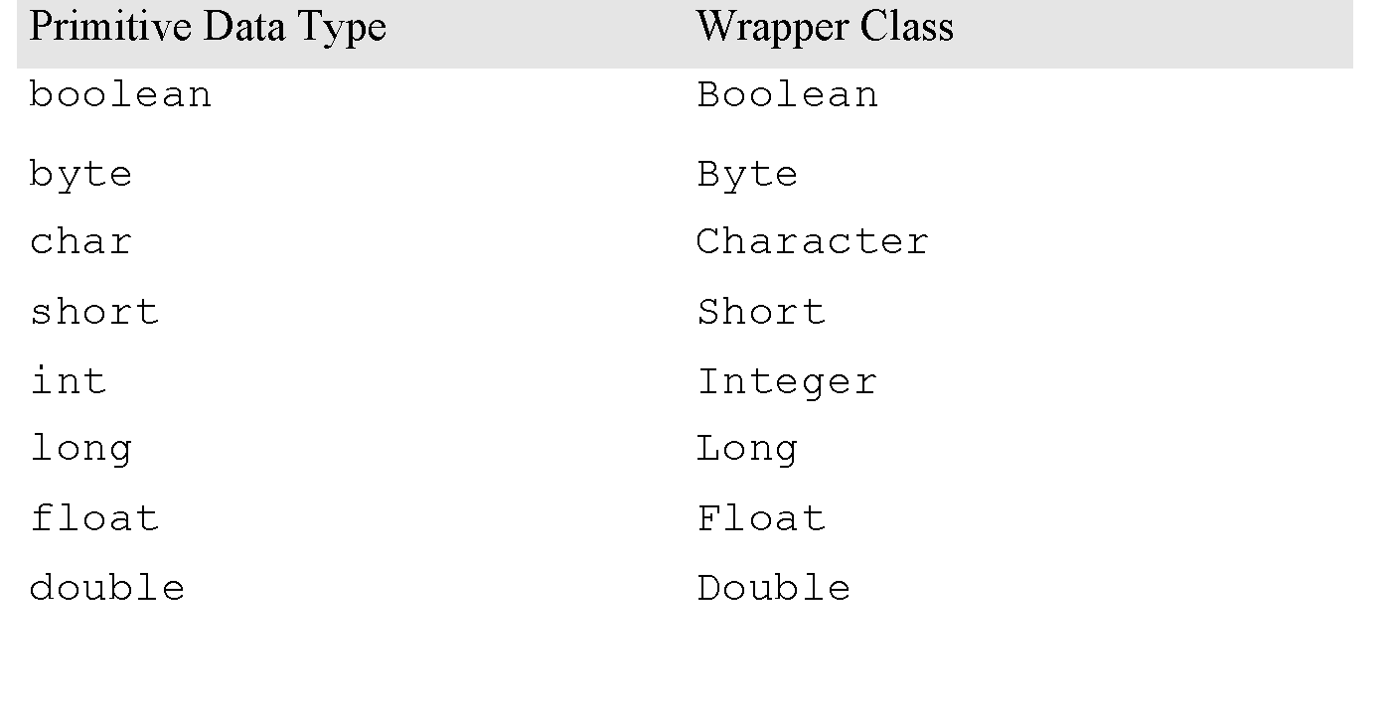

Slide 39

suppose if we have
1) Package name = test
2) File name = Emp.java , Person.java,…..
3)Create a folder with name test and put all class
files inside test folder .
4) Set test folder inside classpath

Slide 40

The source code file in package must contain a package statement as its first non-commented statement
package package_name;
Several packages can be stored in the same directory
Classes in different directories cannot be part of the same package

Slide 41
Putting classes in packages
To put a class into a package, one uses the "package" statement
The package statement MUST be the first line of code within the file.
If no package statement is supplied, the class is placed in the "default" package
The default package is a package with no name
In file Stock.java:
package org.afox.financial.inventory;
public class Stock

Slide 42

Using a fully qualified component name
x = java.lang.Math.sqrt(3);
Import all classes
import package.name.*;
Import particular classes
import package.name.class_name;

Slide 43

Super class of all classes
All classes are to inherit the methods of Object class
Method
Object clone() : To copy the object equally
boolean equals(Object obj) :
Compare the object as parameter with the object which calls this method
Class getClass() : To get Class object corresponding to object
String toString() : Convert the object into string
wait(), notify() : To control the status of thread

Slide 44
.jar files
.jar files are created using the jar command
The jar command is included with the Java SDK distribution
Note: The .jar file format is the SAME as the .zip file format
See the Java SDK Documentation for the jar program.
Jar files can be defined with a main class. If a .jar file has a main class defined, it can be executed using the following command:
java -jar filename.jar

Slide 45

1). Does a subclass inherit both member variables and methods?
A. No—only member variables are inherited.
B. No—only methods are inherited.
C. Yes—both are inherited.
D. Yes—but only one or the other are inherited.

Slide 46
What must a non-abstract child do about an abstract method in its parent class?
a. A child must override an abstract method inherited from its parent by defining a method with the same signature and same return type.
b. A child must define an additional method similar to the one inherited from its parent by defining a method with the same signature and different return type.
c. A child must not define any method with the same signature as the parent's abstract method.
d. A non-abstract child must define an abstract method with the same signature and same return type as the parent's abstract method.

Slide 47
What must be true if a child of an abstract parent class does not override all of the parent's abstract methods?
a. This is always an error.
b. The child class itself must be declared to be abstract.
c. Child classes are automatically non-abstract,
d. The parent class is in error.

Slide 48
Can an abstract method be defined in a non-abstract class?
a. No—if a class defines an abstract method the class itself must be abstract.
b. No—only classes are abstract, not methods.
c. Yes—a method can be declared abstract in any parent as long as the child classes also declare it abstract.
d. Yes—there is no restriction on where abstract methods can be defined.

Slide 49
All the classes in a package can be simultaneously imported using *.
A) True
B) False

Slide 50
Can an abstract method be final?
Can an abstract method be static ?
(false)
(false)

Slide 51
Java 8 - Default Methods
Java 8 introduces a new concept of default method implementation in interfaces.
Example
public interface vehicle {
default void print(){
System.out.println("I am a vehicle!");
}
}

Slide 52
Multiple Defaults
With default functions in interfaces, there is a possibility that a class is implementing two interfaces with same default methods

Slide 53
Example
interface t1{
static void show()
{
System.out.println("show method 2");
}
default void print()
{
System.out.println("printmethod 2");
}}

Slide 54
interface java8interface
{
void paint();
static void show() { System.out.println("show method 1"); }
default void print() { System.out.println("printmethod 1");}
}

Slide 55
class tester implements java8interface,t1
{
public void print()
{ java8interface.super.print();
System.out.println("dsdsd");
}
void show(){}
public void paint(){}
public static void main(String h[])
{tester j= new tester ();
j.print();
java8interface.show();
t1.show();
}}

Slide 59
Q1. What is the error in the following code? class Test {abstract void display( );}
1. No error
2. Method display( ) should be declared as static
3. Test class should be declared as abstract
4. Test class should be declared as public
Correct Answer : 3

Slide 60
Q2. When we implement an interface method, it should be declared as public.
Correct Answer : T
Q3. Any class may be inherited by another class in the package.
Correct Answer : T
Q4. A class may be both abstract and final.
Correct Answer : F

Slide 61
Q5. We can overload methods with differences only in their return type.
Correct Answer : F
Q 6. JAVA supports multi dimensional arrays.
Correct Answer : T

Slide 62
Q14. how do objects pass messages in java ?
1. they pass messages by modifying each other`s fields.
2. they pass messages by modifying the static variables of each other`s classes.
3. they pass messages by calling each other`s instance methods.
4. they pass messages by calling static methods of each other`s classes .
Correct Answer : 3

Slide 63
Q . Because finalize() belongs to the java.lang.Object, it is present in all ________
1. objects
2. classes
3. methods
4. none of above
Correct Answer : 2

Slide 64
Q . A program written in java programing language can run on any computer because the Java Virtual Machine interpret the prog for the native operating system.
Correct Answer : T

Slide 65
Q22. Which statements about the output of following program are true. public class EqualTest { public static void main(String[] args) { String s1="YES"; String s2="YES"; if(s1==s2) System.out.println("equal"); String s3= new String ("YES"); String s4= new String("YES"); if(s3==s4) System.out.println("s3 eq s4"); }}

Slide 66
1. "equal" is printed, "s3 eq s4" is printed.
2. "equal" is printed only.
3. "s3 eq s4" is printed only.
4. nothing is printed.
Correct Answer : 2

Slide 67
Q24. Interface method can be declared with the following modifiers a.public b.none (i.e. no access modifiers) c.private. d. static e. Native f.Synchronized
1. abc
2. abd
3. aef
4. acf
Correct Answer : 2

Slide 68
Q . Once string object is created, its contents cannot be altered.
Correct Answer : T
Q . Every method of final class is implicitly final.
Correct Answer : T

Slide 69
Q. Interfaces can be declared abstract.
Correct Answer : T

Slide 70
Q. An interface can extend any number of other interfaces and can be extended by any number of interfaces
Correct Answer : T
Interface t1{}
Interface java8interface{}
interface p extends t1,java8interface{}

Slide 73

http://download.oracle.com/javase/tutorial/java/package/packages.html

