Slide 1
Indian Institute of Technology Kharagpur
Department of Industrial and Systems Engineering
Master Thesis Project: Final Evaluation
A Multi-Agent LLM Framework for Explainable Algorithmic Trading on NSE-Listed Equities
Presented by
Vipluv
Roll No. 22MF3IM22
Under the guidance of
Prof. S. P. Sarmah
Department of Industrial and Systems Engineering
November 2026

Slide 2
Introduction and Problem Statement
Background
Most stock-prediction models output a direction or a score without a supporting rationale.
Trading desks combine technical, fundamental, news and risk views before committing capital.
LLM-based trading agents have mainly been evaluated on US equities [2], [3]; NSE-listed stocks remain under-studied.
Transaction costs such as STT, stamp duty and slippage are often left out, although they decide whether a strategy is viable in practice.
Problem Statement
To design and evaluate an explainable multi-agent decision-support framework for NSE-listed equities that combines deep-learning price forecasting, LLM-based news sentiment, company fundamentals and a structured bull–bear debate, under a realistic Indian transaction-cost model.
Scope: 10 liquid NSE large-cap stocks (core study) and 30 stocks (extended study); daily buy, hold or flat decisions; out-of-sample evaluation from December 2018 to November 2026.
Vipluv (22MF3IM22)
Department of Industrial and Systems Engineering, IIT Kharagpur
2

Slide 3
Work Done Since the Mid-Semester Evaluation
Table 1. Plan presented at the mid-semester evaluation and the work carried out.
Planned work | Work carried out | Status
Larger LLM for the sentiment agent | Qwen2.5-3B scored on 10,240 headlines and compared with the 1.5B model | Completed
Longer data window and wider stock universe | 30 stocks, data up to 4 November 2026 (58,620 out-of-sample decisions) | Completed
Earnings-event study | Sentiment tested separately on 1,803 earnings-day observations | Completed
Point-in-time fundamentals agent | Annual reports of 30 companies, made visible to the agent 61 days after the year end | Completed
Cost-aware position sizing | Edge-versus-cost gate and a 5% no-trade band added to the risk manager | Completed
Full ablation re-run and explainability study | 16 configurations re-run on the core universe; four explainability checks | Completed
The mid-semester configurations were re-run with the final code and reproduce within 0.004 Sharpe.
Vipluv (22MF3IM22)
Department of Industrial and Systems Engineering, IIT Kharagpur
3

Slide 4
Proposed Framework
Daily OHLCV
prices
Technical agent
LSTM with attention [1]
Indian news
headlines
Sentiment agent
LLM headline scoring [2]
Bull–bear debate
LLM researchers [3]
Risk manager
Rule-based sizing,
cost gate and band
Trader
Buy, hold or flat
with rationale
India VIX and
Nifty 50
Regime agent
Trend, strength, volatility
Annual
reports
Fundamentals agent
Point-in-time ratios (new)
Fig. 1. Architecture of the framework. The fundamentals agent, the cost gate and the no-trade band were added after the mid-semester evaluation.
Each agent returns a stance, a confidence score and a written reason, or abstains when it has no evidence.
The debate is called only when the agents disagree with conviction: 10.5% of decisions with three agents, against 97.4% at mid-semester.
The rule-based risk manager applies volatility targeting, a drawdown brake and exposure caps, and now also checks the expected edge against the trading cost.
Vipluv (22MF3IM22)
Department of Industrial and Systems Engineering, IIT Kharagpur
4

Slide 5
Data and Experimental Design
Table 2. Data and evaluation setup.
Table 3. Indian transaction-cost model, per side.
Item | Details
Universe | 10 large-cap stocks (core); 30 stocks (extended)
Price data | Daily adjusted OHLCV (Yahoo Finance)
News data | 34,992 Indian financial headlines (Google News)
Fundamentals | Annual P&L and balance sheet, FY2015 – FY2026
Test period | Dec 2018 – Aug 2026 (core); to Nov 2026 (extended)
Validation | Walk-forward: 3-year train, 6-month test, 16 folds, with purging and embargo [4]
Decisions | 19,110 (core); 58,620 (extended)
Statistics | Block-bootstrap intervals, Holm correction [5], Deflated Sharpe Ratio [6]
Component | Buy | Sell
Securities transaction tax | 0.100% | 0.100%
Stamp duty | 0.015% | –
NSE transaction charge | 0.003% | 0.003%
SEBI turnover fee | 0.0001% | 0.0001%
GST (18% on charges) | 0.0006% | 0.0006%
Slippage | 0.050% | 0.050%
Total | 0.169% | 0.154%
Round trip ≈ 0.32% (32 bps). Decisions are taken at the close of day t and executed at the open of day t + 1.
Vipluv (22MF3IM22)
Department of Industrial and Systems Engineering, IIT Kharagpur
5

Slide 6
Fundamentals Agent and Cost-Aware Sizing
Point-in-time fundamentals agent
Cost-aware sizing in the risk manager
Annual profit-and-loss and balance-sheet data for 30 companies, FY2015 to FY2026.
A report is used only from 61 days after the financial year end, in line with the 60-day filing limit of SEBI LODR Regulation 33, so there is no look-ahead.
Inputs are profit growth, revenue growth, ROE and change in ROE, standardised across the peer group on each date.
Changes of financial year (HCLTECH 2016, NESTLEIND 2024) are handled separately.
Edge-versus-cost gate: a trade is placed only if the expected edge is larger than the 32 bps round-trip cost.
No-trade band: an existing position is left unchanged unless the target weight moves by more than 5% of the book.
Table 4. Effect of the band and the gate on the core universe.
Configuration | Net Sharpe | Turnover | Exposure
Regime+Fund | 0.21 | 24× a year | 88%
Regime+Fund+Band | 0.28 | 16× a year | 84%
All4+CostAware+Band | −0.52 | 14× a year | 7%
Both parameters were fixed before the run.
Vipluv (22MF3IM22)
Department of Industrial and Systems Engineering, IIT Kharagpur
6

Slide 7
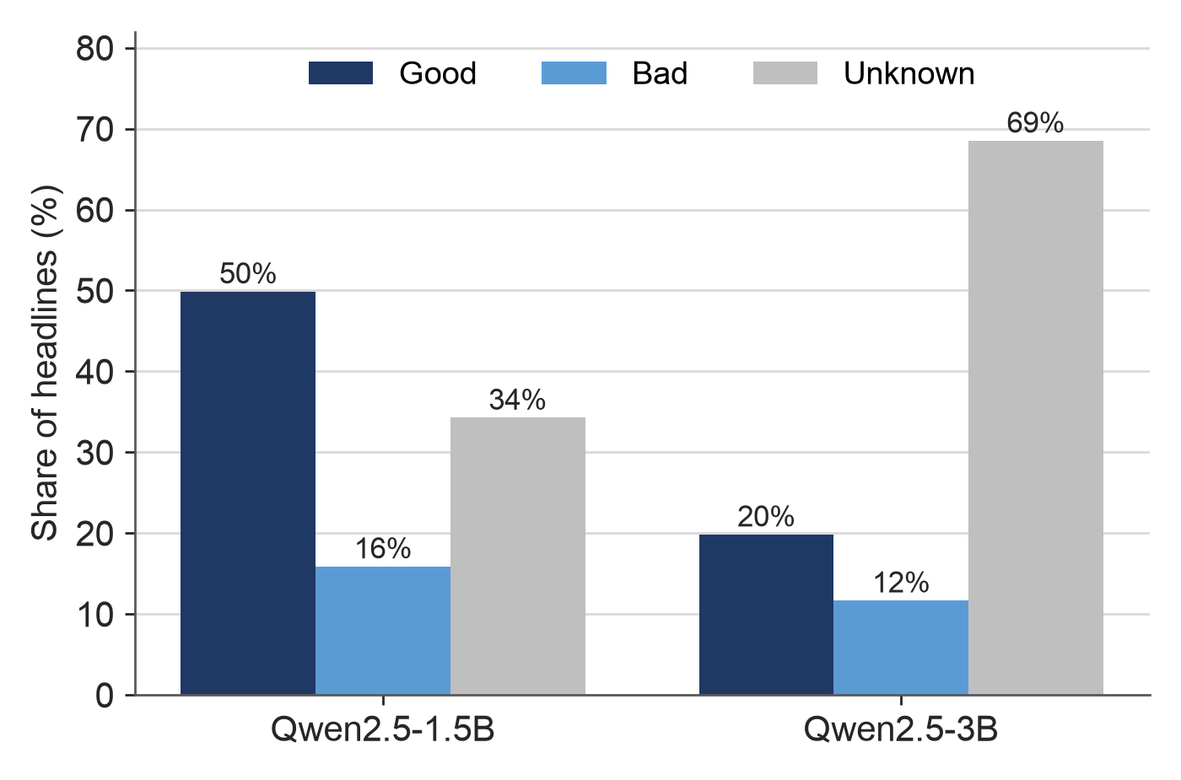
Sentiment Agent: Larger LLM and Earnings Days
Table 5. Next-day predictability of the sentiment score (debiased).
Model | Headlines | n | IC | Holm p | Hit rate
Qwen2.5-1.5B | All news | 15,190 | 0.00 | 1.00 | 50.1%
Qwen2.5-1.5B | Earnings | 1,803 | −0.03 | 1.00 | 48.7%
Qwen2.5-1.5B | Non-earnings | 13,387 | 0.01 | 1.00 | 50.2%
Qwen2.5-3B | All news | 6,480 | −0.03 | 0.82 | 49.2%
Qwen2.5-3B | Earnings | 1,803 | −0.06 | 0.36 | 47.9%
Qwen2.5-3B | Non-earnings | 4,677 | −0.01 | 1.00 | 49.7%
The information coefficient is close to zero for both models and the hit rate is close to 50%.
Earnings days do move more (133 against 126 bps absolute next-day return, p = 0.029), but the direction is not predicted.
Fig. 2. Labels given by the two models to the same 10,240 headlines with the same prompt.
Label agreement between the models is 60.3% (Cohen's κ = 0.39). The Good-to-Bad ratio falls from 3.14 to 1.70 with the larger model.
Vipluv (22MF3IM22)
Department of Industrial and Systems Engineering, IIT Kharagpur
7

Slide 8
Results (1/3): Ablation on the Core Universe
Table 6. All 16 strategies on the core universe after costs, in order of net Sharpe ratio. Holm p is for the paired test against Buy-and-Hold.
Strategy | Net Sharpe | Gross Sharpe | Max. drawdown | Turnover / year | Exposure | Holm p
Buy-and-Hold | 0.59 | 0.59 | −38.6% | 0× | 100% | –
RSI(14) | 0.43 | 0.47 | −39.8% | 4× | 60% | 0.82
Tech+Regime | 0.35 | 0.58 | −20.7% | 20× | 86% | 0.82
Regime+Fund+Band | 0.28 | 0.47 | −22.2% | 16× | 84% | 0.60
Tech+Regime+Fund | 0.24 | 0.50 | −23.2% | 23× | 88% | 0.59
Regime+Fund | 0.21 | 0.48 | −23.2% | 24× | 88% | 0.59
Tech+Sent+Regime | 0.17 | 0.66 | −25.0% | 43× | 90% | 0.41
All4+Debate(conviction) | 0.14 | 0.60 | −24.7% | 43× | 93% | 0.09
Full+Debate(conviction) | 0.14 | 0.62 | −27.2% | 44× | 91% | 0.21
Tech+Regime+Fund+CostAware+Band | 0.14 | 0.37 | −5.3% | 5× | 7% | 0.82
Tech+Sent+Regime+Fund | 0.04 | 0.59 | −25.0% | 49× | 91% | 0.14
MACD | 0.02 | 0.46 | −29.9% | 43× | 78% | 0.39
KDJ+RSI | −0.34 | 0.24 | −39.3% | 51× | 34% | 0.01
Tech-only | −0.41 | −0.27 | −25.4% | 5× | 16% | 0.09
All4+CostAware+Band | −0.52 | 0.20 | −5.1% | 14× | 7% | 0.21
Mean reversion | −1.41 | 0.68 | −79.6% | 223× | 76% | 0.00
Vipluv (22MF3IM22)
Department of Industrial and Systems Engineering, IIT Kharagpur
8

Slide 9
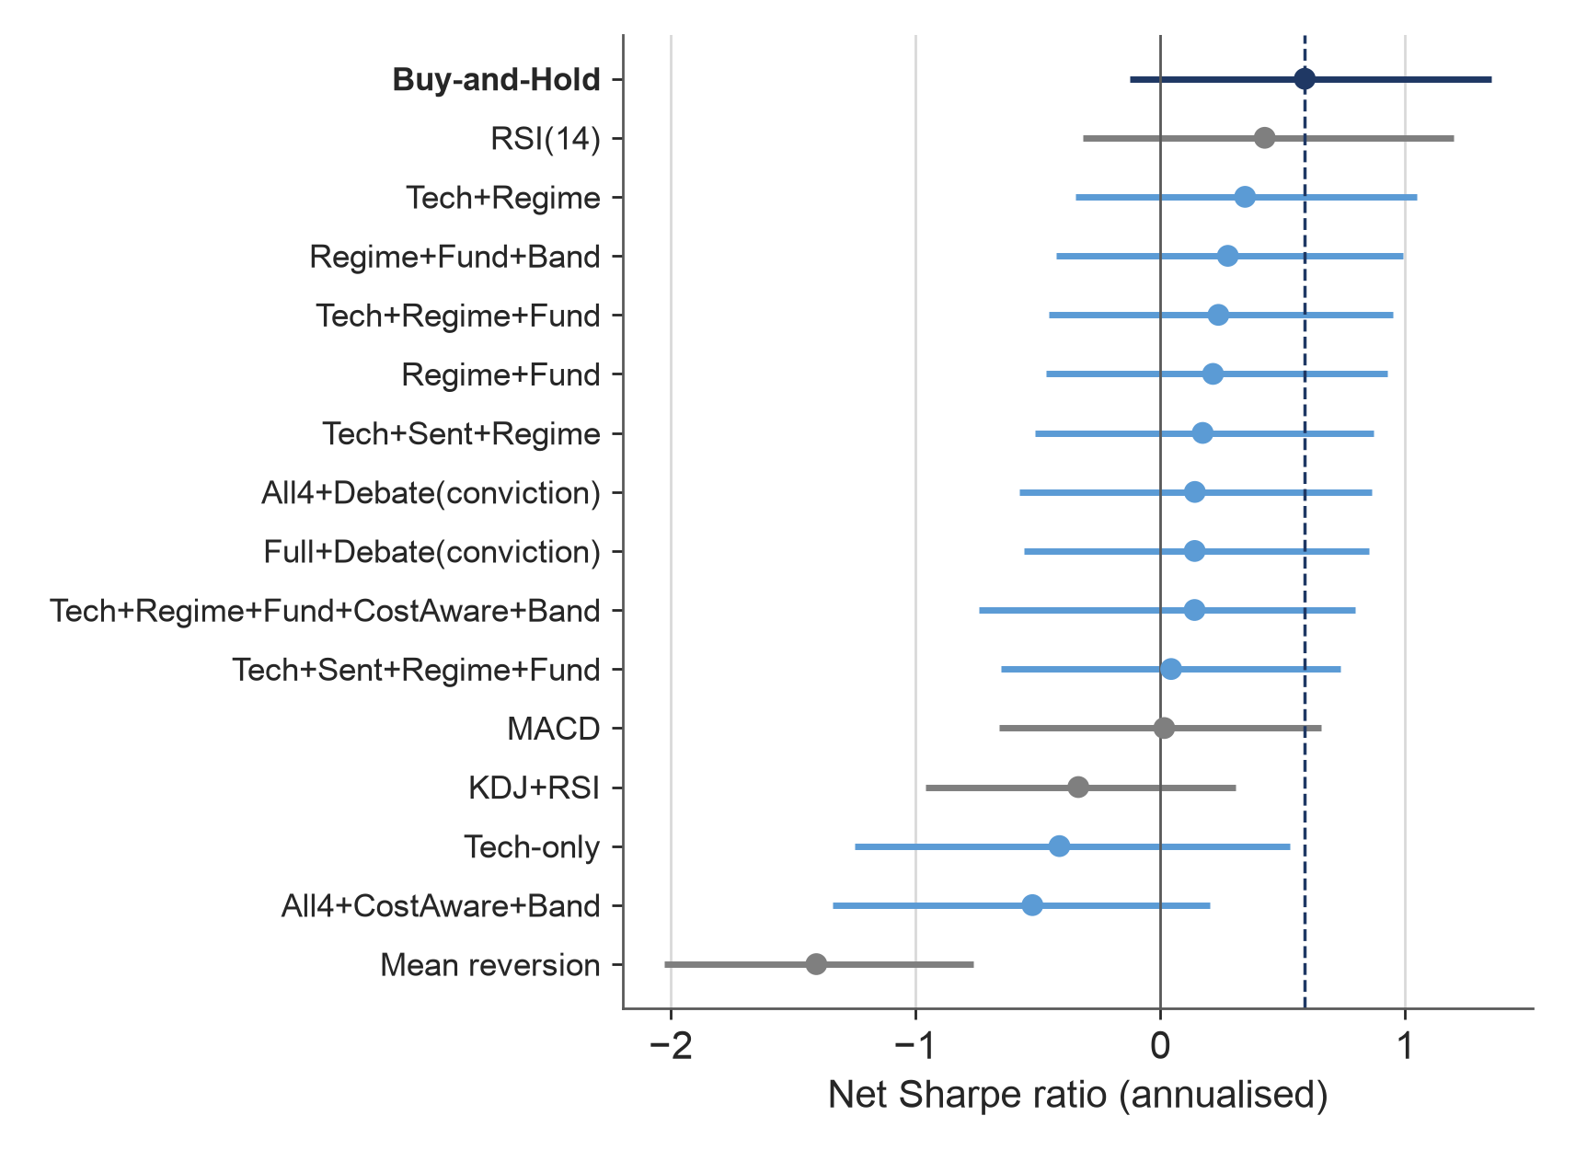
Results (2/3): Statistical Significance
Observations
The best agent configuration is Tech+Regime with a net Sharpe of 0.35, against 0.59 for Buy-and-Hold.
The interval of every agent configuration overlaps that of Buy-and-Hold.
After Holm correction no strategy is significantly better than Buy-and-Hold.
Only KDJ+RSI and mean reversion differ significantly, and both are worse.
Fig. 3. Net Sharpe ratio with 95% block-bootstrap interval. Dashed line: Buy-and-Hold.
Vipluv (22MF3IM22)
Department of Industrial and Systems Engineering, IIT Kharagpur
9

Slide 10
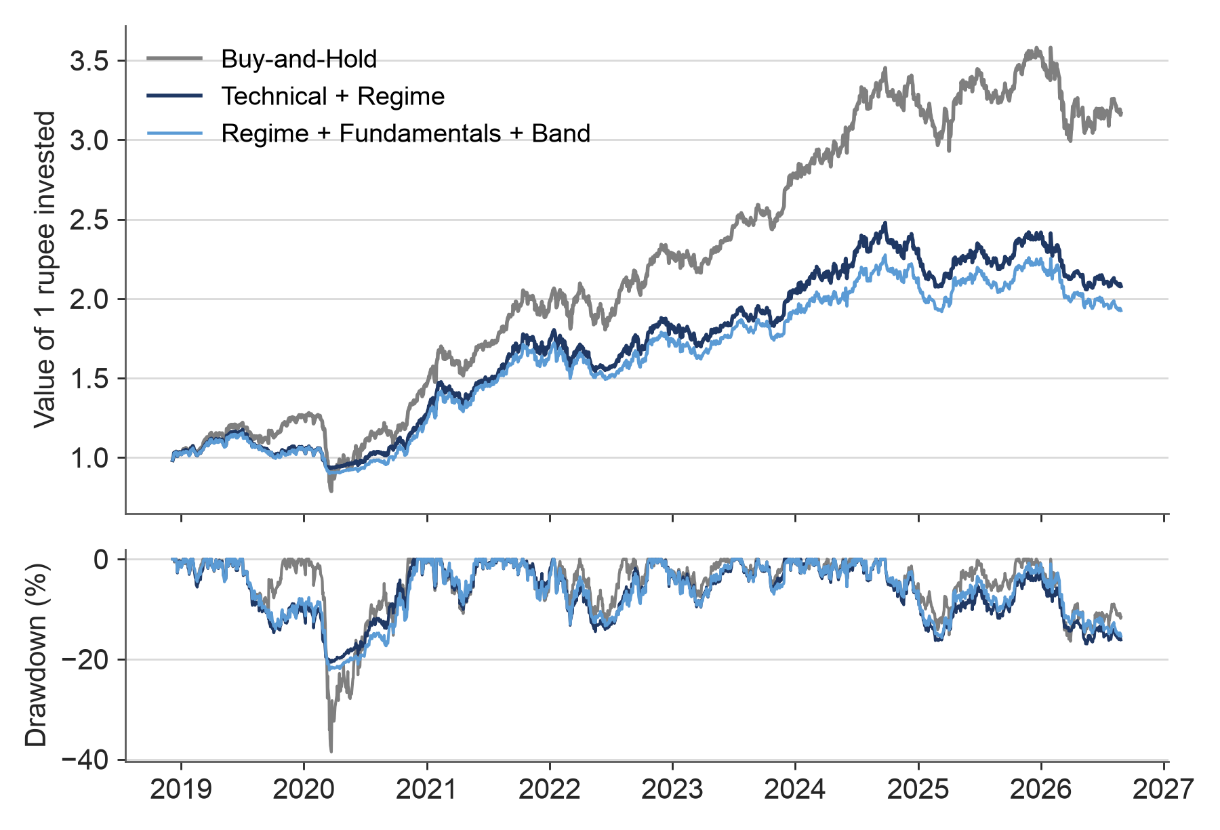
Results (3/3): Equity Curve and Drawdown
Observations
Buy-and-Hold gives the highest return: 16.4% a year against 10.1% for Technical + Regime.
The maximum drawdown is −20.7% for Technical + Regime against −38.6% for Buy-and-Hold.
Annualised volatility is also lower: 13.8% against 19.0%.
The risk overlay gives up return in rising markets and limits losses in the 2020 crash.
Fig. 4. Growth of 1 rupee and drawdown, core universe, after costs.
Vipluv (22MF3IM22)
Department of Industrial and Systems Engineering, IIT Kharagpur
10

Slide 11
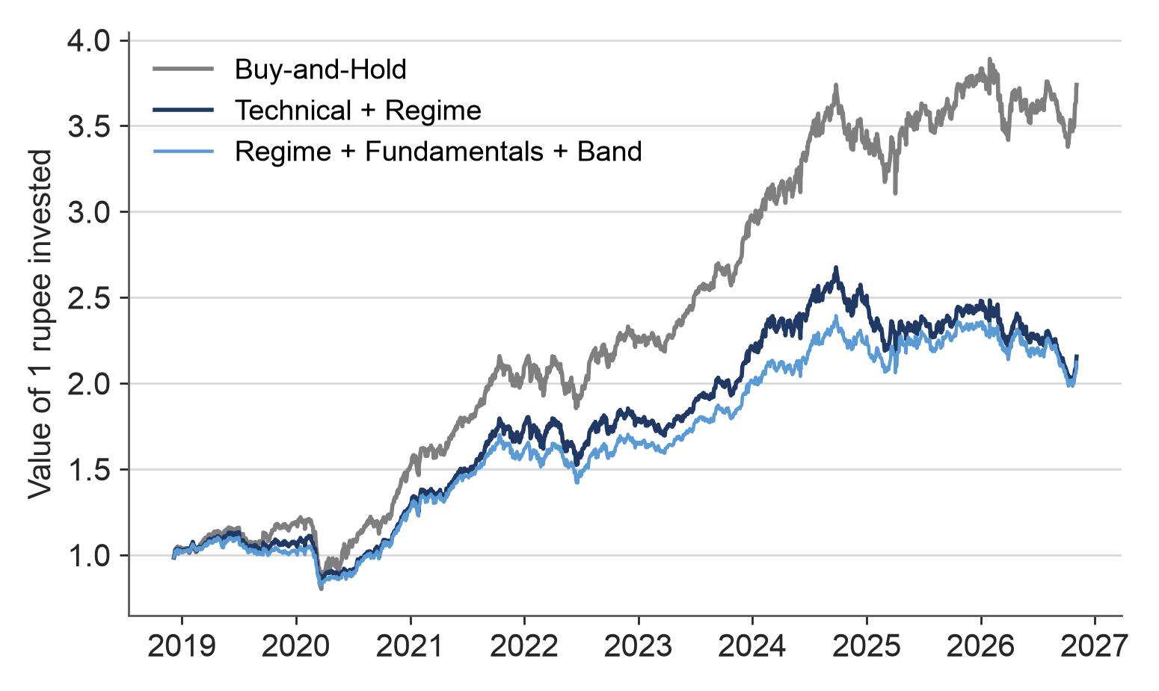
Extended Universe: 30 Stocks, Data to November 2026
Table 7. Strategies on the extended universe (58,620 decisions).
Strategy | Net Sharpe | Max. DD | Turnover
Buy-and-Hold | 0.74 | −34.3% | 0×
RSI(14) | 0.66 | −38.5% | 9×
Regime+Fund+Band | 0.36 | −25.1% | 16×
Tech+Regime | 0.35 | −24.7% | 29×
Tech+Regime+Fund | 0.25 | −27.8% | 29×
Regime+Fund | 0.25 | −27.8% | 29×
MACD | 0.23 | −29.1% | 70×
Tech-only | 0.09 | −7.7% | 7×
Tech+Regime+Fund+CostAware+Band | 0.06 | −17.8% | 17×
KDJ+RSI | −0.92 | −64.2% | 119×
Mean reversion | −1.97 | −91.8% | 311×
Fig. 5. Growth of 1 rupee on the extended universe, after costs.
The conclusion is the same with three times as many stocks: the best agent configuration reaches 0.36 against 0.74 for Buy-and-Hold.
It also holds on data that was not available at the mid-semester evaluation.
Vipluv (22MF3IM22)
Department of Industrial and Systems Engineering, IIT Kharagpur
11

Slide 12
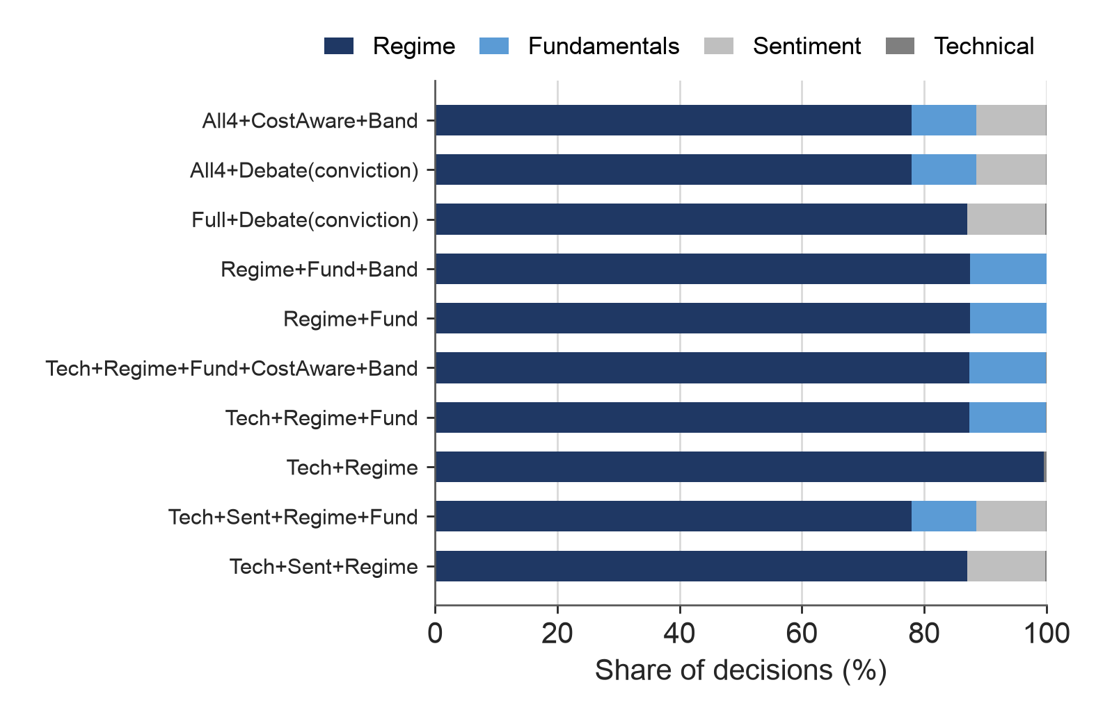
Explainability Evaluation
Table 8. Checks on the stored rationales (core universe).
Check | Question | Result
Provenance | Does the rationale name the model that produced the number? | 0% at mid-sem, 100% now
Integrity | Do the stated stances match the logged stances? | 100%
Reconstruction | Can the final score be recomputed from the agent opinions? | 100%
Deletion | Does removing the most influential agent change the decision? | 37% to 71% of decisions
Fig. 6. Agent with the largest attribution in each decision.
The provenance check found that all 19,110 mid-semester rationales named PLSTM-TAL although the predictions came from the LSTM-TAL model. This has been corrected. Removing any other agent changes only 0.0% to 3.4% of decisions.
The regime agent decides most of the calls, so the system behaves largely as a trend filter.
Vipluv (22MF3IM22)
Department of Industrial and Systems Engineering, IIT Kharagpur
12

Slide 13
Conclusions
The complete framework was implemented and tested: four agents, a bull–bear debate, a rule-based risk manager, a cost-aware backtester and a paper-trading pipeline.
No configuration performs better than Buy-and-Hold after Indian transaction costs. This holds on 10 stocks, on 30 stocks and on data up to November 2026.
None of the components added after the mid-semester evaluation changes this result. The no-trade band improves the net Sharpe ratio only by reducing turnover.
The risk overlay reduces the maximum drawdown from 38.6% to 20.7% on the core universe.
The stored explanations were checked and found consistent with the decisions; the check also identified an error in the mid-semester rationales.
Vipluv (22MF3IM22)
Department of Industrial and Systems Engineering, IIT Kharagpur
13

Slide 14
Limitations and Future Work
Limitations
Future work
Only open 1.5B and 3B language models were used; a frontier model was not tested.
The stock universe consists of current large caps, so there is survivorship bias.
Fundamentals are restated figures, not the figures as first published.
With about eight years of daily data, only a Sharpe difference of about 1.0 can be detected.
Event-time and intraday horizons, where news may carry more information.
Point-in-time fundamentals from a data vendor.
Debate with a frontier LLM.
A market-neutral formulation in place of the long-only book.
Vipluv (22MF3IM22)
Department of Industrial and Systems Engineering, IIT Kharagpur
14

Slide 15
References
[1]
S. Latif, N. Javaid, F. Aslam, A. Aldegheishem, N. Alrajeh and S. H. Bouk, “Enhanced prediction of stock markets using a novel deep learning model PLSTM-TAL in urbanized smart cities,” Heliyon, vol. 10, no. 6, e27747, 2024.
[2]
A. Lopez-Lira and Y. Tang, “Can ChatGPT forecast stock price movements? Return predictability and large language models,” arXiv:2304.07619, 2023.
[3]
Y. Xiao, E. Sun, D. Luo and W. Wang, “TradingAgents: Multi-agents LLM financial trading framework,” arXiv:2412.20138, 2024.
[4]
M. López de Prado, Advances in Financial Machine Learning. Hoboken, NJ: Wiley, 2018.
[5]
S. Holm, “A simple sequentially rejective multiple test procedure,” Scandinavian Journal of Statistics, vol. 6, no. 2, pp. 65–70, 1979.
[6]
D. H. Bailey and M. López de Prado, “The deflated Sharpe ratio: Correcting for selection bias, backtest overfitting, and non-normality,” Journal of Portfolio Management, vol. 40, no. 5, pp. 94–107, 2014.
Vipluv (22MF3IM22)
Department of Industrial and Systems Engineering, IIT Kharagpur
15

Slide 16
Thank You
Questions and suggestions are welcome
Demonstration: vipluv01.github.io/nse-multi-agent-trading
Code: github.com/Vipluv01/nse-multi-agent-trading

