Slide 1
Manufacturing Analytics and Dataset Analysis
Presented by
Vipul dass

Slide 2
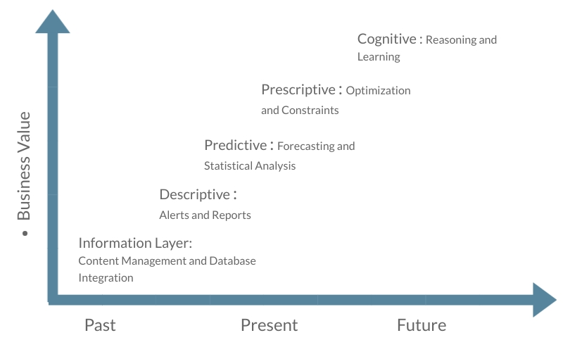
Analytics & Analytics Maturity Model
“Systematic Computational Analysis of Data or Statistics”.

Slide 3
Data Driven Business
2 Components:
Analytics = Descriptive + Predictive + Prescriptive + Cognitive
Data = Possessed data + Data for Competition + Data in Motion

Slide 4
Industry 4.0 – Smart Manufacturing
4 initiatives of Smart Manufacturing:
Interoperability.
Information transparency.
Technical assistance.
Decentralized decision-making.
Cross-Organization Changes as a result of data driven decision making:
Analytics in Warranty: Whirlpool
Analytics in Supply Chain Management.
Analytics in Finance: Better Cashflow reporting

Slide 5
Case Study: Implementation of an intelligent and self-controlled production unit in production of Phosphoric Acid
CPS and BDA in self-controlled concentration of Phosphoric Acid.
Upgrade manufacturing equipment to cloud-based manufacturing equipment
Intelligent Adaptive Control Module, Equipment Monitoring Module and Data Processing Module.
Result : phosphoric acid quality increased, decrease in water waste and decrease in HFC emission.

Slide 6
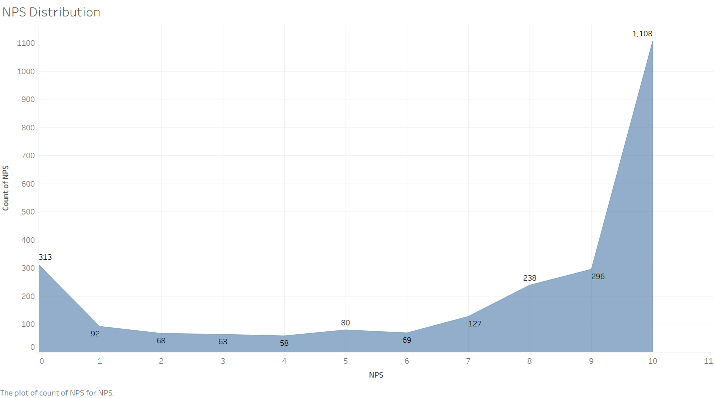
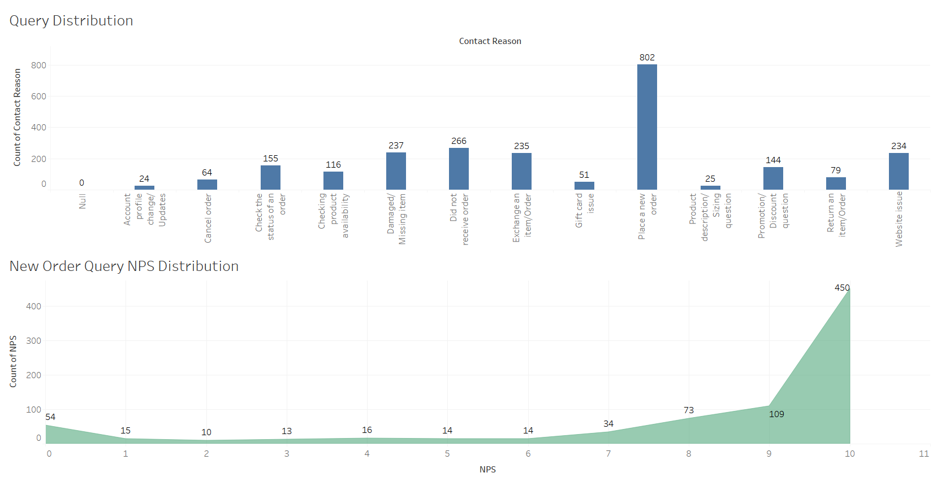
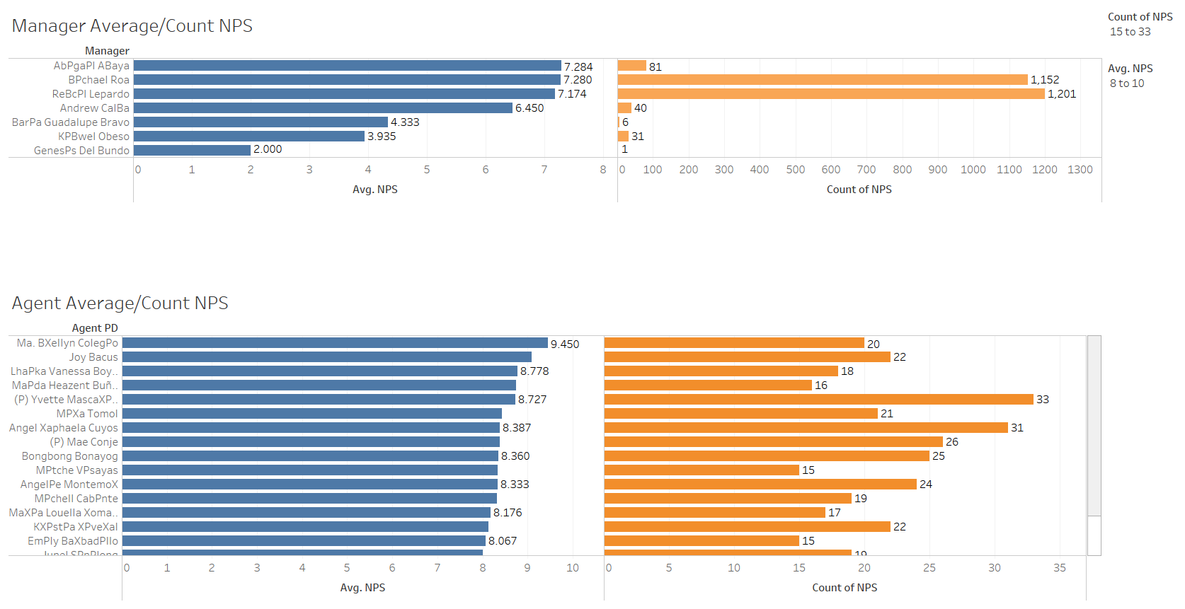
Analysis of the ‘NPS Data’ Dataset
Voice of Customer Survey
Language, Line of Business
NPS Score
Promoters = 1404
Detractors = 743
NPS Score = 26 (rounded down)
Word Count Analysis of NPS Comment Section:
Most common words for Promoters: service, customer, helpful, order and multiple other positive words.
Most common words for Detractors : order, service, customer, call, told, time

Slide 7
Bibliography
‘Analytics in Manufacturing’ by LPA Solutions.
Understanding the capabilities of Big Data Analytics for manufacturing process: insights from literature review and multiple case study - Behaldi,Zkik (2019)
Diagrams created with Visme
Graphs and Tables created in Tableau.

