Slide 1
Tech Instagram Influencer Account Analysis.
SQL Project

Slide 2
Dataset Overview
For this project, the analysis was performed on an Instagram Influencer Activity dataset designed to evaluate account performance, audience engagement, and content effectiveness. The dataset contains detailed information on Instagram account activity, follower growth, profile engagement, and post-level performance metrics. The primary goal of the dataset is to help understand how different types of content perform and how audience interaction contributes to influencer growth over time. The database is structured using three relational tables, which are interconnected through the date column and together provide a complete view of the influencer account’s activity and engagement patterns. The three tables included in the dataset are:
Dim date Table
The dim date table serves as a date dimension table, containing calendar-related information to support time-based analysis.
Fact account Table
The fact account table contains high-level Instagram account performance metrics. This table focuses on the overall growth and visibility of the influencer account rather than individual posts. Indicating strong audience engagement during that period.
Fact content Table
The fact content table is the most detailed and important table in the dataset. It contains post-level performance data and engagement metrics for different types of Instagram content.

Slide 3

RESULT OF QUERY 1
TASK-1
How many unique post types are found in the fact content table?
INTERPRETATION OF QUERY 1
There are four different types of Instagram posts in this dataset: IG Image, IG Reel, IG Carousel, and IG Video.

Slide 4

RESULT OF QUERY 2
TASK-2
What are the highest and lowest recorded impressions for each post type?
INTERPRETATION OF QUERY 2
The data clearly indicates that IG Reels are the most effective content format for maximizing impressions and audience reach. If the objective is to increase visibility and attract a larger audience, focusing on Reel-based content would be the most effective strategy. Traditional image posts can serve as a strong secondary content type, while videos and carousels may require optimization to improve their performance.

Slide 5
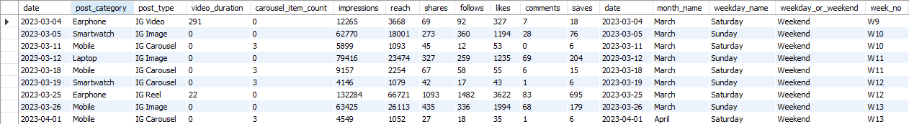
RESULT OF QUERY 3
TASK-3
Filter all the posts that were published on a weekend in the month of March and April and export them to a separate csv file.
INTERPRETATION OF QUERY 3
Content format significantly influences Instagram performance. IG Reels are the top-performing format, driving the highest reach, impressions, engagement, and follower growth. IG Images also perform well, generating strong audience interactions through likes and comments. Meanwhile, IG Carousels and Videos contribute to content variety but deliver comparatively lower visibility. To maximize growth and engagement, brands should prioritize Reels, supported by Images for consistent audience interaction.

Slide 6
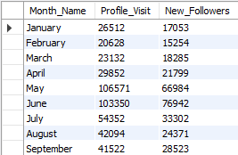
RESULT OF QUERY 4
TASK-4
Create a report to get the statistics for the account. The final output includes the following fields:
• Month Name • Total Profile Visits • Total New Followers
INTERPRETATION OF QUERY 4
May and June were the strongest growth months, with May achieving the highest profile visits (106,571) and June recording the highest new followers (76,942). Performance remained steady from January to April, while profile visits and follower growth declined after June but stayed above early-year levels.

Slide 7
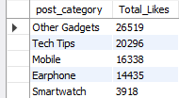
RESULT OF QUERY 5
TASK-5
Write a CTE that calculates the total number of 'likes’ for each post category' during the month of 'July' and subsequently, arrange the post category' values in descending order according to their total likes.
INTERPRETATION OF QUERY 5
Among the post categories, Other Gadgets and Tech Tips received the highest total likes, indicating stronger audience engagement and interest compared to Mobile, Earphone, and Smartwatch content. This suggests that informative and diverse technology-related content resonates most with the audience.

Slide 8
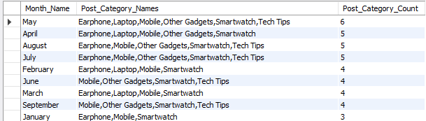
RESULT OF QUERY 6
TASK-6
Create a report that displays the unique post category names alongside their respective counts for each month. The output should have three columns
• month name • post category names • post category count.
INTERPRETATION OF QUERY 6
Content diversity increased significantly from the start of the year, peaking in May with all six categories represented. Mobile and Smartwatch remained core content pillars throughout the year, while category focus evolved based on audience interests and content performance.

Slide 9

RESULT OF QUERY 7
TASK-7
What is the percentage breakdown of total reach by post type? The final output includes the following fields:
• post type • total reach • reach percentage
INTERPRETATION OF QUERY 7
IG Reels and IG Image posts generated significantly higher reach compared to Videos and Carousel posts, indicating that these content formats are more effective at reaching a larger audience. This suggests that prioritizing Reels and Image-based content could help maximize visibility and audience engagement.

Slide 10
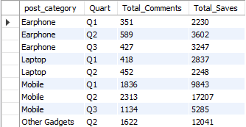
RESULT OF QUERY 8
TASK-8
Create a report that includes the quarter, total comments, and total saves recorded for each post category. Assign the following quarter groupings:
(January, February, March) → “Q1”
(April, May, June) → “Q2”
(July, August, September) → “Q3”.
The final output columns should consist of: • post category • quarter • total comments • total saves
INTERPRETATION OF QUERY 8
Mobile was the highest-performing category, achieving the most comments and saves, with peak engagement in Q2. Other Gadgets also performed strongly in Q2, particularly in saves, highlighting high content value. Earphone content grew from Q1 to Q2 before declining slightly in Q3, while Laptop posts maintained steady but moderate engagement. Overall, Q2 was the strongest quarter across categories, generating the highest audience interaction and content saves.

Slide 11
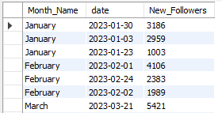
RESULT OF QUERY 9
TASK-9
List the top three dates in each month with the highest number of new followers. The final output should include the following columns:
• month • date • new followers
INTERPRETATION OF QUERY 9
May and June generated the highest follower growth, with June contributing the most top-performing days, indicating strong audience engagement and effective content performance during this period.

Slide 12

RESULT OF QUERY 10
TASK-10
Create a stored procedure that takes the Week no as input and generates a report displaying the total shares for each Post type. The output of the procedure should consist of two columns:
Post type
Total shares
This result only shows ‘W1’.
INTERPRETATION OF QUERY 10
Week 1 Insight:
In Week 1, IG Image was the top-performing post type, generating 861 total shares. This indicates that image-based content received the highest share engagement during the first week.
If we call the stored procedure again for W2, W3, and so on, then we get the results for other weeks..

Slide 13
Key Insights and Strategy
IG Reels were the best-performing format, driving the highest reach, impressions, engagement, and follower growth.
IG Images ranked second, generating strong likes and comments, making them effective for audience interaction.
IG Reels and Images significantly outperformed Carousels and Videos in terms of visibility and reach.
May and June were the strongest growth months, with May recording the highest profile visits and June achieving the highest follower gain.
Other Gadgets and Tech Tips received the most likes, indicating strong audience interest in informative technology content.
Mobile content generated the highest comments and saves, making it the most engaging content category.
Q2 was the strongest-performing quarter, delivering the highest engagement, saves, comments, and follower growth.
Content diversity peaked in May, while Mobile and Smartwatch remained consistent content pillars throughout the year.
June contributed the highest number of top-performing days, highlighting peak audience engagement and content effectiveness.
Focus on IG Reels and Images, prioritize Mobile, Other Gadgets, and Tech Tips content, and replicate the successful strategies used during May and June to maximize growth and engagement.

Slide 14
THANK YOU …
VIPUL GOUR

