Slide 1

Consumer Goods Ad Hoc Insights

Slide 2
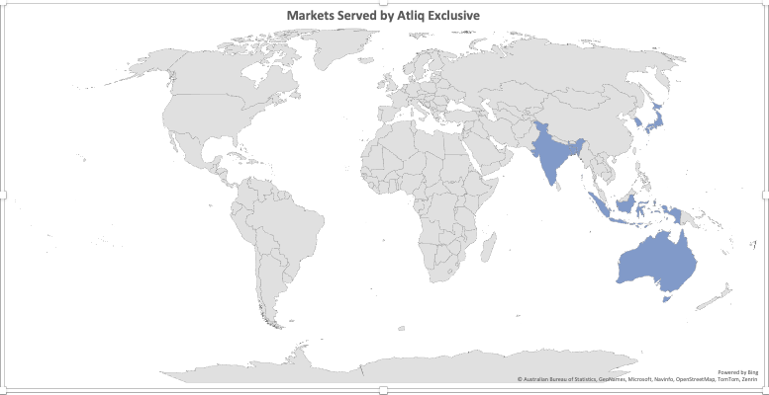
1. Provide the list of markets in which customer "AtliqExclusive"operates its business in the APAC region.
Market
Australia
Bangladesh
India
Indonesia
Japan
Newzealand
Philiphines
South Korea

Slide 3
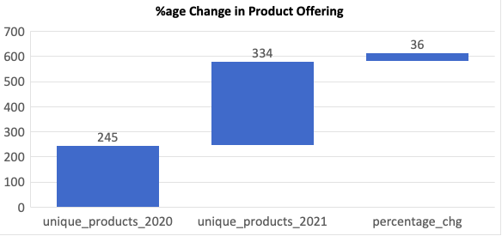
2. What is the percentage of unique product increase in 2021 vs. 2020? The final output contains these fields,
unique_products_2020, unique_products_2021 , percentage_chg
unique_products_2020 | unique_products_2021 | percentage_chg
245 | 334 | 36.00
As compared with fiscal year 2020 unique product offering has been increased to 334, which is an increase of around 36%.

Slide 4
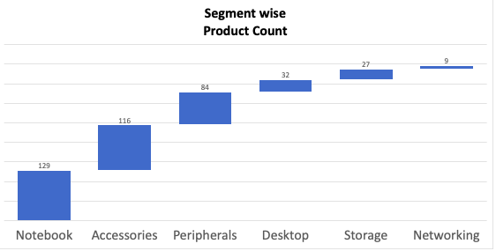
3. Provide a report with all the unique product counts for each segment and sort them in descending order of product counts. The final output contains 2 fields
segment , product_count
segment | product_count
Notebook | 129
Accessories | 116
Peripherals | 84
Desktop | 32
Storage | 27
Networking | 9
Including both the fiscal years 2020 and 2021, Notebook segment has the highest number of unique products (129) then followed by Accessories with 116 and peripherals segment with 84 unique products.
Atliq is focused towards offering higher product range to it’s more in demand products. Notebook and Accessories have generated most revenue for the company.

Slide 5
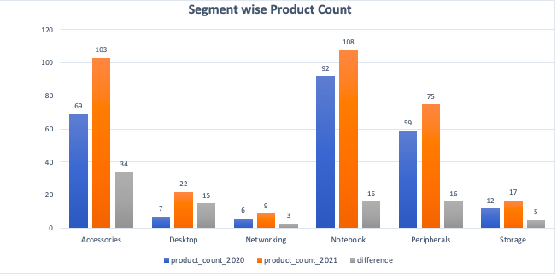
4. Follow-up: Which segment had the most increase in unique products in 2021 vs 2020? The final output contains these fields
Segment, product_count_2020 ,product_count_2021, difference
segment | product_count_2020 | product_count_2021 | difference
Accessories | 69 | 103 | 34
Desktop | 7 | 22 | 15
Networking | 6 | 9 | 3
Notebook | 92 | 108 | 16
Peripherals | 59 | 75 | 16
Storage | 12 | 17 | 5
As compared with fiscal year 2020. In year 2021, in Accessories segment 34 new products were added, followed by Networking and Peripherals with 16 new products.
Increased accessory product offerings have had a favorable effect on its sales. In fiscal year 2020 accessories accounted for23.82 % of total revenue while in 2021, 28.61%. However, management need to pay attention towards notebook and peripherals segments they both have shown decline in revenue contribution 31.96 % from 36.77 % and 23.82 % from 28.67% respectively.

Slide 6
5. Get the products that have the highest and lowest manufacturing costs. The final output should contain these fields,
product_code , product, manufacturing_cost
product_code | product | manufacturing_cost
A6120110206 | AQ HOME Allin1 Gen 2 | 240.54
A2118150101 | AQ Master wired x1 Ms | 0.89

Slide 7
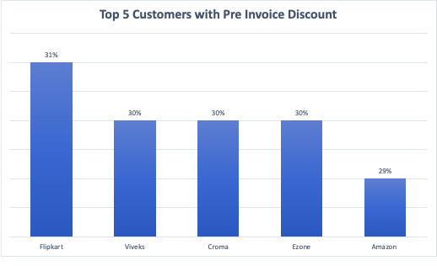
6. Generate a report which contains the top 5 customers who received an average high pre_invoice_discount_pct for the fiscal year 2021 and in the Indian market. The final output contains these fields,
customer_code, customer average_discount_percentage
customer_code | customer | Avg_discount_pct
90002009 | Flipkart | 31%
90002006 | Viveks | 30%
90002002 | Croma | 30%
90002003 | Ezone | 30%
90002016 | Amazon | 29%
Atliq’s strategic decision to have strong trade deals with dominant ecommerce channels such as flipkart and amazon is positively impacting its revenue generation. Amazon and Flipkart are among the top 3 clients in terms of revenue.

Slide 8
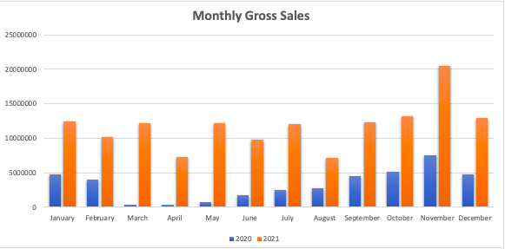
7. Get the complete report of the Gross sales amount for the customer “Atliq Exclusive” for each month. This analysis helps to get an idea of low and high-performing months and take strategic decisions. The final report contains these columns
Month , Year, Gross sales Amount
month | year | gross_sales
January | 2020 | 4740600.31
February | 2020 | 3996228.01
March | 2020 | 378770.94
April | 2020 | 395035.34
May | 2020 | 783813.24
June | 2020 | 1695216.71
July | 2020 | 2551159.42
August | 2020 | 2786648.34
September | 2020 | 4496259.94
October | 2020 | 5135902.52
November | 2020 | 7522892.84
December | 2020 | 4830404.88
January | 2021 | 12399393.6
February | 2021 | 10129736.2
March | 2021 | 12144061.4
April | 2021 | 7312000.26
May | 2021 | 12150225.7
June | 2021 | 9824521.71
July | 2021 | 12092347
August | 2021 | 7178707.82
September | 2021 | 12353510.3
October | 2021 | 13218636.8
November | 2021 | 20464999.7
December | 2021 | 12944660

Slide 9
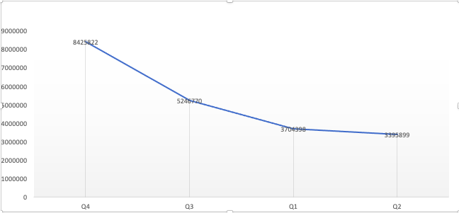
8. In which quarter of 2020, got the maximum total_sold_quantity? The final output contains these fields sorted by the total_sold_quantity,
Quarter, total_sold_quantity
Quarter | total_sold_quantity
Q4 | 8425822
Q3 | 5246770
Q1 | 3704398
Q2 | 3395899

Slide 10
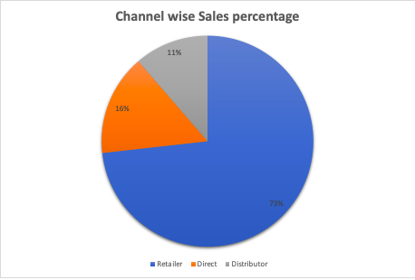
9. Which channel helped to bring more gross sales in the fiscal year 2021 and the percentage of contribution? The final output contains these fields
channel , gross_sales_mln , percentage
channel | gross_sales_mn | percentage
Retailer | 1924.17 | 73.22
Direct | 406.69 | 15.48
Distributor | 297.18 | 11.31

Slide 11
10. Get the Top 3 products in each division that have a high total_sold_quantity in the fiscal_year 2021?
The final output contains these fields,
Division, product_code, product, total_sold_quantity, rank_order
division | product_code | product | total_sold_quatity | rank_order
N & S | A6720160103 | AQ Pen Drive 2 IN 1 | 701373 | 1
N & S | A6818160202 | AQ Pen Drive DRC | 688003 | 2
N & S | A6819160203 | AQ Pen Drive DRC | 676245 | 3
P & A | A2319150302 | AQ Gamers Ms | 428498 | 1
P & A | A2520150501 | AQ Maxima Ms | 419865 | 2
P & A | A2520150504 | AQ Maxima Ms | 419471 | 3
PC | A4218110202 | AQ Digit | 17434 | 1
PC | A4319110306 | AQ Velocity | 17280 | 2
PC | A4218110208 | AQ Digit | 17275 | 3

