Slide 1
Financial Adviser
A Project by Team: Agent_47

Slide 2

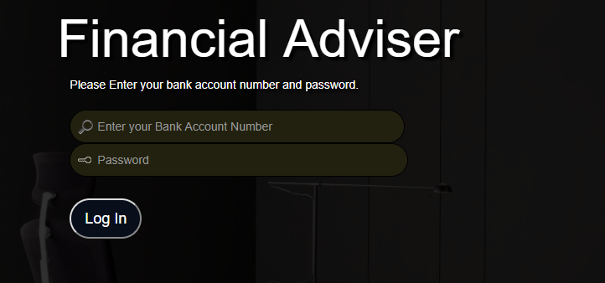
LOGIN
Login with Bank Account Number

Slide 3

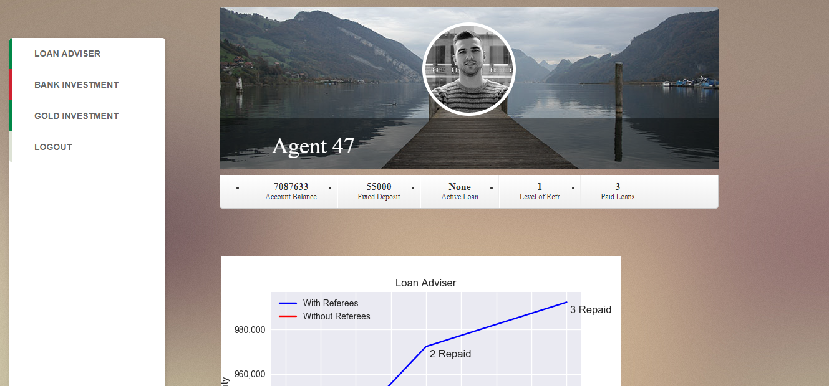
Home
This frontpage shows details of your financial record like a/c balance, loans paid, fixed Deposit etc

Slide 4
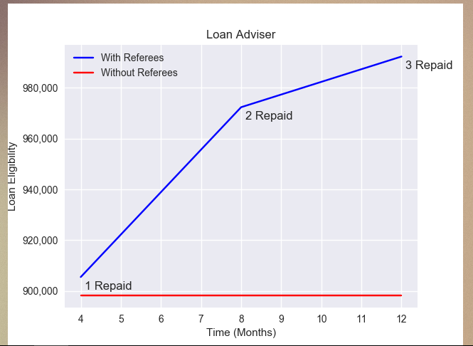
LOAN ADVISER
X-axis : Time
Y-axis : Loan amount that you are eligible for according to our system.
Real time evaluation of your financial record, based on which a loan amount for which you’re eligible is displayed.

Slide 5
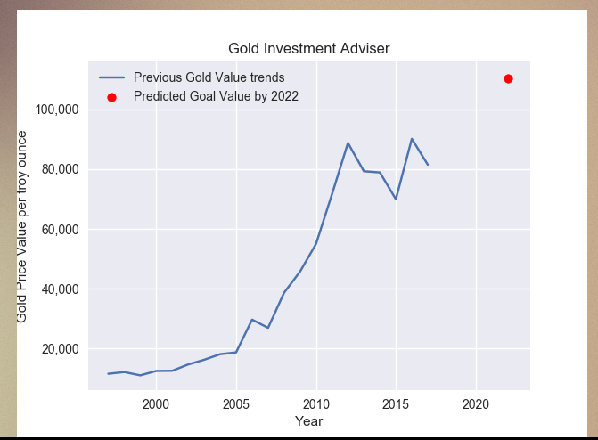
Gold Adviser
Based on past trends, graph shows possible future values of this commodity.

Slide 6

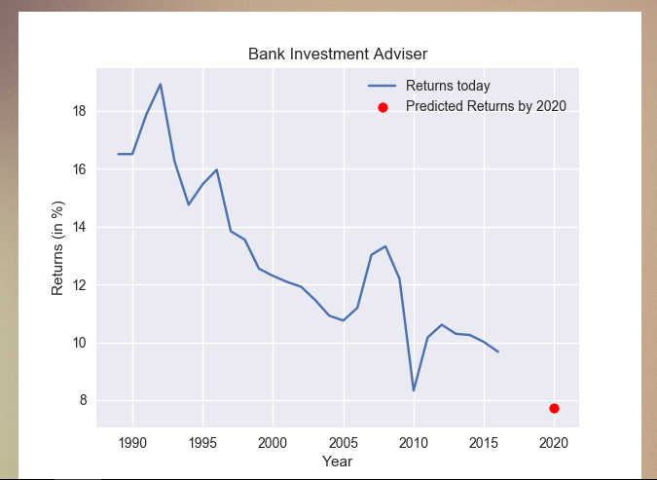
Bank Investment Adviser
Predicts future bank returns based on previous year’s data.

Slide 7


