Slide 1

Solar Power Forecasting Using Neural Networks
COURSE NAME- RENEWABLE ENERGY
COURSE CODE-16B19EC691
MINI PROJECT

Slide 2
Introduction
Solar power generation is highly dependent on weather conditions and atmospheric parameters. Accurate forecasting of Global Horizontal Irradiance (GHI) can improve energy management and grid reliability. This project leverages deep learning techniques to predict GHI using meteorological data from multiple years.

Slide 3
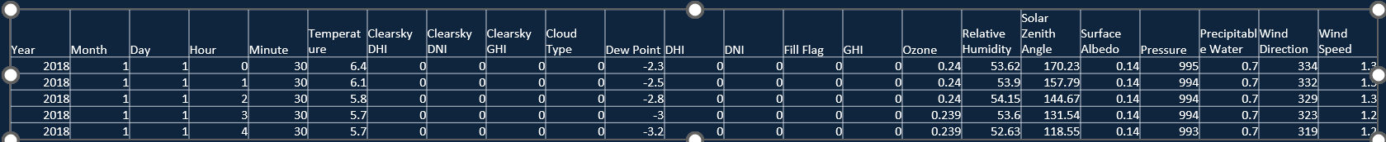
Dataset
The dataset consists of historical weather records from 2017 to 2019 hourly data of New Delhi.
Key features include temperature, humidity, wind speed, cloud type, ozone levels, and solar zenith angle.

Slide 4
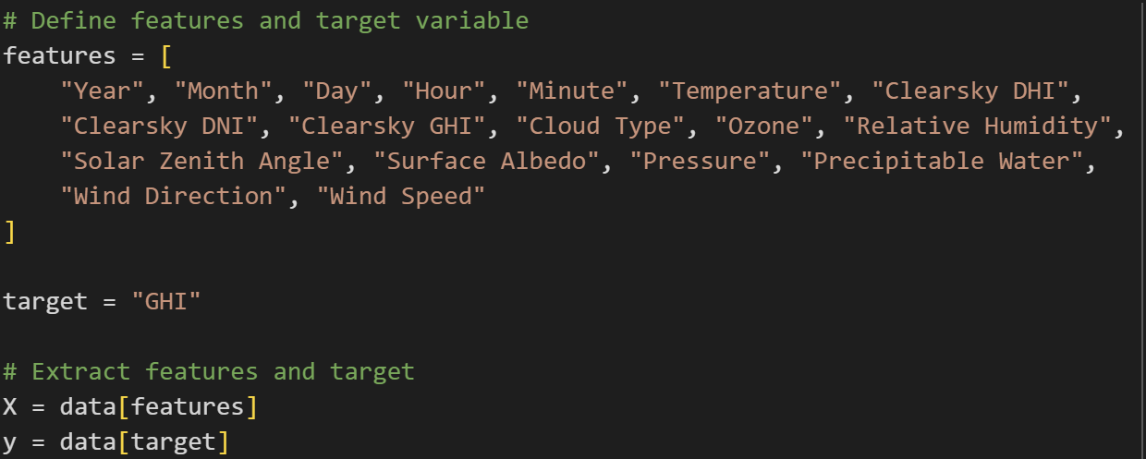
Methodology
Data Preprocessing:
  Merged multiple years of data.
  Selected relevant meteorological features.
  Applied Min-Max scaling for normalization
  Data split: 80% training, 20% testing
4

Slide 5
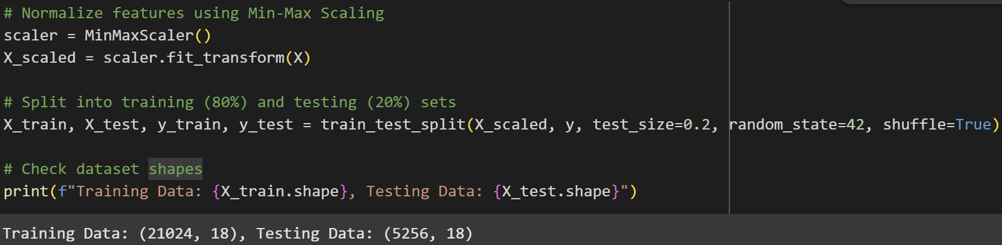

Slide 6
Model Architecture
A feedforward neural network with three hidden layers:
  64 neurons (ReLU activation)
  32 neurons (ReLU activation)
  16 neurons (ReLU activation)
Output layer with a single neuron (Linear activation) for GHI prediction.
Compiled using Adam optimizer and Mean Squared Error (MSE) loss function.
Model trained for 50 epochs with batch size 32.

Slide 7
RNN Model Architecture for GHI Prediction
1. Model Summary
Model Type: Simple Recurrent Neural Network (RNN)
Framework: Keras (TensorFlow backend)
2. Architecture Details
Input Shape: (1, n_features) — reshaped time-independent input for RNN
Layers:
  SimpleRNN with 64 units and ReLU activation
  → Captures temporal structure in data
  Dense(1) — Output layer for GHI regression
Output: Single continuous value (Predicted GHI)
3. Training Configuration
Loss Function: Mean Squared Error (MSE)
Optimizer: Adam
Metrics: Mean Absolute Error (MAE)
Epochs: 50
Batch Size: 32
Validation: Evaluated on test set (X_test_rnn, y_test)

Slide 8
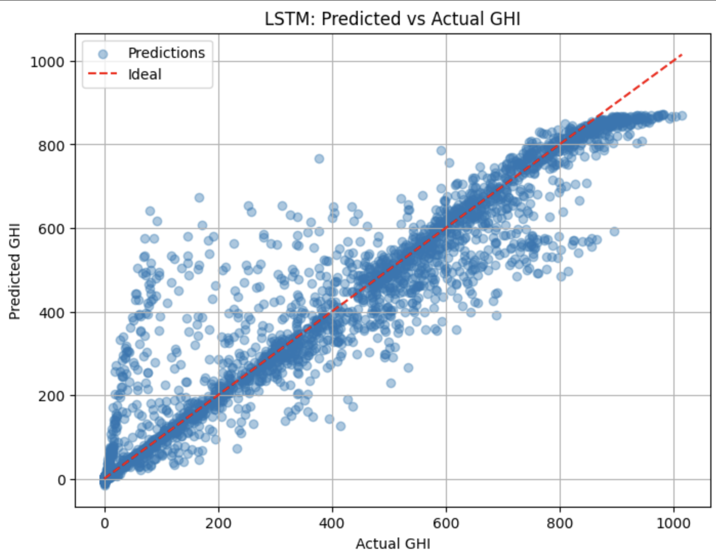
LSTM Model Architecture
1. Model Summary
Model Type: Long Short-Term Memory (LSTM) Network
Framework: Keras (TensorFlow backend)
2. Architecture Details
Input Shape: (1, n_features) — reshaped to suit LSTM input requirements
Layers:
  LSTM(64) with tanh activation
  → Captures long-term dependencies and patterns
  Dense(1) — Regression output for GHI
Output: Single continuous value (Predicted GHI)
3. Training Configuration
Loss Function: Mean Squared Error (MSE)
Optimizer: Adam
Metrics: Mean Absolute Error (MAE)
Epochs: 50
Batch Size: 32
Validation: (X_test_rnn, y_test)

Slide 9
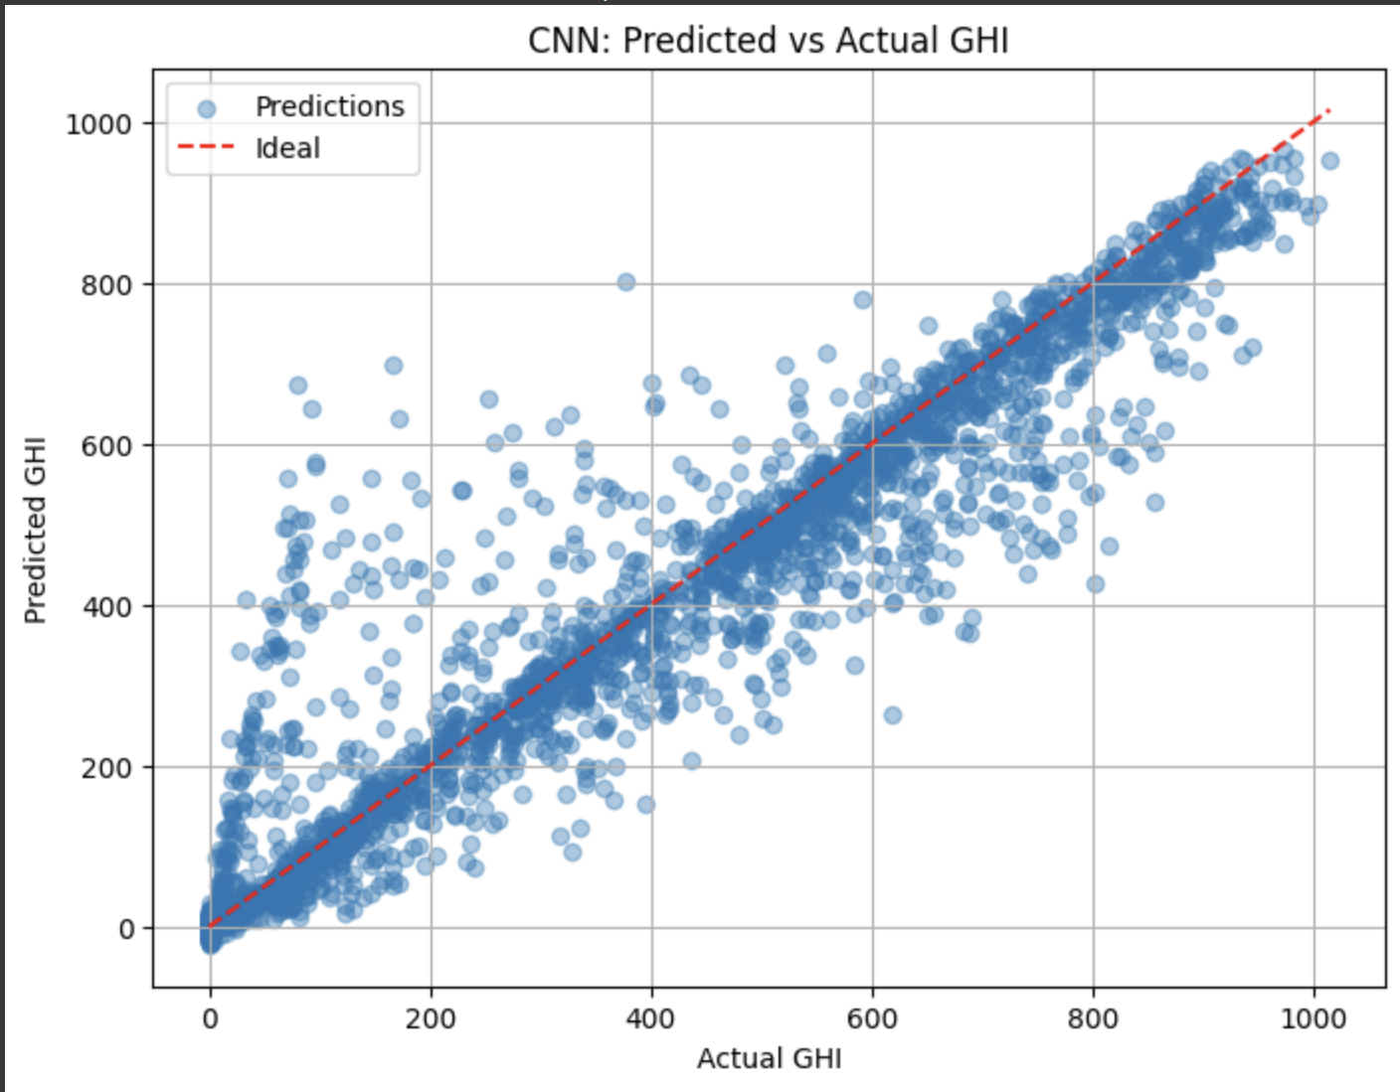
1D CNN Model Architecture
1. Model Summary
Model Type: 1D Convolutional Neural Network (CNN)
Framework: Keras (TensorFlow backend)
2. Architecture Details
Input Shape: (n_features, 1) — each feature treated as a time-like sequence
Layers:
  Conv1D(32, kernel_size=3, activation='relu')
  → Learns local temporal/spatial feature patterns
  MaxPooling1D(pool_size=2)
  → Downsamples features, reduces dimensionality
  Flatten()
  → Converts 2D to 1D for fully connected layers
  Dense(64, activation='relu')
  → Learns complex patterns
  Dense(1)
  → Regression output (GHI prediction)
3. Training Configuration
Loss Function: Mean Squared Error (MSE)
Optimizer: Adam
Metrics: Mean Absolute Error (MAE)
Epochs: 50
Batch Size: 32
Validation Data: (X_test_cnn, y_test)

Slide 10
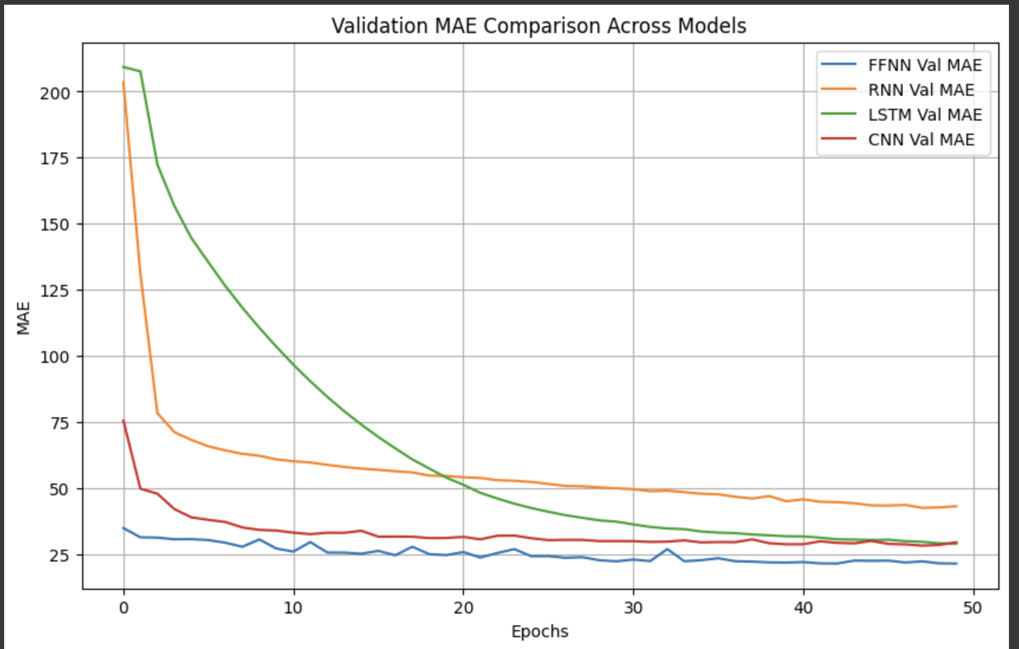
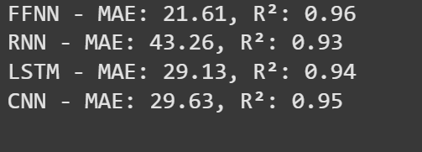
Final Comparison

Slide 11
Thank you

