Slide 1
Analysis and Comparison of Deep Learning Techniques for Classification using CNNs
Yating Fang
Eric Zeng
Vipul Gharde
Patrick Hickey

Slide 2
Overview
We primarily examine 3 aspects of the CNN model
Layer specifications (kernel size, padding, etc.)
Optimizer (SGD, RMSProp, etc.)
Data augmentation
Evaluate difficulty of building/optimizing custom architecture from scratch
Question: How changing different model aspects affect the performance?

Slide 3
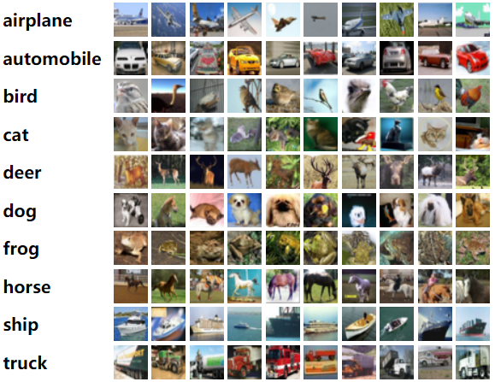
Dataset
CIFAR-10 [1]
60000 32x32 color images
10 classes, with 6000 images per class
40000 training images
10000 validation images
10000 test images

Slide 4
Procedure
Use standard baseline CNN model on the CIFAR-10 dataset
Individually experiment with different combinations of hyperparameters for each aspect of CNN
Ray Tune and Bayesian Optimization are used to efficiently train models with different hyperparameters
Compare validation accuracies of all the models
Combine the hyperparameters for each individual experiment and evaluate results on the test set

Slide 5
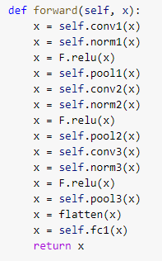
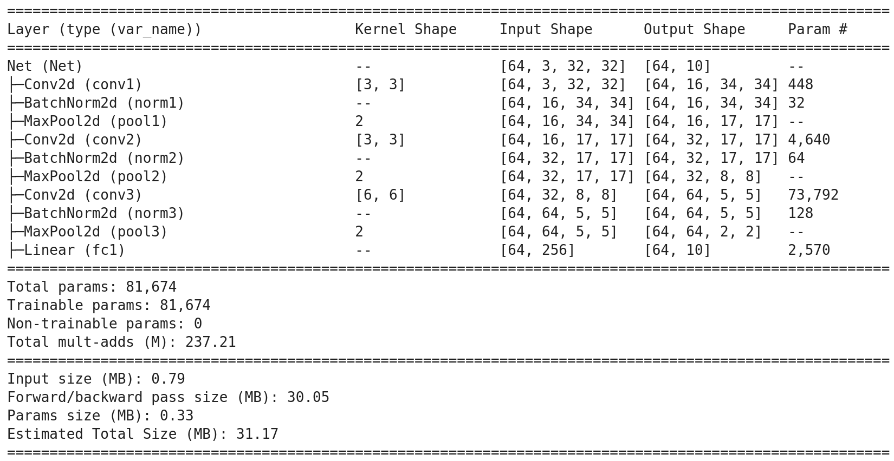
Baseline Model
Baseline accuracy after 10 epochs: 0.7157

Slide 6
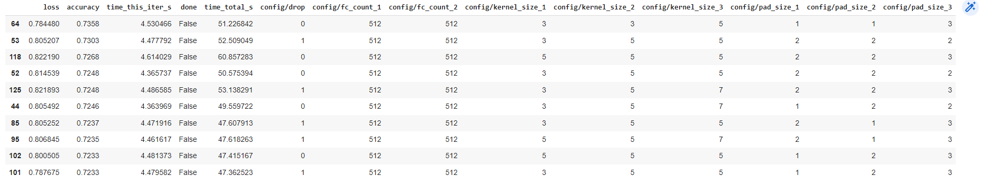
Hyperparameter/Architecture Tuning
1st Iteration: Adding multiple fully connected layers, adjusting kernel and pad size for all three convolutional layers
Baseline Accuracy: 0.7157 Current Accuracy: 0.7358

Slide 7
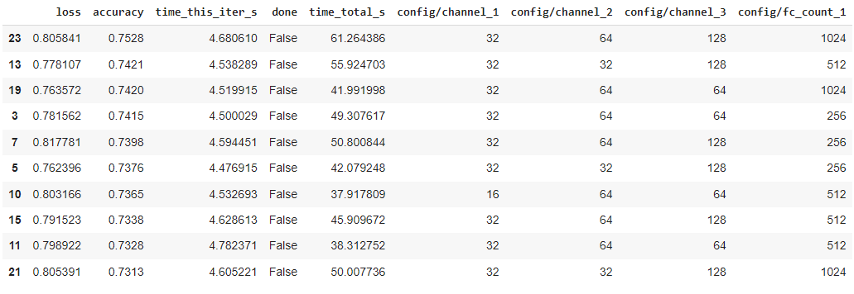
Hyperparameter/Architecture Tuning (Cont.)
2nd Iteration: Tweaking channel sizes and intermediate fully connected layer count
Previous Accuracy: 0.7358 Current Accuracy: 0.7528

Slide 8
Optimizer Tuning
Optimizers Tested:
Stochastic Gradient Descent (SGD)
Stochastic Gradient Descent with Nesterov Momentum
Adaptive Gradient Algorithm (Adagrad)
Root Mean Square Propagation (RMSprop)
Adam Optimizer
Parameters Tuned (where applicable):
Learning Rate
Momentum
Weight Decay

Slide 9
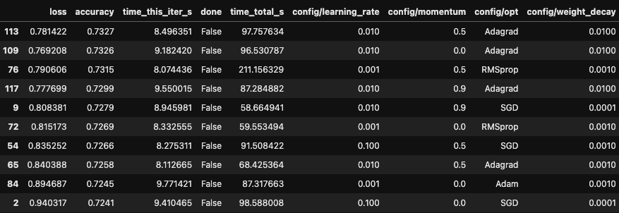
Optimizer Tuning on Baseline Model
Baseline Accuracy: 0.7157 Highest Validation Accuracy: 0.7327
Best optimizer for baseline architecture: Adagrad with a 0.01 learning rate and 0.01 weight decay
Performance of this optimizer on Test set: 0.6589

Slide 10
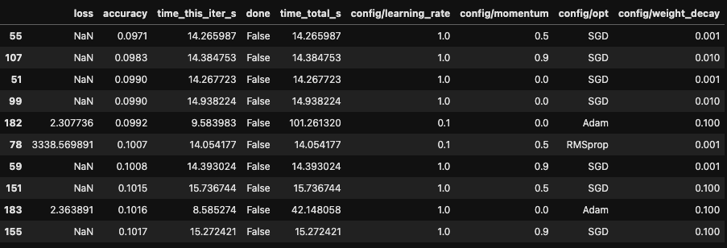
Optimizer Tuning on Baseline Model
SGD performs poorly with a high learning rate (in this case 1)
Adam performs poorly with a high weight decay (0.1)

Slide 11
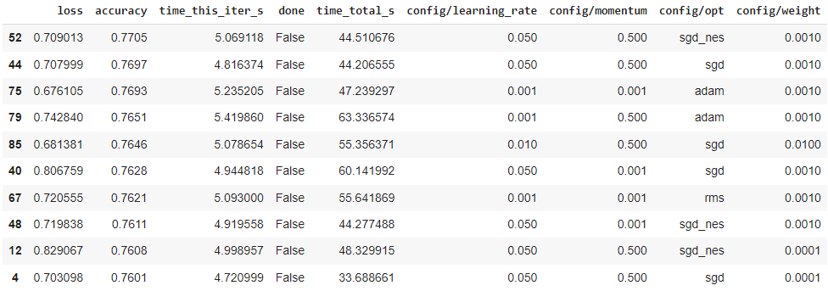
Similar Optimizer Tuning but on Previously Optimized Model
Previous Accuracy: 0.7528 Current Accuracy: 0.7705

Slide 12
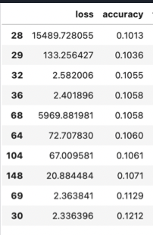
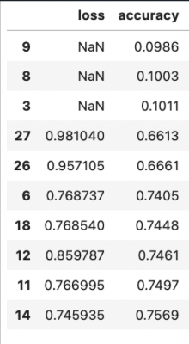
Bayesian Optimization
We tried to apply some Bayesian optimization to find better learning rate and weight, it only improved a little, but if we compare the worst trials of Grid Search and Bayesian Optimization, Bayesian Optimization only tests high quality trials which is obviously more desirable
Previous Accuracy: 0.7705 Current Accuracy: 0.7707
Worst trials of Grid Search
Worst trials of Bayesian Optimization

Slide 13
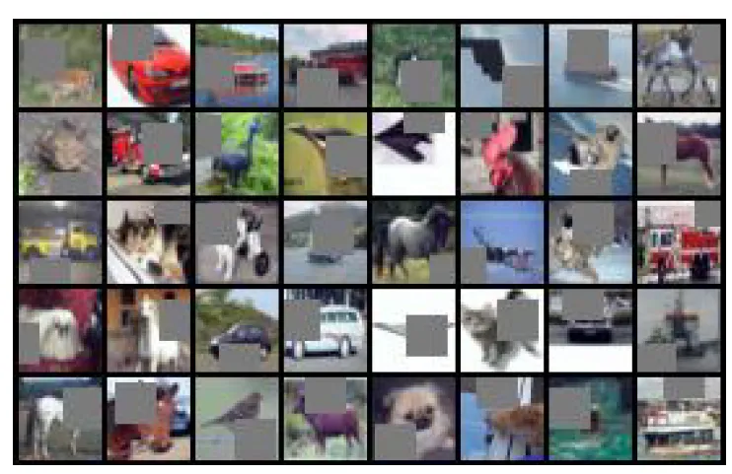
Data Augmentation
Motivation: Much of the effort has been put in finding a better architecture, while the data augmentation technique back in 2012 remain largely the same
Idea: We experimented some newer data augmentation techniques such as:
Mix-up
Cutout
AutoAugmentation
Use machine learning to find best augmentation policy
We used one optimized for CIFAR-10
We also used one optimized for ImageNet to test the idea of transfer learning but with augmentation
Visualization for Cutout:

Slide 14
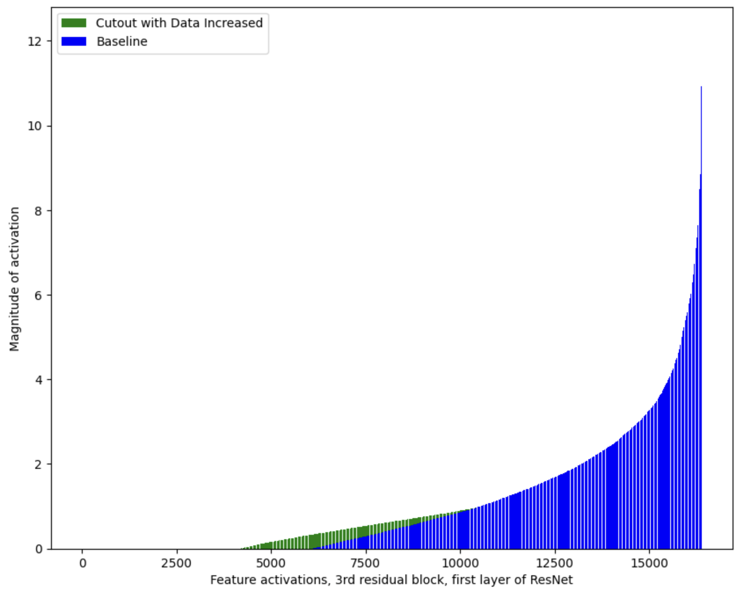
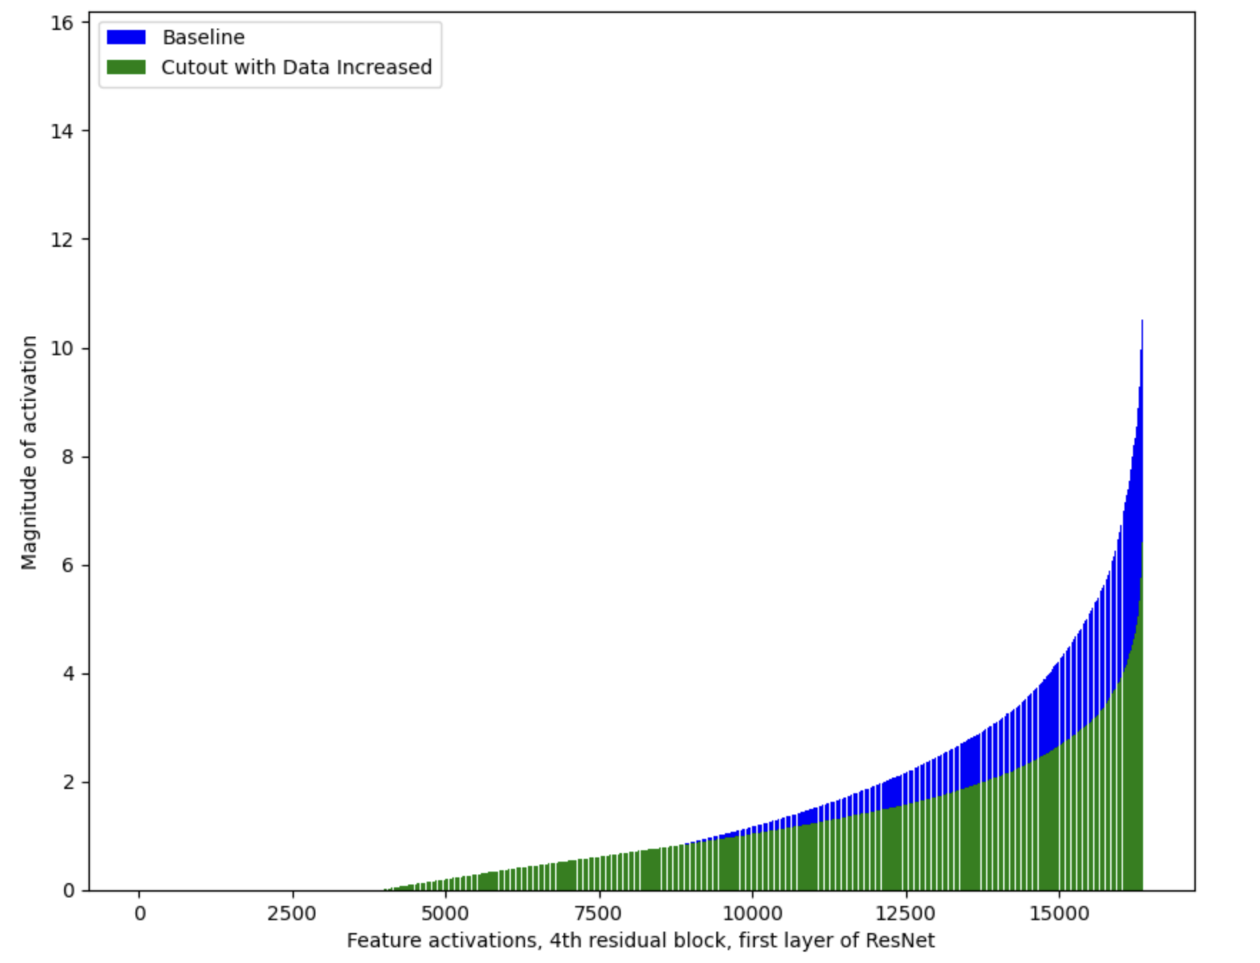
Data Augmentation - Cutout + Increase Data
Visualization to show that Cutout works by encouraging the model to pay more attention to the context

Slide 15
Data Augmentation: Initial Comparison
Baseline | ResNet
CIFAR10 AutoAugmentation + increase data | CIFAR10 AutoAugmentation + increase data
ImageNet AutoAugmentation + increase data | ImageNet AutoAugmentation + increase data
Cutout + increase data | Cut out + increase data
CIFAR10 AutoAugmentation | Mix-up
Mix-up | CIFAR10 AutoAugmentation
Cutout | ImageNet AutoAugmentation
ImageNet AutoAugmentation | Cutout
best
Conclusion:
Increase data is better
AutoAugmentation best, even if it was optimized for ImageNet. Transfer learning for augmentation works :)
Mix-up is comparable to AutoAugmentation, showing its potential
worst

Slide 16
Data Augmentation: Applied to Previously Optimized Model
Methods Used:
CIFAR-10 AutoAugmentation
Previous Accuracy: 0.7707 Current and Final Accuracy: 0.78230

Slide 17
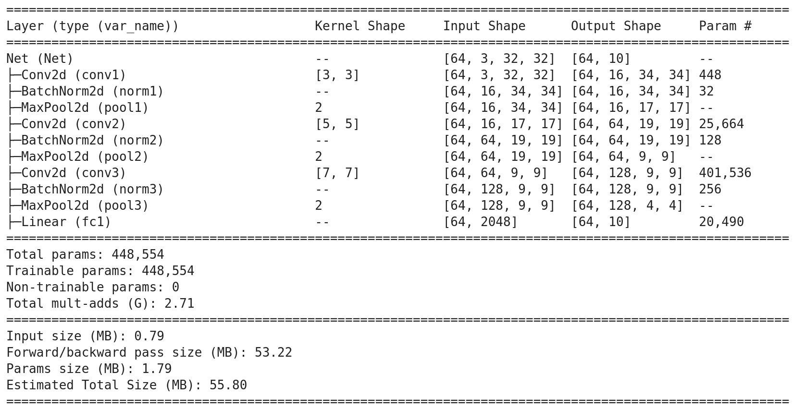
Final Model Comparison
Baseline Model:
channel_1 = 16
channel_2 = 32
channel_3 = 64
kernel_size_1 = 3
kernel_size_2 = 3
kernel_size_3 = 6
pad_size_1 = 2
pad_size_2 = 1
pad_size_3 = 1
learning_rate = 1e-2
momentum = 0.5
weight_decay = 1e-4
Intermediate Fully Connected Layer = None
Optimizer = SGD
Data Augmentation = None
Baseline Validation Accuracy: 0.7157
Baseline Test Accuracy: 0.6507
Final Model:
channel_1 = 32
channel_2 = 64
channel_3 = 128
kernel_size_1 = 3
kernel_size_2 = 5
kernel_size_3 = 7
pad_size_1 = 2
pad_size_2 = 3
pad_size_3 = 3
learning_rate = 0.015221
momentum = 0.900000
weight_decay = 0.001
Intermediate Fully Connected Layer = 1024
Optimizer = SGD with Nestorov
Data Augmentation = CIFAR-10 AutoAugmentation
Final Validation Accuracy: 0.78230
Final Test Accuracy: 0.7434

Slide 18
Insights (Model Related)
In general, moving from smaller to larger kernels worked better for subsequent convolutional layers
Increasing channel size almost always increased performance
Increasing the amount and size of fully connected layers had a minimal impact
Optimization methods had a very large impact on performance
Optimal learning rates vary widely with different methods
AutoAugmentation optimized for CIFAR-10 + increase data is the best way
The one optimized for ImageNet is runner up!
Tuning hyperparameters of a given architecture can lead to significant improvements, even without changing the number of layers of the architecture itself

Slide 19
Insights (Process Related)
Time to test scales exponentially with increased hyperparameters
Solution: Experiment incrementally
Automated tools such as Ray Tune make testing parameters much simpler
More advanced Hyper-parameter tuning algorithm such as Bayesian Optimization that only tries higher quality configurations

Slide 20
References
[1] Dataset: https://www.cs.toronto.edu/~kriz/cifar.html
[2] Ray Tune: https://docs.ray.io/en/latest/tune/getting-started.html

