Slide 1
Bullseye: A Stock Market Visualization and Prediction Service
Vipul Gharde (vig4)

Slide 2
Bullseye
Django web application
Yahoo Finance API (yfinance)
Interactive visualizations on historical stock data using Plotly
Stock Predictions for next working day via LSTM

Slide 3
Target Audience
Individual investors
Business schools and academic researchers
Traders and portfolio managers

Slide 4
Requirements
Libraries
Pandas
NumPy
Plotly
Scikit-Learn
Keras
Frameworks
Django
Bootstrap
API
Yahoo Finance API (yfinance)

Slide 5
Model Building
Split historical stock data into training and validation data (80-20)
Use 5-year Apple Historical Close data from 2018-01-01 to 2023-01-01
Train models on the training data and evaluate on the validation data
Train for 1 epoch
Pick model that performs the best on validation data

Slide 6
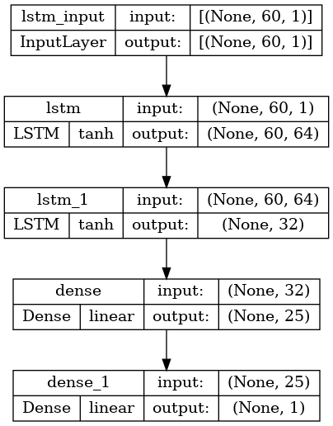
Model Architecture
LSTM
Input: 60 days historical stock data
Scale input data with StandardScaler
Optimizer: adam
Loss: mean_squared_error

Slide 7
Model Evaluation
Training Loss: 0.0153
Validation RMSE: 5.34
Validation R²: 0.71

Slide 8
References
[1] Ran Aroussi. (2021). yfinance: Yahoo! Finance market data downloader. Available at: https://pypi.org/project/yfinance/
[2] Django. (n.d.). The web framework for perfectionists with deadlines. Retrieved from https://www.djangoproject.com/
[3] Plotly. (n.d.). Collaborative data science. Retrieved from https://plotly.com/python/
[4] Lipton, Z. C., Kale, D. C., & Elkan, C. (2015). Learning to diagnose with LSTM recurrent neural networks. arXiv preprint arXiv:1511.03677.
[5] Zhang, X., & Lai, K. K. (2018). Stock price prediction using LSTM, RNN and CNN-sliding window model. Journal of Physics: Conference Series, 1036(1), 012014.

