Slide 1
Sequence Diagrams
Dan Fleck
Coming up: Interaction Diagrams

Slide 2
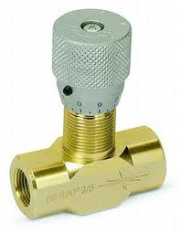
Interaction Diagrams
UML Specifies a number of interaction diagrams to model dynamic aspects of the system
Dynamic aspects of the system
  Messages moving among objects/
  classes
  Flow of control among objects
  Sequences of events
Coming up: Dynamic Diagram Types

Slide 3
Dynamic Diagram Types
Interaction Diagrams - Set of objects or roles and the messages that can be passed among them.
  Sequence Diagrams - emphasize time ordering
  Communication Diagrams - emphasize structural ordering
State Diagrams
  State machine consisting of states, transitions, events and activities of an object
Activity & Swimlane Diagrams
  Emphasize and show flow of control among objects
Coming up: Sequence Diagrams

Slide 4
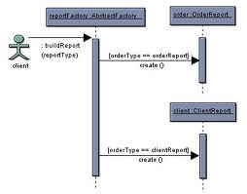
Sequence Diagrams
Describe the flow of messages,
events, actions between objects
Show concurrent processes and
activations
Show time sequences that are not easily depicted in other diagrams
Typically used during analysis and design to document and understand the logical flow of your system
Emphasis on time ordering!

Slide 5
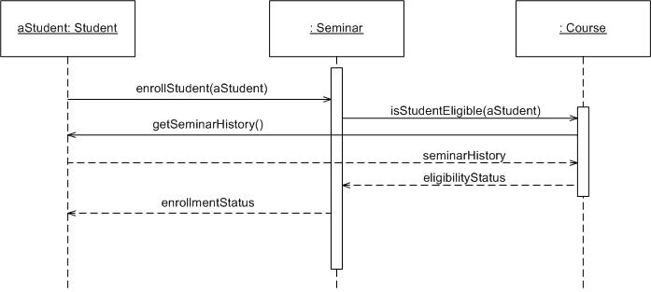
Sequence Diagram
Coming up: Components

Slide 6

Sequence Diagram
Time Increasing -->
All lines should be horizontal to indicate instantaneous actions. Additionally if ActivityA happens before ActivityB, ActivityA must be above activity A
Lower = Later!
Coming up: Components

Slide 7
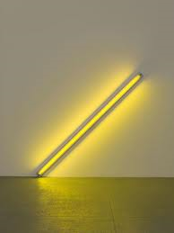
Diagonal Lines
:Student
:Registration System
Time=A
GetDetails()
Time=B
What does this mean?
Do you typically care?

Slide 8
Components
Objects: aStudent is a specific instance of the Student class
Generic (unnamed)
objects
Generic (unnamed)
objects of class type Seminar
and Course
Specific
Instance of an
Object
Coming up: Components

Slide 9
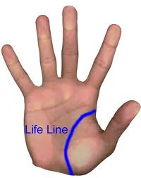
Components
execution
lifeline
Coming up: Components

Slide 10
Components
Method call
Return value
Coming up: Components

Slide 11
Components
c : Client
o : ODBCProxy
create()
: Transaction
setActions(a, b, c)
setValues(a, 3, 4)
setValues(b, c, 7)
(committed)
destroy()
create()
destroy()
Synchronous message
Asynchronous message
Return message
Coming up: Components: Guards

Slide 12
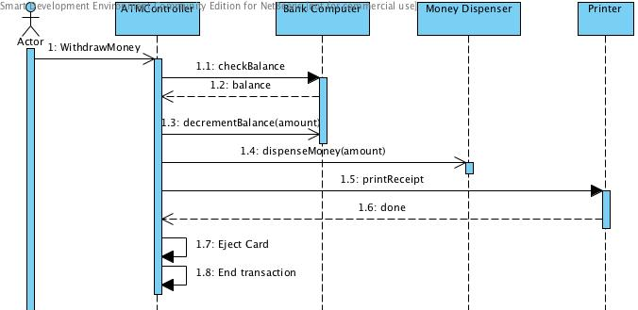
Async Message Example
There are problems here… what are they?
Synchronous message
Asynchronous message
Return message
Coming up: Components: Guards

Slide 13
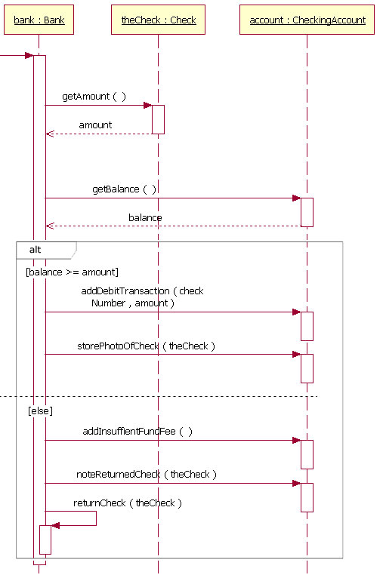
Components: alt/else
Coming up: Components: option

Slide 14
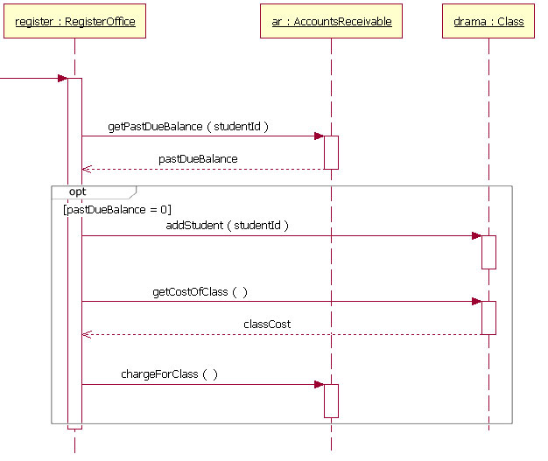
Components: option
Coming up: Components: loop

Slide 15
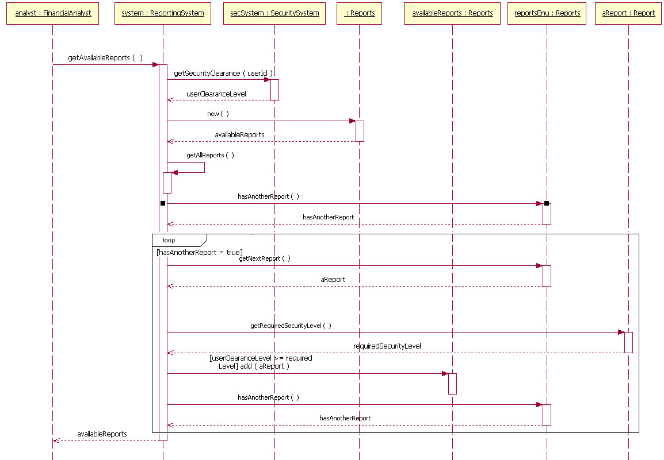
Components: loop
Coming up: In class exercise

Slide 16
Rules of thumb
Rarely use options,loops,alt/else
  These constructs complicate a diagram and make them hard to read/interpret.
  Frequently it is better to create multiple simple diagrams
Create sequence diagrams for use cases when it helps clarify and visualize a complex flow
Remember: the goal of UML is communication and understanding

Slide 17
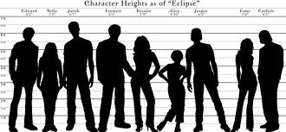
Summary
Sequence diagrams model object interactions with an emphasis on time ordering
Method call lines
  Must be horizontal!
  Vertical height matters!
  “Lower equals Later”
  Label the lines
Lifeline – dotted vertical line
Execution bar – bar around lifeline when code is running
Arrows
  Synchronous call (you’re waiting for a return value) – triangle arrow-head
  Asynchronous call (not waiting for a return) – open arrow-head
  Return call – dashed line
Coming up: In class exercise

Slide 18
In class exercise
Draw a sequence diagram for:
  In Beauty and the Beast kitchen items came to life. Draw a sequence diagram for making a peanut butter and jelly sandwich if the following objects are alive: knife, peanut butter jar (and peanut butter), jelly jar (and jelly), bread, plate. I may or may not want the crusts cut off. Don’t forget to open and close things like the jars, and put yourself away, cleanup, etc…
Coming up: In class exercise

Slide 19
In class exercise
Draw a sequence diagram for:
  Returning a movie to Netflix. When you return it a person scan’s it in, the s/w detects that and then goes through a sequence of steps to get the new movie to you. Think of the different classes that would be involved: Queue, Shipping, Inventory, UserAccount, other classes??
Coming up: In class exercise

Slide 20
In class exercise
Draw a sequence diagram for:
  Adding a picture to Flickr (or any online image database). Login, pick an album, upload a picture, etc… Think about the software classes that would be involved – WebGUI (think of this as reporting what the user does), UserAccount, Album, AlbumList, etc…
  Don’t forget to check and update their current disk usage. For this diagram show the check coming back as acceptable.. you would do a second diagram for them running over quota.
Coming up: In class exercise

Slide 21
In class exercise
Draw a sequence diagram for:
  Getting on a flight. Start at home, check in at the counter, go through security, and end up at the gate. (If you have time during the exercise, get yourself to your seat.)
    You may get searched in security
Coming up: In class exercise

Slide 22

In class exercise
Draw a sequence diagram for:
  Getting money from an ATM machine
    Treat each part of the ATM as a class
      Money dispenser
      Screen
      Keypad
      Bank computer
      Etc…
Coming up: References

Slide 23
References
Example diagrams from: http://www.ibm.com/developerworks/rational/library/3101.html
Also see Booch G.,The Unified Modeling Language User Guide, ch 19.
Coming up: References

