Slide 1
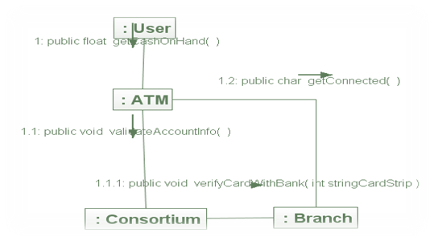
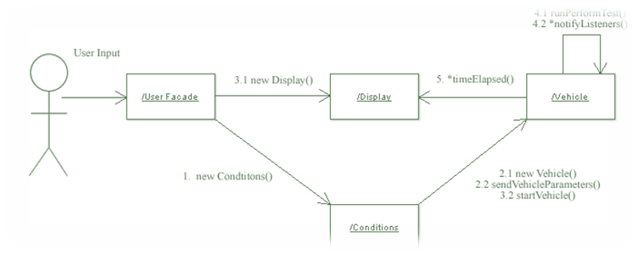
Chapter 10:
Collaboration Diagram - PART1
Chapter 14 & 15 in Applying UML and Patterns Book.

Slide 2
Overview
From analysis to design.
Introduction to Collaboration Diagrams.
How to make collaboration diagram ?

Slide 3
From Analysis to Design
During Analysis:
  We tried to understand (investigate) the problem.
  Answered the question “What”.
During Design:
  We try to solve the problem.
  Answer the question “How”.
Analysis Artifact | Questions Answered
Use Cases | What are the domain processes?
Conceptual Model | What are the concept, terms?
System Sequence Diagram | What are the system events and operation?
Operation Contracts | What do the system operations do?

Slide 4
Collaboration Diagrams
Contracts provide operation post conditions.
Collaboration diagrams show how software objects are going to fulfill these post conditions.
A collaboration diagram is a solution for a system operation.
It carries out a contract of a system operation by assigning responsibilities to objects.

Slide 5
Collaboration Diagrams
Collaboration diagrams are dependent on:
  Conceptual Model.
  Operation Contracts.
  Use cases.
In this set of slides we will concentrate only on its notations.

Slide 6
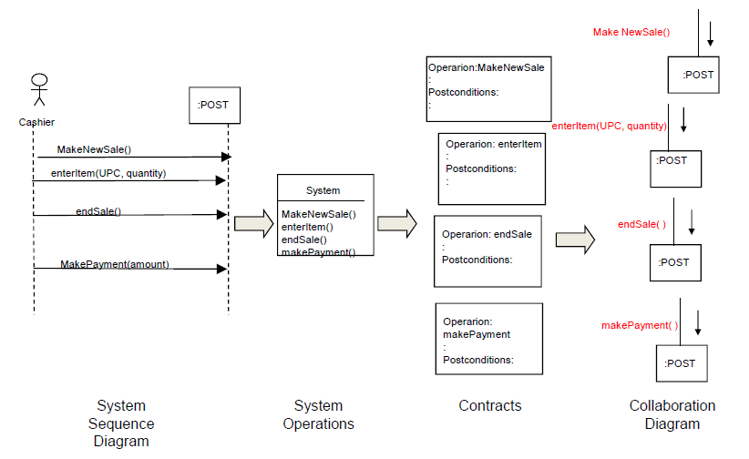
Interaction Diagrams and Other Artifacts

Slide 7
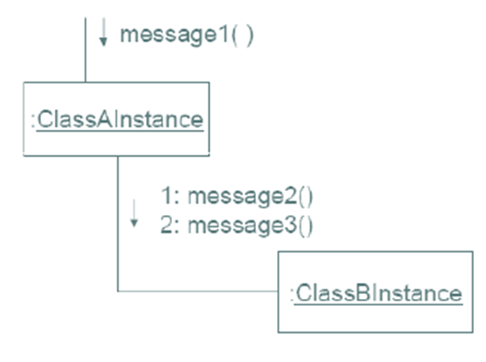
Interaction Diagram and Collaboration Diagram
Interaction Diagrams illustrate how objects interact via messages.
Collaboration Diagrams illustrate object interactions in a graph or network format.

Slide 8
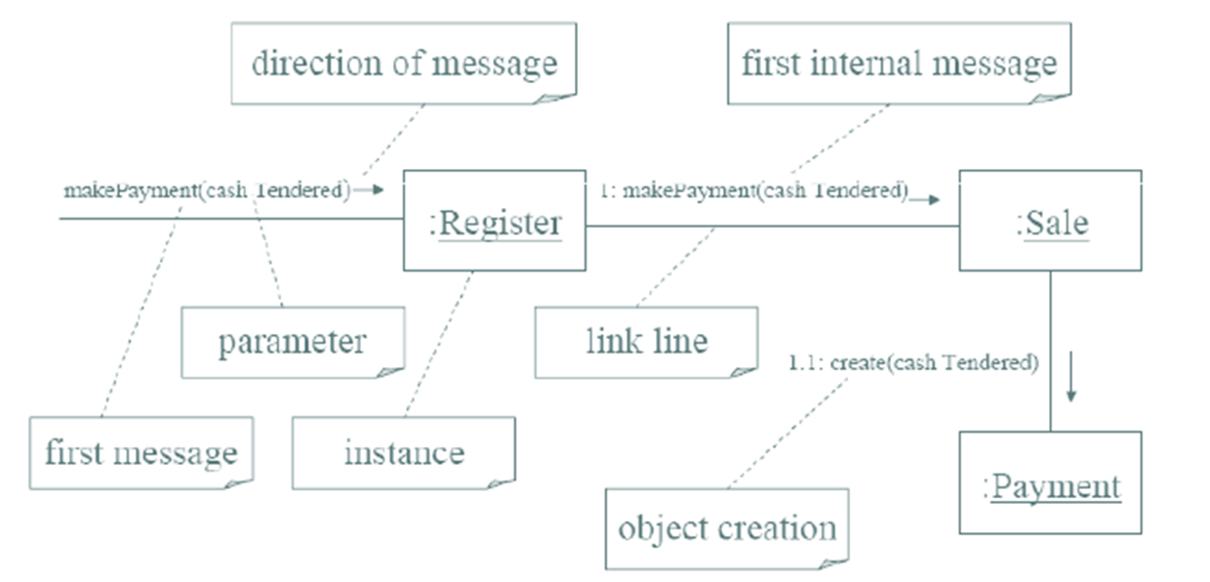
Example of Collaboration Diagram:
“Make Payment”

Slide 9
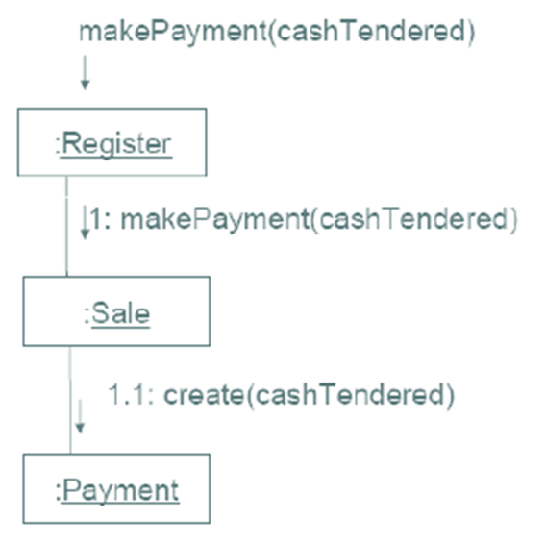
How to read “Make Payment” Collaboration Diagram
The message makePayment is sent to an instance of Register. The sender is not identified.
The Register instance sends the makePayment message to a Sale instance.
The Sale instance creates an instance of a Payment.

Slide 10
How to Make Collaboration Diagrams ?
Create a separate diagram for each system operation.
    For each system event, make a diagram with it as the starting message.
Split into smaller diagrams if it gets complex.
Use the contract post-conditions & use case description to design a system of interacting objects to fulfill the tasks.
Apply GRASP to develop good design. ( Next chapter )

Slide 11
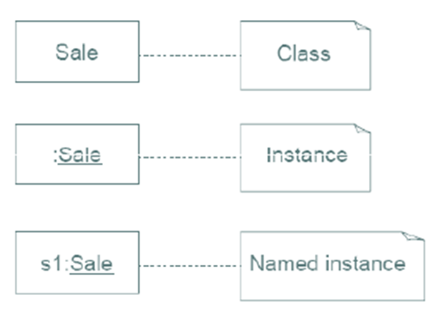
Common Interaction Diagram Notation
Illustrating Classes and Instances
To show an instance of a class, the regular class box graphic symbol is used, but the name is underlined. Additionally a class name should be preceded by a colon.
An instance name can be used to uniquely identify the instance.

Slide 12
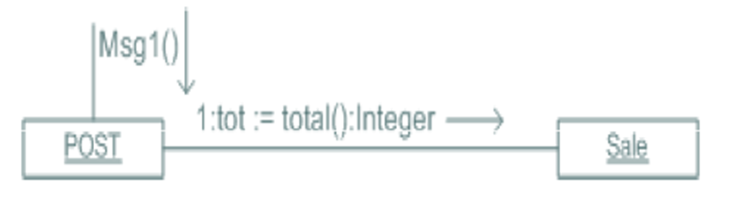
Collaboration Diagram Notation
Links, Messages and Return Value

Slide 13
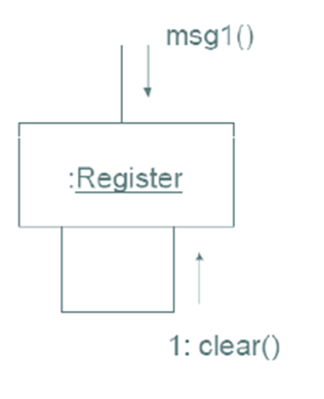
Collaboration Diagram Notation
Messages to “Self” or “This”
A message can be sent from an object to itself.
This is illustrated by a link to itself, with messages flowing along the link.

Slide 14
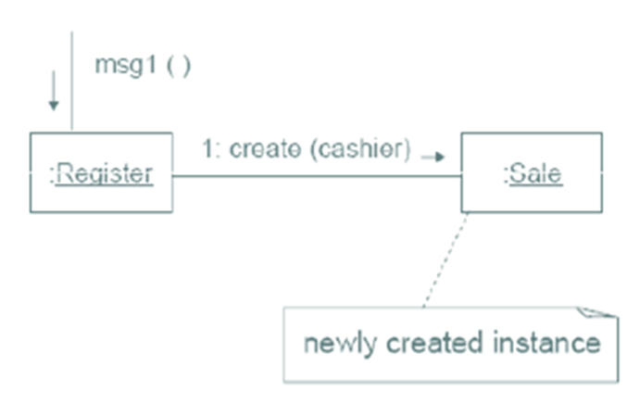
Collaboration Diagram Notation
Creation of Instances
The language independent creation message is create, being sent to the instance being created.
The create message may include parameters, indicating passing of initial values.

Slide 15
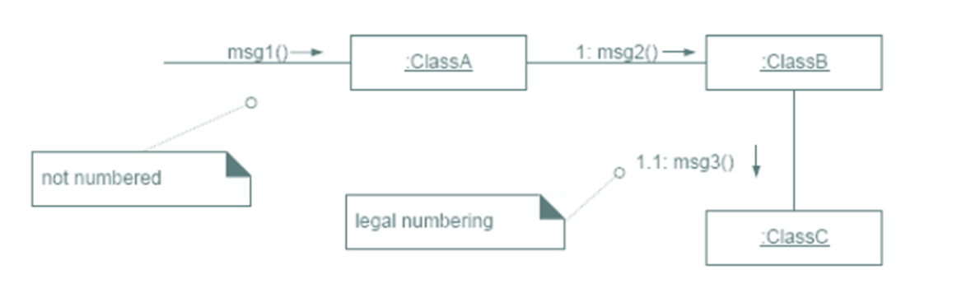
Collaboration Diagram Notation
Message Number Sequencing
The first message is not numbered.
The order and nesting of subsequent messages is shown with legal numbering scheme.

Slide 16
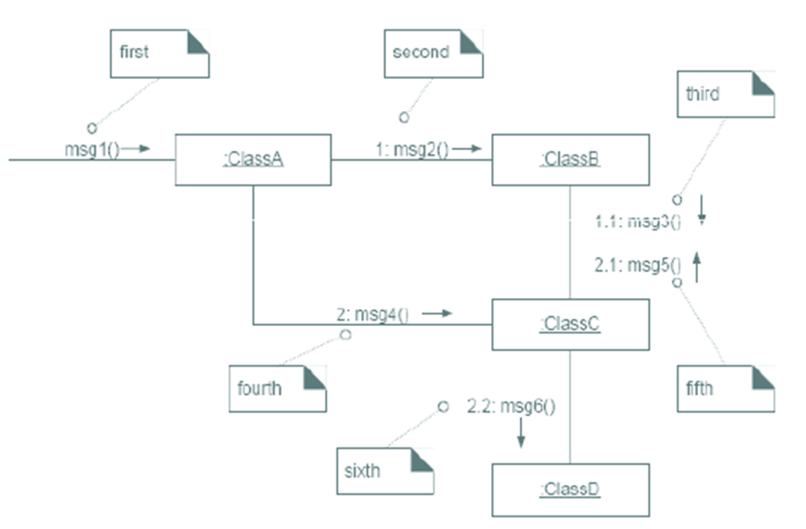
Collaboration Diagram Notation
Message Number Sequencing (cont.)

Slide 17
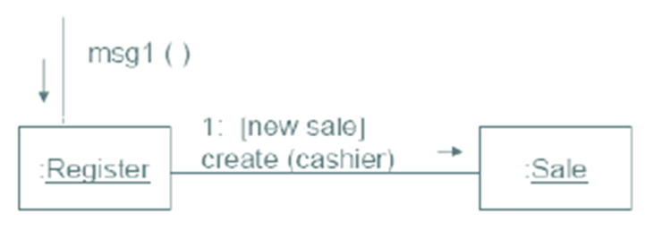
Collaboration Diagram Notation
Conditional Messages
A conditional message is shown by following a sequence number with a conditional clause in square brackets, similar to the iteration clause.
The message is sent only if the clause evaluates to true.

Slide 18
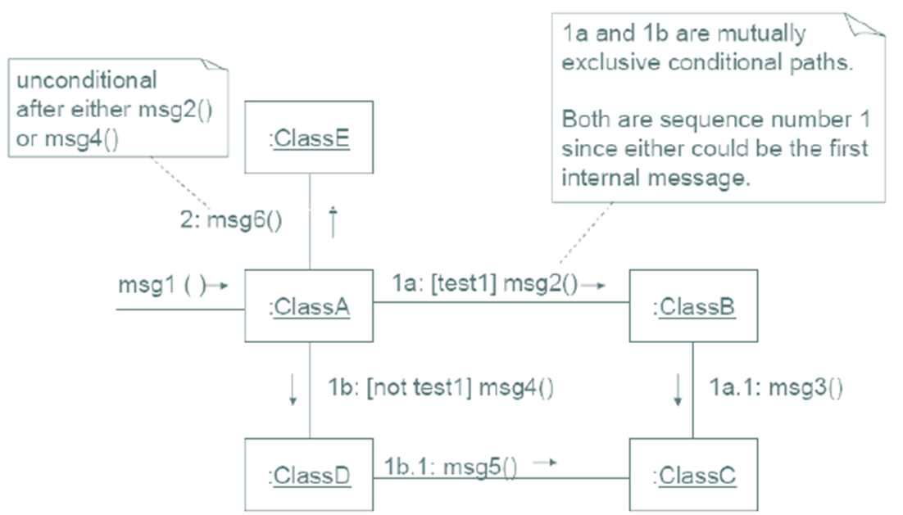
Collaboration Diagram Notation
Mutually Exclusive Conditional Paths

Slide 19
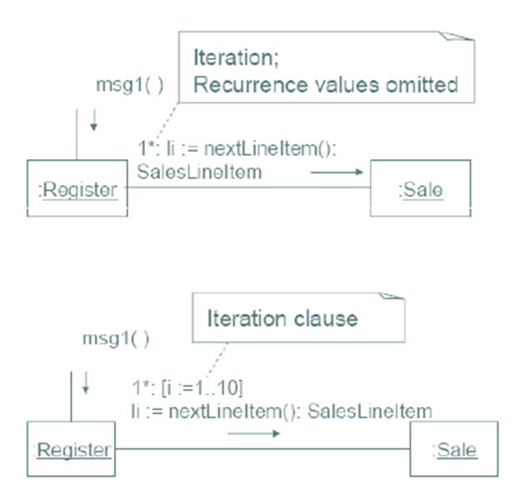
Collaboration Diagram Notation
Iteration or Looping
Iteration is indicated by following the sequence number with a star *.
This expresses that the message is being sent repeatedly, in a loop, to the receiver.
It is also possible to include an iteration clause indicating the recurrence values.

Slide 20
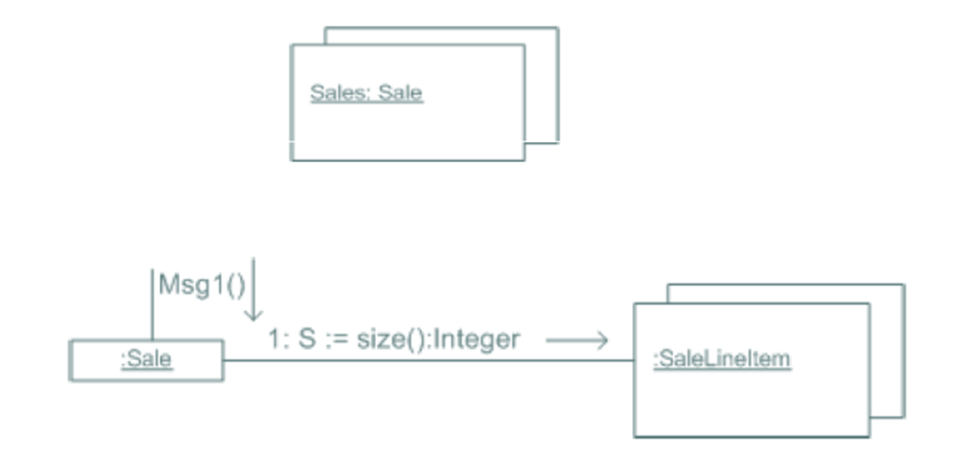
Collaboration Diagram Notation
Illustrating Collections (Multiobject)
A multiobject is a set of instances.

Slide 21
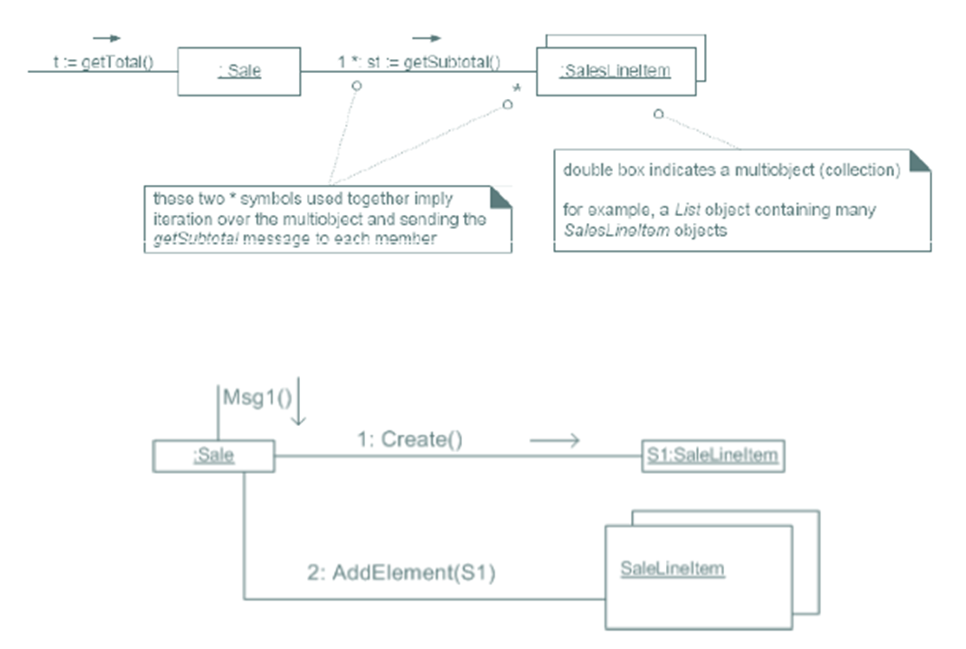
Collaboration Diagram Notation
Illustrating Collections (Multiobject) (cont.)

Slide 22
Collaboration Diagram Notation
Summary
Objects are connected with numbered (sequenced) arrows along links to depict information flow.
Arrows are drawn from the interaction source.
The object pointed to by the arrow is referred to as the target.
Arrows are numbered to depict their usage order within the scenario.
Arrows are labeled with the passed message.

