Slide 1

Mini Project Presentation
2022-2023
(Automatic License Plate Detection System)
Submitted by :- Vipul Chauhan
University Roll No. : 2018855
Class Roll Number. 61
Section: A
DEPARTMENT OF COMPUTER SCIENCE AND ENGINEERING
GRAPHIC ERA HILL UNIVERSITY, DEHRADUN

Slide 2
Introduction To Problem Statement :-
Developing a Automatic License Plate Detection System : To Develop the model to detect the License Plates of the Vehicles.
Tech used : tensorflow, opencv-python, easyocr, matplotlib, python
Tools used : Mac OS/Linux OS, Jupyter Notebook/Google Collab

Slide 3
Basic Overview (WORKFLOW) :-
Create the folder structure
Download TF Models Pretrained Models from Tensorflow Model Zoo and Install TFOD
Create Label Map
Cloning the images dataset for training the model
Create TF records
Copy Model Config to Training Folder
Update Config For Transfer Learning
Train the model
Evaluate the Model
Load Train Model From Checkpoint
Detect from an Image
Apply OCR to Detection
OCR Filtering
Bring it Together
Save Results
Real Time Detections from your Webcam

Slide 4
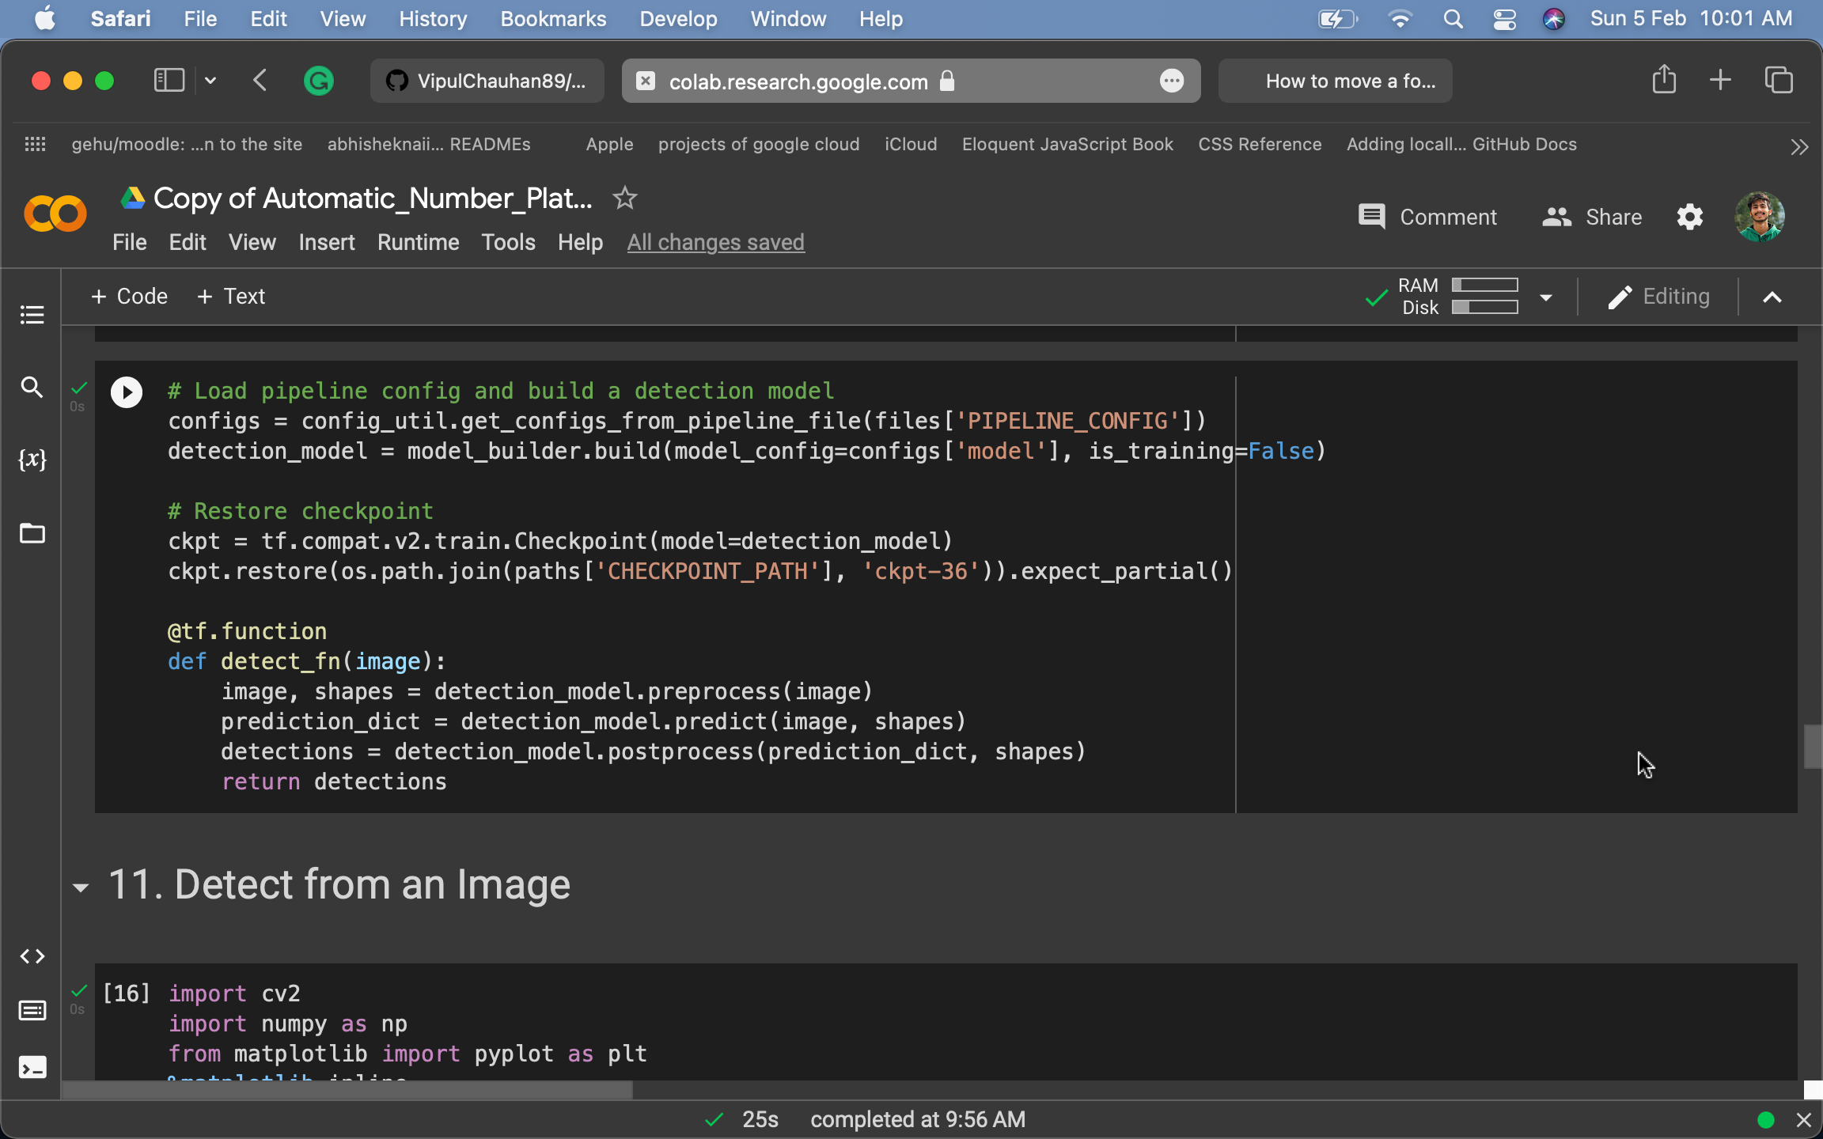
Loading the model from checkpoint :-

Slide 5
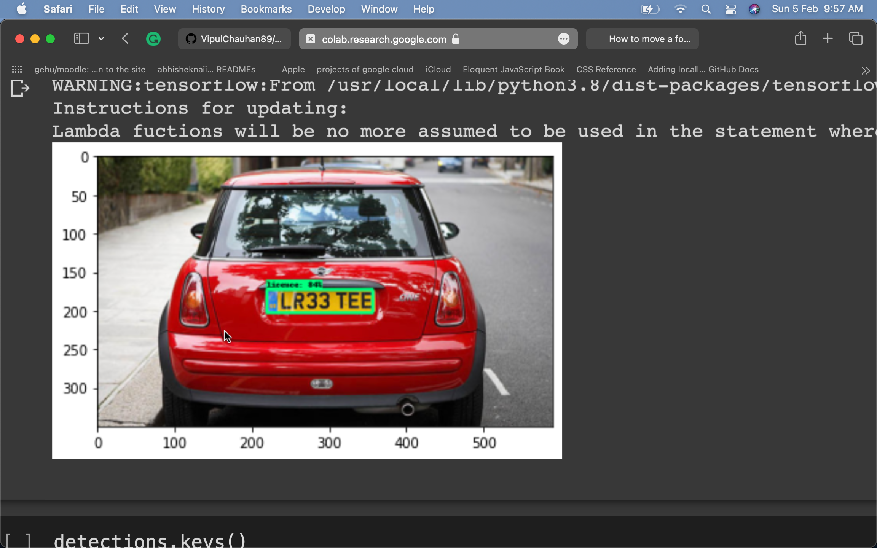
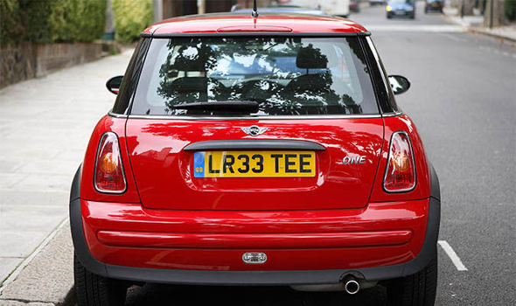
Testing Model

Slide 6
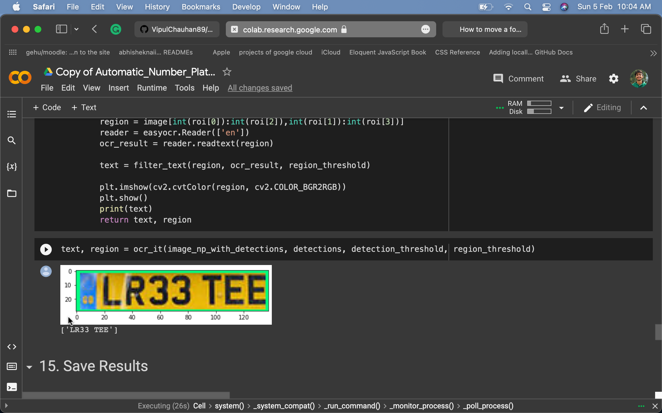
After appliying the filtering and easy ocr :-

Slide 7
HOW IT WORKS:-
Image Acquisition:
Pre-processing:
License Plate Detection:
Character Segmentation:
Recognition:
Result Output:

Slide 8
THANK YOU

