Slide 1

Mini Project Presentation
2021-2022
(Supermarket Billing Calculation System)
Submitted by :- Vipul Chauhan
University Roll No. : 2018855
Class Roll Number. 62
Section: A
DEPARTMENT OF COMPUTER SCIENCE AND ENGINEERING
GRAPHIC ERA HILL UNIVERSITY, DEHRADUN

Slide 2
Introduction To Problem Statement :-
Supermarket is the self-service shop where the customers come to purchase their daily using products and pay for that.
It is very difficult for the Supermarket team to manage the record of each and every item in the store and keep track of all the sales records and there is also a need to calculate how many products are sold and to generate the bill for the customer.
So all these tasks are not simple and easier so what I did is keeping these points in my mind I build this project using C++ objects and classes concepts.

Slide 3
Basic Overview :-
The project is on Supermarket Billing Calculation System.
In my project I have 2 users. First one is the Manager who has the rights to change the login details of himself and the cashier or to add the new manager or new cashier. The manager also has the rights to change the stock and price of the items of the supermarket and add new item to the supermarket in short we can say that the manager has the rights to update the stock of items in supermarket.
Second one is the cashier who only has the rights to generate the bill by accepting the items and the quantity of the item purchased by the customer and generate the bill according to the item list made by the manager and then finally print the bill and generate the text file of the bill and at last collect the cash.

Slide 4
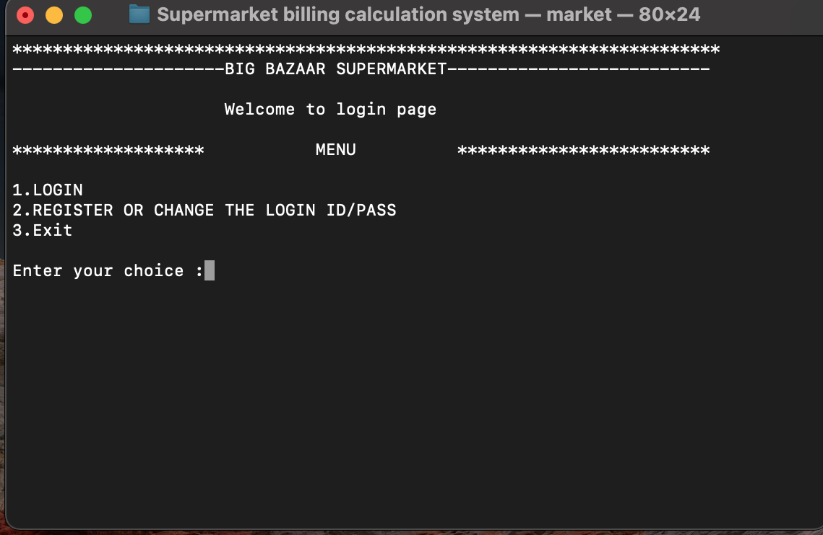
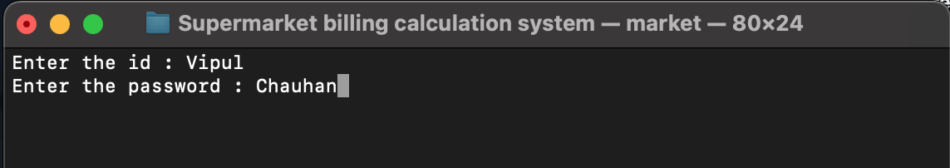
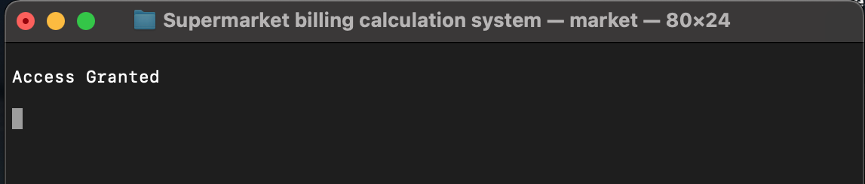
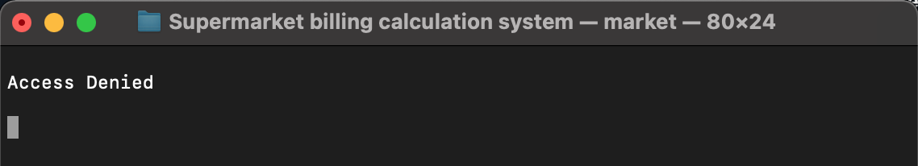
LOGIN INTERFACE
When you press 1 what happens ?
You have to either enter manager’s or cashier’s id and password
If login credentials are correct
If login credentials are not correct

Slide 5
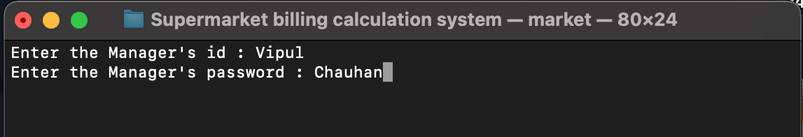
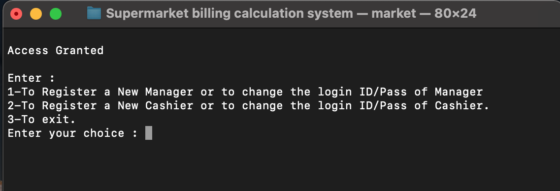
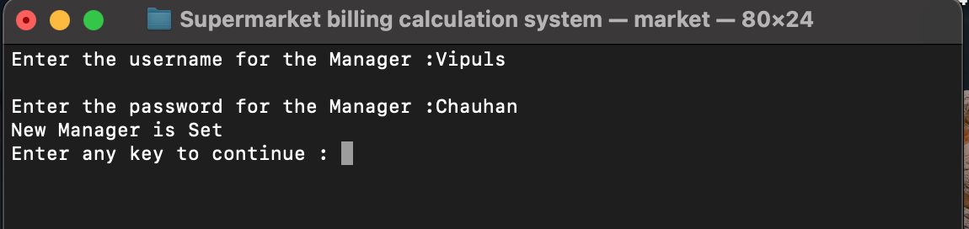
When you press 2 what happens ?
You have to enter manager’s or id and password
When the manager’s id pass are correct
When you press 1 what happens ?
You have to enter new manager’s or id and password

Slide 6
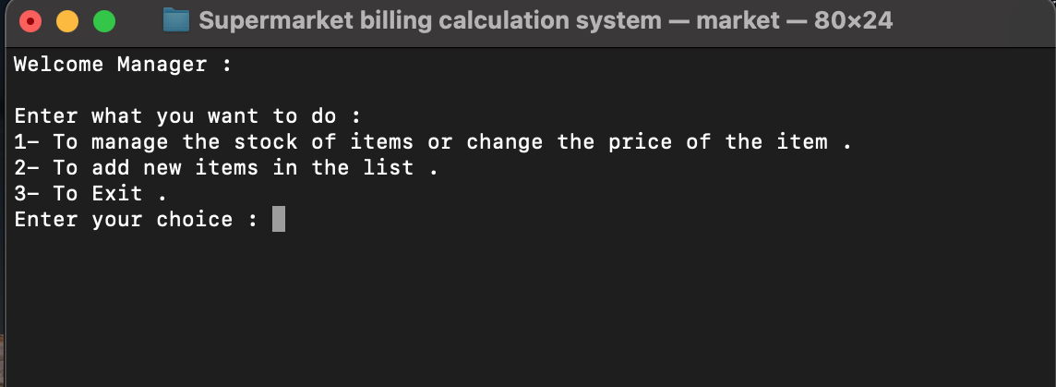
Manager’s interface

Slide 7
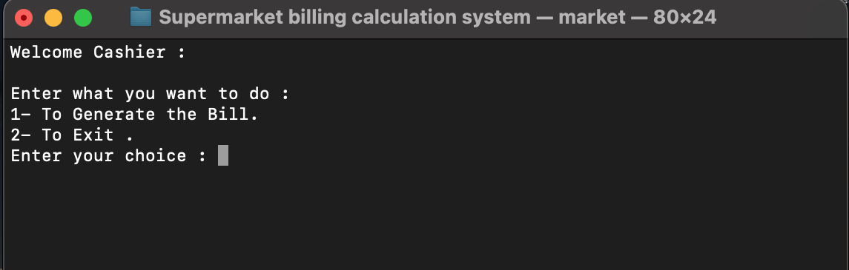
Cashier’s interface
When you press 1 to generate the bill what happens?

Slide 8
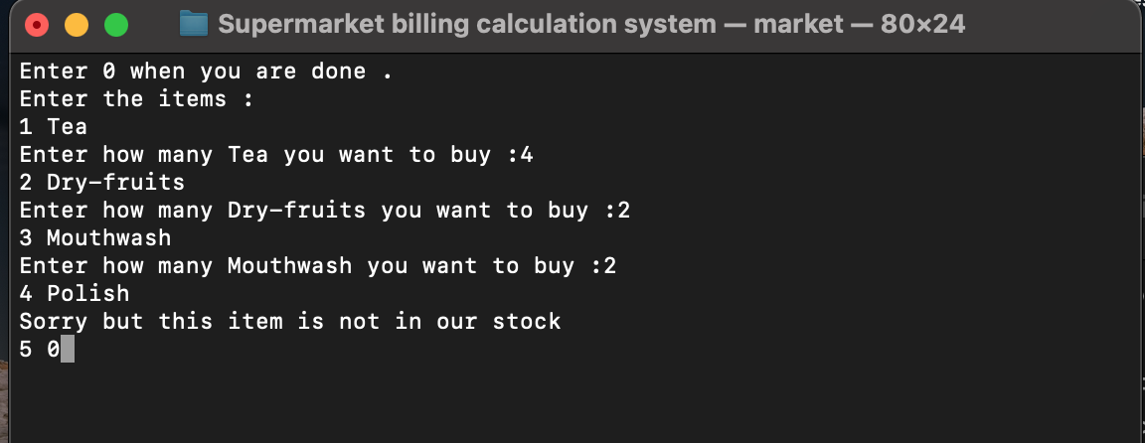
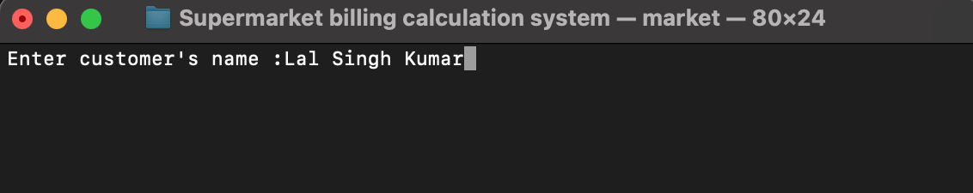
You have to enter the names of the items purchased and then how many items were purchased
And when you are done entering all the items you should press 0

Slide 9
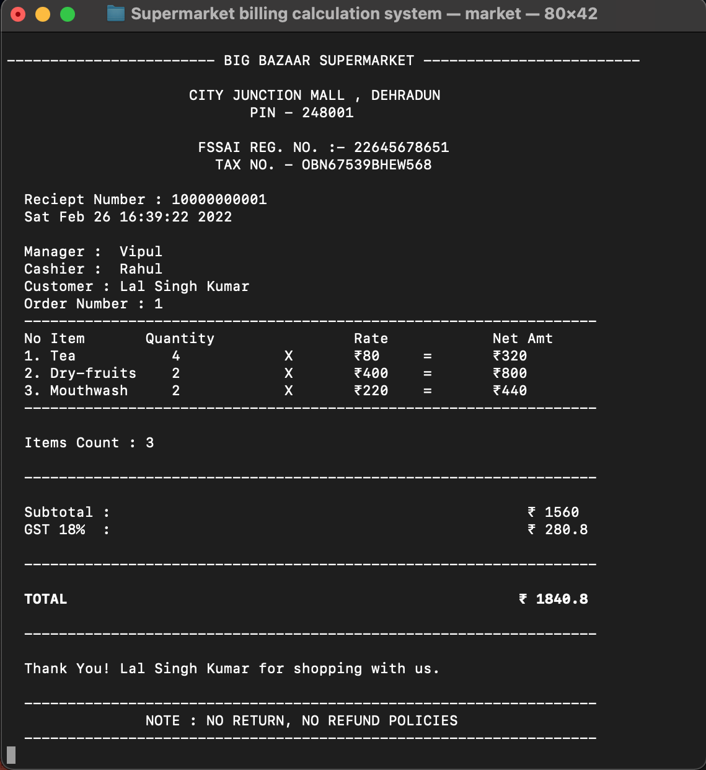
Bill get Generated

Slide 10
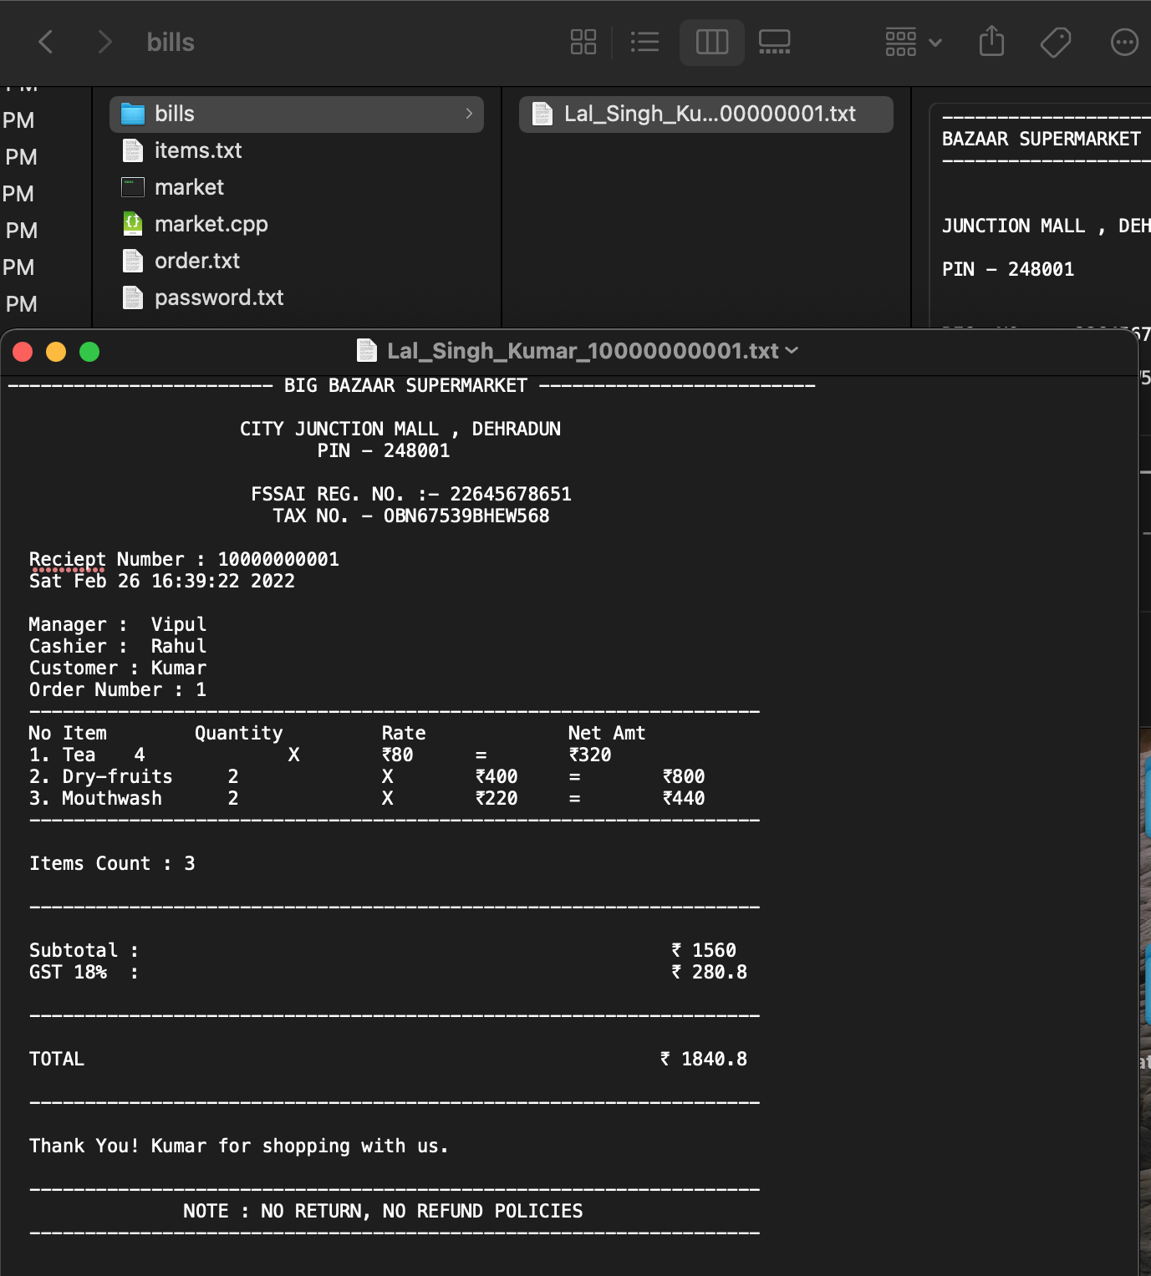
Text file of the bill also get generated in folder bills
With the name of the customer and the receipt number of the bill with extension .txt

Slide 11
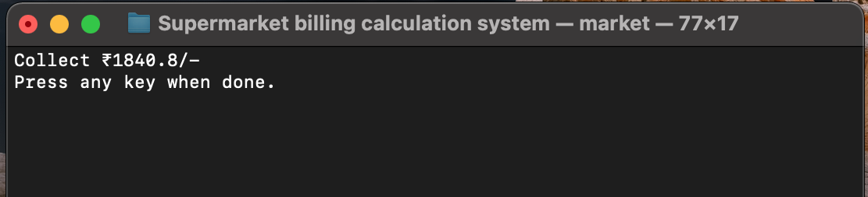
And at last the command to the cashier is given to collect the cash

Slide 12
TOOLS USED :-
C++ programming language.
Visual Studio Code (VS Code) as IDE.
File Handling.
Operating System macOS BIG SUR version 11.6.4
AIM :- To make software fast in processing with good UI so that it could be used for long duration without errors.
Objectives :-
To reduce large paper work.
To increase efficiency and accuracy of system.
To reduce time for organization.
To search for data faster.

