Slide 1
Power BI
By Vipul Dani
Pragati Software Pvt Ltd.

Slide 2
Agenda
Microsoft Power BI: What is it?
A deeper look at the parts of Power BI:
Power BI Service
Power BI Desktop
Power BI Mobile
Power BI Embedded
Creating and publishing a dashboard
My Workspace
Groups

Slide 3

Power BI: What is it?
Power BI is *NOT* business intelligence.
Business Intelligence is an on-going strategy for a company.
You can not buy business intelligence.
You can buy tools and technology but BI is about people and data.
Power BI is a set of tools and technologies.

Slide 4
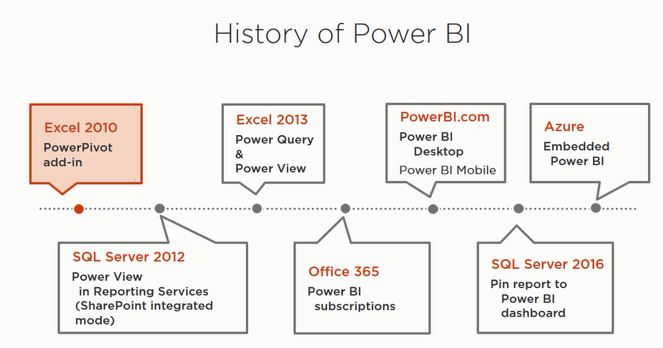
Notes:
Microsoft has also released a standalone Power BI Desktop application, which ties together Power Query, Power Pivot, and Power View in a standalone application, removing the Excel 2013 constraint. Power BI Desktop is available for free
Power BI (with O365 and SharePoint Online) provides a site where users can upload and share their created content with other users, as well as manage gateways into enterprise data source, enable data refresh, and advanced features like Q&A, which allows natural language querying of data models.

Slide 5

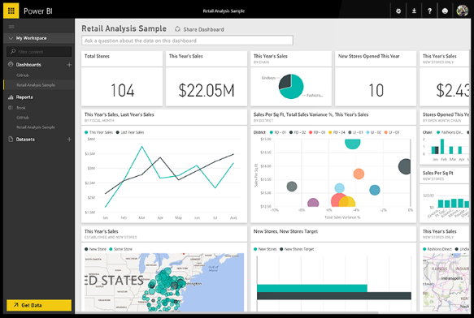
Power BI Service
Microsoft Power BI
Cloud based service (Part of Office 365)
Access to all data, wherver it may live
Ask questions, integrate with cortana analytics and more
Create curated content based on your company needs
Share insights across web, mobile and embedded within your own applications.
“Any data, anywhere, any time”

Slide 6
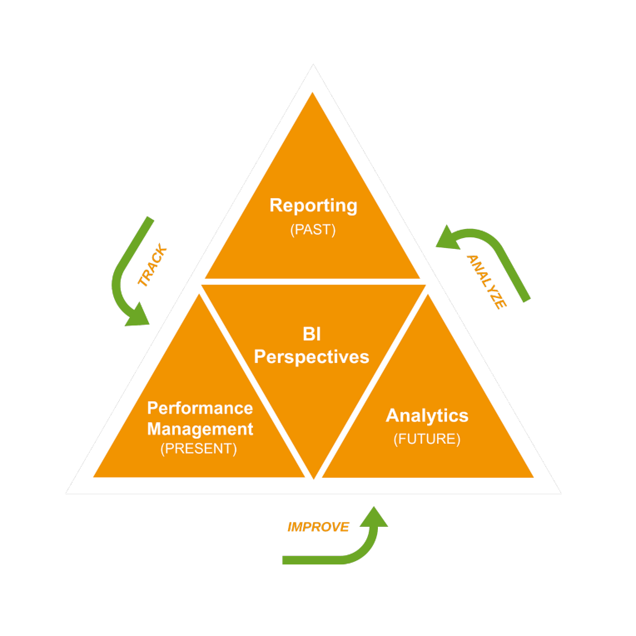
Three perspectives of data
PAST: What Happened?
Reactive reporting
Common among most companies
PRESENT: What is Happening?
KPI’s and CPM Concepts
Streaming analytics
FUTURE: What will Happen?
Predict based on trends and external data
Understand impact and what-if analysis

Slide 7
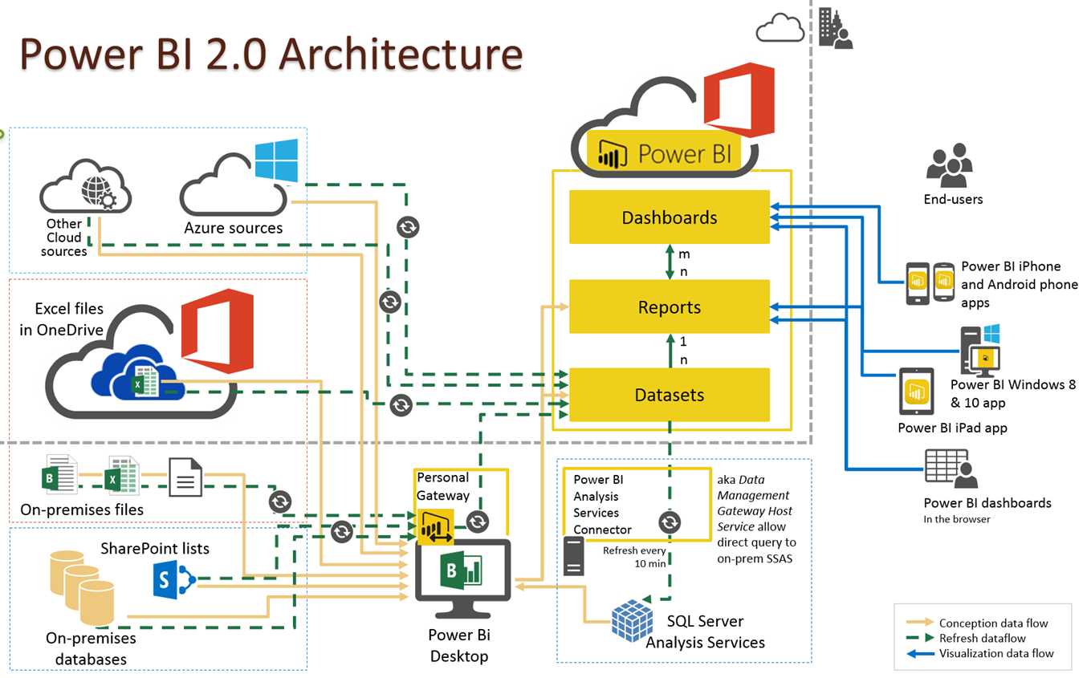

Slide 8
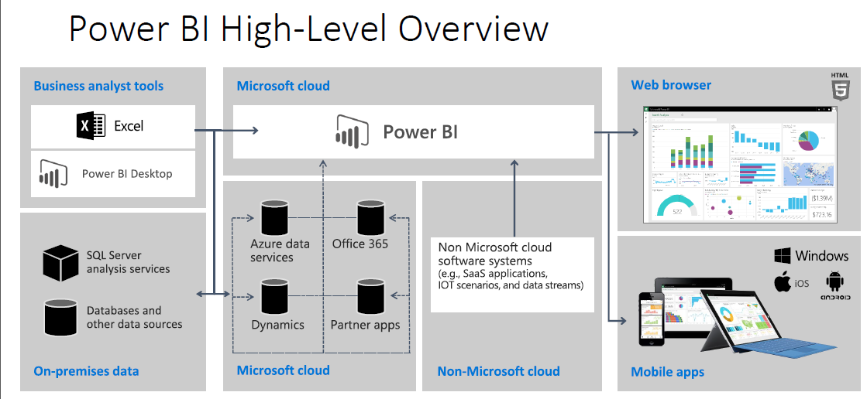

Slide 9
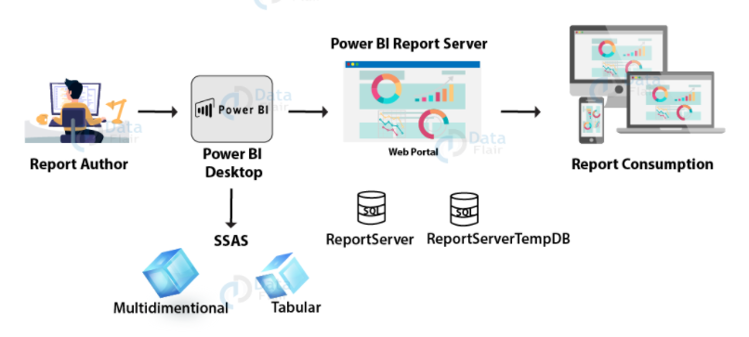
Notes:
The report authors work on Power BI authoring tools such as Power BI Desktop to create reports. The reports are developed using data from data sources available to connect with Power BI. Once the reports are ready, you then go to the Report Server. The server hosts the reports and its web portal is displayed. Users can consume the reports hosted on the report server via the web portal. They can use the web portal from any device that supports it such as a desktop, laptop, tablets, and phones.
https://www.mssqltips.com/sqlservertip/5000/install-and-configure-power-bi-report-server-and-power-bi-desktop/#:~:text=Power%20BI%20Report%20Server%20installation,to%20install%20the%20Database%20Engine.
https://www.bluegranite.com/blog/introducing-power-bi-report-server

Slide 10
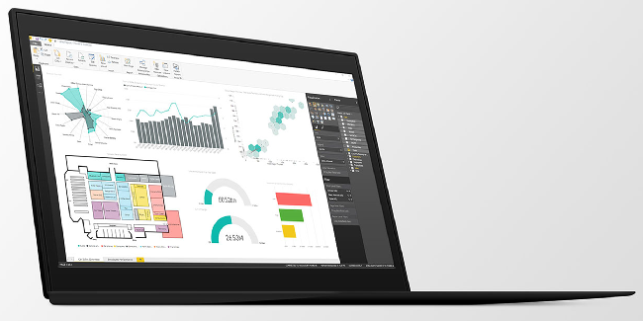
Power BI Desktop
Free download that starts your Power BI experience.
Not an end user tool, but a power user and designer tool.
Can be used to create, model and design engaging experiences.
Transform and clean data
Design once and view anywhere
“Any data, anywhere, any time”

Slide 11
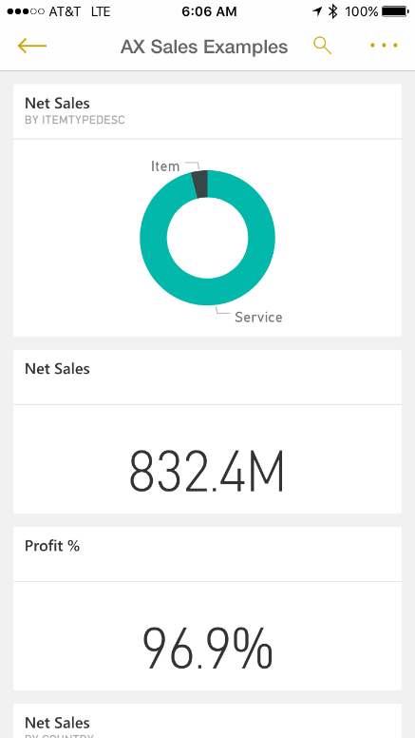
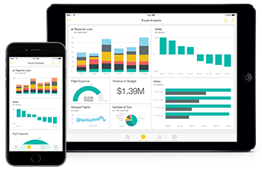
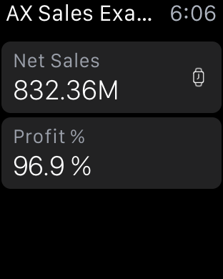
Power BI mobile
Consume from almost any device
Microsoft
Android
Apple – Including Apple Watch
Set alerts that allow for proactive engagement
Offline cache for dashboard consumption without an internet connection.
“Any data, anywhere, any time”

Slide 12

Power BI embedded
Microsoft Power BI
Ability to embed within any application or website.
Includes Dynamics ERP and CRM
Ability to deploy quickly with the scale of the Microsoft cloud.
Showcase Dashboard example: Northwind Traders.
“Any data, anywhere, any time”

Slide 13
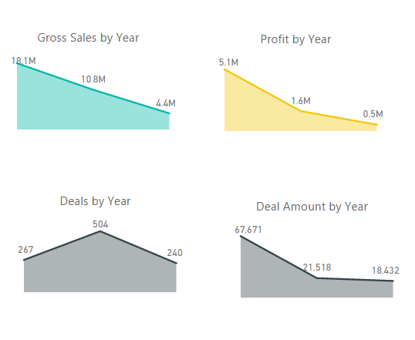
Create and publish
Create an example Power BI Report
Publish to PowerBI.com
Groups vs. My workspace
Pin to create a new dashboard.
Review Question and Answer option (Importance of Semantics)
Security Modeling with “View As” and assigning to user.
“Any data, anywhere, any time”

Slide 14
A new generation of business intelligence
BI is about understanding the facts - and the relationship between facts - in a way that guides decision-making and action.
From a technology standpoint, BI is a set of techniques and tools for transforming raw data into meaningful business insights.
IT professionals have consistently played a key role in unlocking value from data by creating and maintaining data warehouses, building and exposing complex data models, or report creation
end users have been relying largely on the support from IT to meet their BI needs, including the development of reports.

Slide 15
Microsoft made self-service BI
it was the first step in giving business analysts the ability to gain insights from data
Microsoft made self-service BI a reality with Power Pivot, extending capabilities to Excel that were previously found only in databases
rather than replace, existing analytics platforms and tools. With Power BI, a business analytics service for visualizing and analyzing all of your data in one place

Slide 16
With Power BI, the IT professional can
Focus on what they love – Data, and provide quality and authoritative data sets to end users, business analysts and data scientists
Meet the growing business need for consumable data
Spend less time on infrastructure maintenance or report development
Focus on increasing demand for real-time and streaming data sources
Implement data governance and data-level security for cloud and on-premise data sources

Slide 17
The BI analyst is able to
BI analyst
end user
connect to authoritative data with ease and confidence
visually explore data
navigate through data quickly, optimized for performance
pull data together from different sources, create data models and impactful, interactive reports
easily share data models and reports with end users
get started and see results quickly
monitor in real-time what matters most, in one place
explore and use certified data sets to find immediate answers
share reports and dashboards with others
stay connected from anywhere

Slide 18
Microsoft Power BI overview
Power BI is a SaaS offering that enables anyone and everyone to easily connect to any of their data, create live dashboards and reports, and explore data through interactive visualizations at any time. With Power BI, you can make all of your data viewable in a single location, regardless of where the data resides, enabling a consolidated view of business operations.
Power BI includes two companion applications. The first is Power BI Desktop, a visual data exploration and reporting tool. The second is a set of native, interactive mobile applications for Windows, iOS, and Android devices, providing secure access to live Power BI dashboards and reports from any device.
In addition, Power BI can be extended with a set of REST APIs which enable developers to integrate client and web solutions with Power BI or to build custom visualizations.

Slide 19
Power BI differentiators
Pre-built dashboards and reports for popular SaaS solutions
Real-time dashboard updates
Secure, live connectivity to your data sources, on-premises and in the cloud
Intuitive data exploration using natural language query functionality
Integrated with other Microsoft products and cloud services, including Azure Data Warehouse, Azure Stream Analytics, Azure Machine Learning, Office 365. Power BI benefits from the same commitment for scale & availability as Azure.

Slide 20
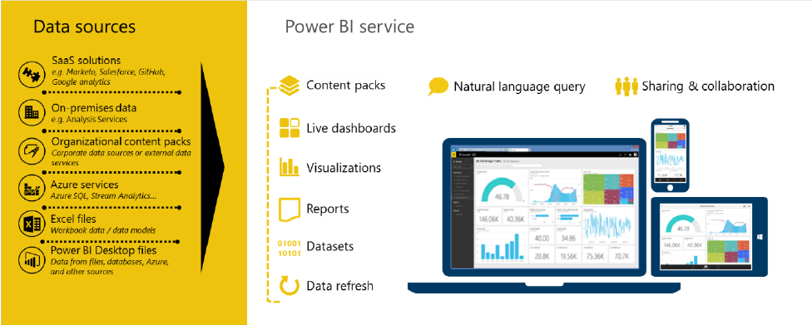
The Power BI service
The Power BI service offers a simple, intuitive experience for interacting with data. From creating and sharing dashboards to exploring and enhancing reports, Power BI makes it easy to engage with data from heterogeneous sources, fueling faster, more insightful business decisions. With Power BI, you get a rich, consolidated view of key information, no matter where all of the underlying data is stored

Slide 21
Thanks

