Slide 1
Working with Charts

Slide 2
Agenda for today session [11:00-1:00 pm]
Creating different types of charts
Column charts
Bar-Line graph charts (Pareto charts)
Water fall charts
Bubble charts
Floating Bar / Football Field charts
Pie charts
Customizing Scale (Changing x-axis and y-axis scale)
Producing Complicated charts (if time permits).
Notes:
Vipul : 7th Oct (Webex)
Evaluation to begin at 11:30 am to 12:30pm IST. Please be available/connected ahead of time

Slide 3
Common form of Data analysis
Comparison of Data
Relationship Data
Composition of Data
To Identify high and Low of the data
You want to establish (or show) relationship between 2 (or more) variables Examples: which sector gives more revenue at minimum customer
.
To understand how the data value breaks down into constituents
which attempt to show viewers “this is how my data is composed.”
Distribution of data
You want to show the distribution of a set of values (to understand the outliers, normal ranges etc.) Examples:
For example, in sales, it is said that 20% of customers are responsible for 80% of sales
Selecting Right Chart for your data
Example from the portfolio which sector is doing best or worst
You want to compare one set of value(s) with another
Notes:
3 main types of data analysis are needed for everyday business decisions - comparison, transition and composition of data
http://chandoo.org/wp/2010/04/19/chart-selection-process/

Slide 4
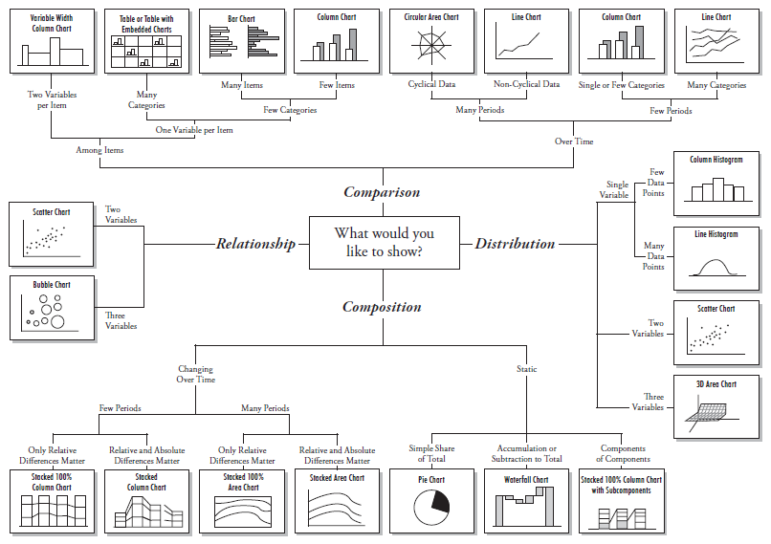
More details of selecting charts…
Notes:
Before you start tweaking design elements, you need to know that your data is displayed in the optimal format. Bar, pie, and line charts all tell different stories about your data, you need to choose the best one to tell the story you want. Always order your graph from biggest to smallest, or in chronological order so it is simple, easy and clear to understand.
In simple words, just by looking at the graph we can easily distinguish between the various variables.

Slide 5
We will be looking few charts..
Comparisons of data
Creating Column Chart....
Floating chart/Foot ball [Bar Chart]
Relationship data chart
Bubble Chart
Distribution of data
Pareto Chart [combination of Column Line and Chart]
Composition
Pie
Stacked col... %
Water fall

Slide 6
Working with Column Charts
Let’s see an example of net annual revenue for different Institutional Securities Group
Institutional Securities Group | Annual Revenue
Wealth Management | 71614
Fixed Income and Commodities | 14013
Equity sales and Trading | 35739
Investment Banking | 30358
Investment Management | 20622
Others | 5811

Slide 7
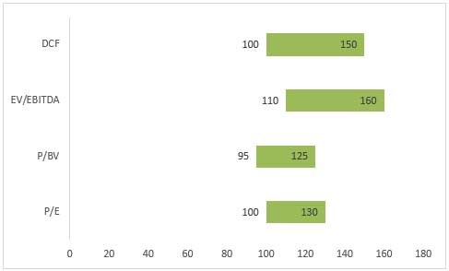
Working with Floating chart /Football Field Graph
A football field graph is a graph showing the valuation of a company based on different methodologies.
Many types of valuation methods are used, involving several sets of metrics. For equities, the most common valuation metric to use is the P/E ratio, although other valuation metrics include: Price/Earnings, Price/Book Value, Price/Sales, Enterprise Value/EBIDTA, Economic Value Added and Discounted Cash Flow
Share Price Based On:
Parameter | 2011 | 2012 | 2013
P/E | 100 | 120 | 130
P/BV | 125 | 95 | 100
EV/EBITDA | 110 | 160 | 150
DCF (discount rate from 5% to 7%) | 100 | 150 | 125
The graph clearly indicates the maximum and minimum range of the shares. Graphical data not only makes us easy to understand but also it is compact and more presentable.
Notes:
Steps for Floating Chart
Calculate Max/Min and Difference
Make a Stacked bar
Remove legends and gridlines
Remove the Bar corresponding to MAX values
Add the data labels [Align Right]
“No fill” the bar corresponding to minimum values
Link the labels of “Difference” bar to “Maximum” value
Many types of valuation methods are used, involving several sets of metrics. For equities, the most common valuation metric to use is the P/E ratio, although other valuation metrics include: Price/Earnings, Price/Book Value, Price/Sales, Enterprise Value/EBIDTA, Economic Value Added and Discounted Cash Flow.
Most of the time, Discounted Cash Flow valuation will give the higher valuation
Read more: Sum-Of-Parts Valuation Definition | Investopedia http://www.investopedia.com/terms/s/sumofpartsvaluation.asp#ixzz4MKeJUVpJ Follow us: Investopedia on Facebook

Slide 8
Bubble Chart
Bubble charts plot data defined in terms of three distinct numeric parameters. They allow the relationship of entities in terms of their relative positions with respect to each numeric axis and their size as well. When you have a table with 3 related dimensions of data
Sector | Total Customer | Net Revenue | Percentage
Wealth Management | 25 | 71614 | 40%
Fixed Income and Commodities | 40 | 14013 | 7%
Equity sales and Trading | 70 | 35739 | 20%
Investment Banking | 90 | 30358 | 15%
Investment Management | 20 | 20622 | 10%
Other | 100 | 5811 | 3%

Slide 9
Working with Pareto Charts
The technique is called a Pareto analysis because it is based on the Pareto Principle, also known as the 80/20 Rule. This rule states that roughly 80% of the problems stem from around 20% of the possible causes
A Pareto chart, also called a Pareto distribution diagram, is a vertical bar graph in which values are plotted in decreasing order of relative frequency from left to right. Pareto charts are extremely useful for analyzing what problems need attention first because the taller bars on the chart, which represent frequency, clearly illustrate which variables have the greatest cumulative effect on a given system.
Notes:
http://ppmexecution.com/tag/portfolio-reporting/
What is a Pareto Analysis?
History of the 80-20 Rule
The 80-20 rule was first proposed by Italian economist Vilfredo Pareto in 1906. Pareto found that 20% of Italians owned 80% of the land. This distribution of wealth observation has since expanded to use in other fields.
The technique is called a Pareto analysis because it is based on the Pareto Principle, also known as the 80/20 Rule. This rule states that roughly 80% of the problems stem from around 20% of the possible causes. The Pareto principle follows a mathematical power law distribution. The principle's use has since expanded to other areas in business. For example, The 80-20 rule generally holds that 20% of the holdings in a portfolio are responsible for 80% of the portfolio’s growth. On the flip side, 20% of a portfolio’s holdings could be responsible for 80% of that portfolio’s losses.

Slide 10
Example of Pareto Chart
We also find that the 80/20 rule often applies (20% of the projects deliver 80% of the portfolio’s value). This type of Pareto chart provides great visibility of the entire portfolio and highlights how a subset of projects support overall financial contribution.
Sector | Revenue | Cumulative Amount | Cumulative %
Wealth Management | 71614 | 71614 | 40%
Equity sales and Trading | 35739 | 107353 | 60%
Investment Banking | 30358 | 137711 | 77%
Investment Management | 20622 | 158333 | 89%
Fixed Income and Commodities | 14013 | 172346 | 97%
Others | 5811 | 178157 | 100%
Total | 178157

Slide 11
Comparing the components of a whole
Example : To identify the Net Revenue for Year 2014 and what % of Revenue comes from Which sector from[Pie Chart]

Slide 12
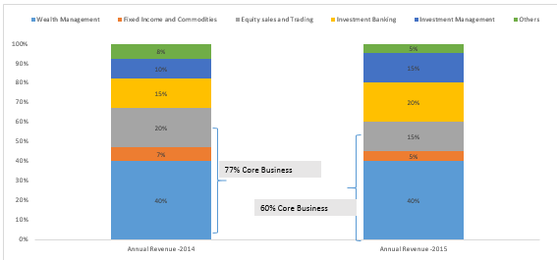
Working with Stacked Charts
The stacked charts are used when data sets have to be broken down into their constituents, and then the data sets as a whole also need to be compared against one another.
Institutional Securities Group | Annual Revenue -2014 | Annual Revenue -2015
Wealth Management | 40% | 40%
Fixed Income and Commodities | 7% | 5%
Equity sales and Trading | 20% | 15%
Investment Banking | 15% | 20%
Investment Management | 10% | 15%
Others | 8% | 5%

Slide 13
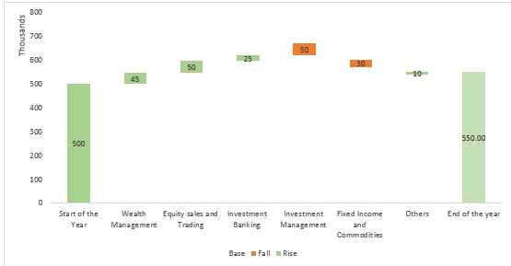
Waterfall chart
A waterfall chart is actually a special type of Excel column chart. It is normally used to demonstrate how the starting position either increases or decreases through a series of changes.
As per our example, consider the following data table.
Start of the year we had 500,000 and at the end of the year we are at 550,000 so let’s see in the graphical which sector has given positive or negative growth for the year
Institutional Securities Group | Revenue
Intial of the year | 500000
Wealth Management | 45000
Equity sales and Trading | 50000
Investment Banking | 25000
Investment Management | -50000
Fixed Income and Commodities | -30000
Others | 10000
End of the year | 550000

Slide 14
Any Question???..
For any doubts or clarification you can send a mail on training@pragatisoftware.com

