Slide 1
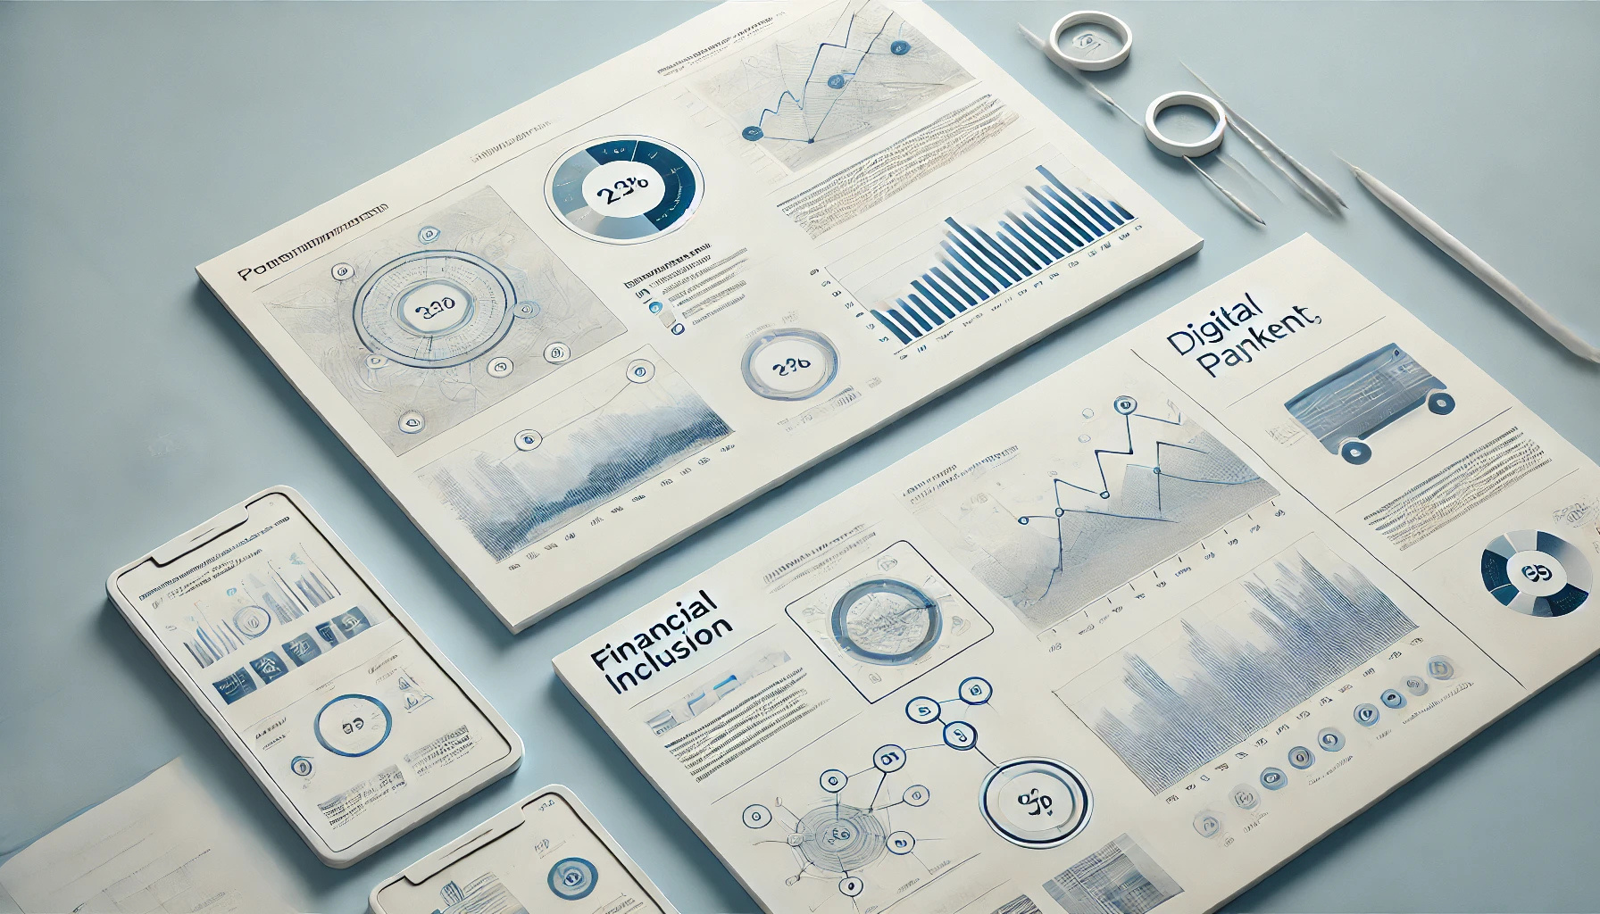
Bridging the Financial Access Gap: Insights & Recommendations
A Data-Driven Approach to Financial Inclusion

Slide 2
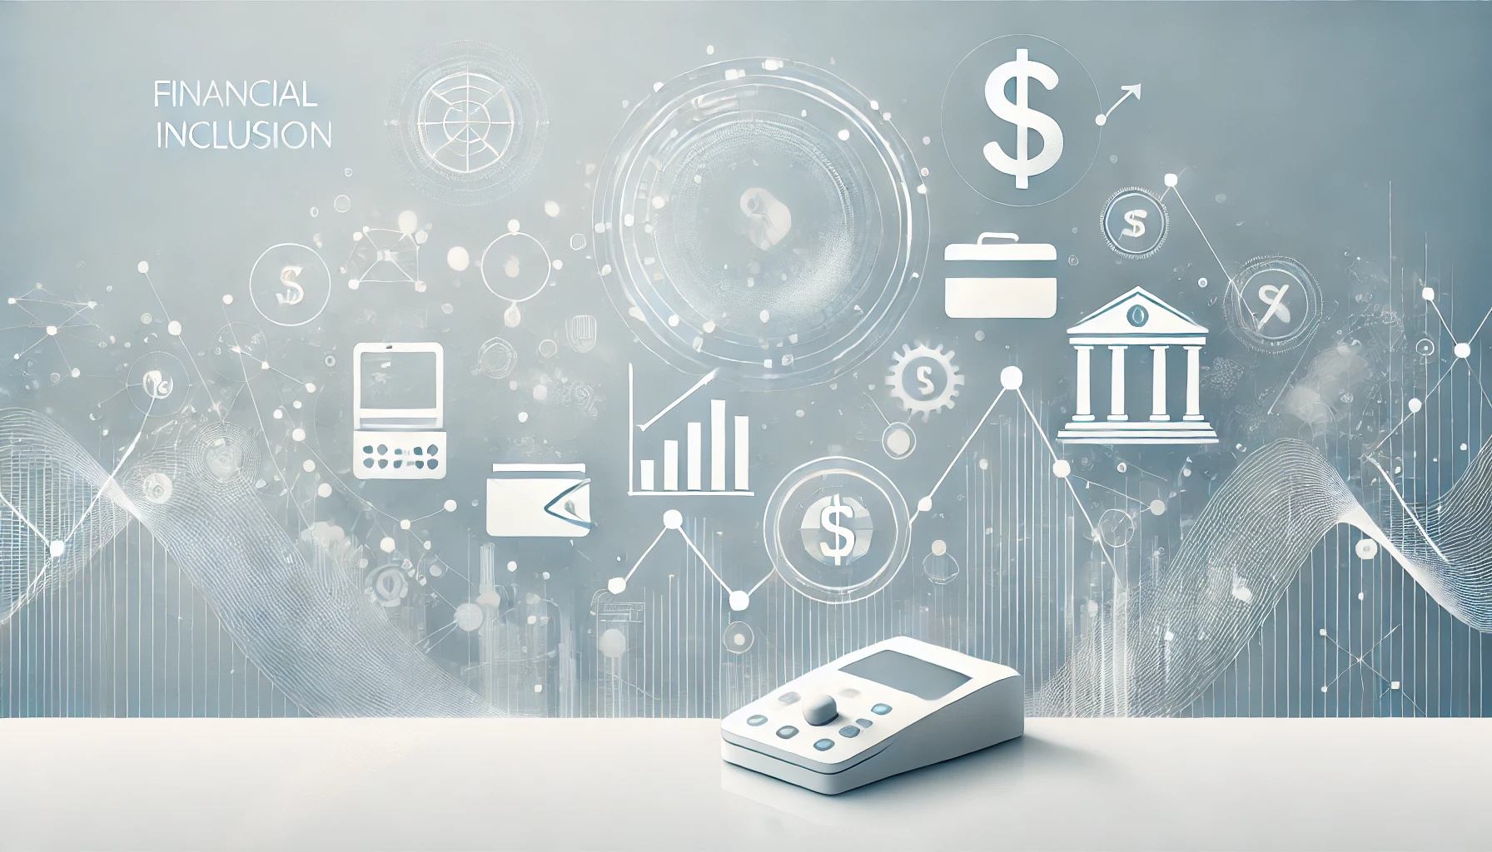
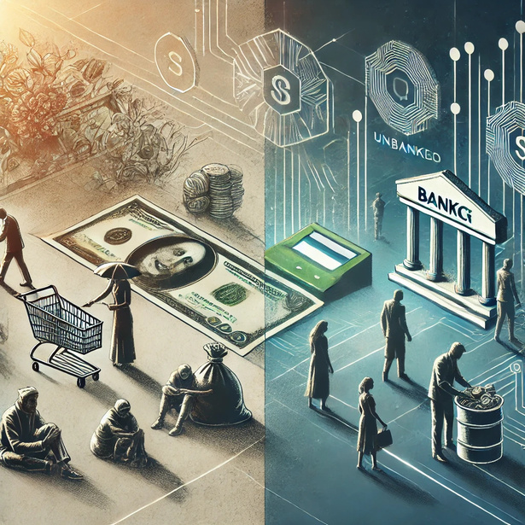
Problem Statement
"The future of financial inclusion lies in digital innovation and equitable access." – Bill Gates
Millions face barriers to banking and digital payments due to cost, literacy gaps, and limited infrastructure. This project analyzes financial behavior, identifies key challenges, and provides data-driven solutions to improve financial inclusion globally.

Slide 3

Data Exploration
The provided datasets offer a comprehensive view of financial inclusion at both individual and country levels.
The micro-level dataset (CSV) contains over 144,000 rows and 128 columns that include individual financial behaviors such as bank account owners, mobile banking, borrowing, and the use of digital payments.
It also includes demographic data such as age, gender, education and income level, making it ideal for behavioral analysis. Capita, inflation, financial access, economic classification.

Slide 4
The dataset contains 658 rows and 1,232 columns, covering various economic and financial indicators at the country level.
It includes information such as country names, country codes, years, population statistics, financial inclusion metrics, and internet/mobile banking usage.
The data spans multiple years and regions, categorized by income groups. Many columns contain financial behavior details, including account ownership and mobile banking usage segmented by demographics. ​​

Slide 5
Data Exploration
Exploratory Data Analysis (EDA) – Uncovering trends, correlations, and financial behavior patterns.
Feature Engineering – Optimizing raw data, handling missing values, and scaling for better model performance.
Clustering Analysis – K-Means clustering to segment countries based on financial behavior.
Classification Models – XGBoost & Logistic Regression predict digital payment adoption with high accuracy.
Time-Series Analysis – Tracking financial inclusion trends and policy impacts over time.

Slide 6
Summary of Findings
Financial
Access Gaps
Digital
Payment Trends
Many remain unbanked due to lack of documentation, financial literacy, and trust issues.
Mobile banking and digital transactions are increasing, but rural areas lag in adoption.
Gender &
Income Disparities
Predictive
Modeling
Women and low-income groups face
systemic barriers to financial services.
Machine learning can identify vulnerable populations needing financial support.

Slide 7
Financial Access Gaps
1.7 Billion People Remain Unbanked – A significant portion of the global population lacks access to financial institutions, limiting economic participation and opportunities.
Rural & Low-Income Communities Face the Biggest Barriers – Geographical constraints, limited banking infrastructure, and high costs prevent financial access for underserved populations.
Women Are Disproportionately Affected – Cultural norms, legal restrictions, and lower credit access make it harder for women to own bank accounts or access financial services.

Slide 8
Financial Literacy Gaps Limit Participation – Many unbanked individuals struggle with financial knowledge, making it difficult to navigate formal banking systems and digital transactions.
Legal & Documentation Challenges Hinder Inclusion – Lack of proper identification, complex banking regulations, and documentation barriers prevent millions from opening accounts.
--Digital & Mobile Banking Offer Solutions – Increasing mobile and internet penetration can help bridge the financial gap, but adoption remains uneven
due to infrastructure and awareness challenges.

Slide 9
Digital Payment Trends & Disparities in Adoption
Explosive Growth of Mobile Banking – Platforms like M-Pesa in Kenya are transforming financial inclusion, enabling millions to access banking services without traditional infrastructure.
Surging Adoption of Contactless Payments – QR code and tap-to-pay solutions are rapidly gaining traction, especially in Asia, streamlining transactions for businesses and consumers.
Fintech Expanding Financial Access – Digital wallets, neobanks, and online banking are bridging the gap for unbanked populations, making financial services more accessible than ever.

Slide 10
Blockchain Revolutionizing Transactions – Decentralized finance (DeFi) and blockchain innovations are enhancing security, transparency, and efficiency in global financial ecosystems.
Governments Driving Cashless Economies – Policymakers worldwide are supporting the shift to digital payments, fostering economic growth, reducing fraud, and improving financial inclusion.
Infrastructure & Accessibility Challenges – Despite progress, low smartphone penetration and limited digital literacy in rural areas remain significant barriers to widespread adoption

Slide 11
Gender &
Income Disparities
Women Face Barriers to Financial Independence – Lower earnings, restricted credit access, and cultural limitations prevent women from fully participating in the financial system.
Low-Income Groups Rely on Informal Systems – Many depend on unregulated financial services, exposing them to higher risks and limiting opportunities for economic growth.
Financial Literacy Gaps Limit Inclusion – Lower financial knowledge among women and low-income groups reduces their ability to access and benefit from formal banking services.

Slide 12
Rural Communities Lack Banking Infrastructure – Fewer banking services in remote areas restrict access to essential financial tools, keeping rural populations financially excluded.
Targeted Policies Can Drive Inclusion – Governments and financial institutions must implement policies that empower marginalized groups through inclusive banking and credit access.
Education is Key to Economic Empowerment – Financial literacy programs play a critical role in equipping underserved communities with the knowledge needed to make informed financial decisions.

Slide 13
Key Insights
Expanding digital financial services can bridge access gaps.
Trust and literacy programs are crucial for adoption among unbanked populations.
Women's financial empowerment leads to higher household stability.
Regulatory support and policy frameworks play a vital role in driving financial inclusion.
Financial service providers must innovate to cater to underserved demographics effectively.
Collaboration between public and private sectors enhances financial reach and sustainability.
Infrastructure improvements, such as internet connectivity, are key to digital finance adoption.

Slide 14
Recommendations
Enhance Digital Payment Adoption – Expand mobile banking, e-wallets, and digital transactions for seamless financial access.
Improve Financial Literacy Programs – Use AI-driven chatbots and NLP tools to educate users on financial services.
Target Financial Barriers – Address cost, documentation, and accessibility issues identified through EDA and clustering analysis.
Use AI for Predictive Analytics – Leverage XGBoost and time-series models to forecast digital payment adoption trends.
Policy Recommendations – Provide data-driven insights for governments and banks to boost financial inclusion in underserved communities.

Slide 15
Results
Our analysis on financial inclusion highlights key trends in account ownership, digital payments, and economic impact.
The XGBoost model achieved 90.30% accuracy, effectively predicting financial behaviors.
K-Means Clustering revealed three major financial behavior groups, while hierarchical clustering mapped regional disparities.
Correlation analysis confirmed that higher GDP per capita correlates with increased digital payment adoption.
The dashboard visualizes financial behavior across different regions, showcasing disparities in savings vs. borrowing habits and growth trends in digital payments. Key insights indicate that financial literacy programs, fintech expansion, and government policies can bridge inclusion gaps.

Slide 16
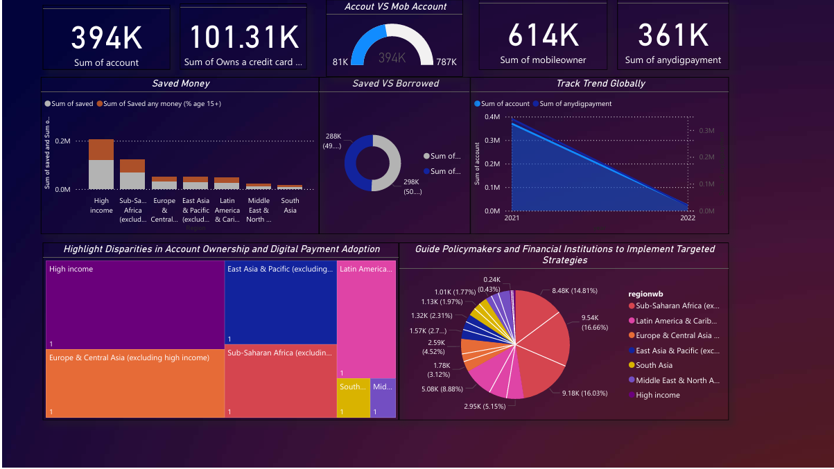

Slide 17
Conclusion
Our AI-driven analysis successfully predicts financial behavior with 90.30% accuracy using XGBoost.
K-Means clustering identifies three financial segments, while hierarchical clustering maps regional disparities.
The interactive dashboard visualizes key trends in savings, borrowing, and digital payments, empowering policymakers and fintech leaders.
This project delivers an end-to-end financial inclusion solution, ensuring data-driven decisions to bridge financial accessibility gaps.

