Slide 1
PROJECT
MADHAV STORE DIWALI SALES

Slide 2
MADHAV STORE DIWALI SALES
PROJECT OBJECTIVE
Improve Customer Experience by Analyzing Sales Data.
Increase Revenue.
Find Top 10 States With Sales.
Best Products.

Slide 3
DATA SOURCE
That Madhav Store Diwali Sales I got from one of My Friend.
DATA CLEANING AND
UNDERSTNDING PROCESS
Importing the Specified Library like ( Numpy, Matplotlib.pyplot, Pandas and Seaborn)
Loading the data in csv file.
After that understanding the First 5 rows and Last 5 Rows.
The shape of data is 11,251 Rows and 17 columns.
Change the data type of Amount column Float to int.
Null are present only in Amount column.
In the Madhav Store Diwali Sales have 17 unique columns.
All the Data cleaning process done in Python like dropping the some null values and removing the unrelated columns in the data like Status , unnamed1,unnamed: 15,unnamed: 16.

Slide 4
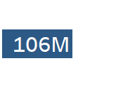
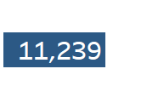
TASK-1
TOTAL SALES
Display the Total sales ?
INTERPRETATION
Total sales in Madhav store Diwali sales is 106M.
COUNT OF TOTAL ORDERS
TASK-2
Display the Total count of Orders?
INTERPRETATION
Total Orders in Madhav store is 11,239.

Slide 5
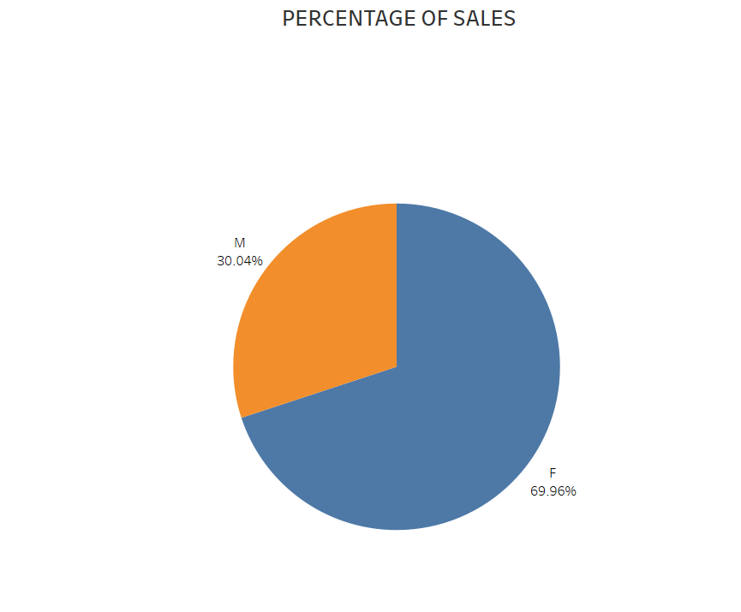
TASK-3
Display the percentage of sales.
INTERPRETATION
Mostly sales are coming from Female that is 69.96%

Slide 6
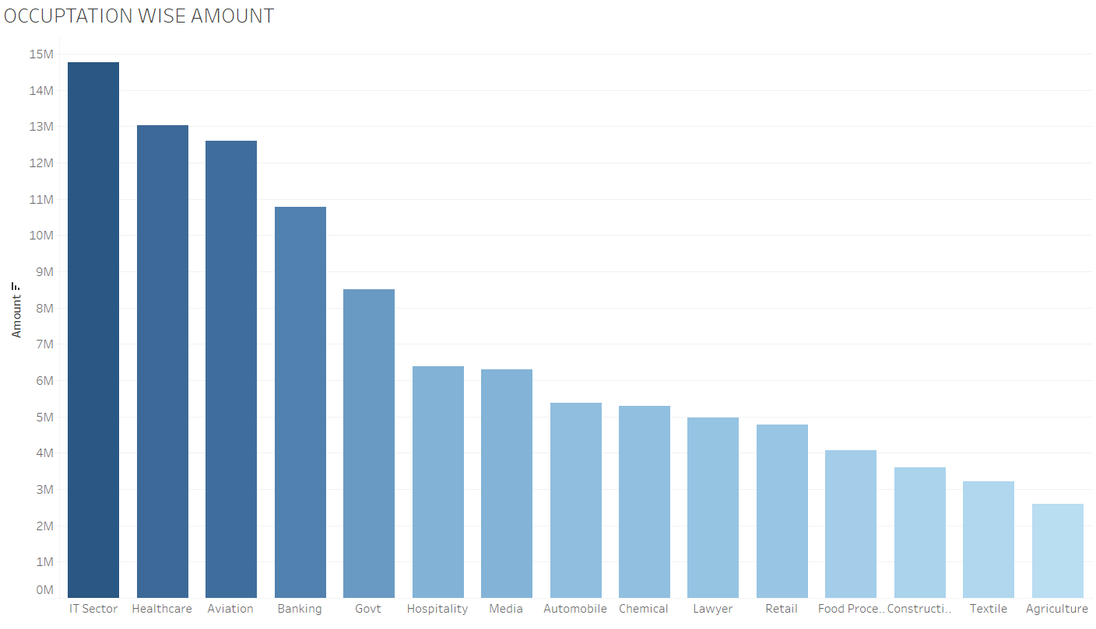
TASK-4
Find out the TOP 10 occupation wise sales?
INTERPRETATION
Mostly sales are coming in IT , Health Care, Aviation Sector.

Slide 7
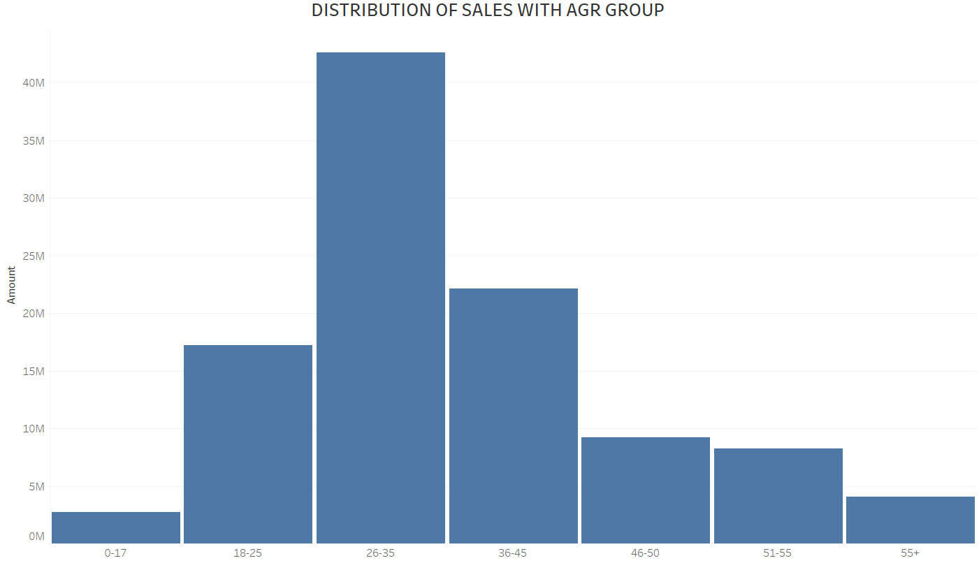
TASK-5
Display the distribution wise sales with age group?
INTERPRETATION
Age-Group of 26-35 have generated Highest sales.

Slide 8
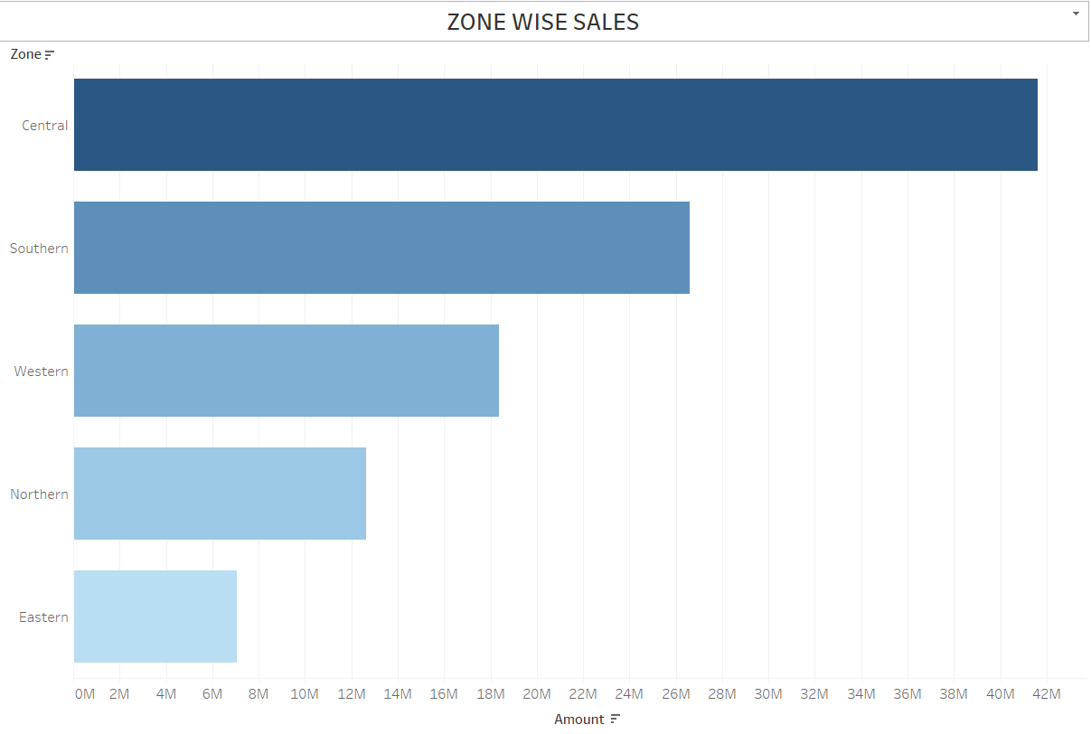
TASK-6
Display the zone wise sales ?
INTERPRETATION
Central Zone generated highest sales.

Slide 9
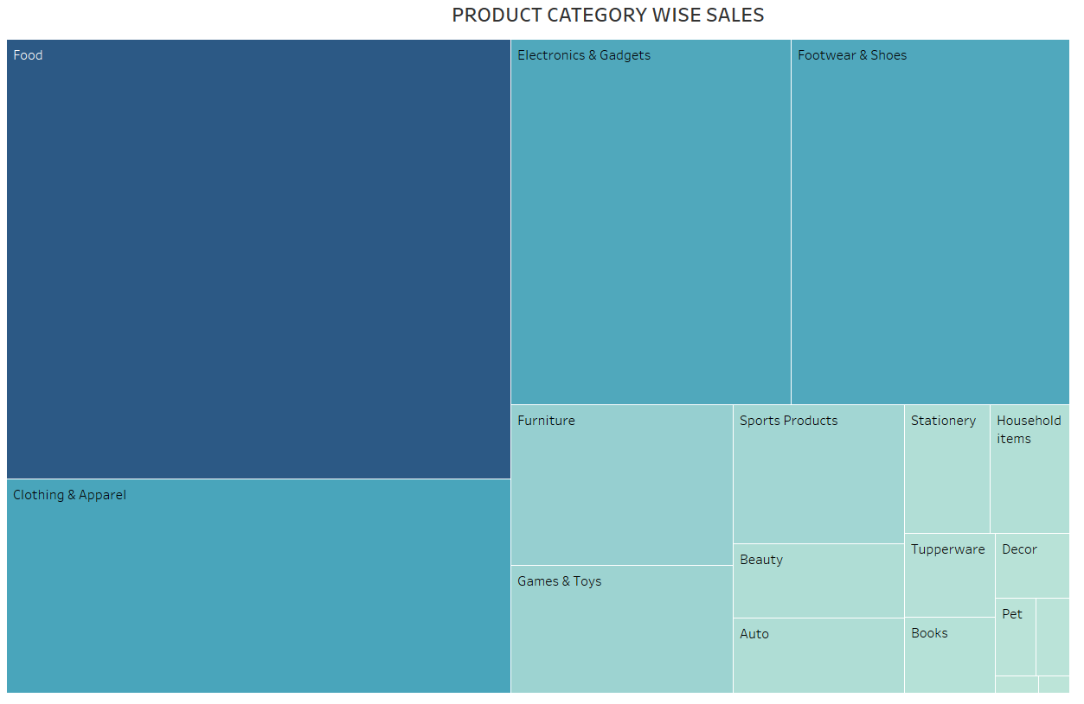
TASK-7
Display the Product Category wise sales ?
INTERPRETATION
Food ,Clothing & Apparel ,Electronics & Gadgets Generates Highest Sales in the Product Category.

Slide 10
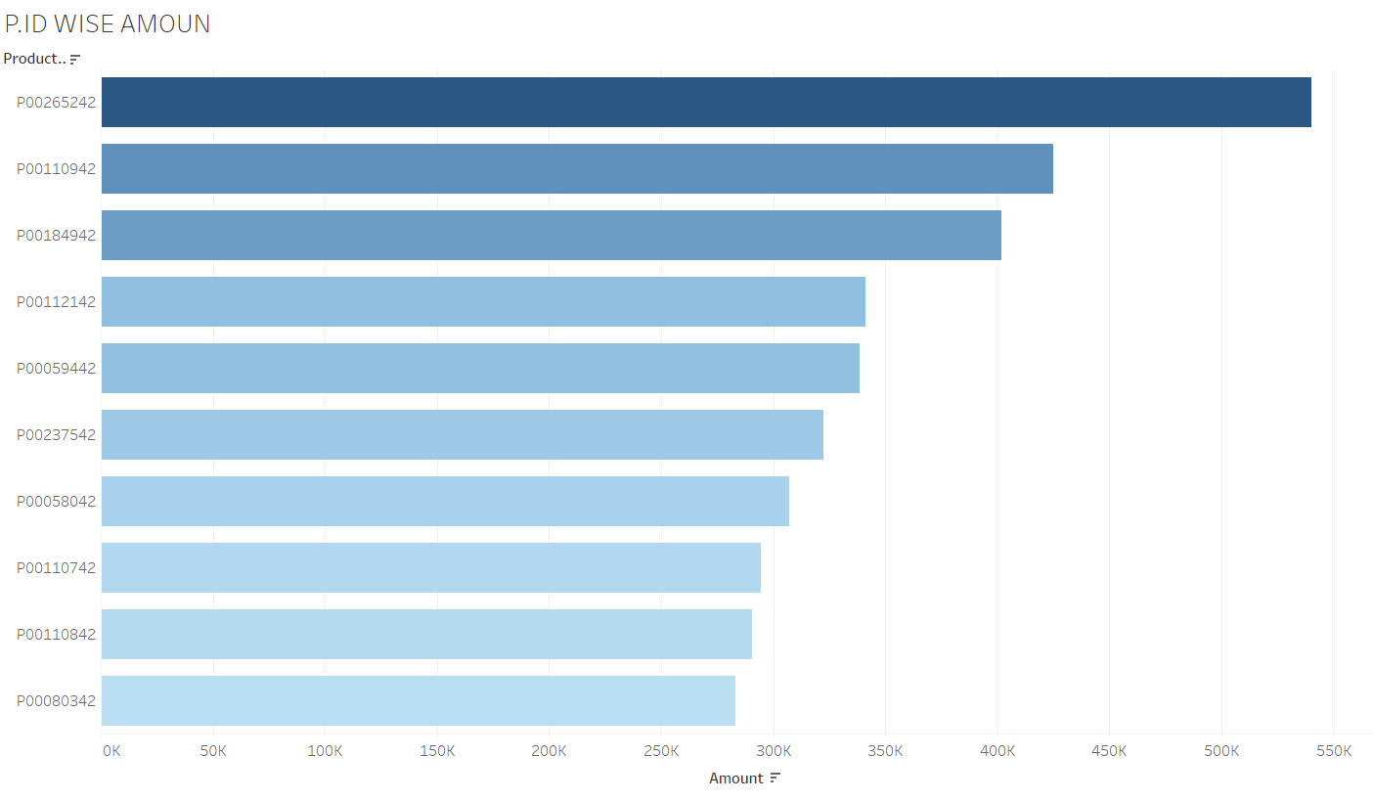
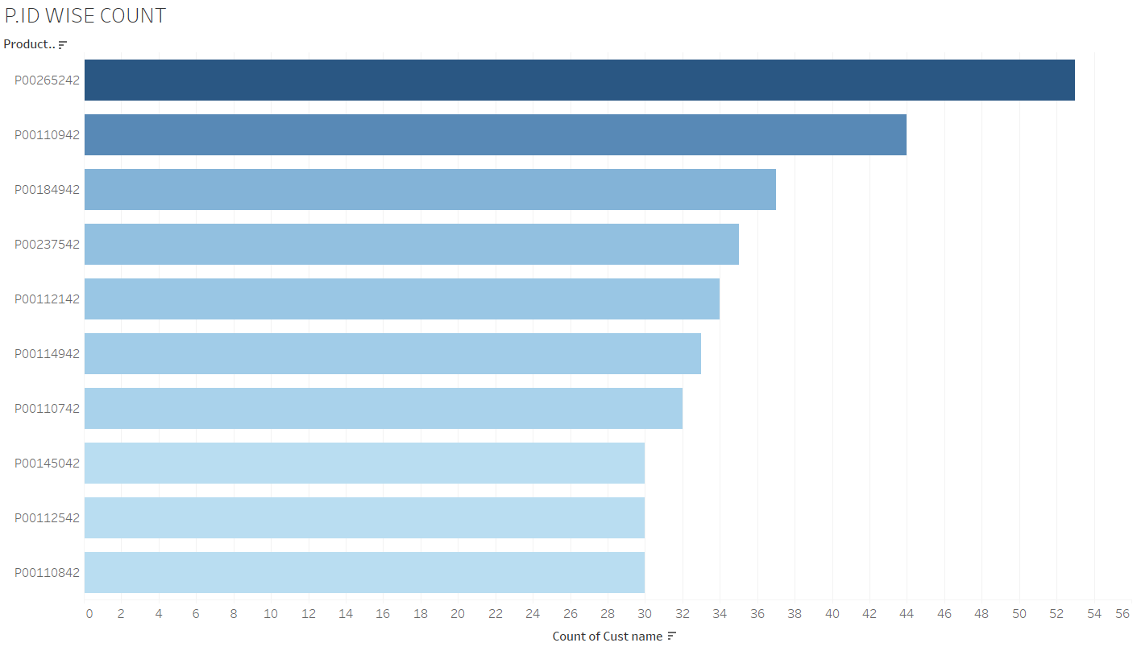
TASK-8
Find out Top 10 Product id based on sales?
INTERPRETATION
P00265242 ,P00110942 and P00184942 Product Id Generates Highest Sales.
TASK-9
Find out Top 10 Product id based count of buy?
INTERPRETATION
Mostly Customer Buy this Product Id P00265242 ,P00110942 and P00184942.

Slide 11
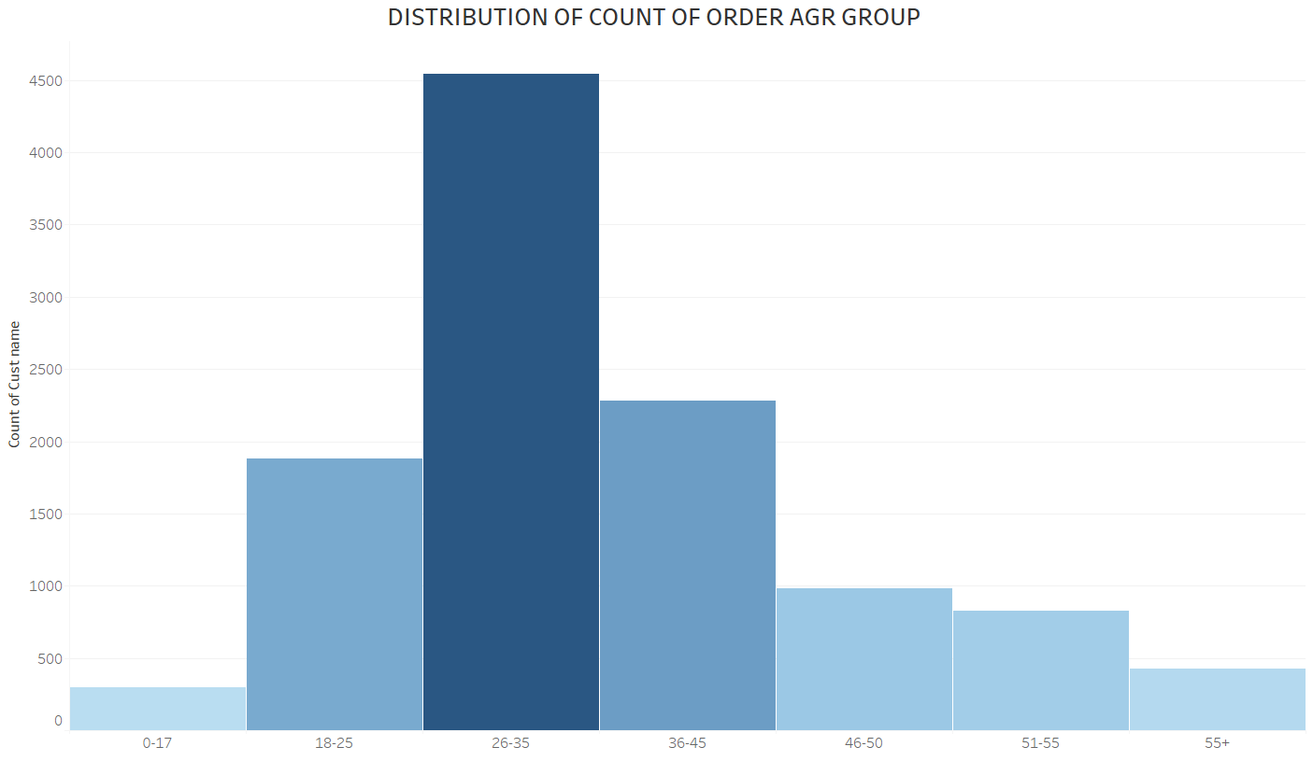
TASK-10
Display the Distribution of Age Group Wise count of customer?
INTERPRETATION
The Age Group of 26-35 have more customer in Madhav store.

Slide 12
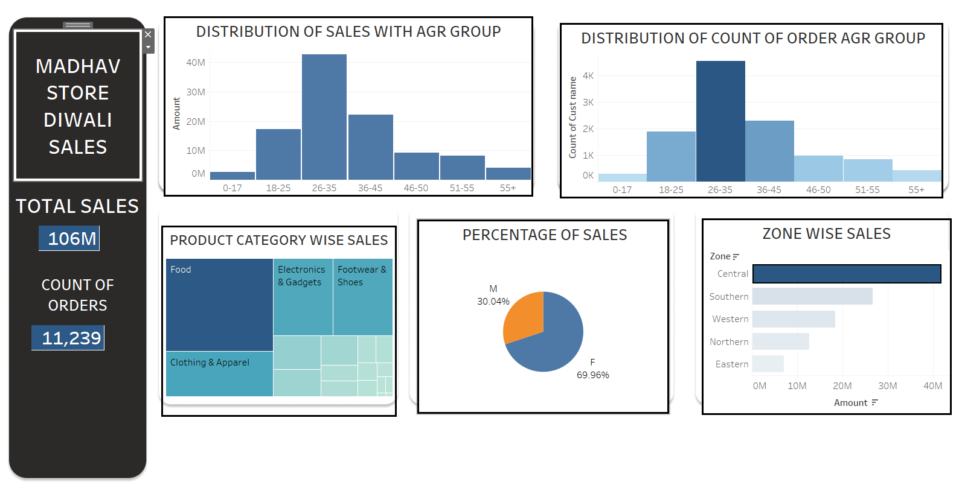
MADHAV STORE DIWALI SALES DASHBOARD

Slide 13
CONCLUSION
Total Sales Are Generated in Madhav Store Diwali Sales is 106 Millions and Total Orders Count in Store is 11,234. Mostly Sales are Generated in Female Category. Those who are 26-35 Age Group who Generated more Sales and the Number of Customer are also Higher than other Age-Group. Married women age group 26-35 yrs. From UP, Maharashtra and Karnataka working in IT, Healthcare and Aviation are more likely to buy products from Food, Clothing and Electronics category.

Slide 14
THANK YOU
VIPUL GOUR

