Slide 1
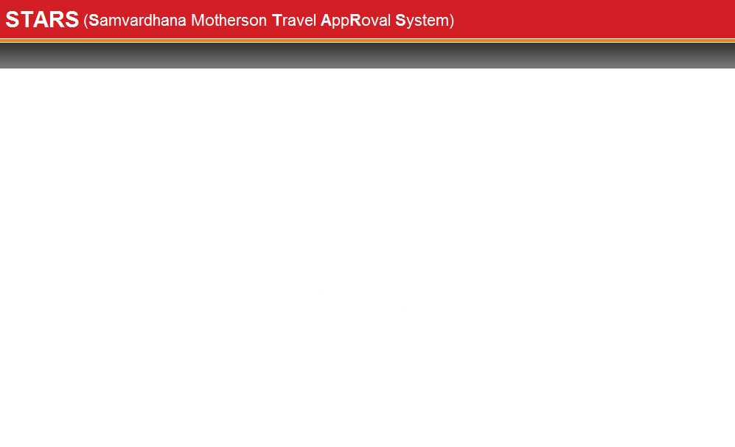


STARS CREATION PROCESS
STARS is a workflow based solution automating Travel Requisition Approval process within a unit or across all the units of an enterprise with an objective of making quick approval system in order to save time & hence money.

Slide 2


CONTENTS
How to access STARS
How to Register in STARS
How to create International Single/Group/Guest travel request
How to create Domestic Single/Group/Guest travel request
How to check the status of the request
How to Change Password & Update Profile
How to mark Out Of Office
How to give Suggestions

Slide 3
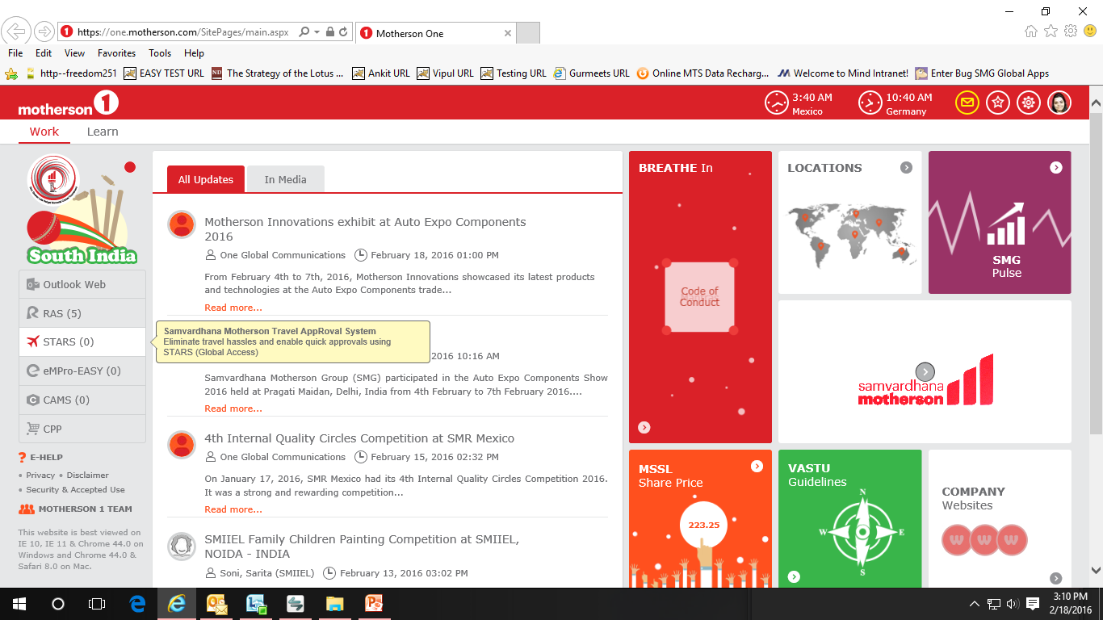
How to access STARS
You can access STARS through motherson1 https://one.motherson.com/SitePages/main.aspx
Go to STARS from here

Slide 4
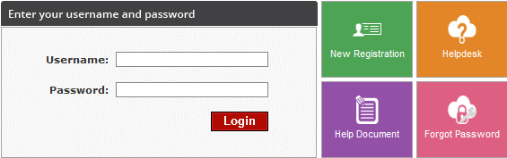
How to access STARS
You can also access STARS through this URL : http://stars.mindeservices.com
Please enter Username
Please click here for New Registration
Click here to send mail to STARS Administrator
Please enter Password
Click here to view Help Tips
Click here to retrieve your password
New Registration: It allows the New User to register himself in STARS. The user is required to enter the necessary information in the NEW User Registration Page which will appear on clicking the link "New Registration". After registration user will be activated only by Local Administrator.
User Name: The user is required to enter his user name in the specified text box.
Password: The user is then required to enter his password in the specified text box.
Forgot Password: If user have forgotten password, please enter the username and click on this. And after giving Secret answer user will be able to login.

Slide 5
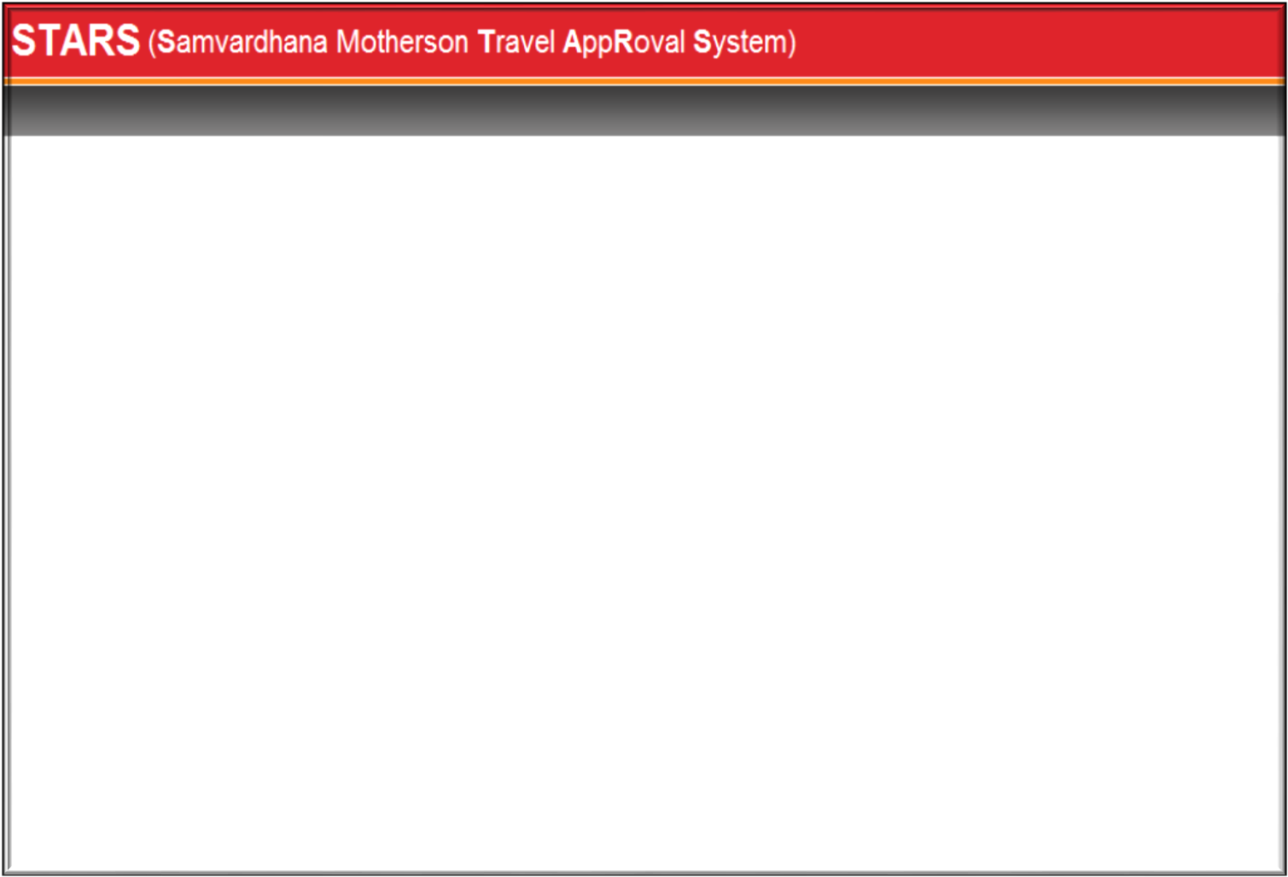

How to Register in STARS
To use the system, user has to register himself once by clicking "New Registration" option of the below screen.
Click on “New Registration” for new registration
After clicking on “New Registration” new screen will open (in next slide)

Slide 6
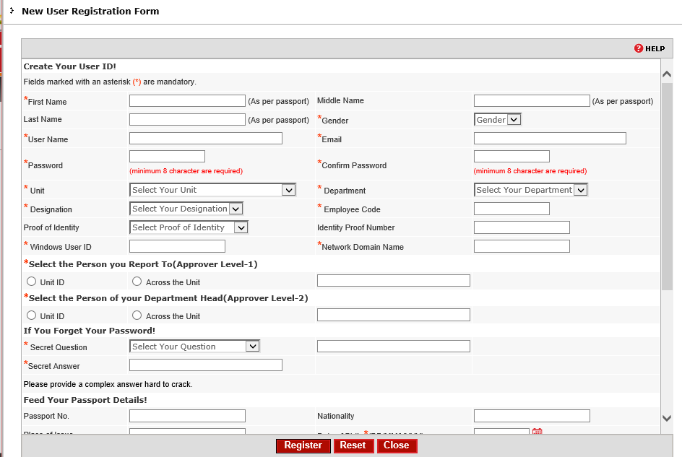
Fill your First name as per Passport
Fill your User Name
Put password as per choice
Confirm the password
Select Unit Name
Select Designation
Select Department
Mention Windows user Id
Mention Network Domain name
Select your reporting person
Select your Department head
Select Secret Question
After filling all the fields of this registration screen form please press “Register" button.
Put your Secret Answer

Slide 7
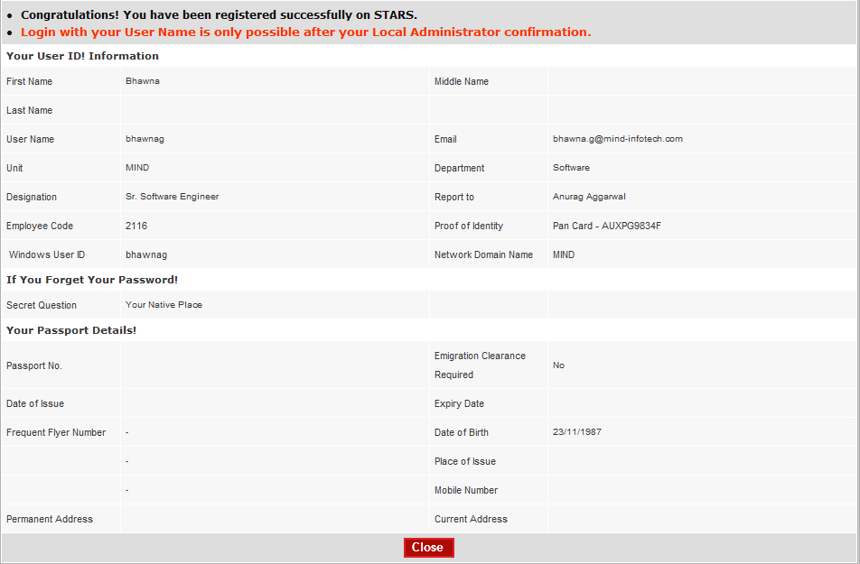

After clicking on “REGISTER” below screen will open
After only getting verification confirmation mail from the Local Administrator, user can access STARS by using his/her user id & password

Slide 8

If a user forgets his/her STARS password then he/she can easily retrieve it from the login screen itself instead of sending mails to Helpdesk & Password is sent to registered e-mail id in STARS. Complete details are given below:
Enter your username here and click on Forgot Password

Slide 9
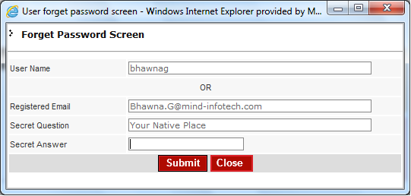
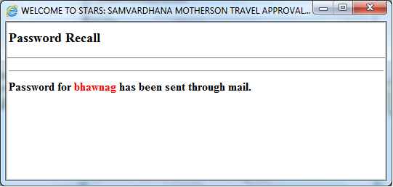
Whenever a user click on “Forgot Password” below screen prompts for the secret question put by the user at the time of registration in STARS which helps in retrieval of password.
Click on “SUBMIT” button for retrieving the password
Write Answer of your secret question

Slide 10
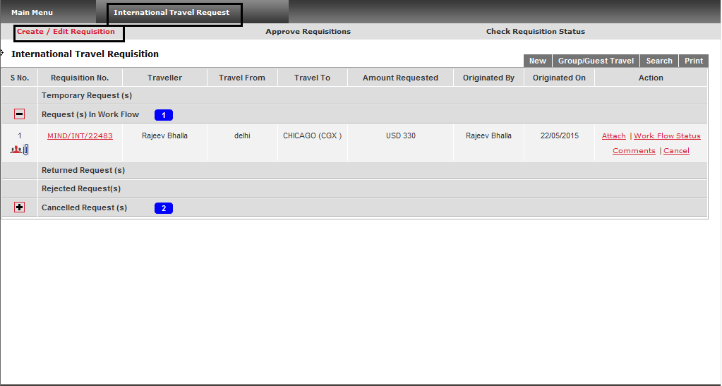
How to create International Travel Request
Click on “International Travel Request”
Click on “Create/Edit Requisition”
Click on “New” to create single traveler Requisition
Click on “Group/Guest Travel” to create group travel Requisition

Slide 11
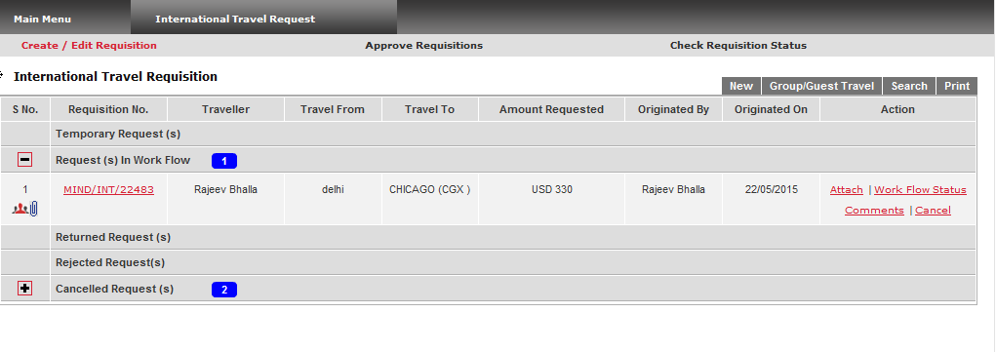
SINGLE INTERNATIONAL TRAVEL
Click on “New” to create single traveler request

Slide 12
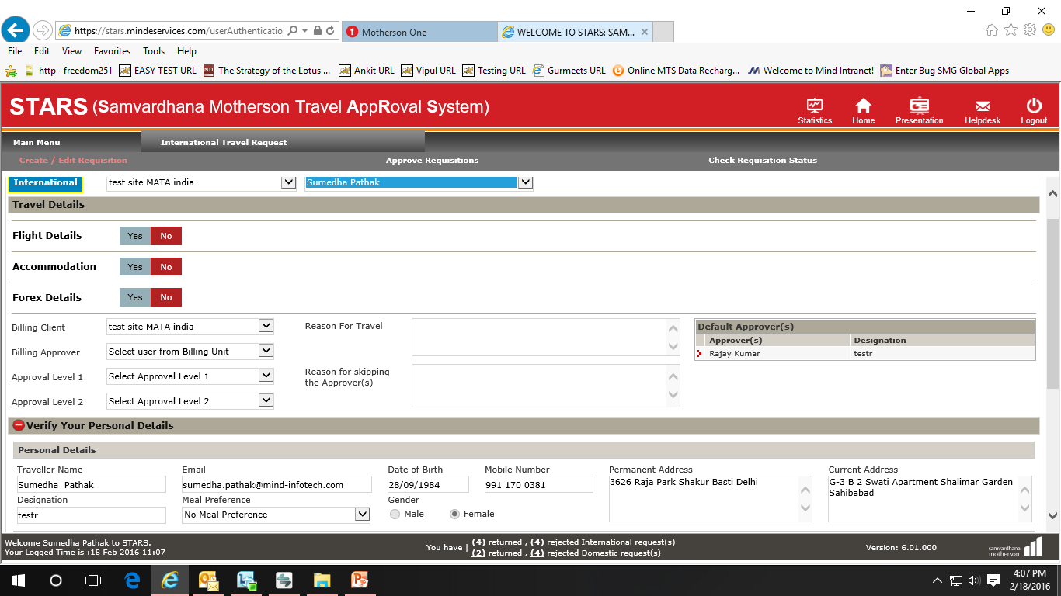
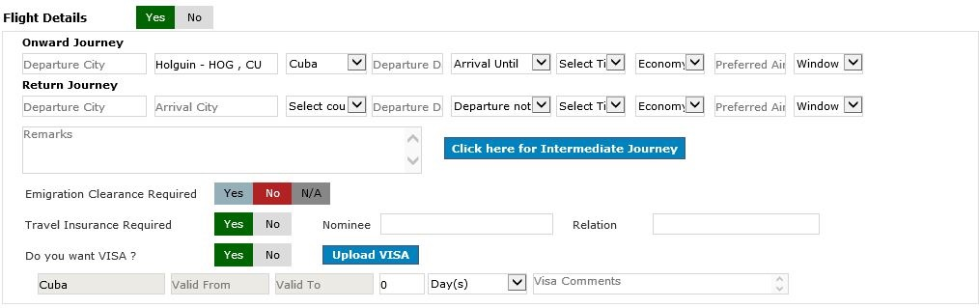
Select Traveler Name. By default it takes Logged in user name while one registered user can create request for other registered user of the same Unit
Please select Mode of request – Flight/Accommodation/Forex
Please enter reason for travel here
Select Yes for opting Flight journey
Please fill all the itinerary

Slide 13
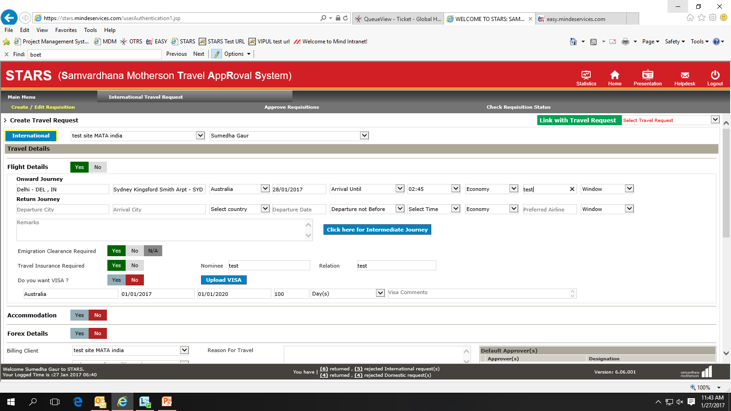
Visa Row will be created automatically per itinerary, except for home country.
If user has already valid VISA for their destination country, VISA selection will be ‘No’ by default and VISA details already coming from your profile page.
You can Upload existing VISA from a particular country from here OR from‘ Update Profile’ page.

Slide 14
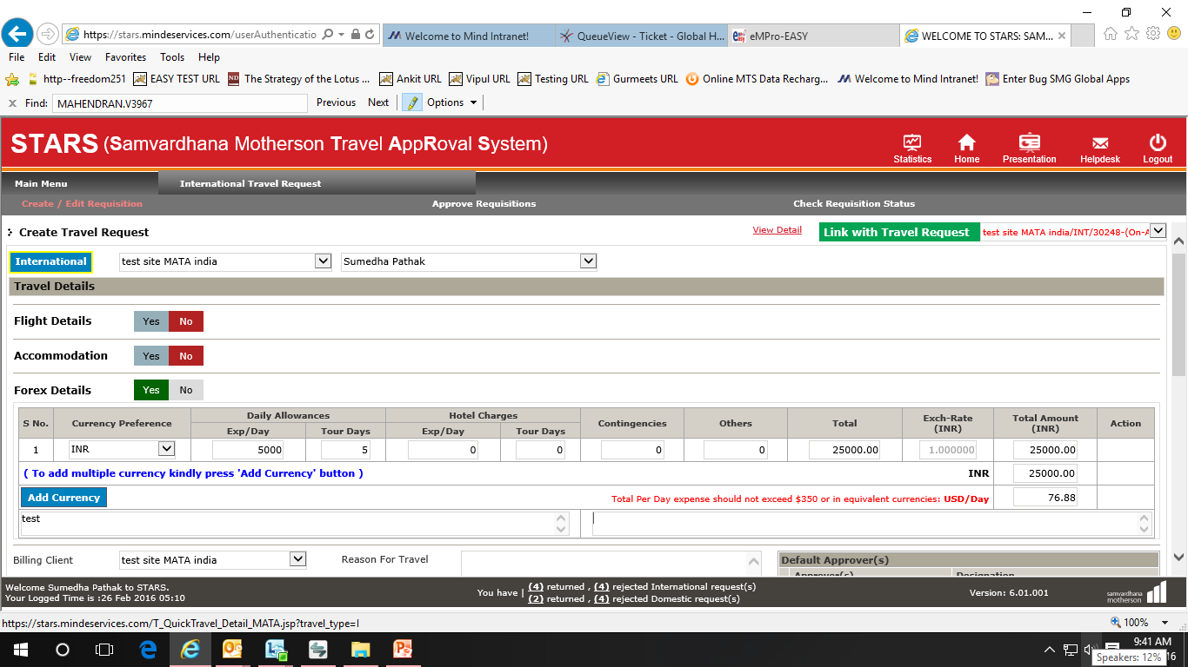
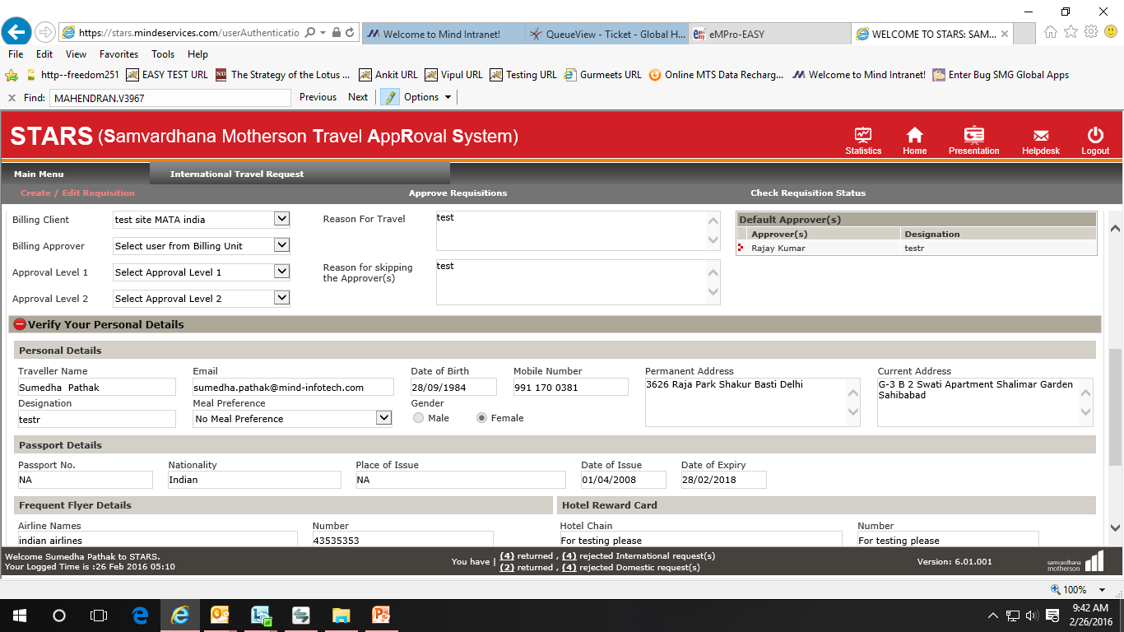
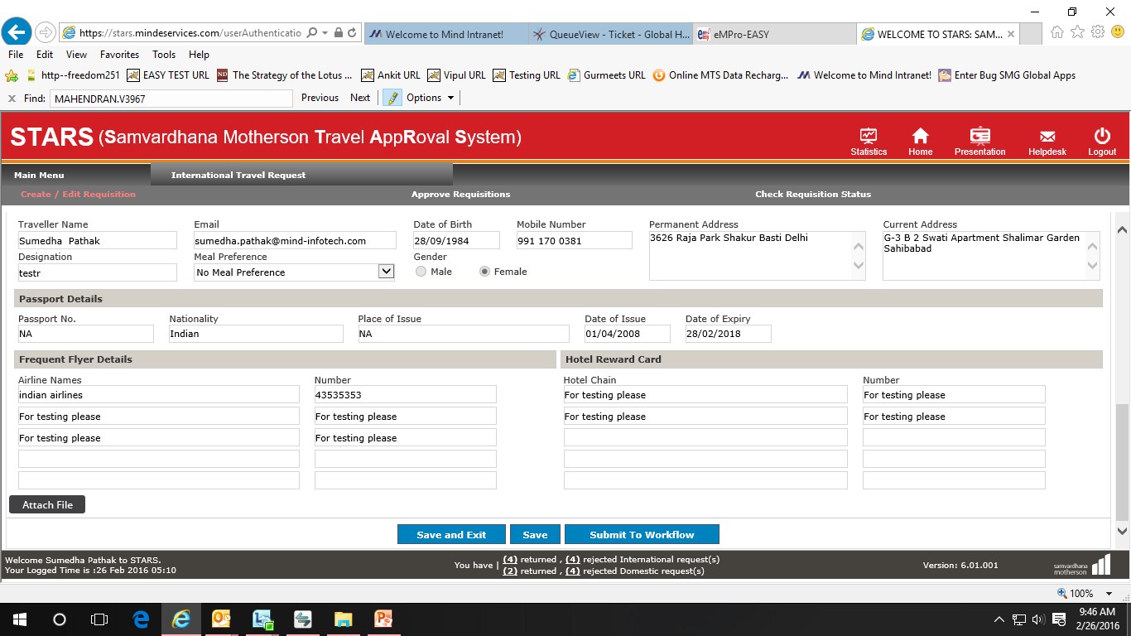
After pressing Yes , a block is display to fill all details of Forex required, however request created for this type should be link with ‘On-Air request’
Please select On Air travel request from here
Mention reason for Travel
You can view default approvers from here
You may enter Frequent flyer detail and Hotel reward card detail here
All the details system picks up from user’s profile, if required it can be modified on this screen
Click to Save & Exit
Click to submit to workflow
Click to Save

Slide 15
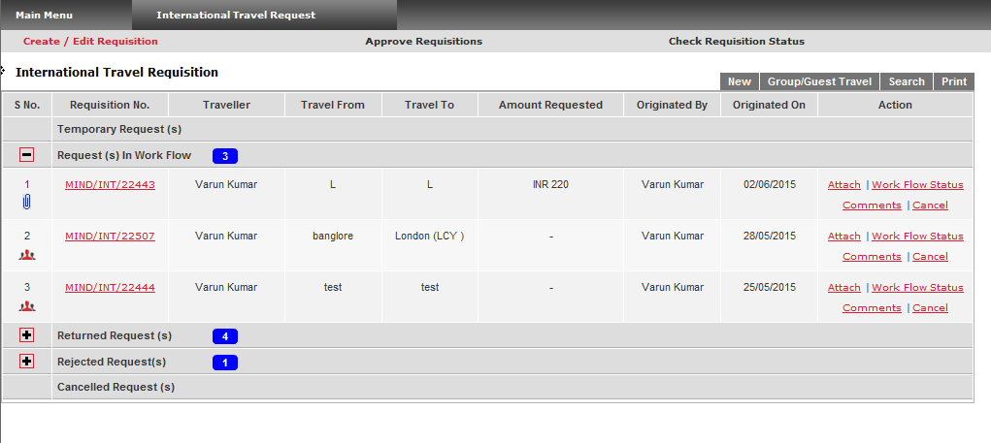
Group/Guest Travel
Click on “Group/Guest Travel” to create Group/Guest traveler request

Slide 16
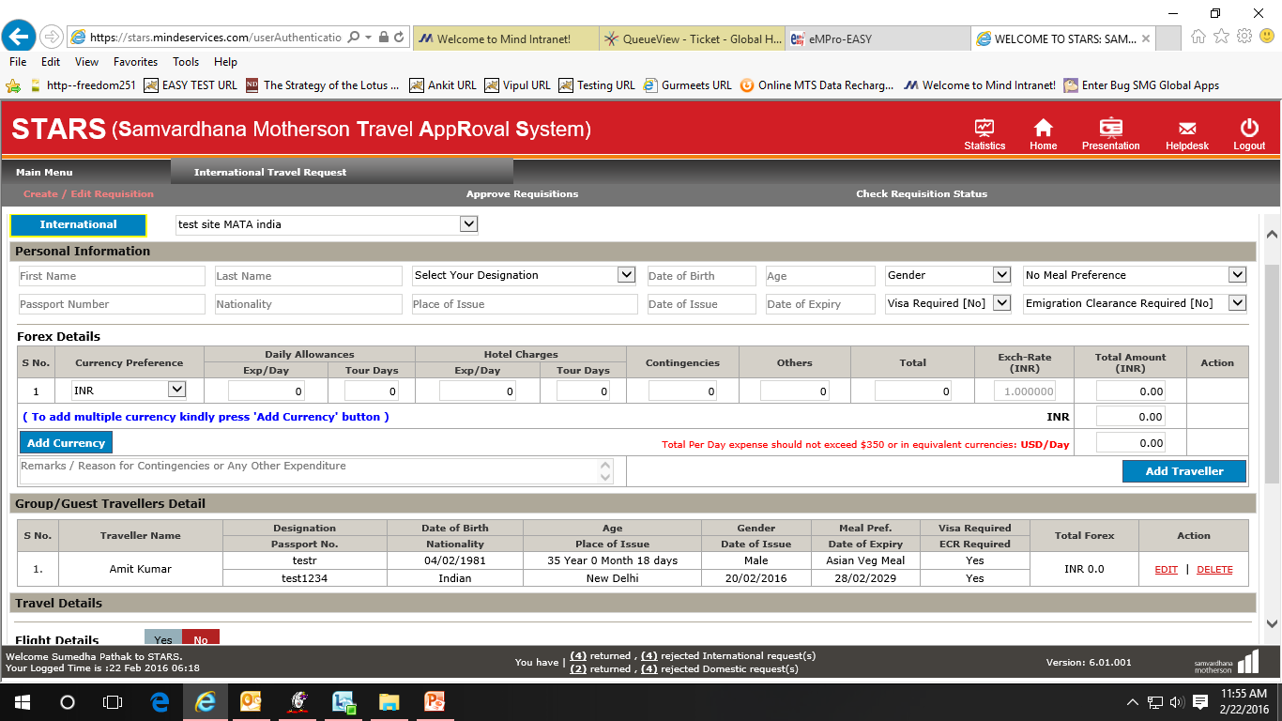
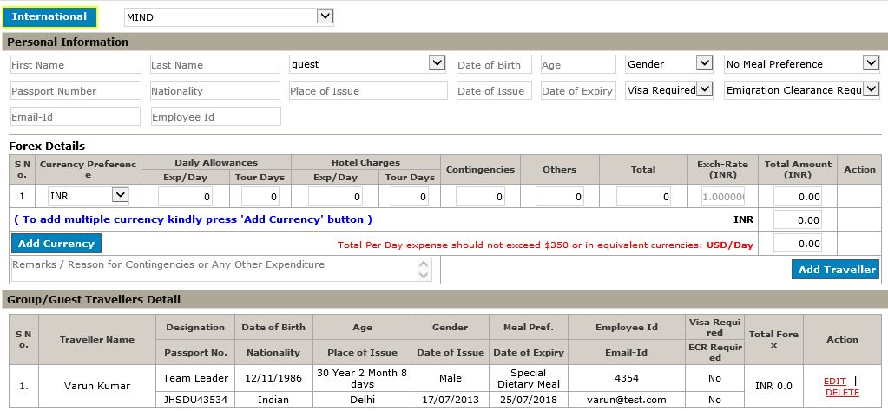
After Clicking “Group/Guest Travel” to create group travel Requisition following screen will open where user can fill the travelers detail and can add expense required for his travel
Add traveler's details
To add multiple currency kindly press 'Add' button
Click button to add multiple traveler
Added traveler details is display here

Slide 17
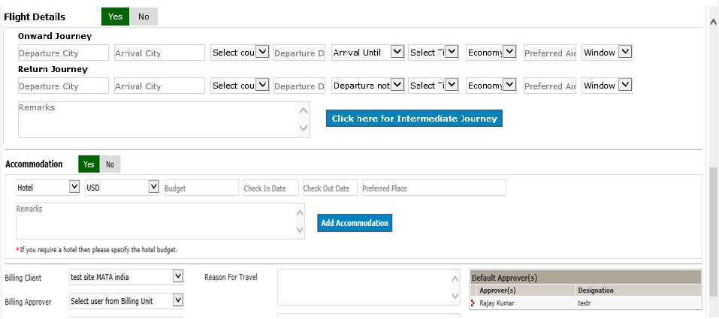
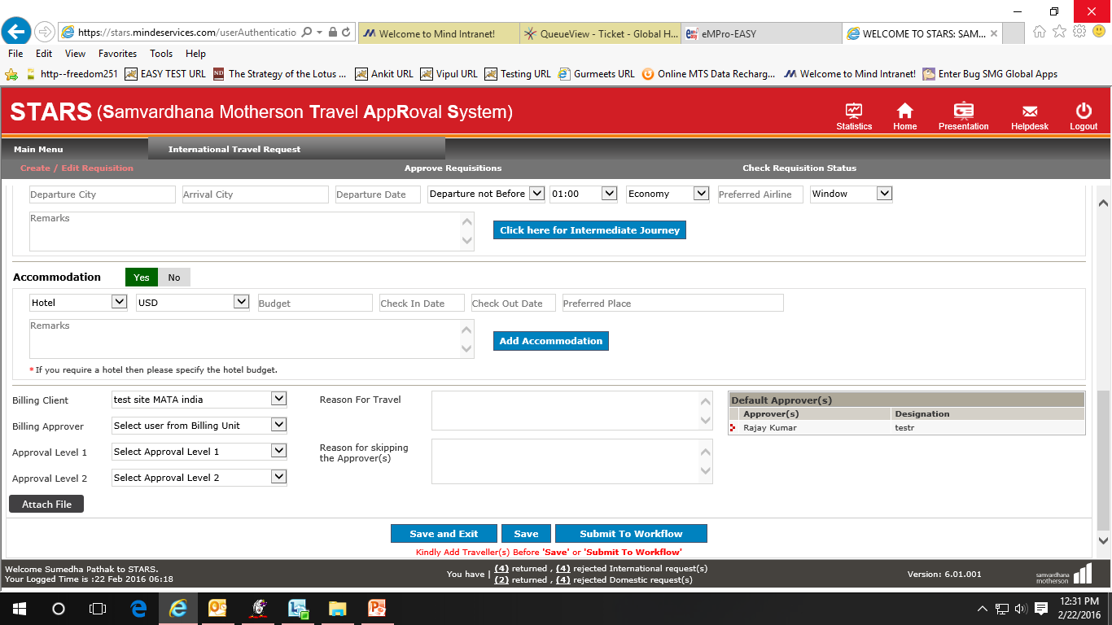
Select Yes for opting Flight journey
Please fill all the itinerary
If accommodation required, please select Yes
Click here for opt Intermediate journey
Click here to add multiple Accommodation
Click here to submit this request to workflow
Click to Exit
Click to Save the Request

Slide 18
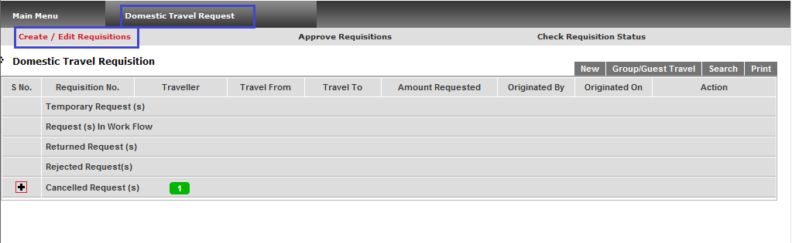
How to create Domestic Travel Request
Click on “Domestic Travel Request”
Click on “Create/Edit Requisition”
Click on “New” to create single traveler Requisition
Click on “Group/Guest Travel” to create group travel Requisition

Slide 19
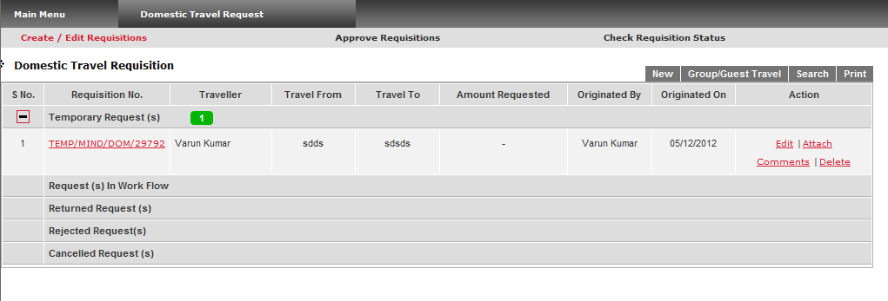
SINGLE DOMESTIC TRAVEL
Click on “New” to create single traveler request

Slide 20
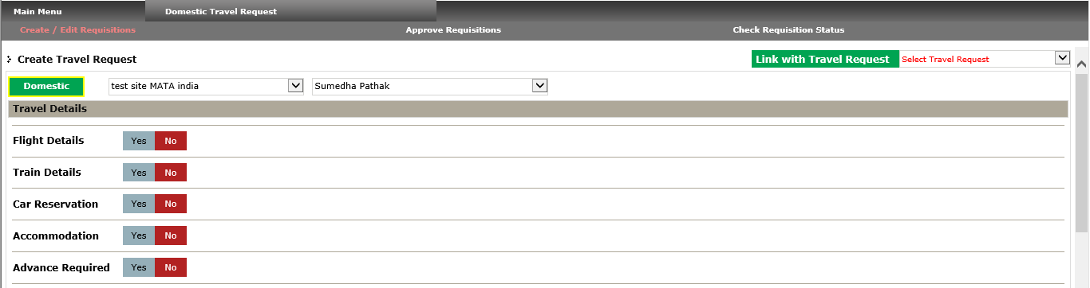
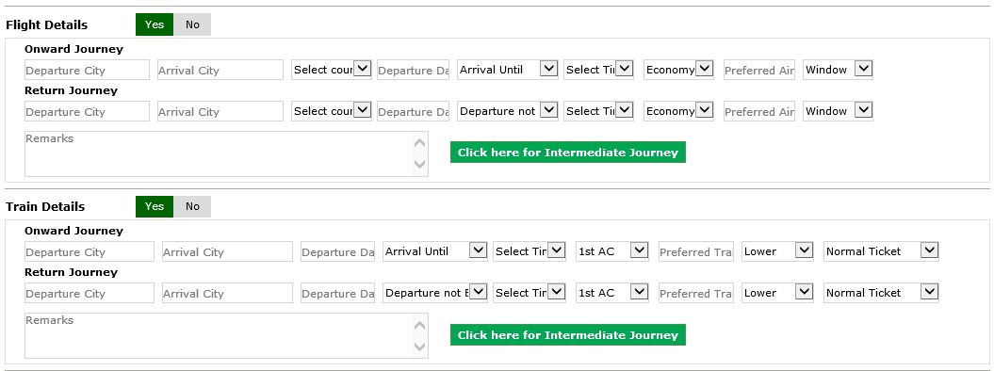
Select Traveler Name. By default it takes Logged in user name while one registered user can create request for other registered user of the same Unit
You can opt these kind of categories for your request, press Yes for particular category
After pressing Yes , a block is display to fill all itinerary of Flight
After pressing Yes , a block is display to fill all itinerary of Train

Slide 21
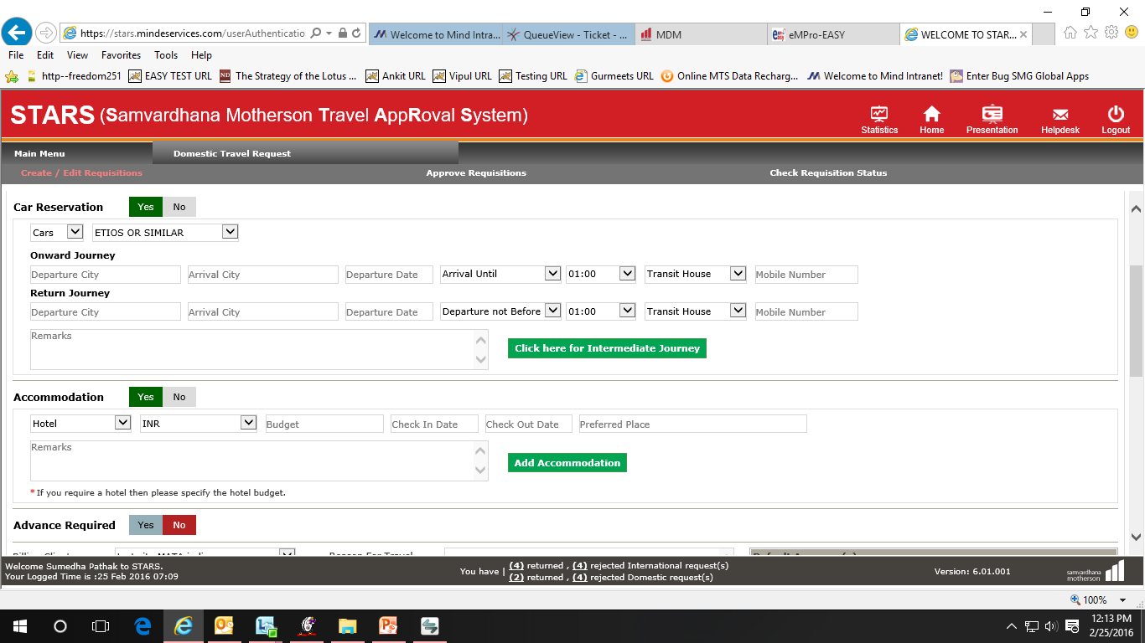
After pressing Yes , a block is display to fill all details of Car Reservation
You can select Car /Coach category from here
Click here to add Intermediate journey
After pressing Yes , a block is display to fill all details of Accommodation
Click here to add multiple Accommodation

Slide 22
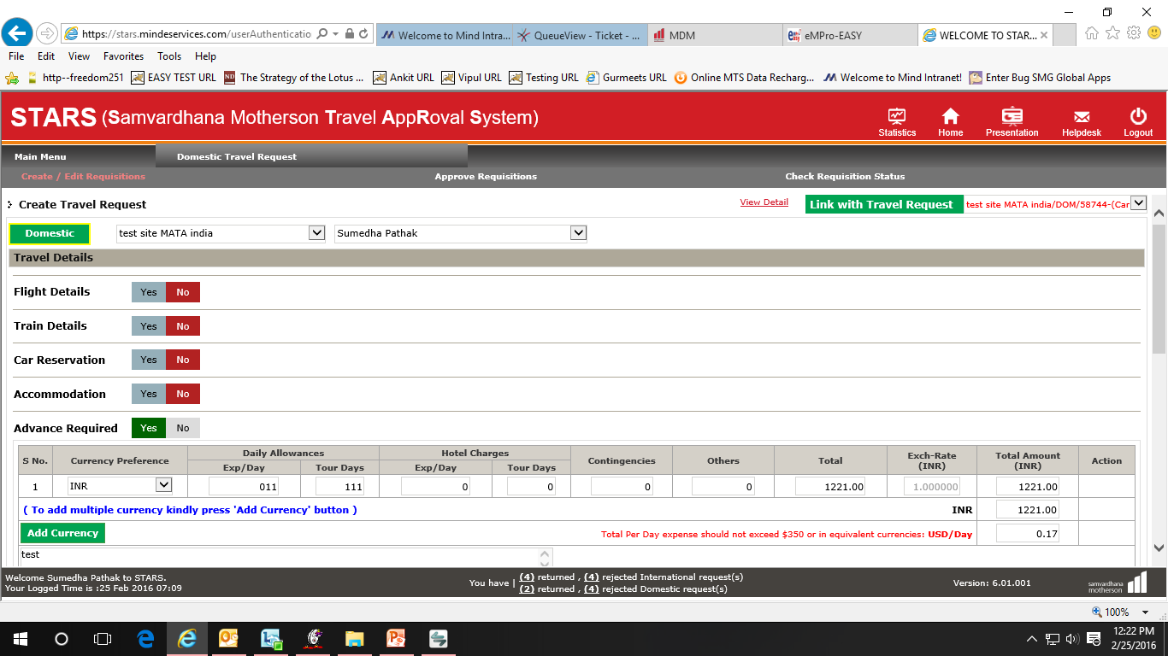
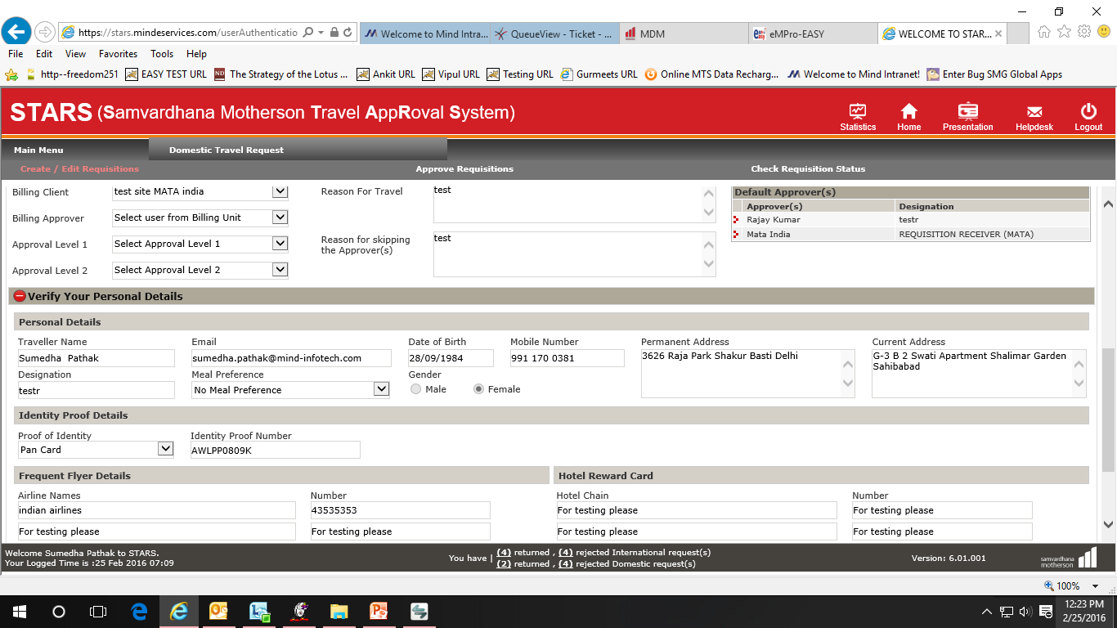
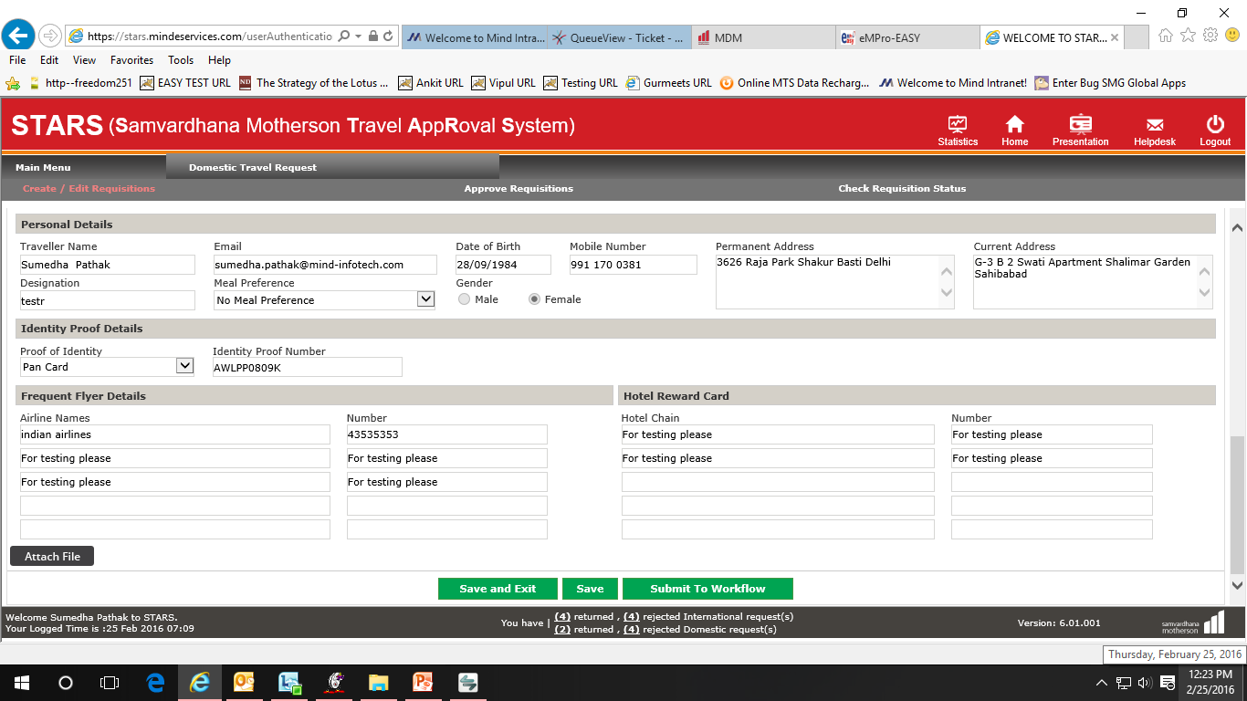
Please select On Air travel request from here
After pressing Yes , a block is display to fill all details of Advance, however request created for Advance should be link with ‘On-Air request’
Mention reason for Travel
If skipping the approvers then mention the reason here for skipping
Select the persons name from these approval fields. By this operation user’s request will go first to Approval Level 1 person and then Approval Level 2 person. Finally, after Approval Level 2, request shall go directly to by default approvers.
Click on this button to save information and exit from this requisition form. System
shall show the saved information in the next login
Click to Submit to Work Flow
Click on Save

Slide 23
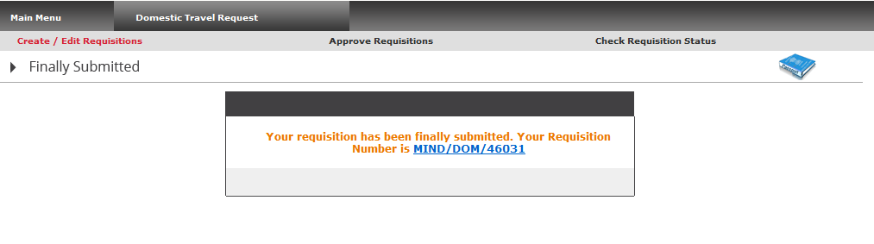

After clicking OK on alert box this screen appears containing Requisition Number
Group/Guest Travel request process is same in International/Domestic

Slide 24
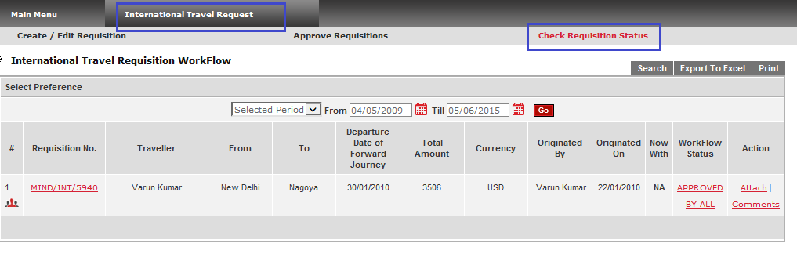
How to Check the Status of the request - International
OR
Click on “International Travel Request”
Click on “Check Requisition Status”
Select Period
Click on GO
Current Workflow Status

Slide 25
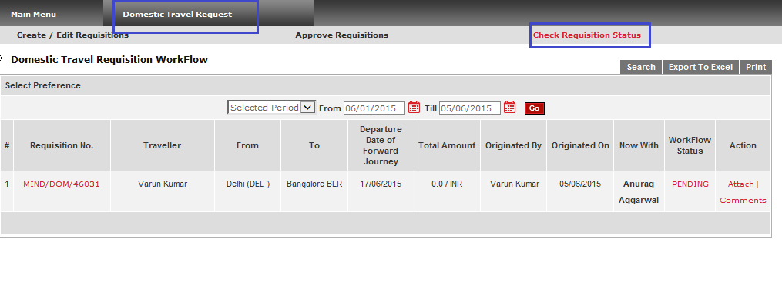
How to Check the Status of the request - Domestic
Click on “Domestic Travel Request”
Click on “Check Requisition Status”
Select Period
Click on Go
Current Workflow Status
To put comments related to Travel Requisition

Slide 26
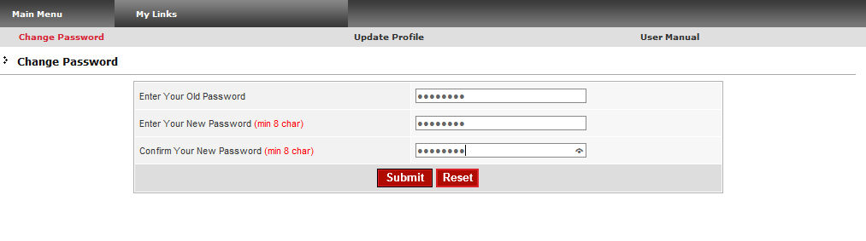
How to Change your Password
Click on “My Links” Main Menu
Enter Your Old Password
Click on “Change Password”
Enter Your New Password
Confirm Your New Password
Click on Submit to change your Password

Slide 27
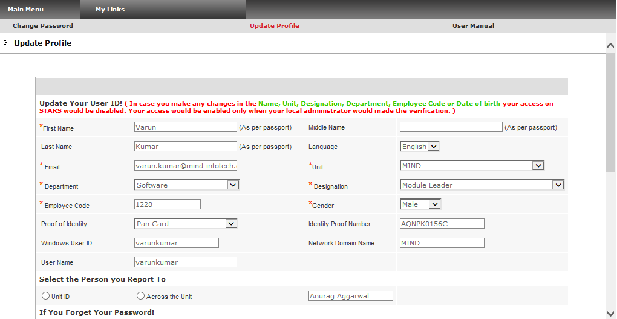
How to Update your Profile
Click on “My Links” Main Menu
Click on “Update Profile”

Slide 28
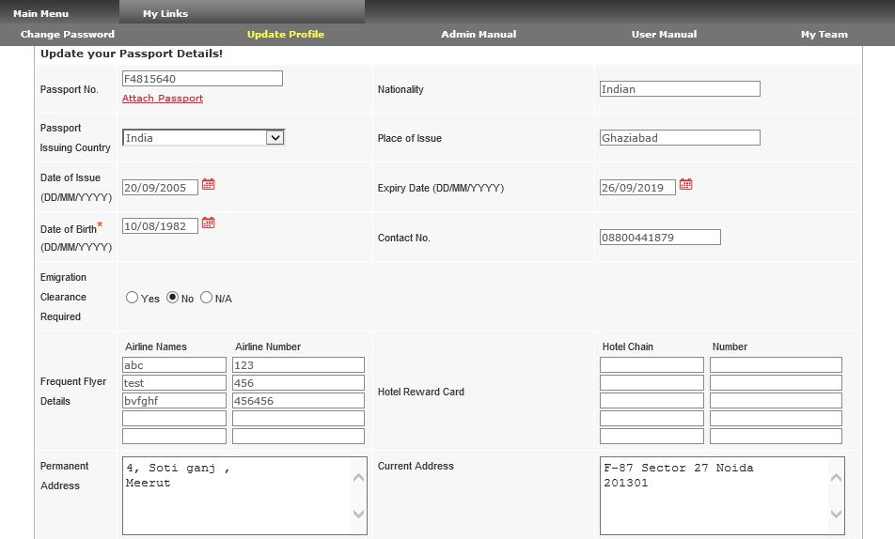
Please select Home Country here
In this screen user can update his Passport information, which is required at the time of International travel request creation.

Slide 29
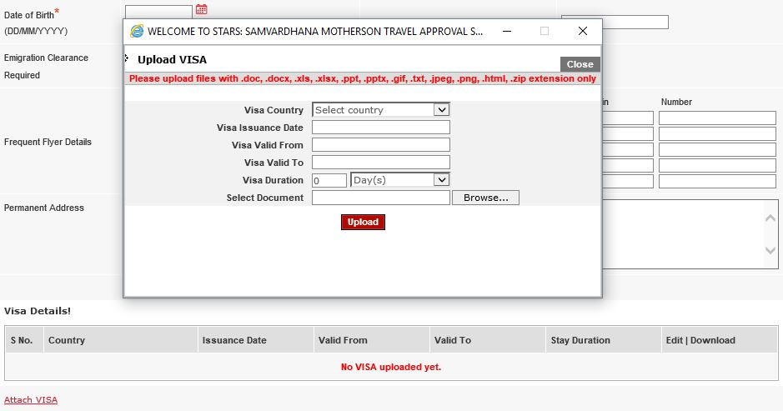
Provide all the VISA Details here.
Attach VISA for a particular country from here.
In this screen user can upload VISA’s for different countries.

Slide 30
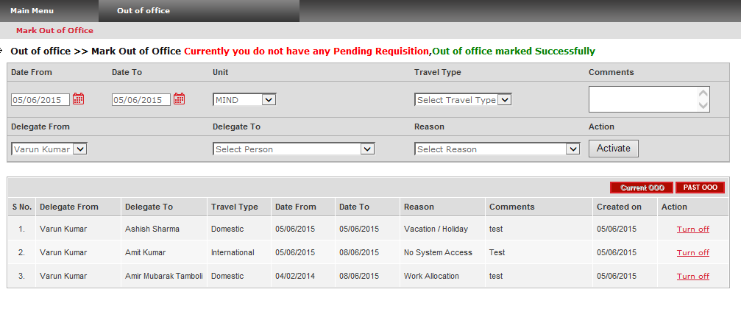
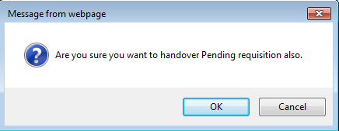
How to Mark Out Of Office
Enter your comments here
Click on “Mark Out of Office”
Please select Date range of OOOffice from here
select Delegate name from here
Select the reason
Click here to Activate “OOOffice”
Alert Box asks for final confirmation, press OK if Approver wants to handover current Pending Requisition also
Click here to Turn Off “OOOffice”
press CANCEL for delegating approvers rights only

Slide 31
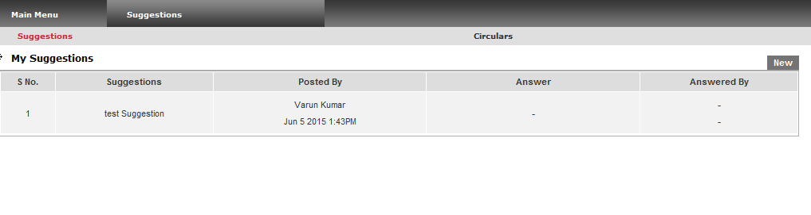
How to post Suggestions
Click on “Suggestions” Main Menu
Click on “Suggestions”
Click on “NEW” to post your suggestion
User can put suggestions by using suggestion menu about application, any new suggestion/ idea to make application function better.

Slide 32


STARS APPROVAL PROCESS
STARS is a workflow based solution automating Travel Requisition Approval process within a unit or across all the units of an enterprise with an objective of making quick approval system in order to save time & hence money.

Slide 33
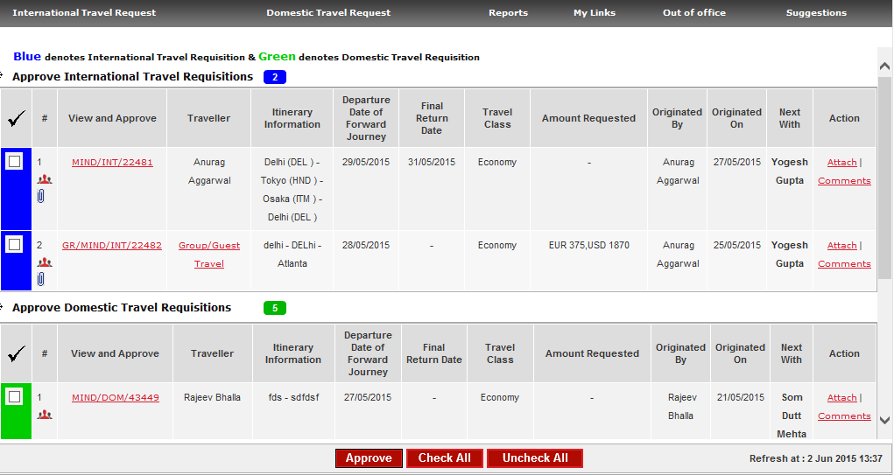
Approve Travel Requisition
If Approver has any pending requisition then after login, approver will directly land on this screen
Click on ‘Check Box’ to select multiple requisitions
Click ‘Approve’ to approve directly
Click on Requisition number to see request details & to take appropriate action, e.g. to approve, return or reject

Slide 34
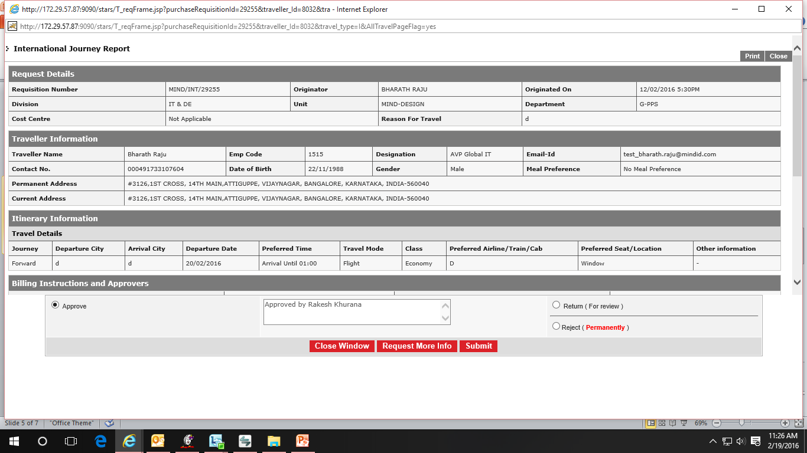
By clicking Requisition No. on previous screen requisition detail & approvers can be viewed
Approver can enter his comments while approving
Select Approve / Return / Reject option and then click on ‘Submit’

Slide 35
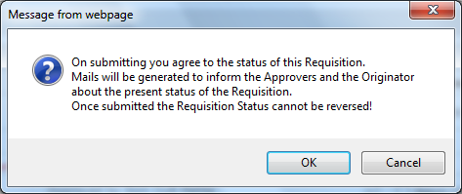
After ‘Submit’, a final confirmation box appears (as shown below) to complete the approval process.

Slide 36

For any query or support please mail us at: support@mind-infotech.com

