Slide 1
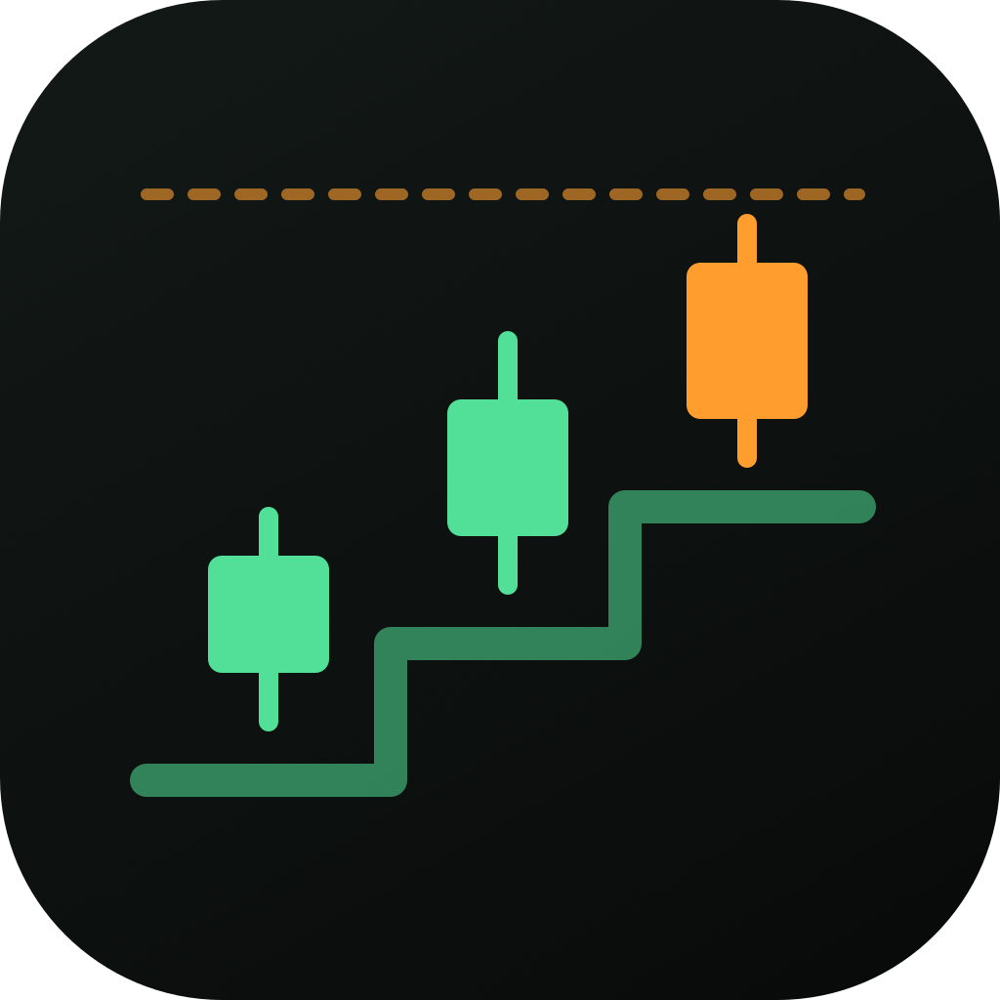
IntelligentPortfolio
Trend-based stock ideas for people who do not have time to research
Vipul Dhotre
Ledelsea | November 7, 2026

Slide 2



Why I am building this
Find the stocks that are trending up and trending down.
Students
Classes, exams and part-time jobs leave little time to follow the market.
Working professionals
A full workday leaves little time to screen hundreds of stocks.
Then tell me when it is worth acting.
No time to research
So the question 'which stock should I look at?' goes unanswered.

Slide 3
What similar platforms cost
$44.95 / mo
IBD Digital
~$69 / mo
IBD Leaderboard
~$150 / mo
MarketSurge
Sources: IBD Digital (App Store) | IBD Digital review | IBD Leaderboard (App Store) | MarketSurge (Google Play) | MarketSurge review | Seeking Alpha (official) | Zacks Premium. Annual = annual plan where listed, otherwise monthly x 12. Vendor prices change; confirm before quoting.

Slide 4
And the work they ask of you
22
2
Market outlook
Is the market in an uptrend or a correction, and how much should you be invested?
16
Fundamentals and demand
EPS rating 90+, EPS growth 25%+, ROE 17%+, relative strength 75+, top 40 industry group
checks per stock
on IBD's Buying Checklist, filled in by hand
4
Chart analysis
Base pattern, buy point, volume up 40%+ on breakout, relative strength line at a new high
And that is per stock. IntelligentPortfolio screens the market and hands you ranked ideas instead.
Source: IBD Buying Checklist (investors.com). Counts are the checklist's market, fundamentals and chart-analysis items.

Slide 5




Introducing IntelligentPortfolio
A research assistant that does the screening for you.
Scans the market
S&P 500, India and forex, refreshed through the day
Reads the trend
Daily trend direction and strength, 4-hour entry trigger
Research tool, not investment advice. It cannot place trades.
Gives the exit
Entry, an exit line and optional profit zones
Tracks what you own
Holdings tracker that follows your exit line

Slide 6

How it picks a trade
1
2
3
4
Direction
Confirmed daily Supertrend says up or down
Strength
Daily ADX at least 20 and rising
Trigger
A 4-hour Supertrend flip sets the entry
Exit line
Stay in until a day closes under the daily Supertrend
The exit is rule-based. Leave when a day closes under the daily Supertrend line, with no fixed target or time limit. Weakness signs show as warnings only. Risk rules can still veto any idea.

Slide 7

How we chose the strategy
24
-0.15%
+1.8%
tests run
Patterns, entries, exits, ML models, factors and the IBD checklist
per trade for pooled patterns
Worse than matched random entries (t = -4.4)
per trade when held until the daily line breaks
The old short-hold levels averaged -0.07%
Chart patterns had no edge. A 20% bull flag looked strong, but a plain 'up 20% in 20 days' control did as well. Supertrend only paid when held until its own line broke. The Excel workbook has the full comparison; the live track record will confirm the edge.

Slide 8
How long a trade runs
~37 days
average hold with no time cap
44%
of trades win; average win +12% against average loss -6%
No time limit
exit only when the daily Supertrend breaks
(120-day safety limit)
Backtest of about 525 daily Supertrend flips, S&P 500 members at the time, 2022 to 2026, next-open entries, 0.2% costs. Mostly a rising market. Not a guarantee.

Slide 9
Live demo
Let's look at the real thing.
The scanner
Ranked long and short ideas
1
One setup
Entry, exit line and profit zones
2
Holdings
Track what you own
3

