Slide 1

KESHAVJI BHARMAL SUMARIA COMMERCE & NATARAJ PROFESSIONAL SCIENCES COLLEGE, VAPI
A
Project Report on
CAMPUS BALLOT
Submitted BY
39 - Vipul Maurya / 75 – Adarsh Singh
Under the guidance of
Mayuri Patel

Slide 2
CAMPUS BALLOT

Slide 3
INTRODUCTION
CAMPUS BALLOT is a web-based E-Voting and Polling System designed for college elections and campus opinion polls. It enables election officers to create ballots, while allowing students to register, vote once per poll, and view live results.
The platform solves the problem of scattered, paper-based, or unofficial voting by combining registration, ballot casting, and result display into a single system. Students no longer need separate processes for enrolment, voting, and checking outcomes, resulting in a more efficient and transparent campus election experience.
CAMPUS BALLOT includes one-vote-per-student enforcement and a live tally of candidates or poll options. These features allow students to cast a fair vote, prevent duplicate voting, and understand results clearly after they submit a ballot.
The system enhances interaction between election officers and students through open and closed ballots, candidate lists, and result bars. Officers can publish elections, close voting, and remove polls, which supports a controlled and accountable election process.
Additionally, CAMPUS BALLOT aims to deliver a simple, interactive, and beginner-friendly environment for both student voters and election officers.

Slide 4
PROJECT USERS AND FUNCTIONALITIES
Student (Voter)
• Register and login using the authentication system
• Browse open elections and campus opinion polls
• View poll details and the candidate or option list before voting
• Cast exactly one vote in each poll
• Access the ballot dashboard after login
• See live result bars after a vote is submitted
• Track which polls have already been voted on
• View total vote counts for each poll
• Receive a confirmation message after a successful vote
• Enroll using college email and a unique student ID
• Open a selected poll from the ballot list
• View candidate names and party or option labels
• Cannot submit a second vote in the same poll
• View results of closed polls
• Log out securely from the current session
• Access only voter features and not the officer desk

Slide 5
PROJECT USERS AND FUNCTIONALITIES
Election Officer
• Login using the officer authentication system
• Open the officer desk to manage campus ballots
• Create and publish new elections or opinion polls
• Add poll details including title, description, and category
• Add at least two candidates or poll options
• View and manage existing polls
• Monitor the total number of votes on each poll
• Close or reopen voting for a poll
• Delete a poll along with its recorded votes
• View results without being allowed to vote
Guest
• View the Campus Ballot home page
• Read how student voting and officer tools work
• Open the login and student registration pages
• Cannot cast a vote without creating an account

Slide 6
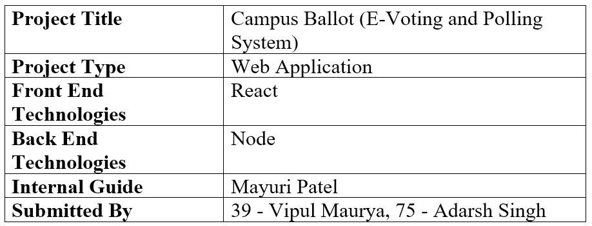
PROJECT PROFILE

Slide 7
DATA FLOW DIAGRAM

Slide 8
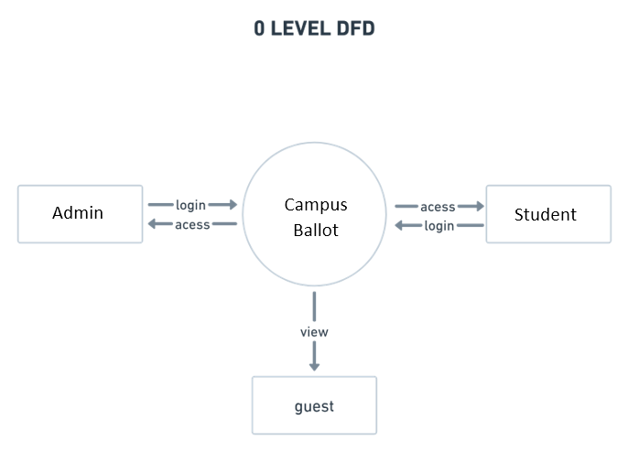
0-LEVEL DFD

Slide 9
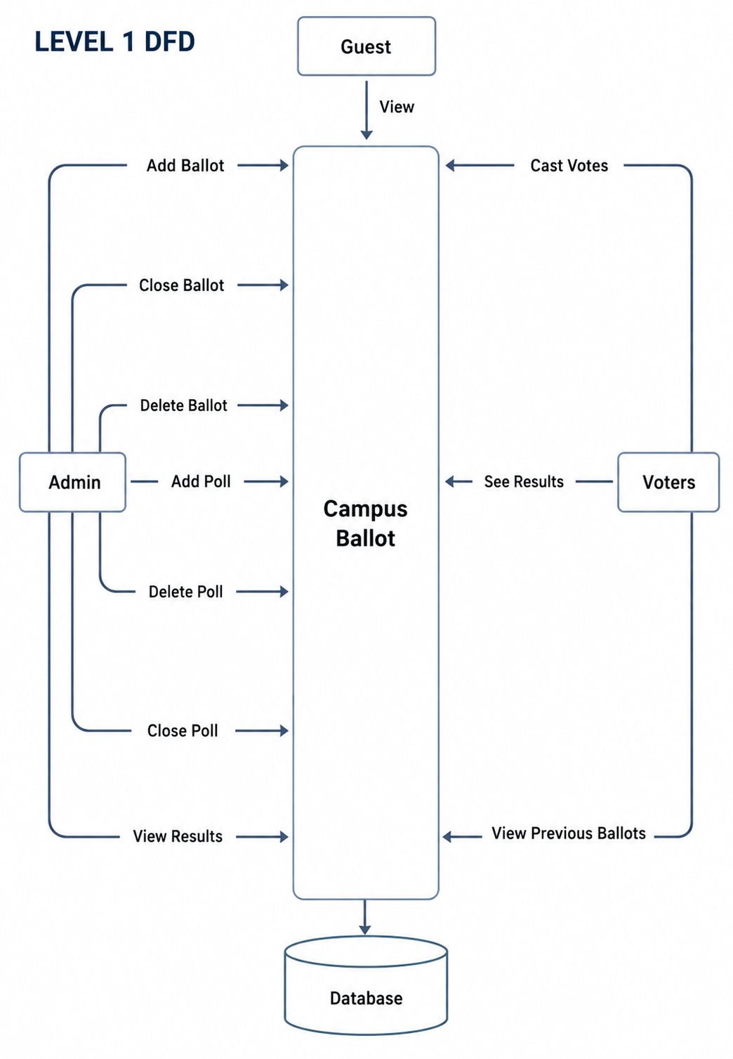

Slide 10
ER DIAGRAM

Slide 11
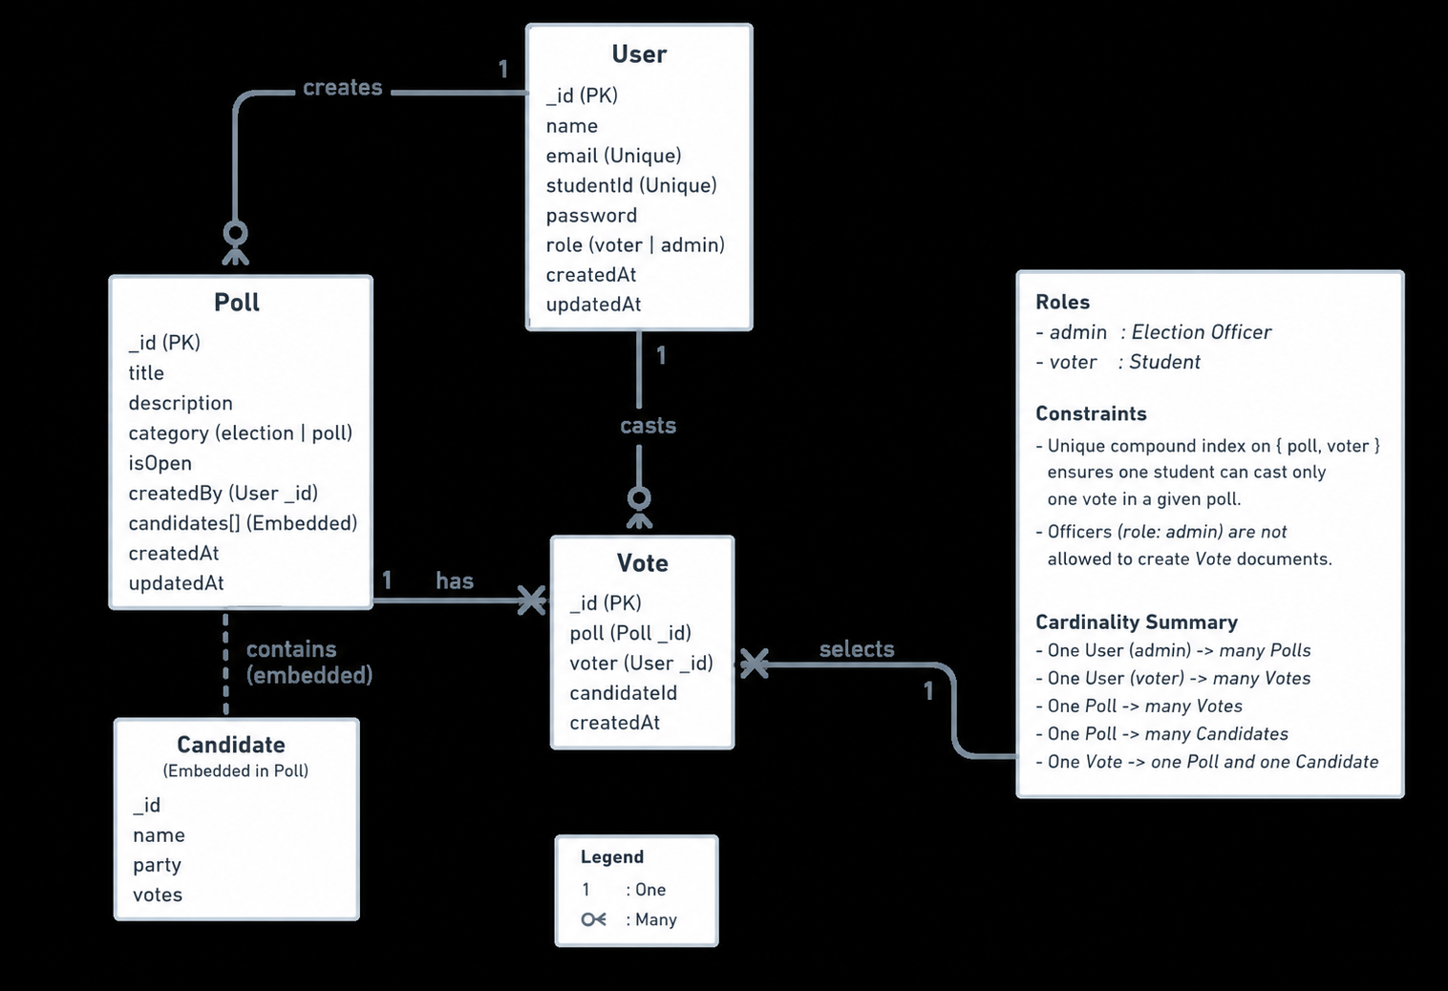

Slide 12
DATABASE DESIGN

Slide 13
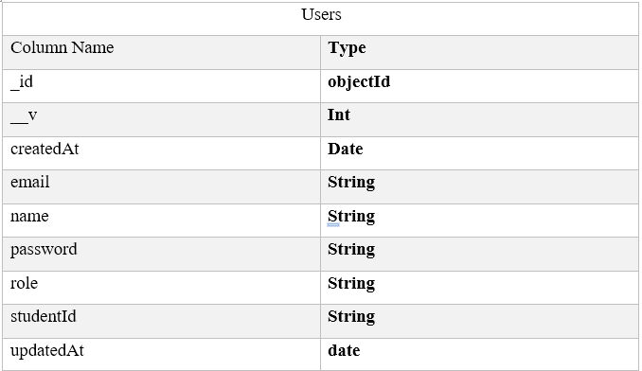

Slide 14
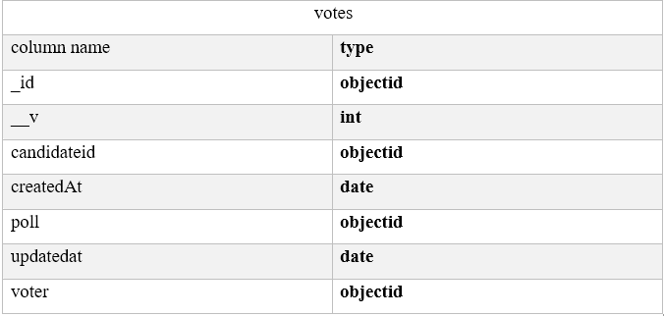

Slide 15
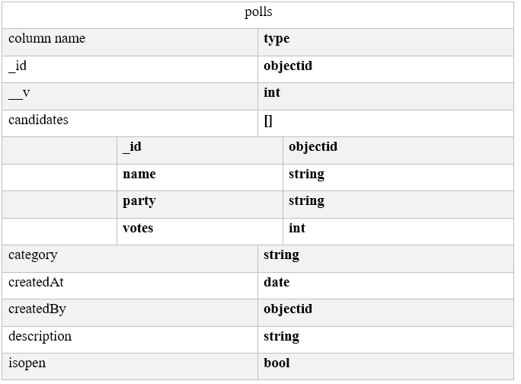

Slide 16
IMPLEMENTATION DETAILS

Slide 17
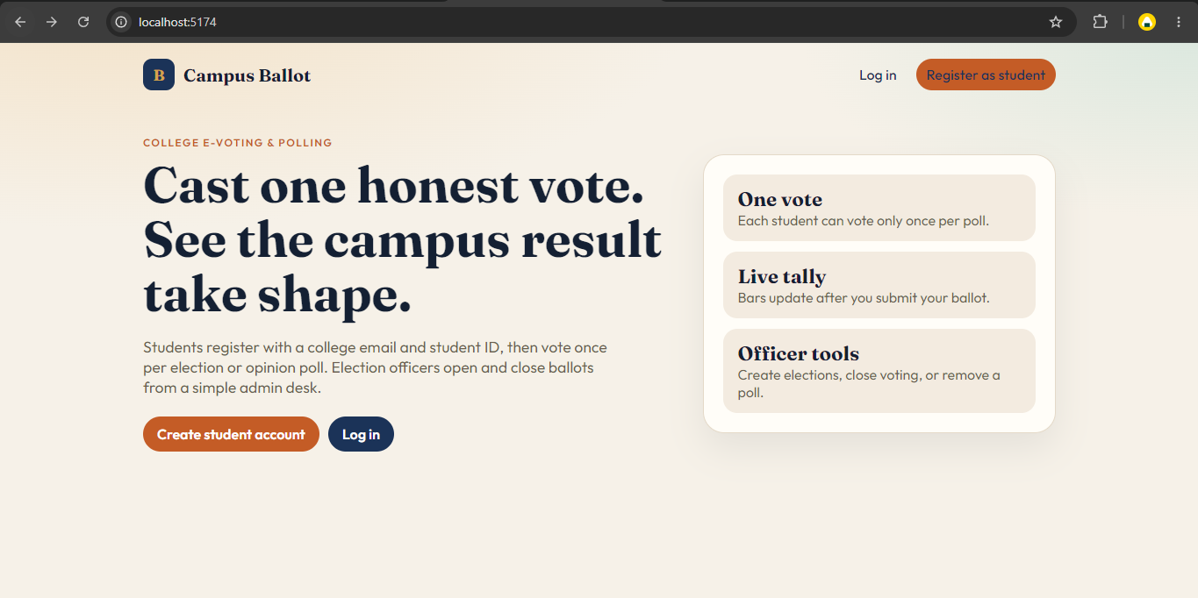

Slide 18
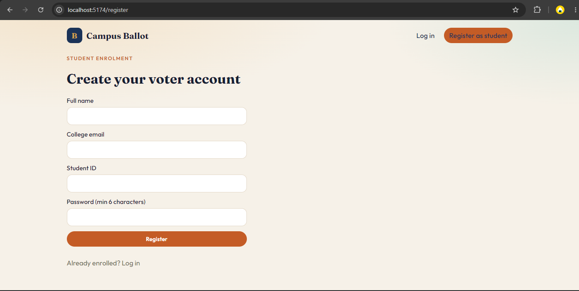

Slide 19
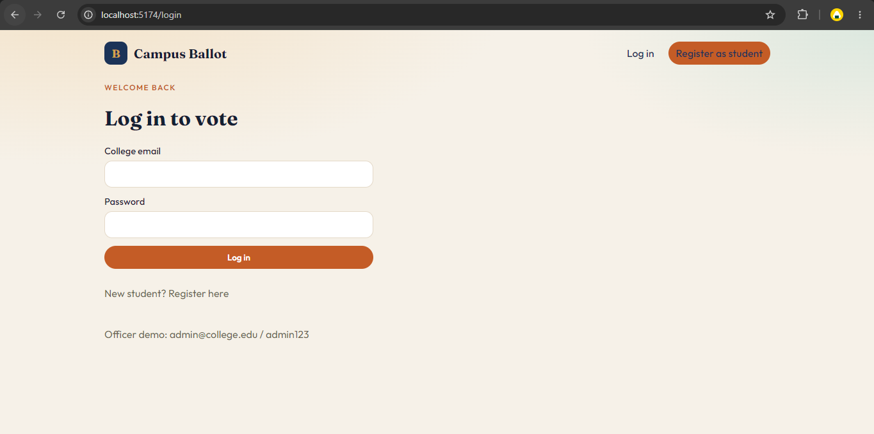

Slide 20
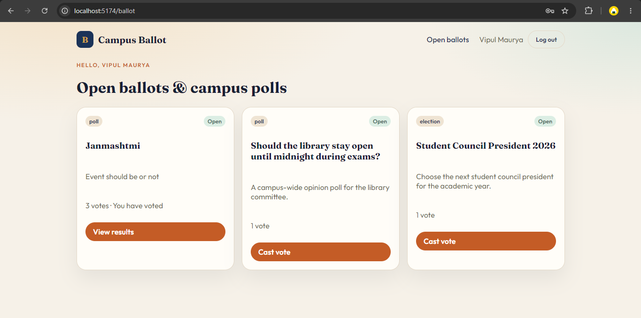

Slide 21
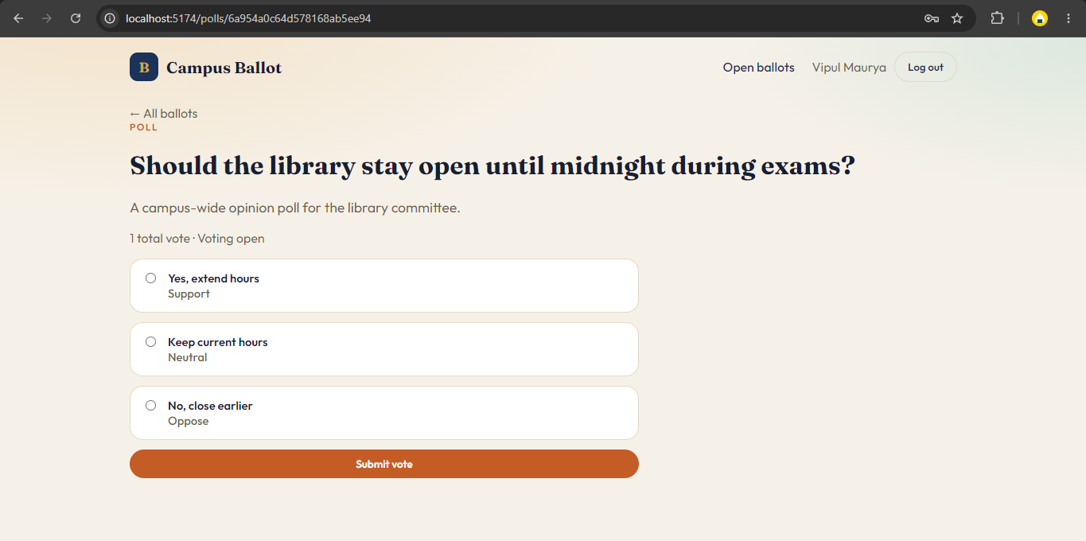

Slide 22
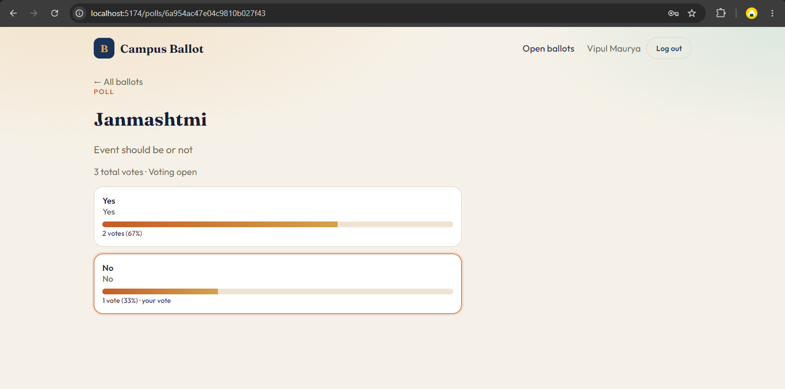

Slide 23
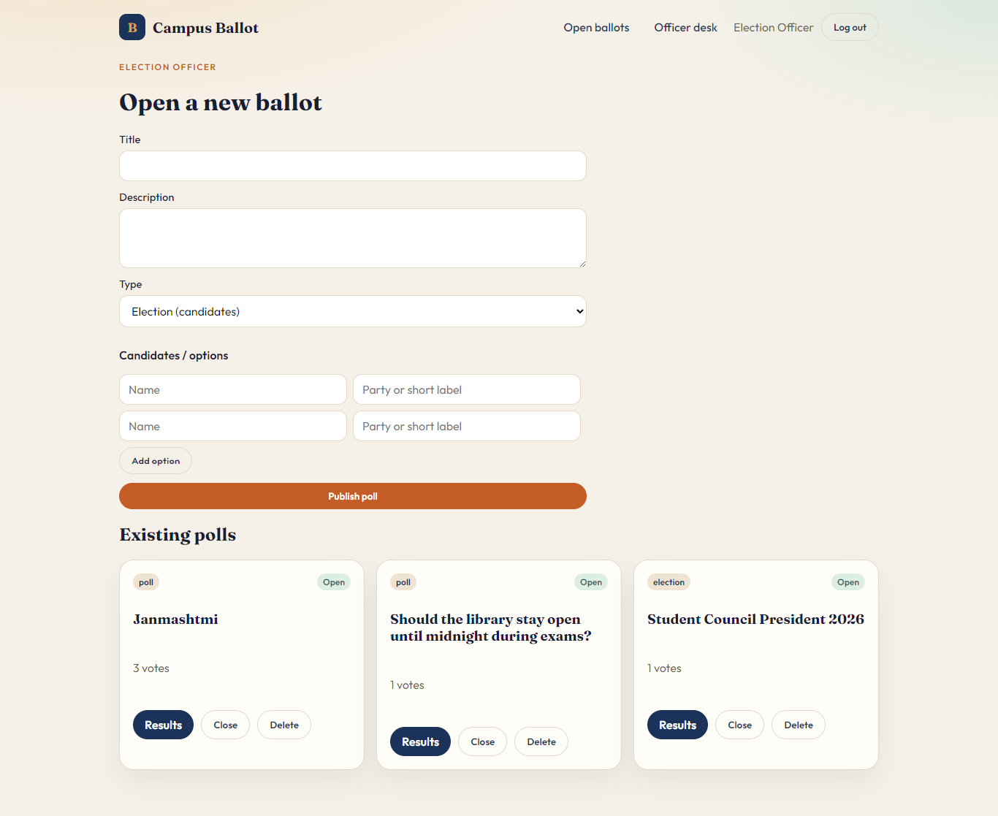

Slide 24
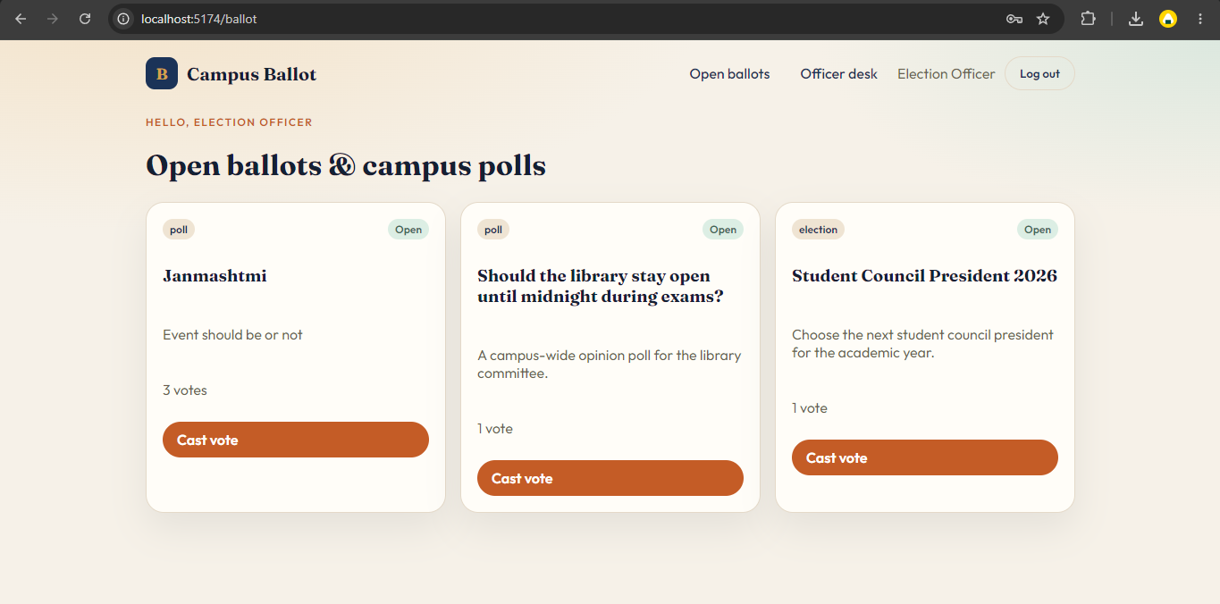

Slide 25
BIBLIOGRAPHY
Search Engine : Google
Online Resources:
  http://www.mongodb.com
  http://www.nodejs.org
  http://www.expressjs.com
  http://www.react.dev

