Slide 1
PROJECT TITLE
PIP104 PROFESSIONAL PRACTICE-II
VIVA-VOCE
Batch Number:
Roll Number | Student Name
20201CSE0596 | Vipul Joseph Pinto
20201CSE0613 | Nikhil Kumar
20201CSE0625 | Disha R
20201CSE0648 | Dhone Chetana Reddy
20201CSE0655 | Hemanth Kumar Shetty M
Under the Supervision of,
Dr . Mohamadi Begum Syed Riaz Ahamed
Professor
School of Computer Science Engineering & Information Science
Presidency University

Slide 2

Introduction
In today's digital age, technological advancements have revolutionized connectivity, but they've also led to a surge in cyber threats. Phishing attacks, deceptive tactics exploiting trust, pose a significant challenge to online security.
We developed the "ScamSniffer Tool”, this sophisticated solution stands against phishing attacks, employing cutting-edge tech to swiftly detect fraudulent links and it also empowers its users with real-time guidance.

Slide 3
Literature Review
1. User Education & Authentication Server:
User Education Importance: Crucial in fortifying against phishing attacks by imparting knowledge on deceptive tactics. Methods include online training modules, awareness campaigns, and workshops.
Authentication Server Functionality: Acts as a critical security component, ensuring secure access to the bank's services. It initiates with user input, employs SSL/TLS for secure data transmission, and enhances security via Nonce/OTP delivery. User involvement in crafting authentication details adds an AI-based layer.

Slide 4
2. Phishing e-Mail & Countermeasures:
Phishing e-Mail Scenario: Explores the common threat of deceptive emails, detailing attack steps from planning to acquiring valuable information.
Countermeasures Complexity: Discusses multi-layered defense mechanisms integrating email filtering, authentication protocols, webpage comparison, and Bayesian filters. Balancing effectiveness, usability, and the need for continuous user education.
3. Future Trends in Phishing:
AI & Machine Learning Impact: Anticipates sophistication in phishing attacks via AI-generated convincing messages, making detection challenging.
Deepfake Technology & Cross-Channel Attacks: Expected methods combining technologies to create more convincing scams across various communication platforms.
IoT Devices, Phishing Tactics Evolution: Identifies emerging targets and the continuous evolution of phishing tactics.

Slide 5
4. Emerging Threats:
Voice Phishing Evolution (Vishing), 5G Networks Impact: Foresees advancements in voice phishing using AI voices and 5G's potential opportunities for phishing.
Quantum Computing, Blockchain Exploitation, AR, and Phishing: Highlights potential threats arising from technological advancements in quantum computing, blockchain vulnerabilities, and augmented reality's use in phishing scenarios.
5. Visual-Similarity-Based Phishing Detection & Malware-Based Phishing:
Visual-Similarity-Based Detection: Explains how visual elements, template matching, and icon/logo verification are used to identify fake phishing sites by examining appearance similarities.
Malware-Based Phishing: Describes the delivery of malware via deceptive content, exploiting social engineering tactics, leading to malware installation without the user's knowledge.

Slide 6
Research Gaps Identified
1. Anti-Phishing Technologies:
Evaluation Metrics: Assessing effectiveness needs refinement in false positive/negative rates.
Adaptability: Research on tools' adaptability to new phishing techniques is essential.
Real-time Detection: Focusing on quick threat identification and response mechanisms.
2. User Behaviour Analysis:
Psychological Factors: Understanding user susceptibility factors requires deeper psychological analysis.

Slide 7
Baseline Establishment: Creating behaviour baselines aids in anomaly detection.
Authentication Patterns: Analysing authentication habits helps detect potential threats.
3. Machine Learning & Behaviour Analysis
Continuous Learning: Integrating machine learning ensures continual pattern recognition.
Behavioural Anomaly Detection: Identifying anomalies through behavioural analysis and ML is crucial.
4. User Education Integration
Real-time Warnings: Providing clear warnings during potential threats enhances user awareness.
Educational Pop-ups: Offering in-time education during phishing attempts improves user knowledge.
5. Phishing in Cloud Environments
Risk Mitigation: Addressing credential theft, unauthorized access, and email-based threats in cloud settings is vital.

Slide 8
6. Disadvantages and Challenges
Understanding Emerging Threats: Lack of research might leave systems vulnerable to new tactics.
Countermeasure Lag: Inadequate research might slow down countermeasure development.
Human Factors Neglect: Insufficient study of user behavior can hinder effective user education.
Legal Frameworks: Research gaps may hinder cybercriminal prosecution.
Delayed Awareness: Research gaps might delay impactful training initiatives.
Tech Integration Hurdles: Lack of seamless integration could miss empowering users.
Protection for New Tech: Insufficient research might leave new tech open to risks.
Global Collaboration: Limited research may impede coordinated responses to phishing attacks.

Slide 9
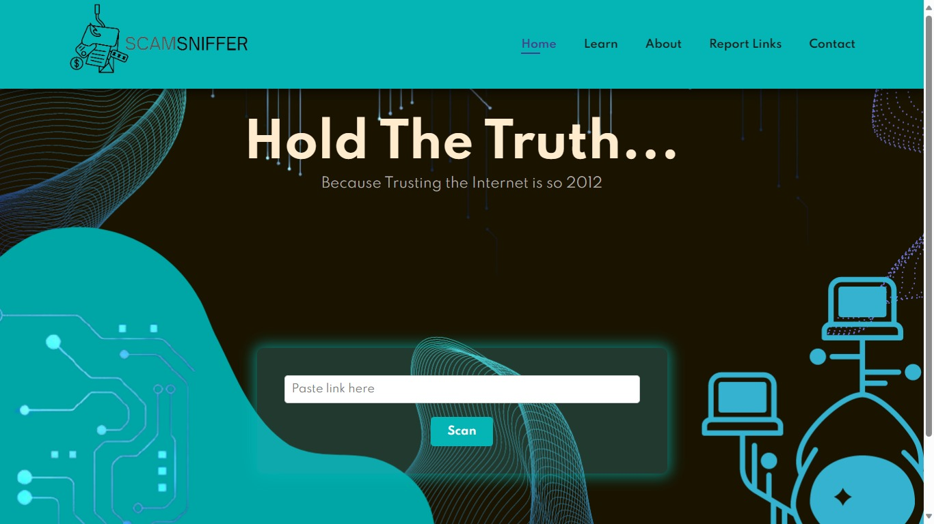
Proposed Methodology
1. Website Overview:
1. Website Structure
Header Section: Logo for ScamSniffer.
Navigation: Easy access sections - Home,
Learn, About, Report Links, and Contact.
2. Home Page
Link Input Box: Allows users to input URLs for analysis.
Scan Results:
Safe Link: Offers a "Proceed" button for site access.
Unsafe Link: Redirects users to an "Unsafe" page, preventing access.
logo
Link input box
Header fields

Slide 10
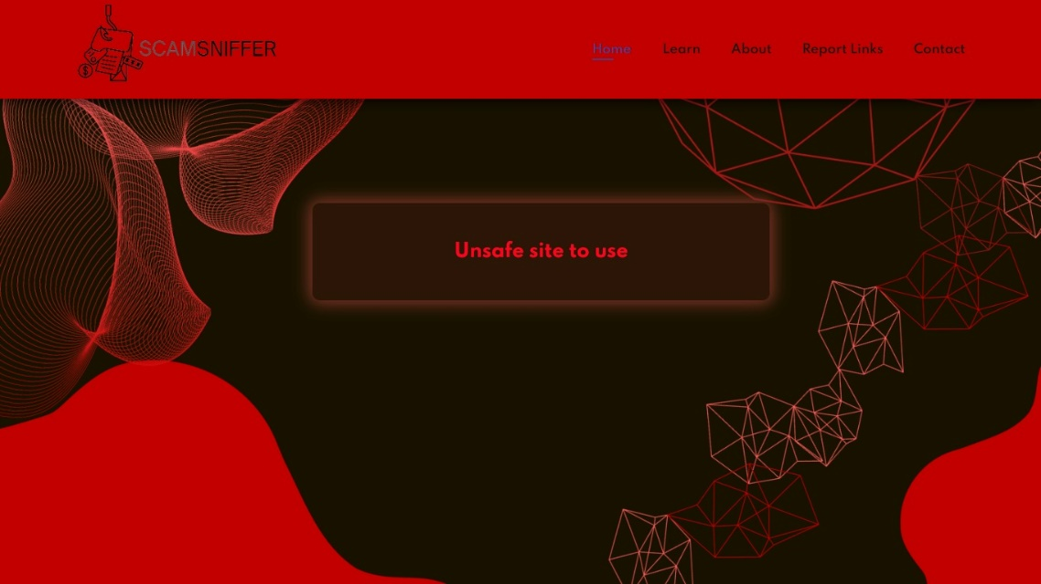
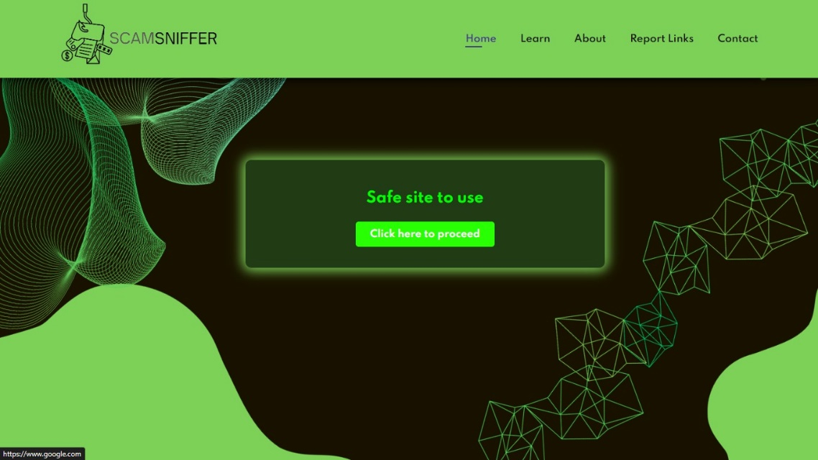
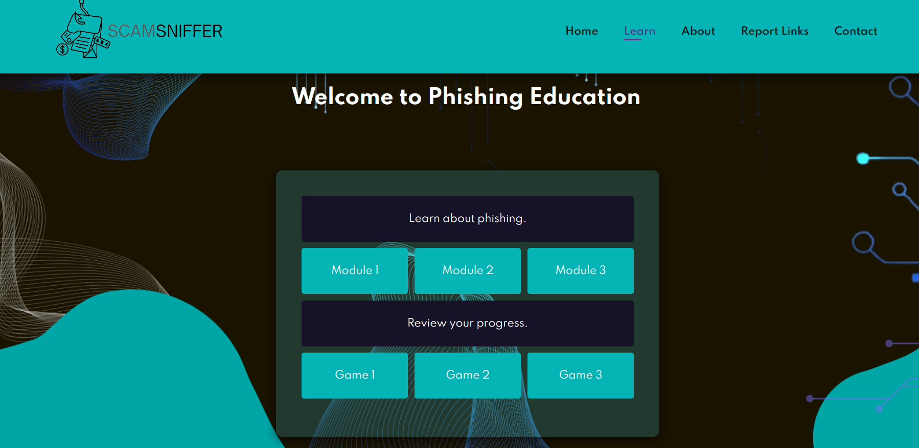
If site is unsafe shows warning
If site is safe we can click on proceed button
which will redirect to safe site
3. Learn Page
Educational Content: Covers phishing aspects like signs, causes, motivations.
Interactive Elements: Quizzes to enhance user engagement.
Learning about
phishing through modules
Learning through games

Slide 11
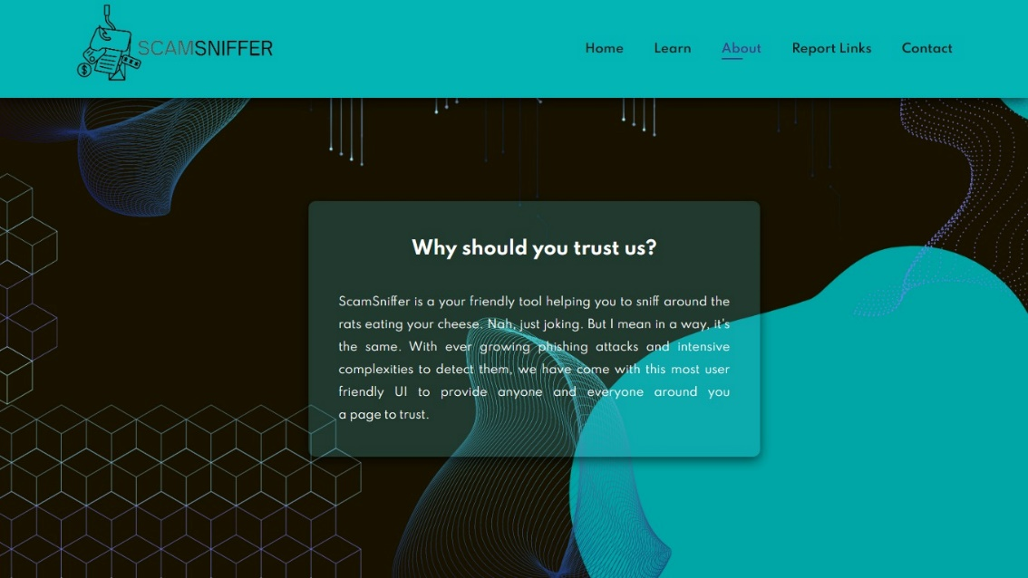
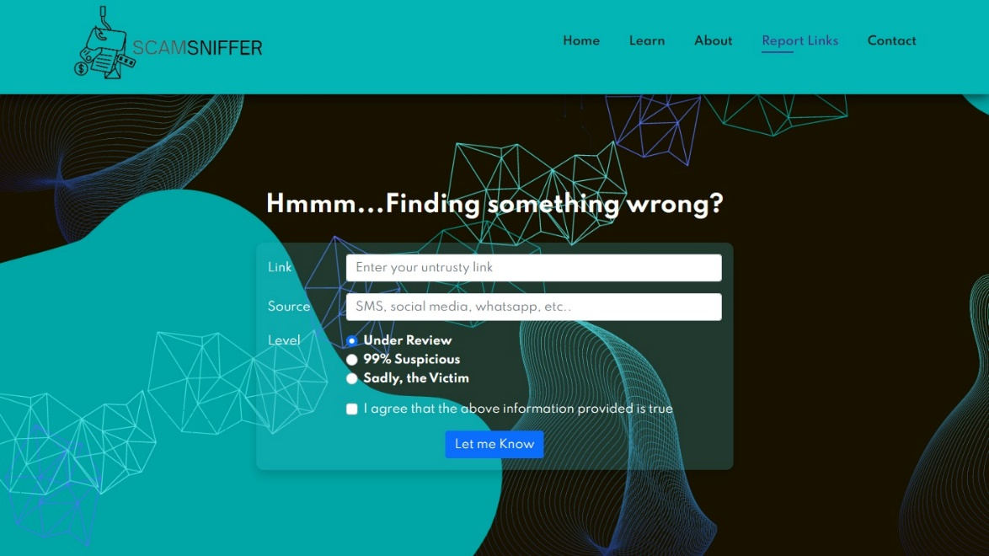
4. About Page
Mission Statement: Details ScamSniffer’s
role in aiding against phishing attacks.
Highlights: User-friendly UI and reliability
in threat detection.
About us
5. Report Link Page
User can give feedback by reporting suspicious
links.
Handling Unsafe Links: Stored in the database
for analysis.
Retraining Algorithm: Triggered for improving
accuracy.

Slide 12
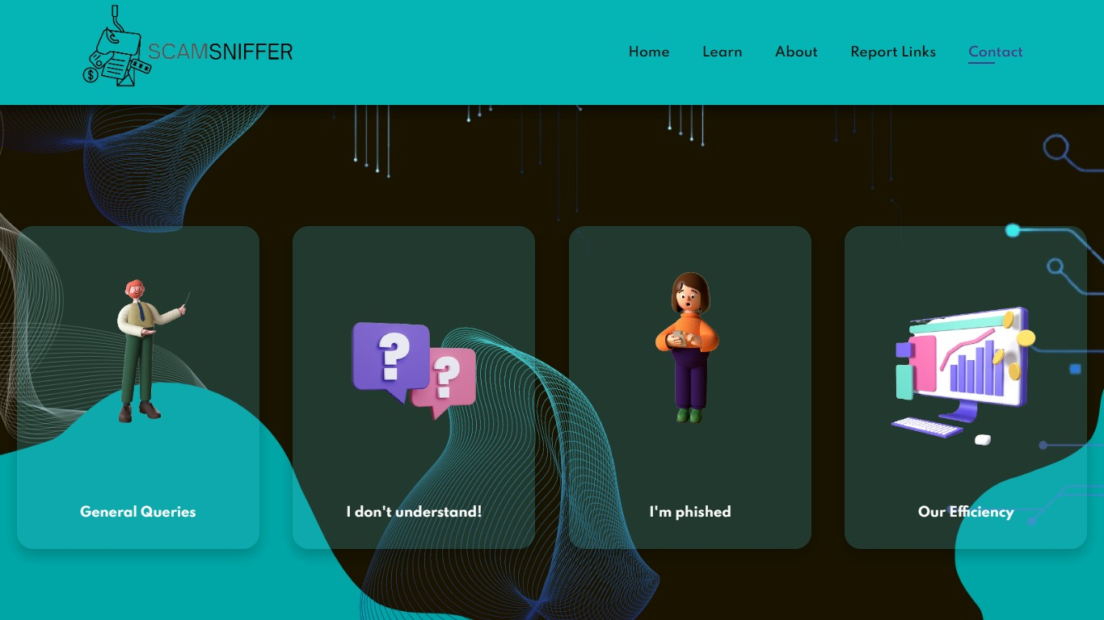
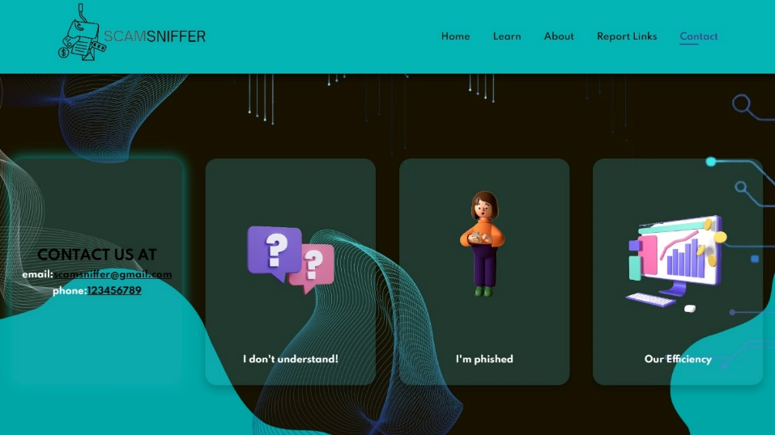
6. Contact Page
Provides multiple contact avenues for user support.
Flip Cards:
General Queries: Contact information provided.
User Education: Directs to Learn page.
Reporting Phishing: Links to cybercrime.gov. to
lodge complaint
Efficiency Showcase: Highlights ScamSniffer’s
success.
Cards which flips when hovered contains info backside
Flipped card with information

Slide 13
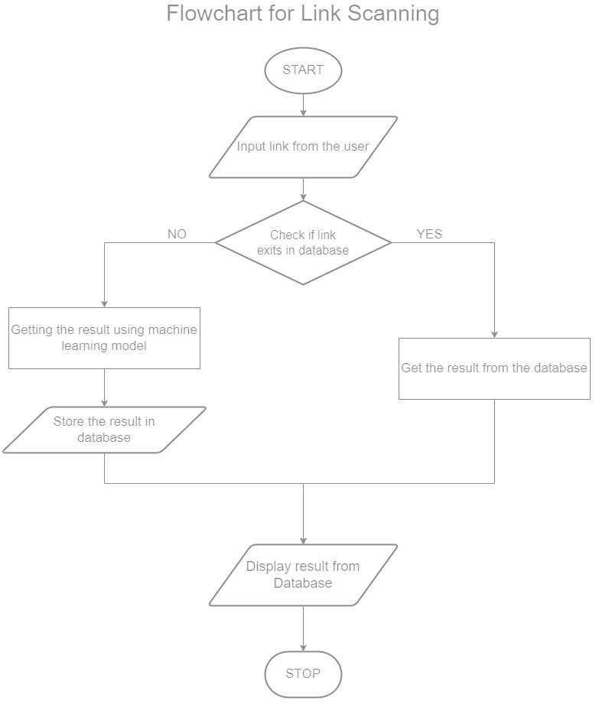
2. Phishing Detection Mechanism
1. Input Method
Link Pasting Box on Home Page: Allows quick submission of suspicious links.
2. Processing: Link Analysis Workflow
Triggers link analysis upon "Scan" button activation.
Analyzes URL elements and metadata for potential risks.
3. Random Forest Classifier
Utilization for Classification: Primary algorithm for link classification.
Reasons for Choosing Random Forest:
Robustness and accuracy in ensemble learning.
Manages multiple URL parameters effectively.
Minimizes false positives and negatives.
Handles imbalanced datasets efficiently.
Maintains precision and recall balance.
Facilitates continuous model improvement.
4. User Interaction
Education page
Covers various phishing types, signs, and causes.
Engages users with quizzes and easy explanations.
Tailored content for different technical levels.

Slide 14
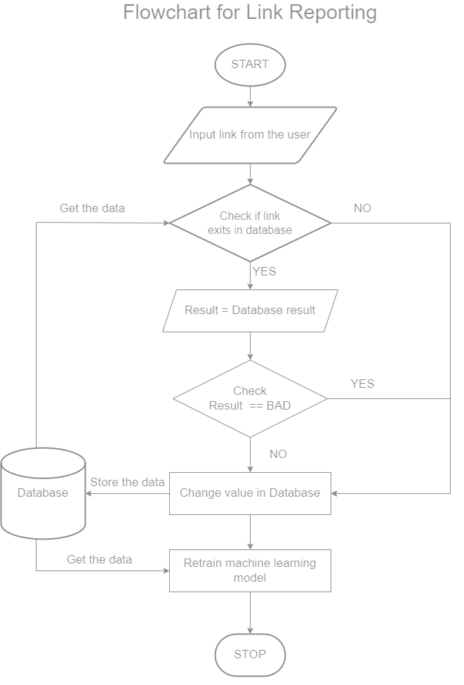
2. Contact Us
Consists of Support Channels
Displayed contact details for traditional communication.
3. Report link feature
Functionality: Allows reporting of suspicious links.
Impact on System Learning:
Stores user-reported data for system learning.
Triggers machine learning model retraining.
Facilitates continuous system improvement.
4. Data Handling and Machine Learning
1. Data Collection
User Reports:User feedback on links (safe/unsafe).
Database Storage:Captures link details and user feedback.
2. Model Retraining
Trigger: Conflicting user reports initiate retraining.
Data Preparation: Extracts features and labels for training.
Model Fine-Tuning: Adjusts parameters using reported data.
Evaluation:Tests retrained model performance.

Slide 15
3. Improvements
Enhanced Accuracy: Learns from user feedback for better accuracy.
Reduced False Flags: Aims to minimize false positives/negatives.
Adaptability: Evolves against emerging phishing threats.
5. Evaluation and Validation
1. Performance Metrics
Accuracy: Overall correctness of classifications.
Precision: Correctly identified unsafe links.
Recall (Sensitivity): Identifying actual unsafe links.
2. System Validation
Holdout Validation:
Dataset split for training and validation.
Model tested on new, unseen data.
Iterative evaluation for continuous improvement.
6. Ethical Considerations
1. User Privacy
Limited Access
Anonymizing User Data
User Education
7. Challenges and Future Work
1. Challenges
Limited Training Data
Data Imbalance
Adapting to Evolving Threats
User-Friendly Interface
Feedback Loop Engagement
2. Future Enhancements
Enhanced Machine Learning
User Experience and Engagement
Privacy and Security Measures
Continuous Improvement Framework

Slide 16
Objectives
Phishing Link Analysis : We use Random Forest Classifier
Objective: Distinguish between legitimate and malicious links.
Machine Learning Techniques: Real-time analysis using ML.
2. User-Friendly Interface : Focused on creating Intuitive design for all user levels.
3. Real-time Warning System: Rapid alerts for suspicious links.
Target Audience: Elderly users' protection.
4. User Education:
Objective: Educate users on phishing tactics.
Empowerment: Knowledge for online safety.
5. Feedback Mechanism: Reporting System
Objective: Engage users in continuous improvement.
Enhancing Detection using User-contributed data.

Slide 17
6. Database Integration: Secure Data Handling
Objective: Maintain user feedback confidentiality.
Enhanced Detection: Utilizing reported data.
7. Machine Learning Integration: Adaptive Algorithms
Objective: Evolving detection capabilities.
Continuous Updates: Staying ahead of evolving threats.
8. User Support: Incorporating help and support features within the tool to guide users in case of confusion or queries.
9. Testing and Validation:
Objective: Rigorous Testing ensuring effectiveness across scenarios.
User Feedback Integration: Refining tool based on user inputs.

Slide 18
System Design & Implementation
1. System Design & Components:
Link Scanning with ML Model:
ML analyses URLs for phishing.
Utilizes URL features for effectiveness.
Centralized Data Store:
Stores scan results and user reports.
Basis for system intelligence and learning.
Educational Learning Module:
Teaches phishing tactics.
Engages users with interactive content.
User-Driven Reporting:
Users report suspicious links.
Improves real-time threat response.

Slide 19
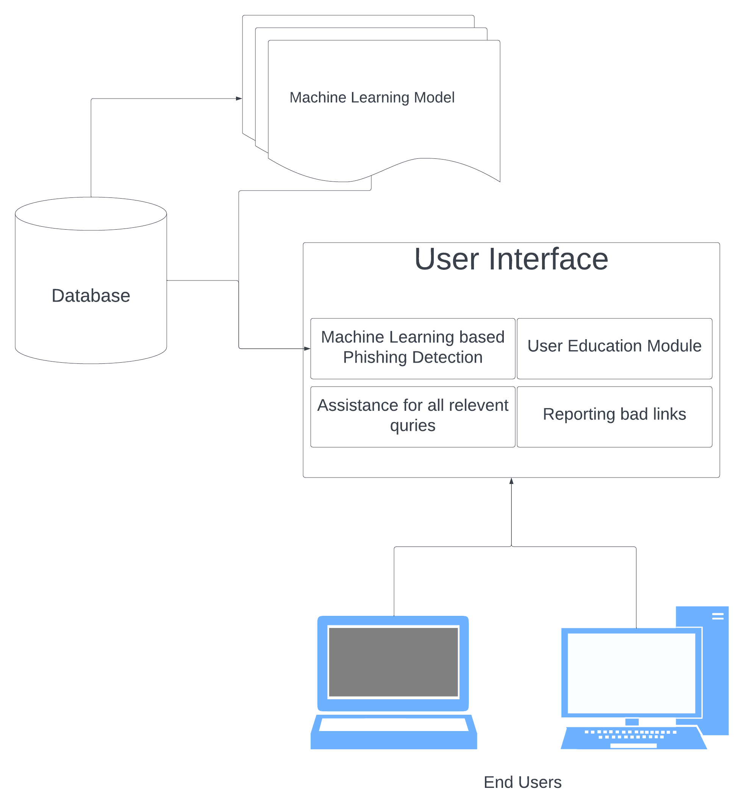
Accessible Help & Support
User-friendly query resolution.
Guides users on phishing awareness.
2. Machine Learning & Features:
1. Random Forest Classifier
Uses ensemble learning.
Analyzes 30 key URL parameters:
Index, UsingIP, LongURL, ShortURL,
Symbol@, Redirecting//, PrefixSuffix-,
SubDomains, HTTPS, DomainRegLen,
Favicon, NonStdPort, HTTPSDomainURL,
RequestURL, AnchorURL, LinksInScriptTags,
ServerFormHandler, InfoEmail, AbnormalURL,
WebsiteForwarding, StatusBarCust,
DisableRightClick, UsingPopupWindow,
IframeRedirection, AgeofDomain,
DNSRecording, WebsiteTraffic, PageRank,
GoogleIndex, LinksPointingToPage.

Slide 20
2. Dataset & Attributes
Carefully selected attributes.
Enhances model prediction accuracy.
3.Model Retraining & Updates
Uses updated dataset for retraining.
Adapts to emerging phishing trends.
4. User Contributions
Active user feedback loop.
Real-time threat mitigation.
3. System Architecture & Tech Stack:
1. Backend Components
Powered by Django framework.
Manages link detection & user data.
2. Frontend Interface
Utilizes HTML/CSS/JavaScript.
Focuses on user experience & interaction.
3. Technology Stack
Python for backend & ML.
Django framework for backend efficiency.
PostgreSQL for robust data management.

Slide 21
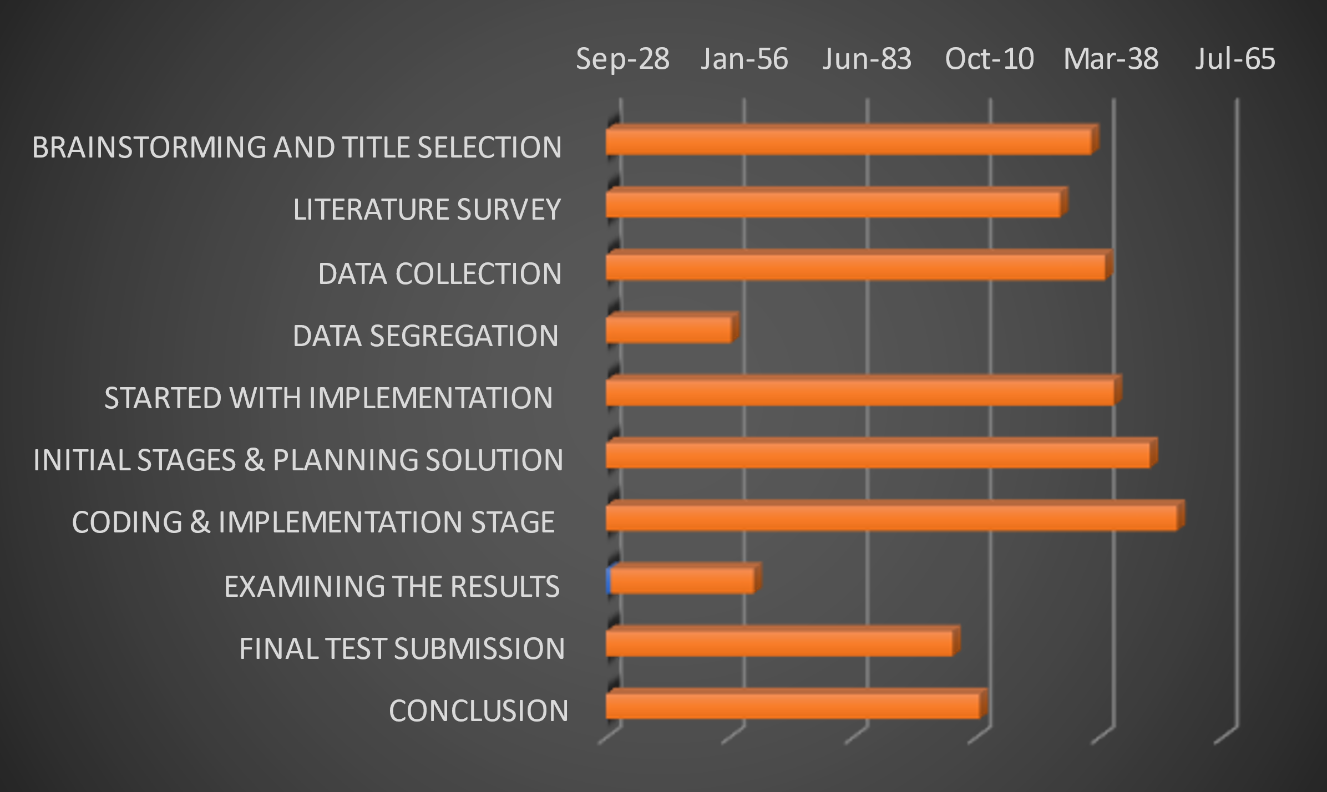
Timeline of Project
TASK ID | TASK DESCRIPTION | START DATE | END DATE
1 | BRAINSTORMING AND TITLE SELECTION | Sep-28 | Oct-07
2 | LITERATURE SURVEY | Oct-08 | Oct-20
3 | DATA COLLECTION | Oct-13 | Oct-25
4 | DATA SEGREGATION | Oct-25 | Oct-30
5 | STARTED WITH IMPLEMENTATION | Oct-19 | Oct-21
6 | INITIAL STAGES & PLANNING SOLUTION | Oct-23 | Oct-25
7 | CODING & IMPLEMENTATION STAGE | Oct-26 | Oct-28
8 | EXAMINING THE RESULTS | Oct-29 | Oct-31
9 | FINAL TEST SUBMISSION | Nov-01 | Nov-03
10 | CONCLUSION | Nov-04 | Nov-06

Slide 22
Outcomes / Results Obtained
1. Functionalities Overview:
Homepage Scan Feature: Allows link evaluation for user safety.
Learn Page Education: Comprehensive info on phishing signs and causes.
Trust Establishment: About page enhances user trust in ScamSniffer.
Report Links Feature: User engagement for potential model retraining.
Interactive Contact Page: Diverse user support options.
2. Impact of Features:
User-Centric Approach: Empowers users with phishing awareness.
Trust Establishment: Builds reliability and user confidence.
Feedback Mechanism: Enhances accuracy through user inputs.
Interactive Contact: Promotes user engagement and support access.
3. System Performance:
Algorithm Responsiveness: Adaptability to conflicting user reports.
User Support: Comprehensive assistance and cyber cell recourse.
4. Future Considerations:
Continuous Improvement: Enhancing user interaction and real-time model adaptation.

Slide 23
Conclusion
1. Holistic Approach:
Extensive Research: Comprehensive exploration and systematic design.
User Awareness: Empowering users to identify and thwart risks.
2. Technological Innovation:
AI/ML Detection: Cutting-edge systems for phishing prevention.
Adaptive Security: Evolving to counter new and emerging threats.
3. Community Collaboration:
Collaborative Frameworks: Shared insights and collective efforts.
Community-Driven Approach: Fostering a united front against cyber threats.
4. Cybersecurity Advancements:
Strengthened Defenses: Lowered risk of phishing attacks.
Blueprint for Security: A model for a more secure digital environment.

Slide 24
References
“No phishing with the wrong bait: reducing the phishing risk by address separation,” IEEE Conference Publication | IEEE Xplore, Sep. 01, 2020.
“Preventive techniques of phishing attacks in networks,” IEEE Conference Publication | IEEE Xplore, Feb. 01, 2020.
M. F. Ansari, P. K. Sharma, and B. Dash, “Prevention of phishing attacks using AI-Based cybersecurity awareness training,” International Journal of Smart Sensors and Ad Hoc Networks, pp. 61–72, Mar. 2022, doi: 10.47893/ijssan.2022.1221.
S. Bojjagani, D. R. D. Brabin, and P. V. V. Rao, “PhishPreventer: A Secure Authentication Protocol for Prevention of Phishing Attacks in Mobile Environment with Formal Verification,” Procedia Computer Science, vol. 171, pp. 1110–1119, Jan. 2020, doi: 10.1016/j.procs.2020.04.119.
Z. Alkhalil, C. Hewage, L. Nawaf, and I. Khan, “Phishing Attacks: a recent comprehensive study and a new anatomy,” Frontiers in Computer Science, vol. 3, Mar. 2021, doi: 10.3389/fcomp.2021.563060
Bhavsar, V., Kadlak, A., & Sharma, S. (2018). Study on phishing attacks. International Journal of Computer Applications, 182(33), 27–29. https://doi.org/10.5120/ijca2018918286
University of Nebraska at Omaha. (2015). Phishing and Online Banking Attack Trends. DigitalCommons@University of Nebraska - Omaha.
Patil, K., & Arra, S. R. (2022). Detection of Phishing and User Awareness Training in Information Security: A Systematic Literature Review. 2022 2nd International Conference on Innovative Practices in Technology and Management (ICIPTM), 2, 780–786. https://doi.org/10.1109/ICIPTM54933.2022.9753912

Slide 25
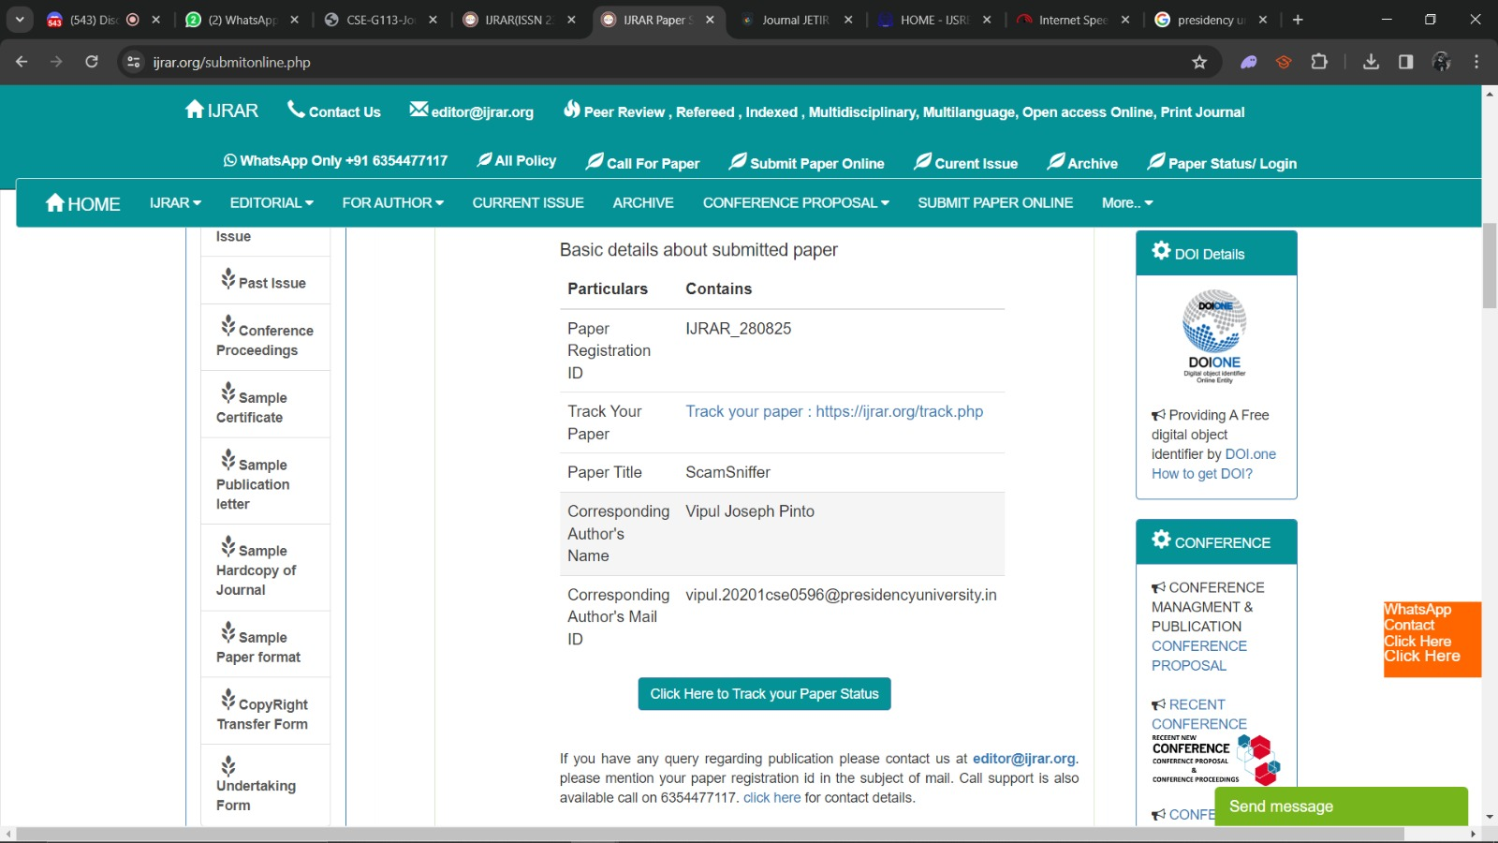
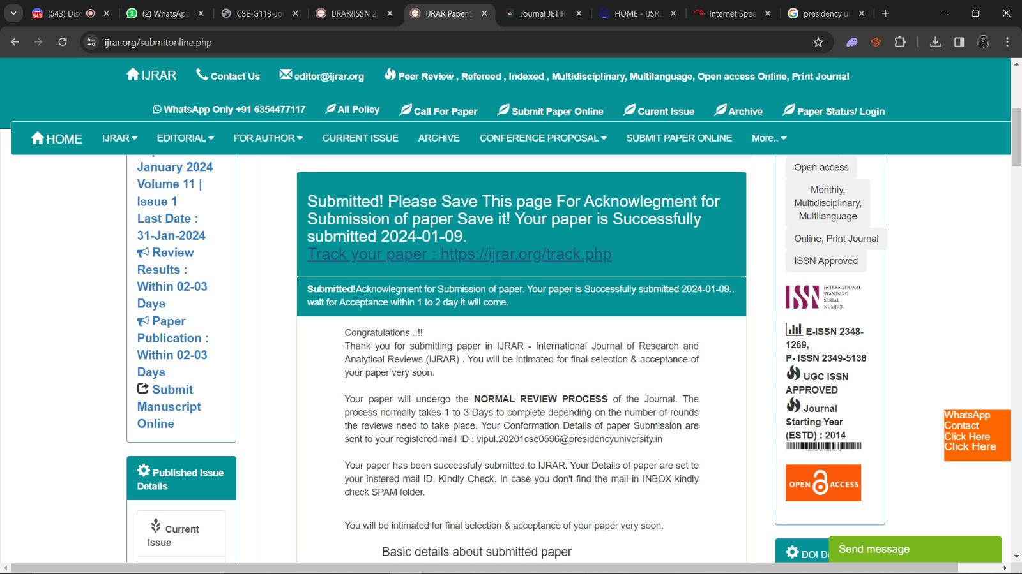
Publication Details

Slide 26

Thank You

