Slide 1

BIG MART SALES PREDICTION
By-
Mendu Mahesh
Shreyash Mishra
Vipul Shinkar
Nishi Kumari
Purushottam Agarwal

Slide 2
Abstract
In today's world big malls and marts record sales data of individual items for predicting future demand and inventory management.
This data Stores a large number of attributes of the item as well as individual customer data together in a data warehouse.
This data is mined for detecting frequent patterns as well as anomalies.
This data can be used for forecasting future sales volume with the help of random forests and multiple linear regression model

Slide 3
Problem statement
BigMart, a prominent retail company, has embarked on a journey to enhance its sales strategy by leveraging data-driven insights. In 2013, the company collected comprehensive sales data from 10 stores across different cities, encompassing 1559 distinct products.
The overarching goal of this analysis is to construct a predictive model capable of forecasting the sales of individual products within each store. By dissecting the intricate relationship between product characteristics, store attributes, and sales figures, BigMart aims to pinpoint the key factors influencing sales.
These insights will not only unravel the underlying patterns governing sales but will also equip BigMart with actionable intelligence to tailor its marketing strategies, optimize product placement, and ultimately amplify sales and revenue.

Slide 4
Data Exploration
Column Attributes | Summary
Item Identifier | Unique product ID
Item Weight | Weight of product
Item Fat Content | Whether the product is low fat or not
Item Visibility | The % of total display area of all products in a store
Item Type | The category to which the product belongs
Item MRP | Maximum Retail Price (list price) of the product
Outlet Identifier | Unique store ID
Outlet Establishment Year | The year in which the store was established
Outlet Size | The size of the store in terms of ground area covered
Outlet Location Type | The type of city in which the store is located
Outlet Type | Whether the outlet is a grocery store or a supermarket
Item Outlet Sales | Sales of the product in the particular store

Slide 5
Software Requirement specification
Numpy - It has advanced math functions and a rudimentary scientific computing package.
Pandas - is a must for data-science. It provides fast, expressive, and flexible data structures to easily (and intuitively) work with structured (tabular, multidimensional, potentially heterogeneous) and time-series data.
Matplotlib, Seaborn and Plotly - These library helps with data analyzing, and is a numerical plotting library.
Scikit-learn - is an open-source machine learning library for Python that provides simple and efficient tools for data mining and data analysis, with various classification, regression, clustering algorithms.

Slide 6
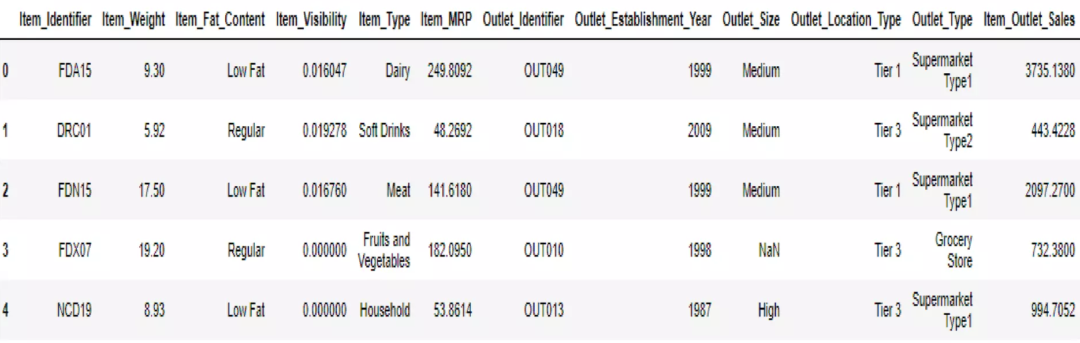
QUICK LOOK AT THE DATA Structure
import numpy as np
import pandas as pd
import matplotlib.pyplot as plt
%matplotlib inline
import seaborn as sns
import warnings
warnings.filterwarnings("ignore")

Slide 7
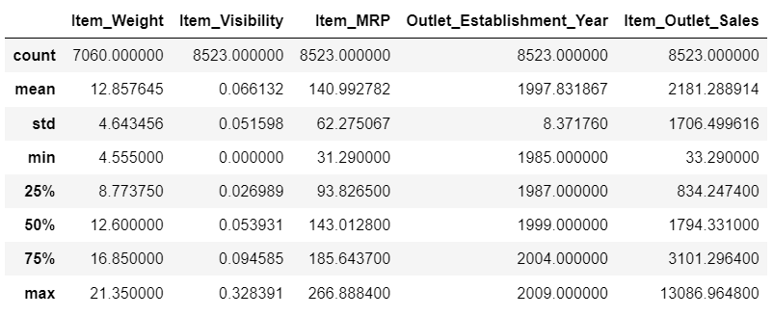
Most of the items in the dataset present 8523 non-null values. However, there are some cases such as Item Weight and Outlet Size which seem to present null values. We always have to consider if this absence of values has a significant meaning or not.
Moreover, from the 12 features, 5 are numeric and 7 categorical,
train.describe()

Slide 8
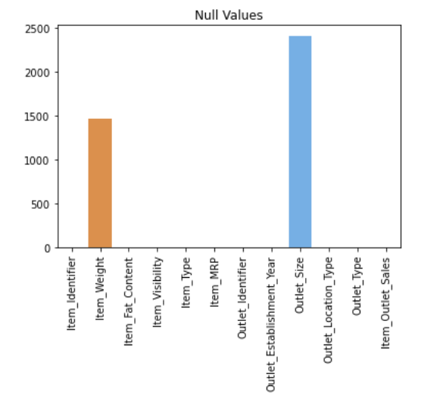
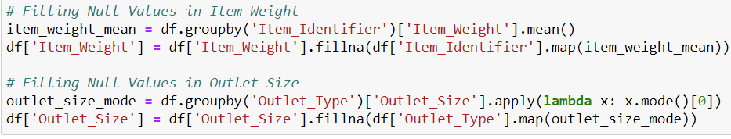
DATA Cleaning
This step typically involves imputing missing values, treat irregularities and treating outliers.
We found two variables with missing values - Item Weight and Outlet Size. Let’s impute the former by the average weight of the particular item.

Slide 9
Item Fat Content contains some mis code values
In Item Visibility, We noticed that the minimum value here is 0, which makes no practical sense. Lets consider it like missing information and impute it with group mean visibility of that product.
Using the unique Item Identifier, which starts with "FD," "DR," or "NC," we can categorize items into Food, Drinks, and Non-Consumables, respectively, and create a new column for these categories.

Slide 10
Three categories of (Food, Non-Consumables and Drinks).We will use this ‘Non Consumable' category to represent the ‘Fat Content' which will be 'Non-Edible’.
As we can see establishment year, let’s calculate the age of the stores. By subtracting the establishment year from the current year (2023), we obtain the number of years that have passed since the outlet was established, giving us an indication of its age. This information might be used to understand patterns related to the outlet's performance

Slide 11
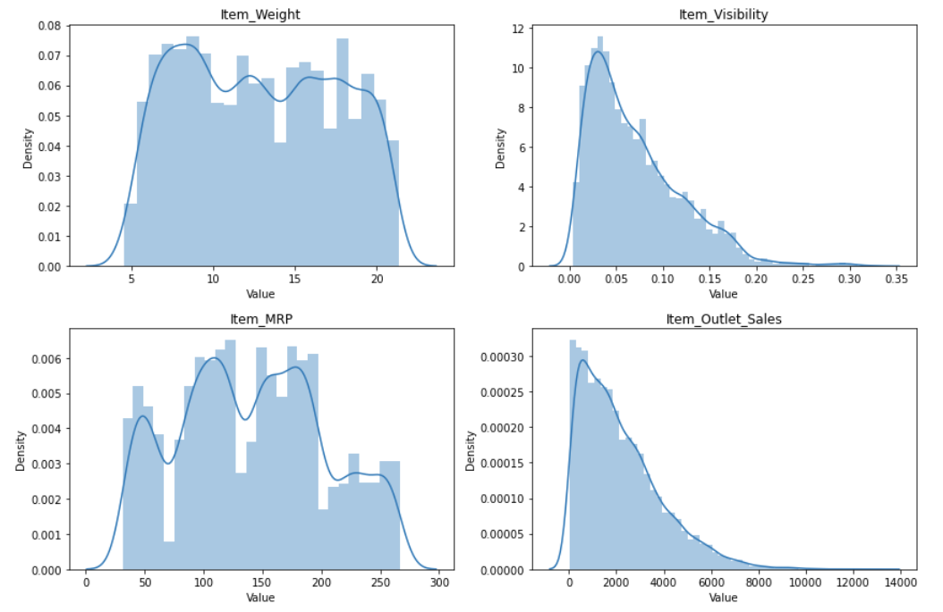
DATA visualization
This step typically involves graphical representation of information and data, using visual elements like charts, graphs, and maps, to provide an accessible way to see and understand trends, outliers, and patterns in data.

Slide 12
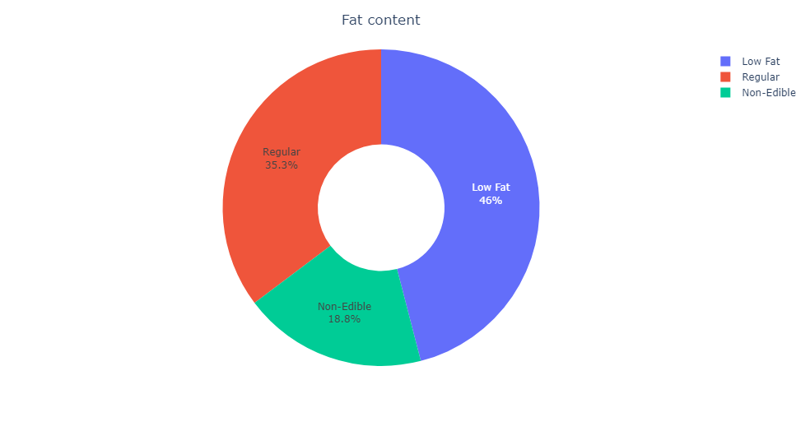
We see that about 46 % items are of low fat. This assumes that nearly half of customers are health conscious and prefer food with lower fat rating.

Slide 13
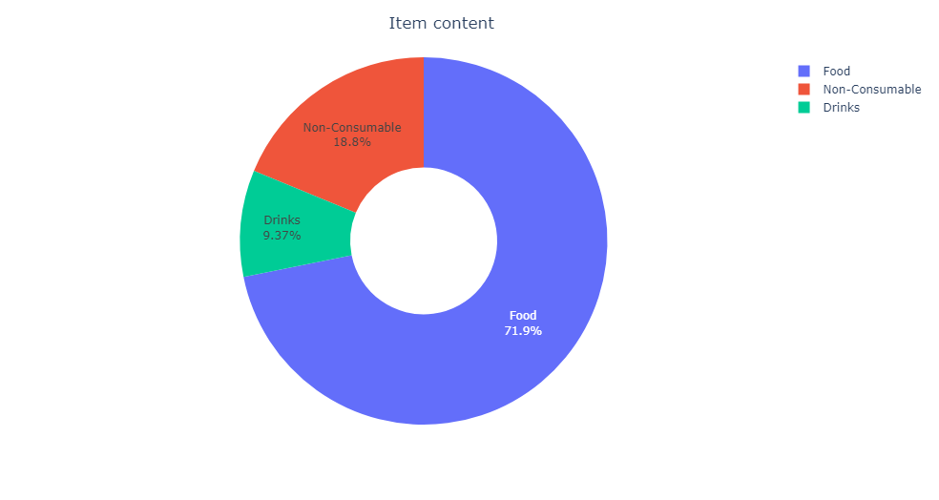
Sd
Around 72% items in the store are under food category

Slide 14
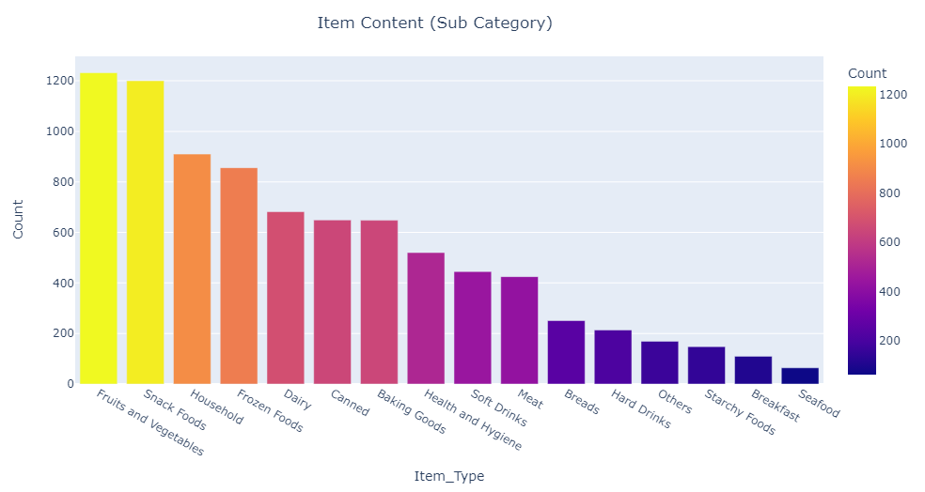
Aafa
From the above plot, we see that fruits and vegetables were the highest sold item followed closely by Snack foods

Slide 15
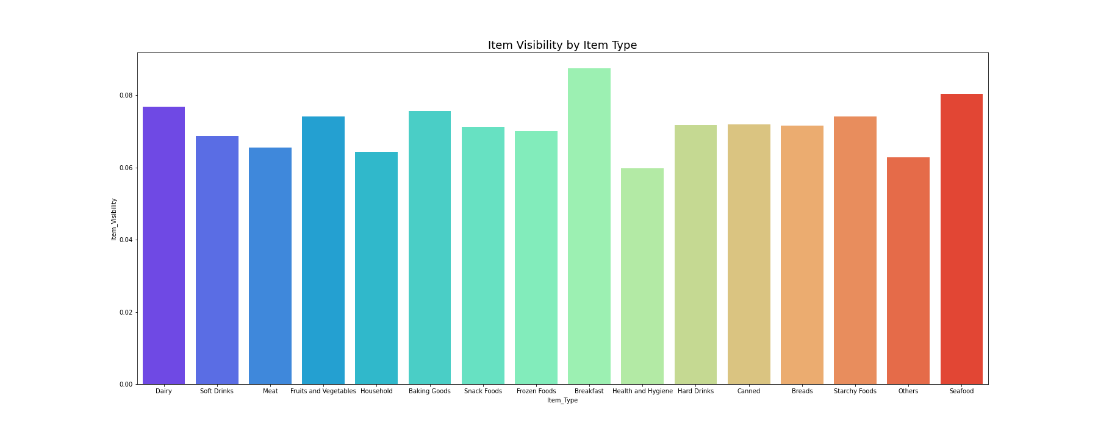
From the above plot, we see that Breakfast item type has the most item visibility.

Slide 16
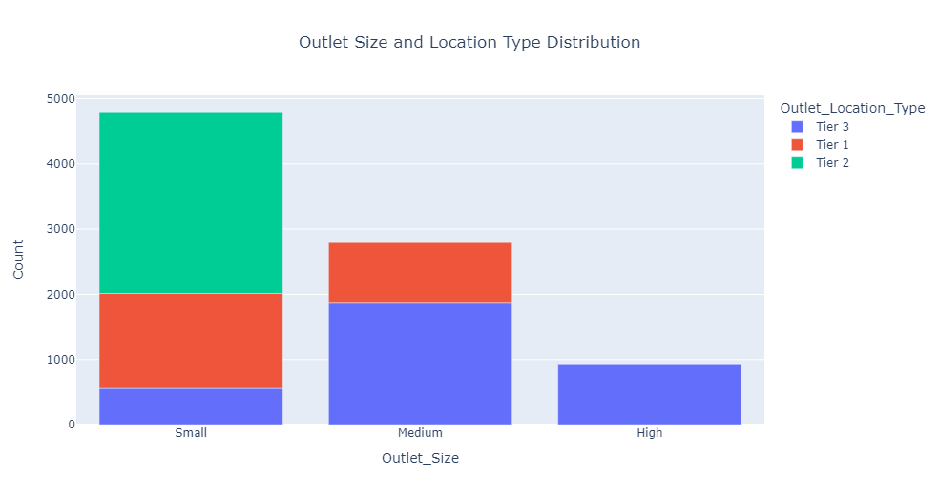
The above count plot shows that the "Small" outlet size is present in all the locations and has the highest store count in comparison to "Medium" and "High."

Slide 17
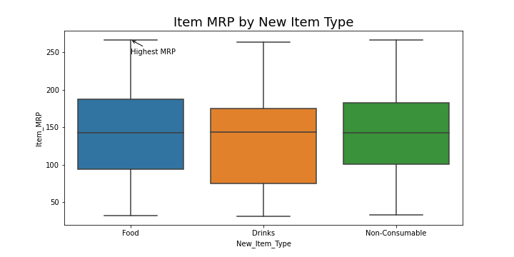
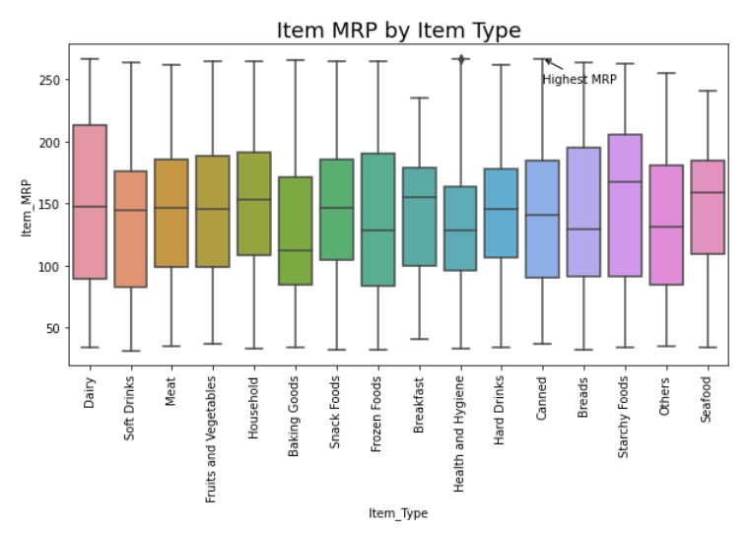
In this boxplot comparison shows that Food category has the highest MRP
From the above boxplot, shows that Canned Item Type has the highest MRP

Slide 18
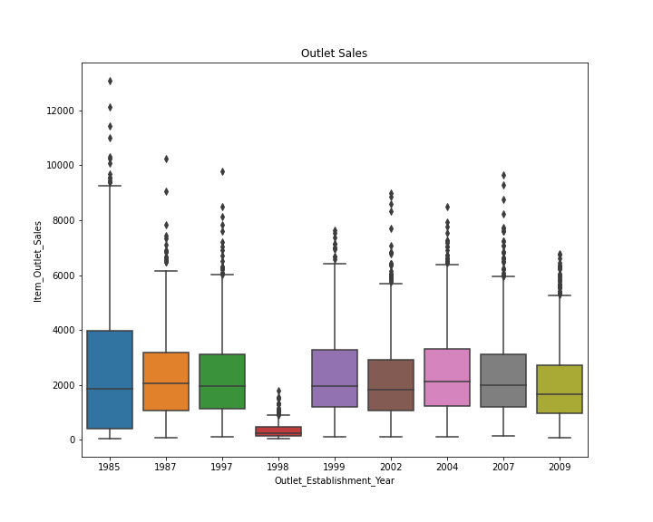
As it can be seen, the sales reported by the older stores is higher than the relatively newer stores (except for the 1998 established store).

Slide 19
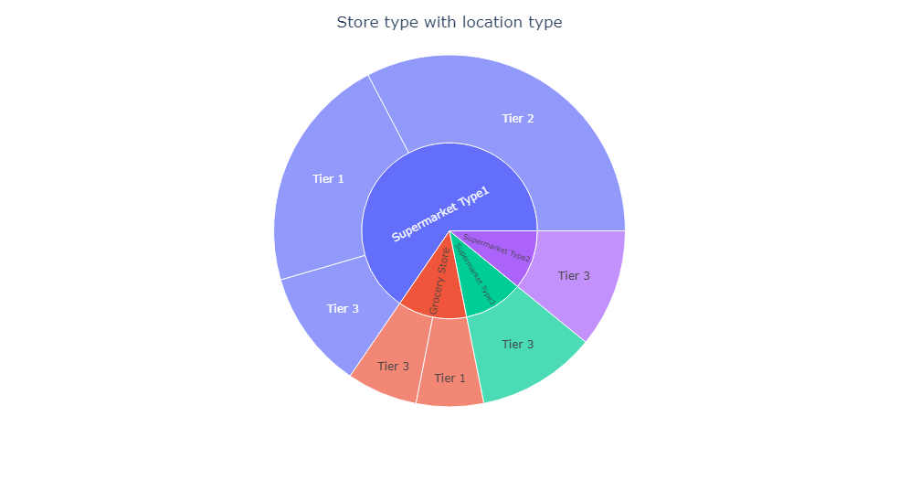
Edad
As we can see, majority of the stores are of type 1 supermarket distributed over various location tiers.
Supermarket type 2 and 3 are confined to only tier 3 locations. Very small section of the stores are actually grocery stores.

Slide 20
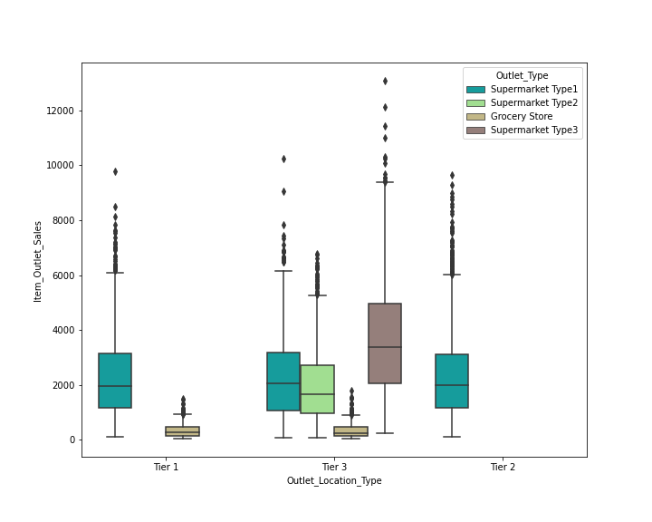
As we can see, tier 3 locations seem to be selling better than both tier 2 and tier 1. It is also to be noted that tier 3 has more number of stores in it. Hence, the sales are better too.

Slide 21
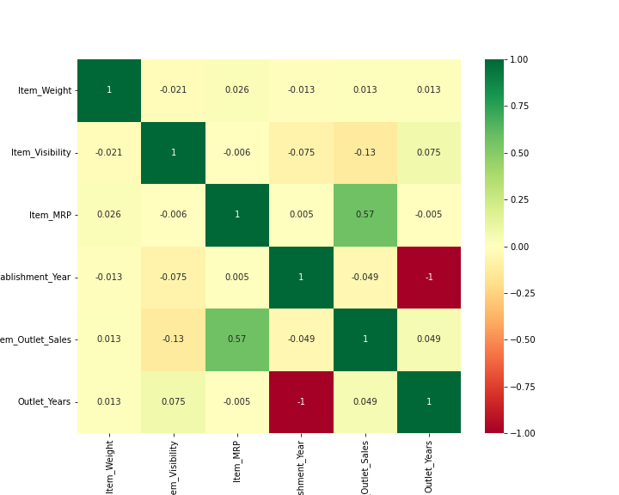
'Item MRP' has a high positive correlation with 'Item Outlet Sales', this indicates that items with a higher maximum retail price tend to have higher sales.

Slide 22

Changing categorical to numerical
Converting categorical data into numerical format is a common preprocessing step in machine learning. Two popular techniques for doing this are label encoding and one-hot encoding
Label Encoding: Label encoding assigns a unique integer to each category of a given feature. It is particularly useful for ordinal data where the order matters.
One-Hot Encoding: One-hot encoding creates binary columns for each category and returns a matrix with binary values representing the presence of each category. It is suitable for nominal data where no ordinal relationship exists.

Slide 23
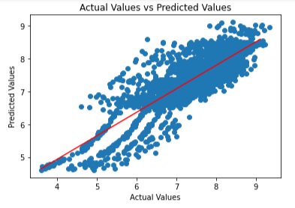
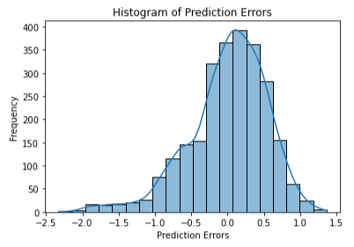

Linear regression
Linear regression is a supervised machine learning algorithm that models the relationship between a dependent variable and one or more independent variables by fitting a linear equation to observed data.
We applied Linear Regression Model in our dataset:

Slide 24
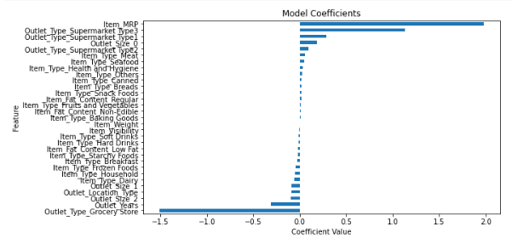
The positive values are attributes with positive coefficients and negative values are attributes with negative coefficients.
There are minor values between positive and negative coefficients. This indicates that the center attributes do not provide significant information.

Slide 25
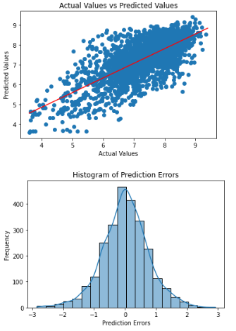

Decision Tree
A decision tree is a supervised machine learning algorithm that uses a tree-like graph of decisions and their possible consequences to make predictions or classify data.
We applied Decision Tree Regressor in our dataset:

Slide 26
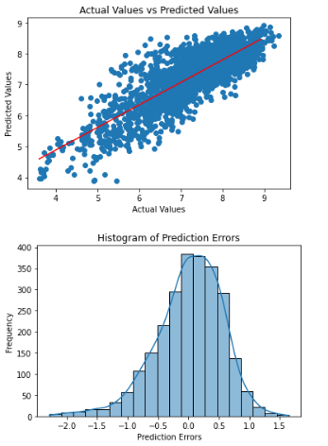

RANDOM FOREST
Random Forest is an ensemble learning method that combines multiple decision trees to create a more accurate and robust prediction model.
We applied Random Forest Regressor in our dataset:

Slide 27
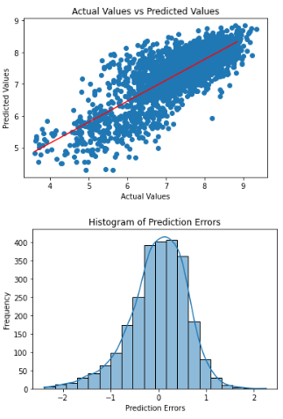

k-Nearest Neighbors (k-NN)
The k-Nearest Neighbors (k-NN) algorithm is a type of instance-based learning that classifies a data point based on how its neighbors are classified, with "k" representing the number of neighbor data points considered.
We applied KNeighborsRegressor in our dataset:

Slide 28
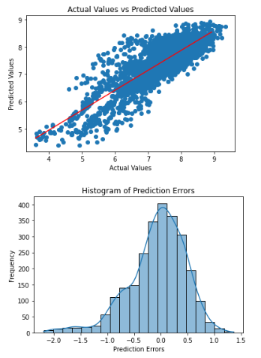

Support Vector Machine (SVM)
Support Vector Machine (SVM) is a supervised machine learning algorithm that finds the optimal hyperplane to separate different classes by maximizing the margin between the closest points of the classes, known as support vectors.
We applied SVM Regressor in our dataset:

Slide 29
FINDINGS & conclusion
Out of all the machine learning algorithms, SVM performed well, followed by linear regression.
This research proposed a framework that predicts mart's sales using a machine learning model and different techniques.
Further, in the future, a retailer checks the score of a specific product by entering product attributes and its store's information, like location, and culture.
Also, we consider an online App for the customer's review regarding the stores and specific products for future work. This App works as a ranking App. Customers rank the stores by giving feedback; this helps the other customers to move on towards the stores. Sort of forum allows checking the demand for a specific store's specific product.
ML Algorithms | R2 Square | Adjusted R2 Square
Linear Regression | 71.12% | 70.80%
Decision Tree | 45.12% | 44.44%
Random Forest | 69.60% | 69.22%
K-NN | 63.50% | 63.05%
SVM | 71.61% | 71.26%

Slide 30


