Slide 1


Bank of Baroda Hackathon - 2022
Technology Partner
Team Name : PiXel
Team bio :
Vipul is a great leader and a hardworking student who always finds his way to the top. | Jagrit is a very bright and quick-witted student and is always eager to learn.
Shreyas is a brilliant student who is always ready to face new challenges. | Sheral: An analytical person who seeks to explore and is always ready to learn. Passionate about solving challenges that involve data, algorithms, statistics ,math and visualisation

Slide 2
Problem Statement?
We decided to solve this problem because on any normal day, a leading bank receives around 3-5 lakhs of cheques for clearance. Being an intricate process, it involves multiple levels of screening and vigilance to ensure regulatory guidelines are met. For all these reasons, major parts of this process are manual in nature till date. A manual review of high volume of cheques is time consuming since most verification happens at odd hours of the nighttime; it is also prone to human errors. The main purpose behind AI based cheque clearance system is to reduce the processing time while also making the process less prone to errors and possible frauds due to collusion. We plan on designing an automated system that will make this process completely smooth and flawless.
Basically, we need to execute the following steps in an efficient manner in our project:
Extract all the handwritten information on the cheque
Extract the signature present in the cheques
Verify the signature present in cheque with that of in the Organization's database
Validate the information against the business rules deemed by the organization
Detecting a fraud or bounced cheque

Slide 3
User Segment & Pain Points
Which user /advertiser segment would be early adopter of your product & why?
The Small Financing or Banking Associates would be our early adopters. These low-budget sectors require services that have a low cost of deployment and, at the same time, the respective services should have a low processing time and highly efficient in comparison to their human counterparts.
The mainstream banking sector can be directly targeted if the proposed solution to the problem is more appealing and, at the same time, scalable in terms of application.The sector has high expenses in this manual human work, which they seek to cut through modern technology.

Slide 4
Pre-Requisite
What are the alternatives/competitive products for the problem you are solving?
Every bank has a signature capture software. This software facts the clients’ signature at the time of account beginning. If the software program detects any discrepancy then the financial institution dishonors your cheque. Industry experts say handwritten signature verification is achieved to verify the identification of the customer. Automated popularity of handwritten signatures gained floor while it changed into tough to differentiate real signatures.
After studying thoroughly about the existing technology and software , we could draw inferences that it is prone to threats due to its inefficiencies and vulnerabilities .The existing tech faces a number of problems that fall under user experience, like producing signatures that are corrupted and unrecognizable, which results in the failure of the software competence and capabilities to verify signatures. Other problems include precision and inconsistencies in scanning and storage of the data read from the image/snapshot, adding to it is the associativity discrepancies and incoherence in data matching and so on that lowers the software’s performance and potential.
Our target primarily focuses on eliminating these vulnerabilities and reinforcing as well as improvising existing software in order to upgrade its potential to meet the ever growing demand of cheque approval and truncation.
The following is the link for the reference to the software used:
https://docs.oracle.com/cd/E74659_01/html/Sign_Verify/SV04_SignVerify.htm

Slide 5
Azure tools or resources
Visual Studio Code: A standalone source code editor that runs on Windows, macOS, and Linux. The top pick for JavaScript and web developers, with extensions to support just about any programming language.
Azure Docker: The Docker Azure Integration enables developers to use native Docker commands to run applications in Azure Container Instances (ACI) when building cloud-native applications. The new experience provides a tight integration between Docker Desktop and Microsoft Azure allowing developers to quickly run applications using the Docker CLI or VS Code extension, to switch seamlessly from local development to cloud deployment.
Azure Grid Event: Grid is a highly scalable, serverless event broker that you can use to integrate applications using events. Events are delivered by Event Grid to subscriber destinations such as applications, Azure services, or any endpoint to which Event Grid has network access. The source of those events can be other applications, SaaS services and Azure services. One can use filters to route specific events to different endpoints, multicast to multiple endpoints, and make sure your events are reliably delivered.
Azure Developer Portal: The developer portal is an automatically generated, fully customizable website with the documentation of your API. Provides tools that makes life easy as it provides assistance while sketching out layouts and wireframes as well as during styling and customizing our applications
Azure Kinect is a cutting-edge spatial computing developer kit with sophisticated computer vision and speech models, advanced AI sensors, and a range of powerful SDKs that can be connected to Azure cognitive services.
Azure-Kinect-Sensor-SDK: required to build this library.ctypes: required to read the library. NumPy: required for the matrix calculations OpenCV-python: Required for the image transformations and visualization.

Slide 6
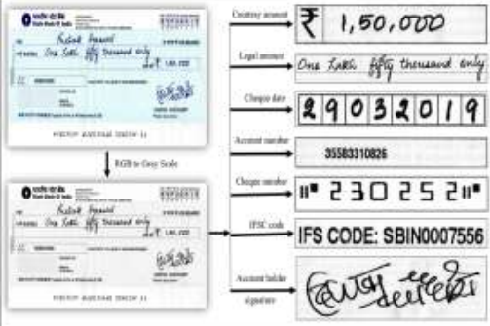
Methodology and Architecture
Present your solution, talk about methodology, architecture & scalability
The image acquisition of a bank cheque is crucial for the CTS (Cheque Truncation System). Generally, flatbed scanners are used to acquire such images. Due to orientation and irregularities presented in the scanned image(s), As we are unable to use the acquired image(s) dire
ctly for the image processing operations therefore it requires some pre-processing step. Image pre-processing [Image preprocessing is a technique used to scan cheque images], as a scanned image obtained from the scanner cannot be directly used thus it is in need of preprocessing, which involves two primary operations, i.e, rotation and removal of unnecessary background information.The process will be as follows:
Segmentation of Cheque -Listing out all the important information in the cheque
Handwritten Text extraction from Cheque
Signature feature extraction and verification

Slide 7
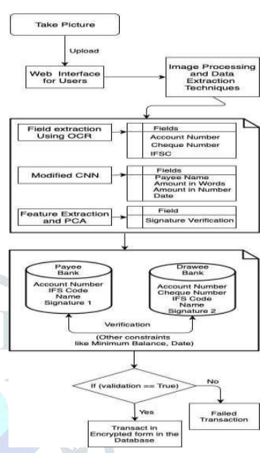
CNN Model for amount identification
After extracting the image segments, CNN model is used for handwritten numeric digits recognition of courtesy amount as well as to convert the legal amount into string. have used Deep Learning Toolbox (a MATLAB toolbox) for CNN implementation on two convolution layers with six and twelve filters

Slide 8
Key Differentiators & Adoption Plan
How is your solution better than alternatives and how do you plan to build adoption?
Uniqueness:Our solution to this problem is better than other solutions discovered as we are going to use OCR method to identify the machine typographic characters with desirable accuracy and efficiency, whereas, we have performed CNN to give precise output for the handwritten digits written on the cheque leaflet and for signature recognition, SIFT and SVM classifier models are used to determine the relevancy for verification of signature and achieved 98.1% accuracy.
Adoption Strategy:We have organized various activities like conducting a survey of a particle bank customers to check how much percentage of people are facing problem with manual cheque processing system. We saw the bank’s database for checking the amount of cheques getting bounced per month and what’s the problem in their system leading to cheque bounce so frequently. This was done to ensure that we don't not face such issues while executing our project. We can also take help of bank IT support team if our project is implemented as real world application.

Slide 9
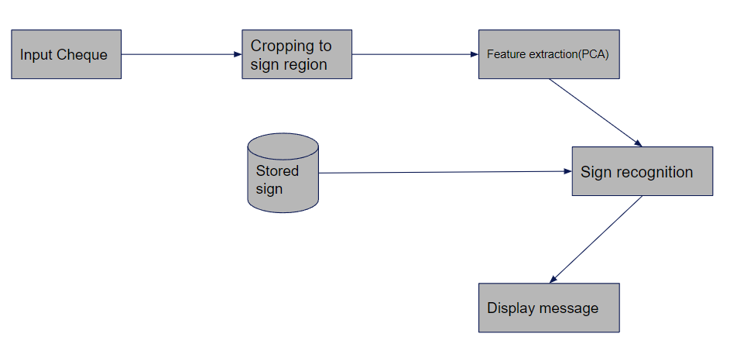
GitHub Repository Link & supporting diagrams, screenshots, if any
How far it can go?
Github Link: https://github.com/VipulTiwari28/Automated-Cheque-Processing
Signature Feature Extraction Diagram

Slide 10
Thank You
Team member names:
Vipul Tiwari
Jagrit Taneja
Shreyas Bhaskar
Sheral Simon Waskar
Date: 13th September 2022

