Slide 1
Optimising Design of Dual and Single Band Antenna using
Deep Learning
Ramesh Chandra Bhanu 211010244 ECE
Vipulesh 211010258 ECE
Dr. Shrivishal Tripathi
International Institute of Information Technology, Naya Raipur

Slide 2
Content
Introduction
Problem definition
Literature Review
Objectives
Proposed Framework
Dataset Description
Results
*
International Institute of Information Technology, Naya Raipur
‹#›

Slide 3
Introduction
The evolution of IoT necessitates unique antennas such as tuned multiple buck antennas to meet changing demands
Machine learning (ML) is revolutionizing antenna design, leveraging its adaptability and power.
Customized ML techniques offer precision and efficiency in automated antenna design processes
Including various antennas like double T-shaped and slot-diff-fed circular antennas enhances the study's applicability in diverse IoT scenarios.
*
International Institute of Information Technology, Naya Raipur
‹#›

Slide 4
Problem Definition/Problem statement
The problem addressed in this paper is the optimization of single and dual-band antenna communication through machine learning (ML) techniques, including DNN, SVM, decision trees, and random forests. These methods aim to enhance antenna design by efficiently selecting parameters and predicting performance across diverse communication applications. The study conducts a comprehensive investigation and comparative assessment of these ML methods against outcomes from the CST Design Studio to validate their precision. Additionally, the paper explores double T-shaped antennas with single-band functionality and slot-diff-fed vias circular antennas with dual-band capability, broadening the investigation's scope to encompass a wider range of antenna designs and applications.
*
International Institute of Information Technology, Naya Raipur
‹#›

Slide 5
Literature Review
1. Machine Learning Techniques for Double T-Shaped Monopole Antenna
Authors: Yashika Sharma, Hao Helen Zhang, and Hao Xin
Proposes ML methods for automatic antenna design optimization, addressing IoT advancements. Develops new ML models,
reviews previous research, and aims to enhance scalability and efficiency in deep learning methods for antennas.
2. Applications of ML and DL in Antenna Design
Authors: Nayan Sarker, Prajoy Podder, M. Rubaiyat Hossain Mondal, Sakib Shahriar Shafin, and Joarder Kamruzzaman
Surveys AI technologies for wireless communication antenna design optimization, focusing on ML/DL algorithms to expedite
design tasks. Discusses EM simulators, optimization techniques, and ML/DL's role in enhancing prediction accuracy and
computational efficiency.
3. Antenna Design Optimization using ML
Authors: Y. Rahmat-Samii and R. Mittra
Reviews recent advancements in ML techniques for optimizing antenna designs, highlighting methodologies like support
vector machines and artificial neural networks. Identifies trends, challenges, and opportunities in ML-based antenna design
optimization.
*
International Institute of Information Technology, Naya Raipur
‹#›

Slide 6
Literature Review
4. Optimization of Conformal Antenna Arrays with ML
Authors: R. P. Torres and L. S. Coelho
Explores ML techniques like genetic algorithms and neural networks for optimizing conformal antenna arrays. Demonstrates ML
algorithms' effectiveness in improving arrays' performance for wireless communication applications.
5. ML-Based Optimization of Dielectric Resonator Antennas
Authors: M. A. Abdalla and S. K. Podilchak
Utilizes artificial neural networks to optimize dielectric resonator antennas, enhancing performance. Presents a novel ML-based
method for achieving optimized designs of dielectric resonator antennas.
6. Multi-objective Optimization of Patch Antenna Arrays with ML
Authors: A. G. Panagopoulos and K. D. Kaklamani
Focuses on patch antenna arrays, exploring multi-objective optimization using ML algorithms. Evaluates techniques like particle swarm
optimization and genetic algorithms for efficient designs of patch antenna arrays.
7. Deep Reinforcement Learning for Antenna Optimization
Authors: S. Chen and X. Tan
Introduces deep reinforcement learning (DRL) for antenna design optimization. Combines DRL algorithms with electromagnetic
simulations for automatic discovery of optimal antenna configurations, demonstrating superior performance and efficiency compared to
traditional methods.
*
International Institute of Information Technology, Naya Raipur
‹#›

Slide 7
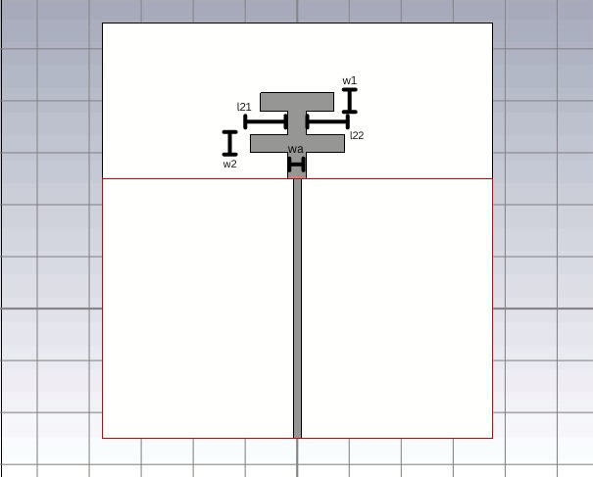
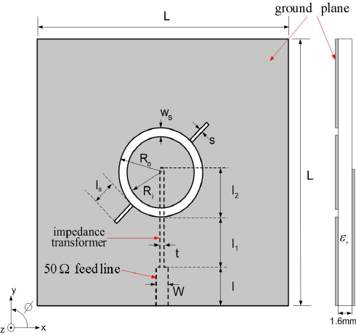
Objectives of the Project
The project explores machine learning (ML) techniques—DNN, SVM, decision trees, and random forests—to optimize single and dual-band antenna communication, enhancing design across various applications. ML outcomes are compared to CST results for precision validation. The study includes double T-shaped and slot-diff-fed vias circular antennas, expanding design investigation.
Double T-shaped antenna
Slot-diff-fed vias circular antenna
*
International Institute of Information Technology, Naya Raipur
‹#›

Slide 8
Proposed Framework/Methodology
Antenna Design Process: The design process utilizes CST Microwave Studio for electromagnetic simulation, incorporating parameters such as antenna geometry, substrate material selection, and feeding mechanism. Optimization techniques are employed to fine-tune antenna dimensions, substrate properties, and feeding parameters for optimal performance across desired frequency bands. Simulation results are analyzed to evaluate performance metrics like impedance matching, radiation pattern, and gain, ensuring alignment with theoretical expectations.
Figure of Merit (FOM) Calculation: The Figure of Merit (FOM) is defined as the sum of absolute values of the reflection coefficient (S11/S12) within specific frequency bands. It is calculated mathematically using frequency points falling within the bands of interest. Design parameters such as antenna dimensions are considered input variables, while FOM serves as the output or response variable. Sensitivity analysis assesses the design's robustness to environmental variations or manufacturing tolerances within defined parameter ranges.
*
International Institute of Information Technology, Naya Raipur
‹#›

Slide 9
Proposed Framework/Methodology
Algorithm Used
1. Linear Regression: Models the relationship between dependent and independent variables using a linear equation. In antenna design, predicts performance metrics based on antenna parameters.
2. Ridge Regression: Handles multicollinearity by adding a penalty term to the least squares regression. Useful in antenna optimization to prevent overfitting.
3. Support Vector Machines (SVM): Finds hyperplane maximizing margin between classes. Applicable in antenna design to classify different configurations based on parameters.
4. Decision Trees: Non-parametric method creating simple decision rules for classification or regression tasks. Useful in antenna design for decision-making based on antenna parameters.
5. Random Forest Regressor: Meta-estimator improving predictive accuracy by averaging decision tree regression on dataset sub-samples.
6. Deep Neural Networks (DNN): Composed of multiple layers of neurons, used in antenna design to predict performance metrics based on parameters
*
International Institute of Information Technology, Naya Raipur
‹#›

Slide 10
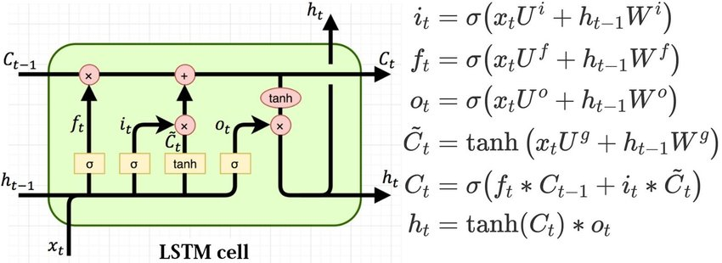
Proposed Framework/Methodology
Algorithm Used
7. Recurrent Neural Networks(LSTMs): An LSTM network
is a type of recurrent neural network that has a special
kind of neuron (LSTM cell) capable of learning long-term
dependencies. The output of an LSTM cell at time t is given
by:
ht = ot ⊙ tanh(ct)
where:
• ht is the output at time t.
• ot is the output gate’s value at time t.
• ct is the cell state at time t.
• ⊙ denotes element-wise multiplication.
In antenna design, the inputs could be the antenna parameters at different times, and the output could be a performance metric
*
International Institute of Information Technology, Naya Raipur
‹#›

Slide 11
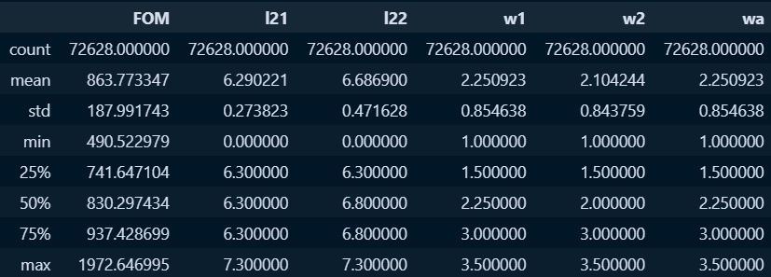
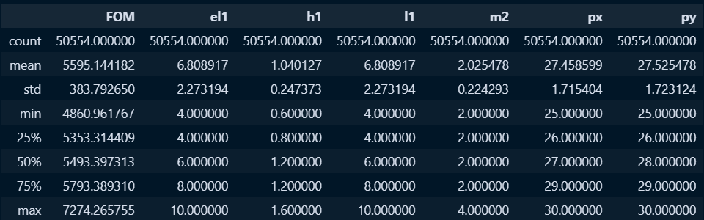
Dataset Description
Description of dataset for Double T-shaped Antenna
Description of dataset for Slot-Diff-Fed vias Circular Antenna
*
International Institute of Information Technology, Naya Raipur
‹#›

Slide 12
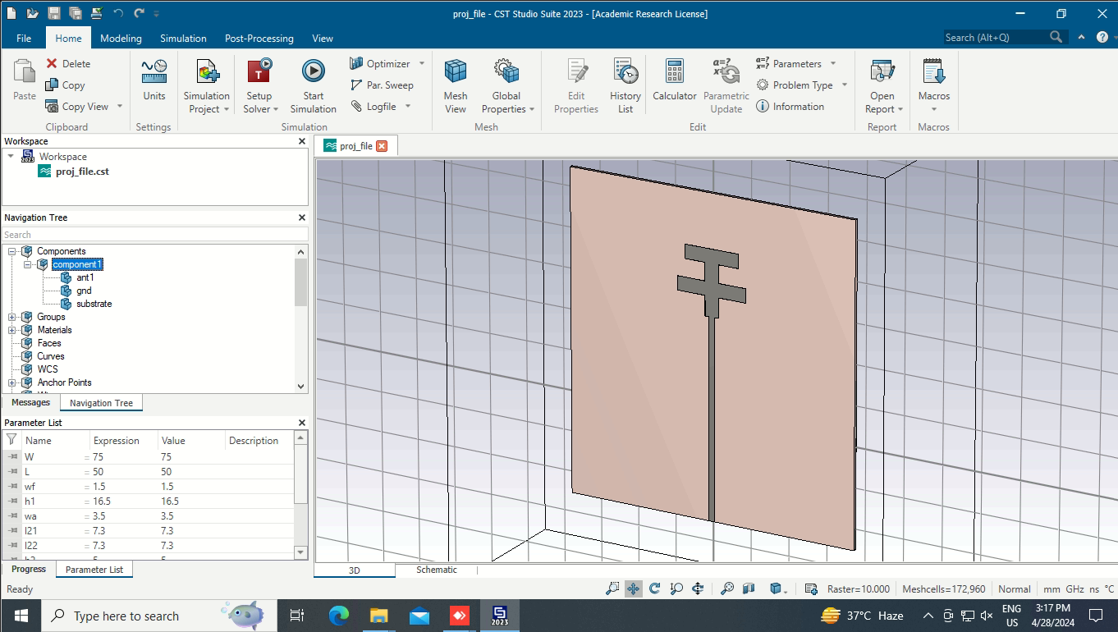
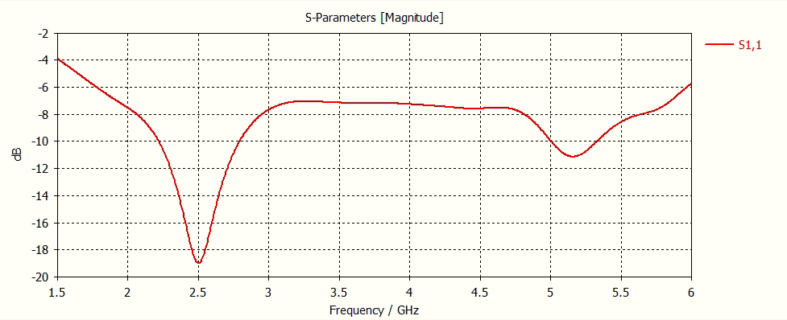
Results
CST Design and S11 Parameter plot for initial parameters of Double T-shaped Monopole Antenna
*
International Institute of Information Technology, Naya Raipur
‹#›

Slide 13
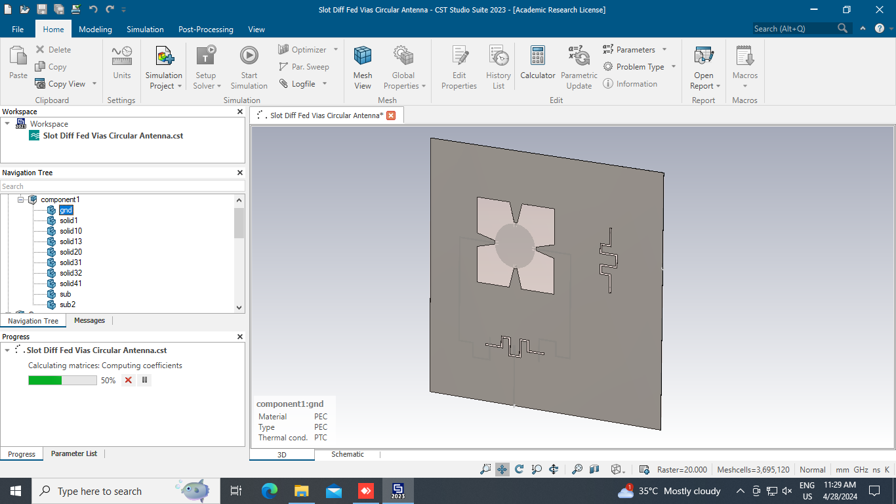
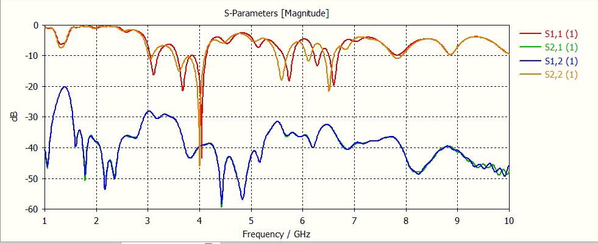
Results
CST Design and S Parameters plot for initial parameters of Slot-Diff-Fed vias Circular Antenna
*
International Institute of Information Technology, Naya Raipur
‹#›

Slide 14


Results
DNN R2 score 0.749 for double T-shaped antenna, LSTM R2 score 0.769 for double T shaped antenna, DNN R2 score 0.584 for Slot-Diff-Fed vias Circular Antenna, and LSTM R2 score 0.679 for Slot-Diff-Fed vias Circular Antenna
Design Parameters | FOM actual | FOM predicted
l21=6.4,l22=6.3,w1=1.3,w2=1.4,wa=1.5 | 1112.36 | 732.64
l21=6.5,l22=6.5,w1=1.5,w2=1.6,wa=1.7 | 1113.35 | 725.60
l21=6.7,l22=6.9,w1=1.8,w2=1.9,wa=2 | 1097.32 | 709.86
l21=7,l22=7.2,w1=2,w2=2.3,wa=2.4 | 1087.77 | 1196.93
l21=7.3,l22=7.3,w1=3.5,w2=3.5,wa=3.5 | 1081.67 | 1218.38
Design Parameters | FOM actual | FOM predicted
el1=5,h1=0.7,l1=5,m2=3,px=26,py=26 | 6060.13 | 5549.87
el1=5,h1=0.9,l1=7,m2=4,px=27,py=27 | 5786.88 | 5587.45
el1=7,h1=0.9,l1=7,m2=4,px=28,py=28 | 5695.29 | 5459.23
el1=9,h1=1.1,l1=9,m2=4,px=28,py=28 | 5599.53 | 5678.08
el1=9,h1=1.3,l1=9,m2=4,px=29,py=29 | 5909.11 | 5754.08
*
International Institute of Information Technology, Naya Raipur
‹#›

Slide 15
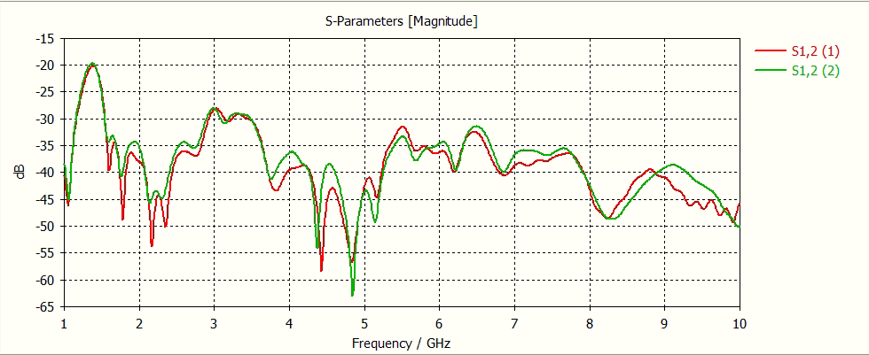

Results
*
International Institute of Information Technology, Naya Raipur
‹#›

Slide 16

Thank You
..
Dr. Shyama Prasad Mukherjee International Institute of Information Technology, Naya Raipur
*
International Institute of Information Technology, Naya Raipur
‹#›

