Slide 1
Vimcryption
Thomas Manner and Miguel Nistal

Slide 2
Motivation: Vim Needs Encryption Options!
Vim is one of the most popular editors of all time (https://stackoverflow.blog/2017/05/23/stack-overflow-helping-one-million-developers-exit-vim/)
Very extensible (and with Python!)
Vim currently doesn't have any good encryption options (pkzip, blowfish, blowfish2, or gnupg plugin)
Vimcryption makes a good foundation for a long term open-source project

Slide 3
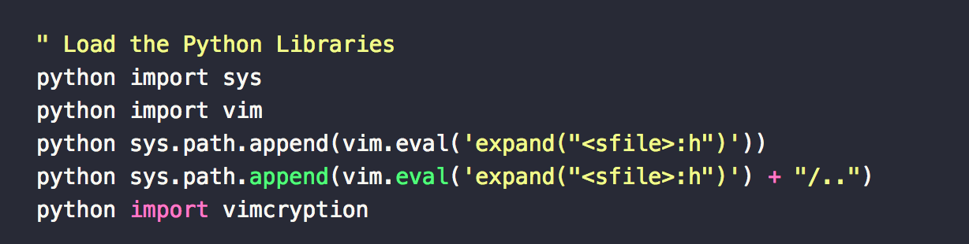
Building a Vim Plugin
Vim Plugins are written in VimScript with a common structure
The "Pathogen-compatible" structure will allow us to release the plugin to be downloaded via package managers
We took the approach of implementing the API in VimScript but offloading the heavy lifting to a Python backend
This is done in Vim by calling the built-in Vim Python Interpreter which is launched at runtime and available globally to VimScript

Slide 4
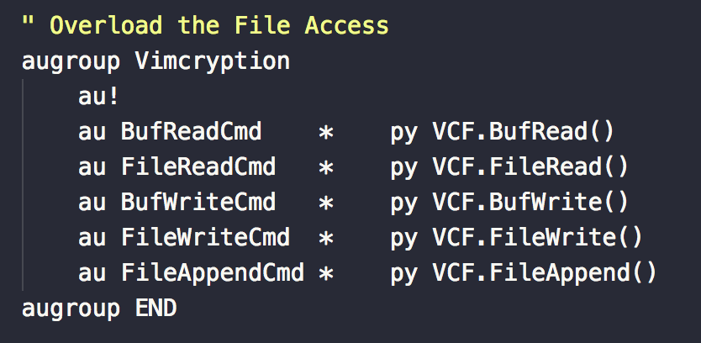
Intercepting File Handling
For security, we need to ensure all disk reads and writes are done by Vimcryption
Anytime the plugin loads, we disable swap, backup, undo history, and viminfo
Vim has builtin support for overloading the rest of the file operations via "Cmd-Events"
Cmd-Events are special callbacks which allow us to replace the built-in file operations with our own callbacks to the Vimcryption Python backend

Slide 5
The Extensible Encryption Engine
To keep up with the cryptographic arms race, any encryption plug in needs to be easy to update and extend.
Engine Architecture
EncryptionEngine – Abstract Base Class
encrypt
decrypt
BlockCipherEngine – Abstract Base Class
encrypt_block
decrypt_block

Slide 6
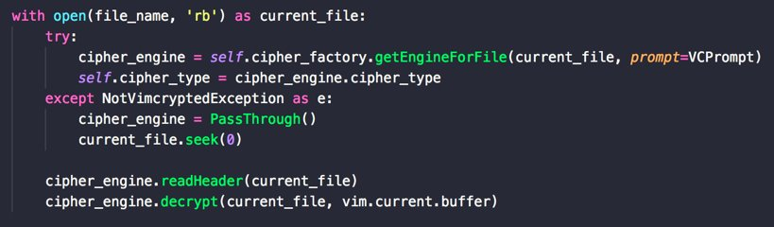
Using the Encryption Engine
We used the Factory design pattern to dynamically get the correct engine based on the meta-data in the file header
Once we have the engine, the code to decrypt a file is only two lines!
Eventually we'll bind readHeader into the Engine and reduce it to one

Slide 7
Efficient Text Processing with Generators
Text files can be larger than the memory space of our machine.
Encryption library doesn’t need to know about everything in the stream at once.
Streaming allows more flexibility:
Network data streams like ftp and ssh
Terminal input and output (tty)
Live log files
Only processes the next character or block.

Slide 8
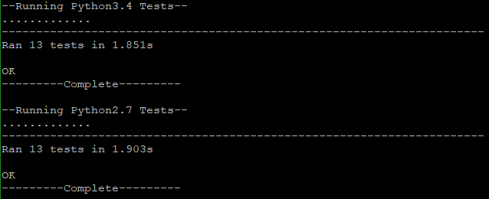
Unit Testing the Engine
To ensure stability and to prevent functional regression, we set up unittests for the EncryptionEngine library. The tests define and check all engine interfaces to guarantee that passing library code will work with VIM on the first try.
Suites
TestPassThrough
TestBase64Engine
Tests
test_encrypt_str
test_encrypt_list
test_decrypt_str
test_decrypt_list
test_readHeader
test_writeHeader

Slide 9
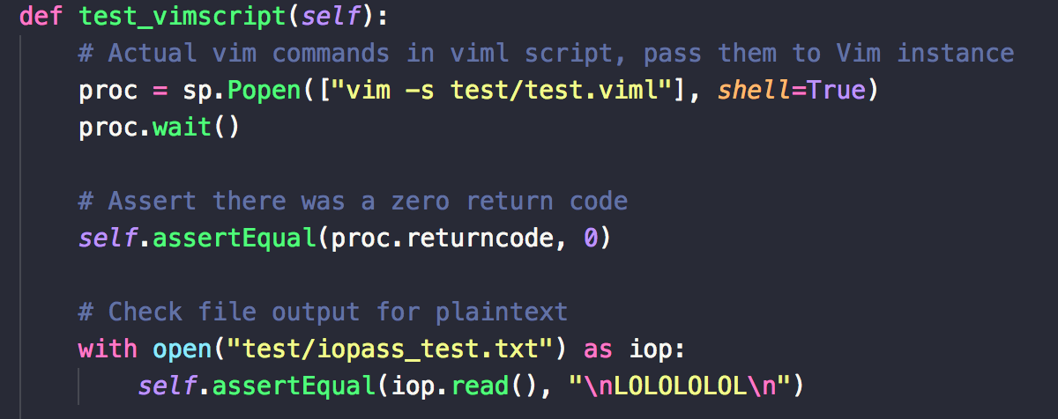
Extending the Testing to Vim Integration
To provide integration testing for the plugin, we needed a way to automate the actual usage of the plugin in a Vim instance
Vim has an argument "-s" which will execute characters in a file as if they were the result of user keystrokes
We were then able to automate the foreground testing we would've done, and do all the verification from a Python based test function

Slide 10
Demo: Let's Vimcrypt!

Slide 11
Final Thoughts
Project will be available via GitHub and installable via Pathogen and Vundle! Look for the project on vimawesome.com!
Learned a lot about the practical implications of security when dealing with File System Operations and text editing
We want to continue development, eventually supporting asymmetric key encryption so you can easily share files with your friends
We've also found that Python lacks a generally accepted encryption library to match the built-in cryptographic hashlib – This is a need we can solve, maybe we'll get a PEP!

Slide 12
Thank you!

Slide 13
Resources
VimScript API:
https://devhints.io/vimscript
VimScript CmdEvent Reference:
http://vimdoc.sourceforge.net/htmldoc/autocmd.html
VimScript Python Reference:
http://vimdoc.sourceforge.net/htmldoc/if_pyth.html
VimScript Tutorial:
http://learnvimscriptthehardway.stevelosh.com/
Python Generators:
https://wiki.python.org/moin/Generators
Python Unit Testing:
https://docs.python.org/3/library/unittest.html

