Slide 1

LORDS INSTITUTE OF ENGINEERING AND TECHNOLOGY
Summer Internship Report
June – July 2022
Title: Web Development
Company Name: REJOLT EDTECH PVT LTD
Presented By:
Name: Mohammed Viquar Ahmed Internal Guide
Roll Number: 160919733110 Dr. Suneel Pappala
Associate Professor, CSE
Course: B.E Year: 4th Semester: I Section: B

Slide 2
Outline
Title
Abstract
Objective
Methodology
Outcome
References
Picture of Certificate

Slide 3
Personal Portfolio Website.
Creating a personal portfolio website to showcase my Front-end and Back-end Skills.

Slide 4
Abstract
An online portfolio is a collection of work samples, achievements, and personal information that showcases a person's skills and capabilities.
It is typically used by creative professionals such as designers, writers, photographers, and artists to demonstrate their talent and expertise to potential clients or employers.
A portfolio website can be a powerful tool for promoting oneself and securing new opportunities, as it allows the individual to present their work in a professional and organized manner.

Slide 5
Objective
Creating a personal portfolio website to showcase my Front-end and Back-end Skills.

Slide 6
Methodology
Identify your audience.
Gather your material.
Choose a platform.
Design a website.
Add your content.
Test and optimize.

Slide 7
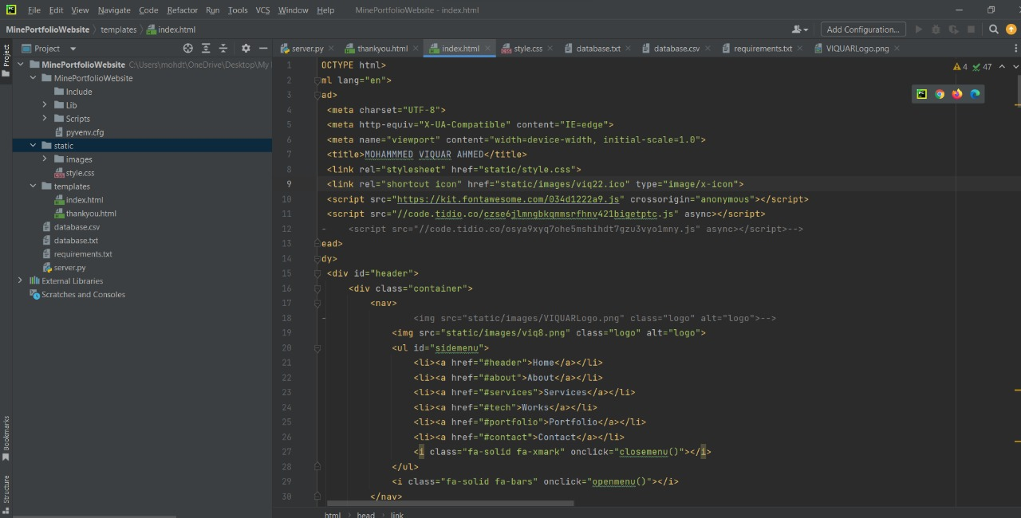
Code

Slide 8
Main HTML ( Home Page )
Main Server.py File

Slide 9
All Files

Slide 10
Back-End Form Data.

Slide 11
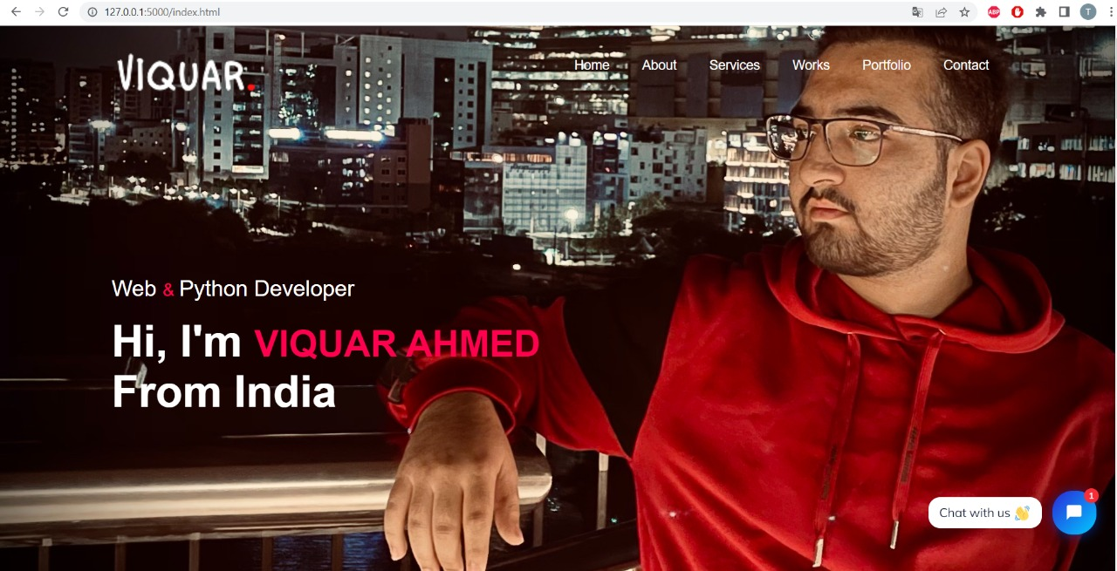
OUTPUT

Slide 12
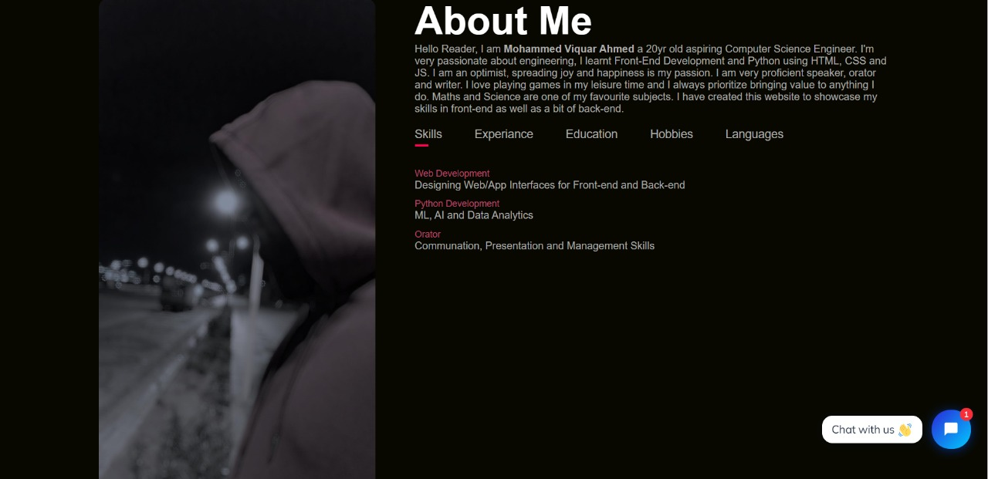
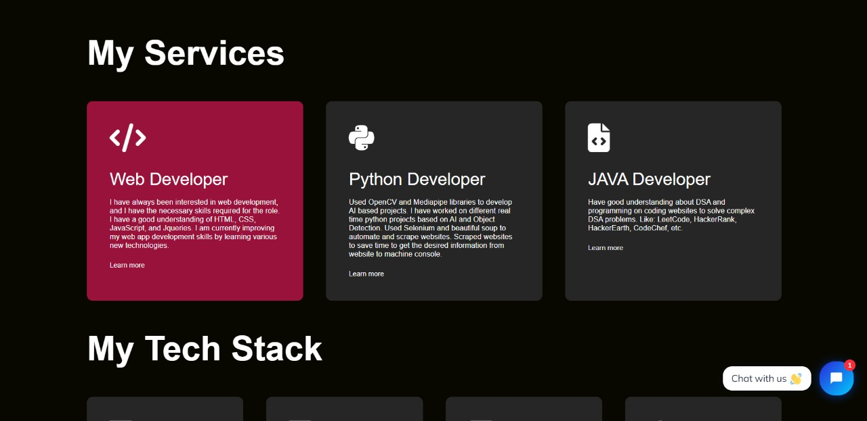

Slide 13
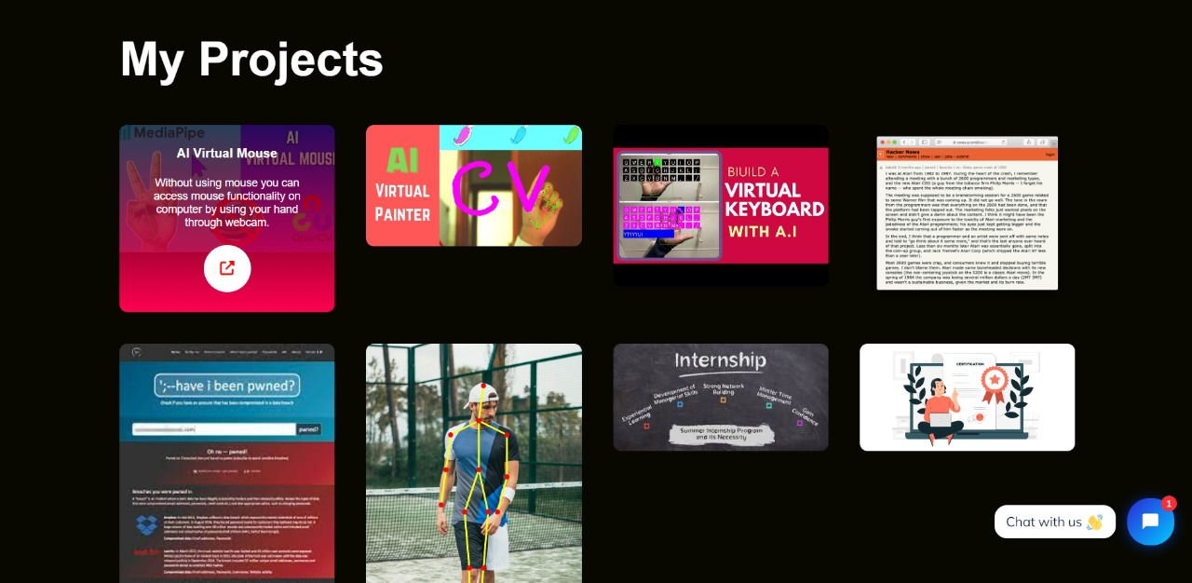
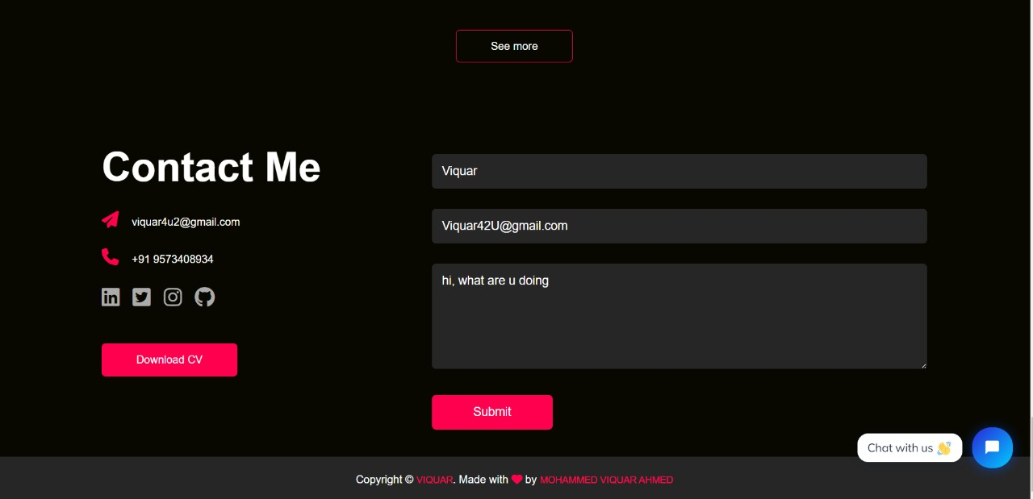

Slide 14
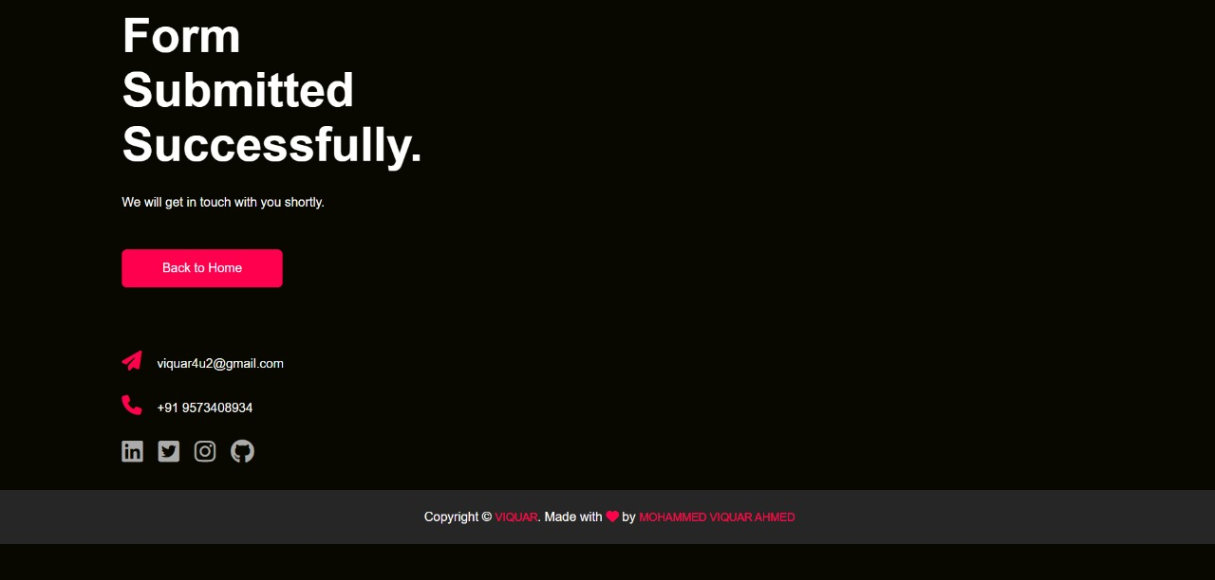
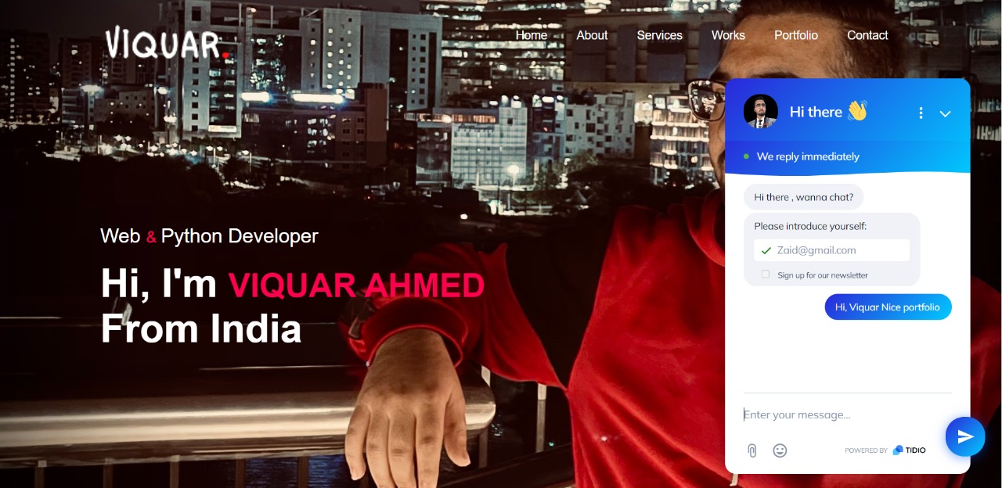

Slide 15


Slide 16
Outcome
I have successfully created my portfolio and hosted on internet and anyone can visit my portfolio website.

Slide 17
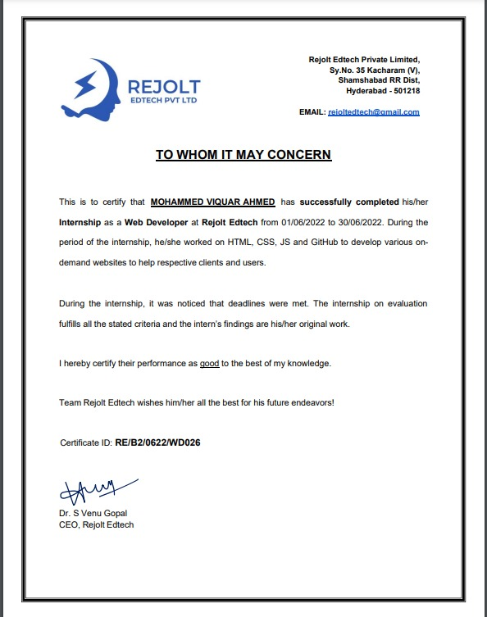
Picture of Certificate

Slide 18
Thank You
Any Questions?

