Slide 1
Object Oriented Programming Text Based RPG
BY
2110030324-CH.NAVYA
2110030300-VIRINCHI KOTHE
2110030315-V.AISHWARYA
2100031719-O MEENA KUMARI
Under the guidance of
Mrs. Figlu Mohanty

Slide 2
INTRODUCTION:
Role-Playing games are basically pretending or to go through a fictional characters journey or choosing how a character lives their life and making choices for them.
While many RPG’s might be animated and have high level graphics, there are still games just based on text which are plain and simple.

Slide 3
How our project works:
In our design of the game, We are planning on providing many endings as many as 3 to 4.
Initially, the Code for the game takes an input of the player’s name and then depending on the choices made by the User will trigger the If, Else, Else-If cases and Print the story.
We will have to then link this to a server upload it.
Then we are planning to make use of HTML for the webpage.

Slide 4
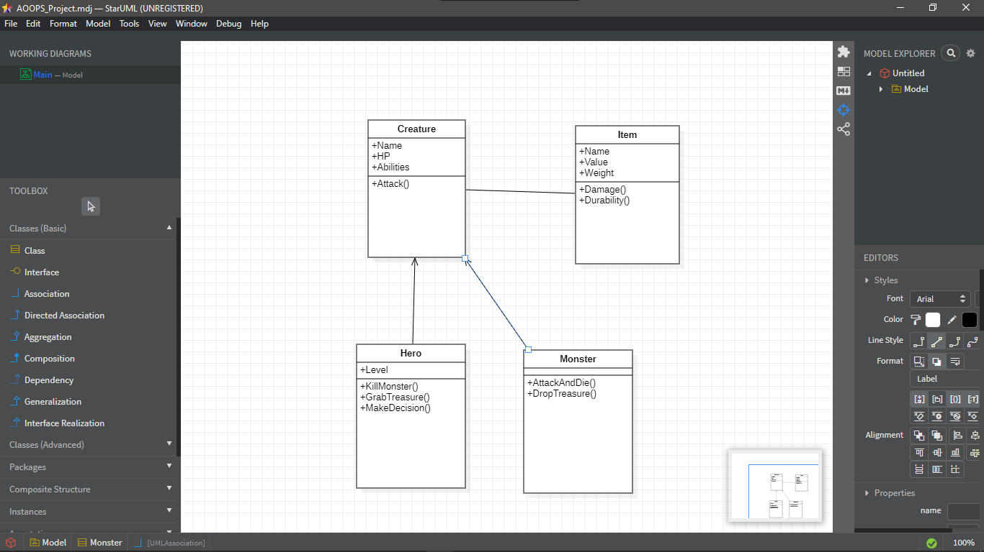

Slide 5
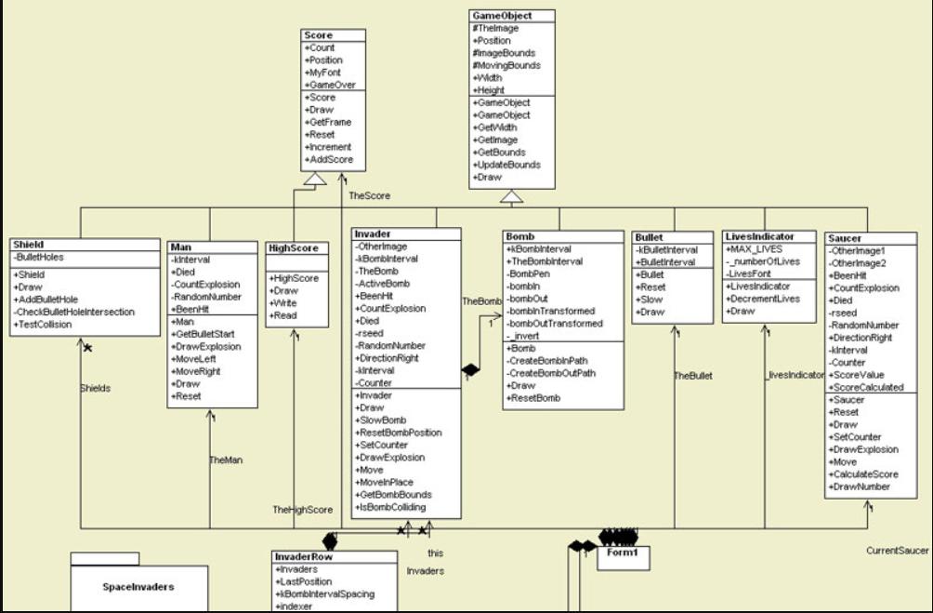

Slide 6
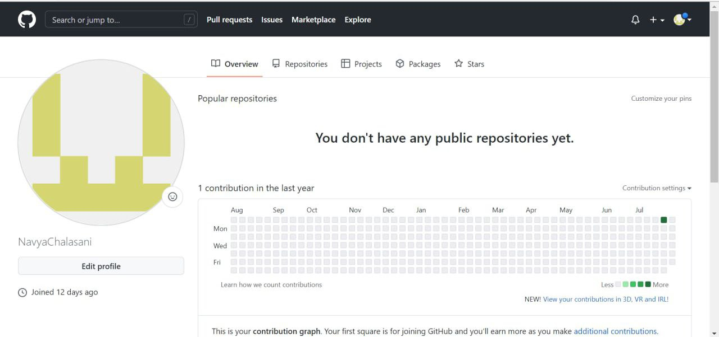
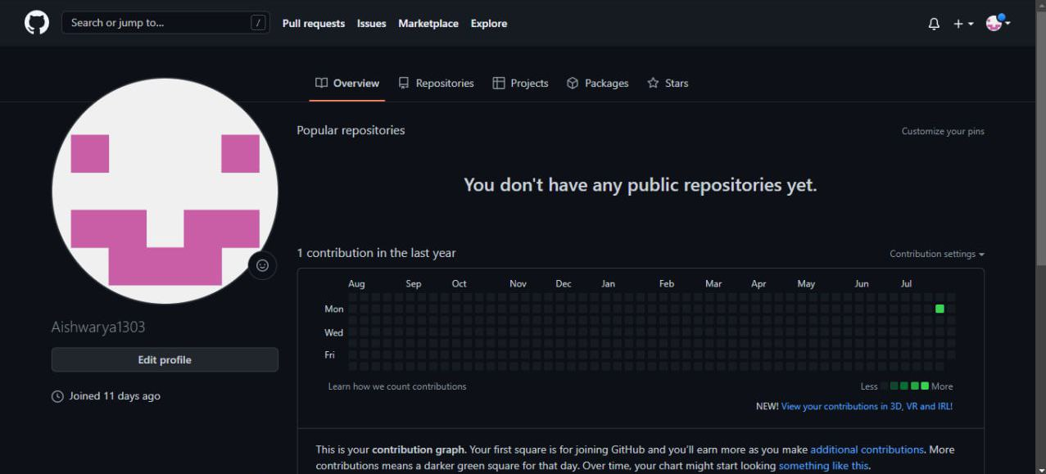
Github Setup:

Slide 7
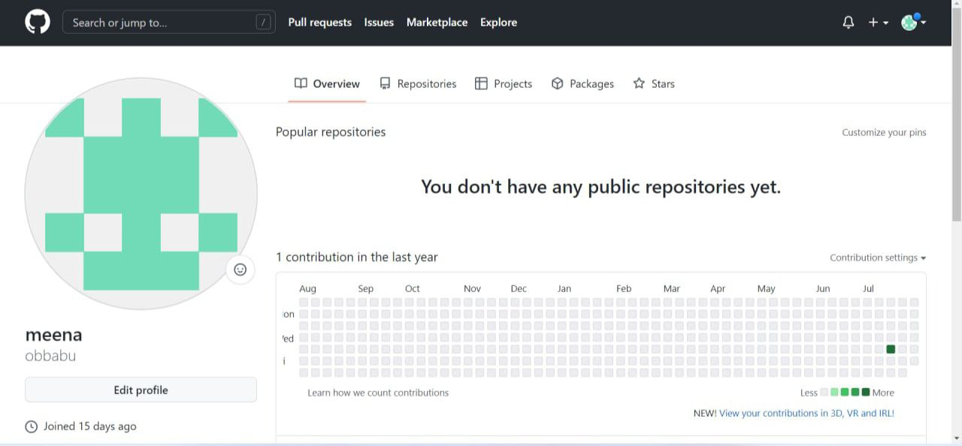
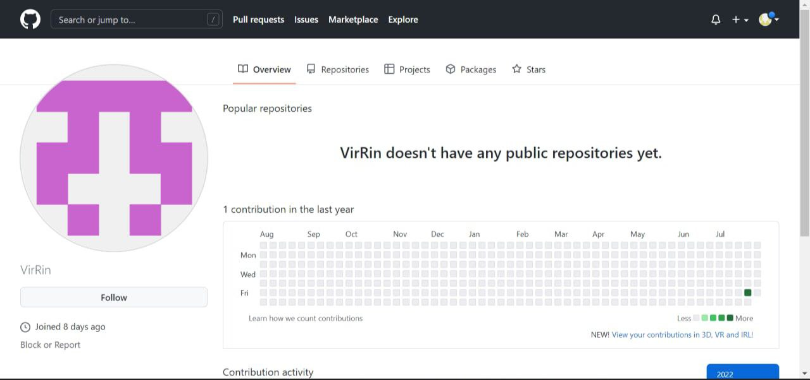
Github Setup:

Slide 8
Conclusion:
In conclusion, we will be using concepts of Object Oriented Programming in Java ,HTML(For the Webpage) and TomCat (to Link Eclipse to a server) to Produce a Game of the Genre Text Based Role Playing Game.

Slide 9


