Slide 1

Speech Recognition with TensorFlow
Vira T Capell
Applied Data Science — Data Stories
November 6 2019

Slide 2
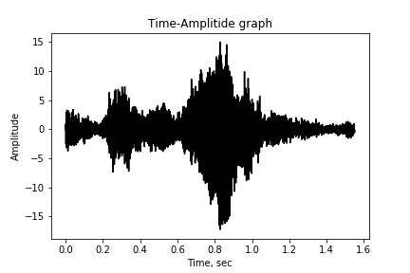
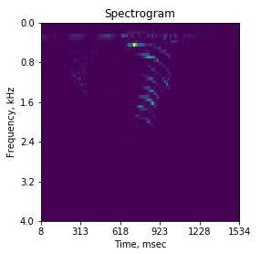

About a dataset
917 wav files,
13 spoken numbers,
many different people spoken:
both genders,
different ascents
Sample Rate=8 kHz
Usable voice frequency band:
0.3 to 3.4 kHz
import scipy.io.wavfile as wv
SampleRate,data = wv.read(‘filename.wav’)

Slide 3
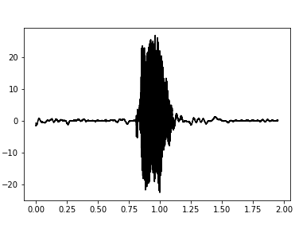
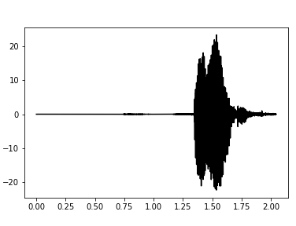
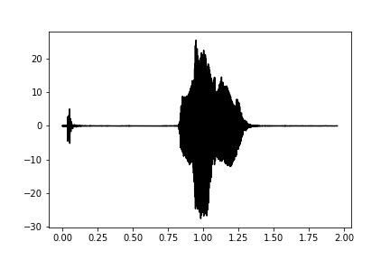
Eyeballing data
- “Silence” before
and after a number
- Noisy: background noise,
“click” sound on beginning

Slide 4
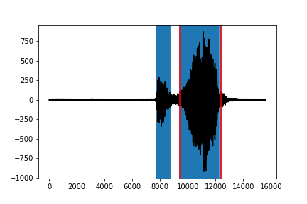
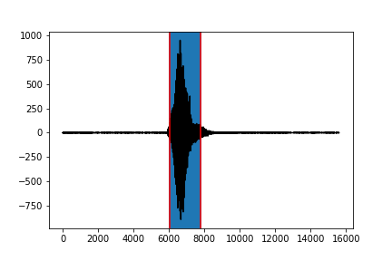
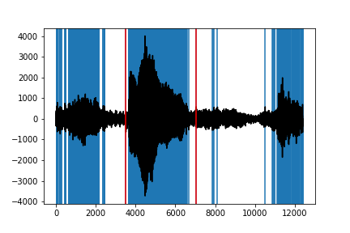
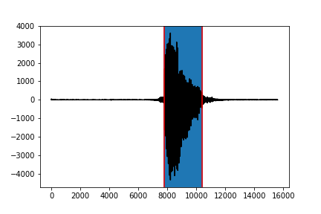
Cleaning the data

Slide 5
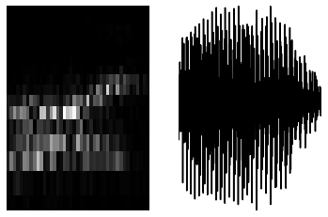
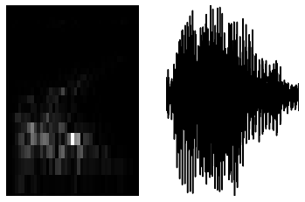
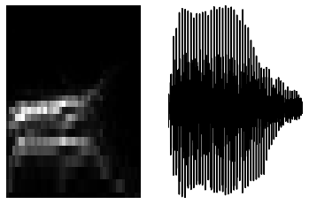
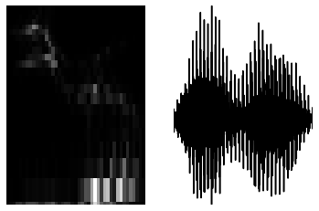
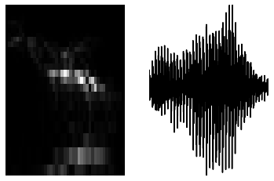
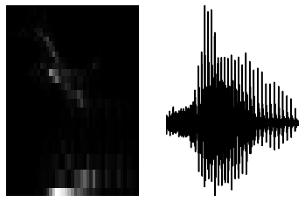
Look different for same number spoken by different people
“5”
“0”

Slide 6
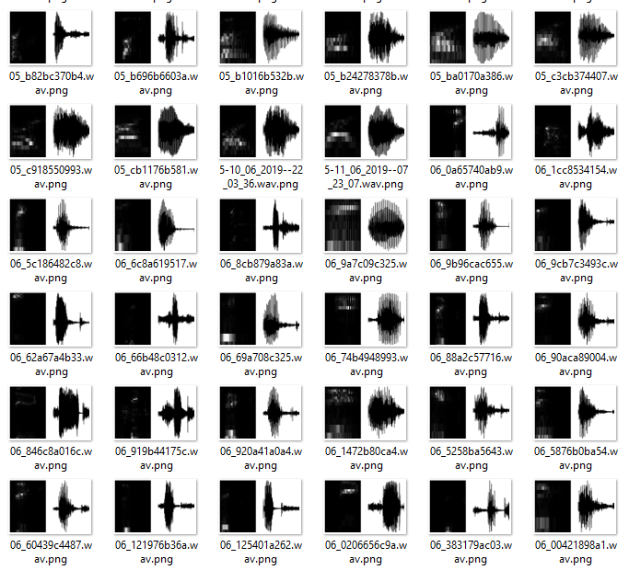

Idea: using TensorFlow to train the CNN to recognize spectrograms and amplitude traces as pictures

Slide 7
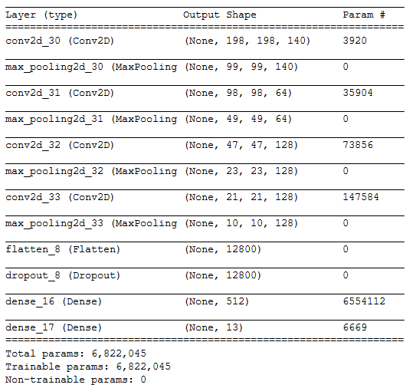
Model

Slide 8
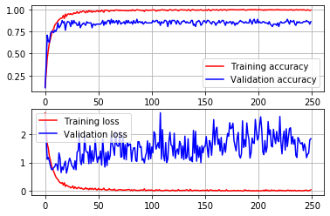
Performance: over 80% on validation set
np.mean(val_acc[18:22])
0.8298611
After about 20 epochs validation accuracy reaches %83, and climbs further up, but the validation loss is going up after 20 epochs, showing over fitting of the network

Slide 9
File name | Spoken Number | Predicted
006a5b2cb6.wav | 11 | 11
0130bbb543.wav | 4 | 1
0217a3b12a.wav | 2 | 8
029830a064.wav | 6 | 6
099743a386.wav | 8 | 8
0c7156ca20.wav | 2 | 8
135451ab23.wav | 2 | 2
1510c30707.wav | 0 | 12
16ac11144b.wav | 4 | 4
17b6a64673.wav | 7 | 3
1aa7222c02.wav | 0 | 3
2581723976.wav | 7 | 6
2885430727.wav | 2 | 8
2918750a33.wav | 3 | 8
298a616a81.wav | 8 | 6
2aa949c3a3.wav | 10 | 10
2b9c815b22.wav | 2 | 2
2c2caacb08.wav | 0 | 8
2ccc498b11.wav | 1 | 1
Predictions on testing set

