Slide 1
UK Top 50 Playlist Market Structure Analysis
Prithviraj Sahu
Data Analyst Intern
Unified Mentor

Slide 2
Problem Statement
Understand UK music market structure
Analyze artist dominance and diversity
Study collaboration trends
Evaluate explicit content impact
Compare single vs album release strategy

Slide 3
Dataset Overview
Total Records: 27,800
Time Coverage: 556 days
Playlist: UK Top 50
Includes artist, song, popularity, duration, album type, explicit content

Slide 4
Tools and Technologies Used
Python
Pandas
Plotly
Streamlit
Jupyter Notebook
GitHub

Slide 5
Data Cleaning and Preparation
Removed duplicate records
Converted date format
Converted duration to minutes
Split multi-artist collaborations
Prepared clean dataset for analysis

Slide 6
Key Performance Indicators
Unique Artists: 366
Artist Concentration Index: 0.0104
Collaboration Ratio: 59.35%
Explicit Content Share: 36.92%
Single Release Ratio: 64.18%

Slide 7
Artist Dominance Analysis
Market shows high artist diversity
No single artist dominates completely
Balanced competitive market structure

Slide 8
Collaboration Analysis
59% tracks involve collaborations
Collaborations increase visibility
Important factor for chart success

Slide 9
Explicit Content Analysis
Explicit content share is 36.92%
Majority content is clean
UK audience shows moderate sensitivity

Slide 10
Single vs Album Analysis
Single releases dominate market
64% playlist entries are singles
Companies should focus on single releases

Slide 11
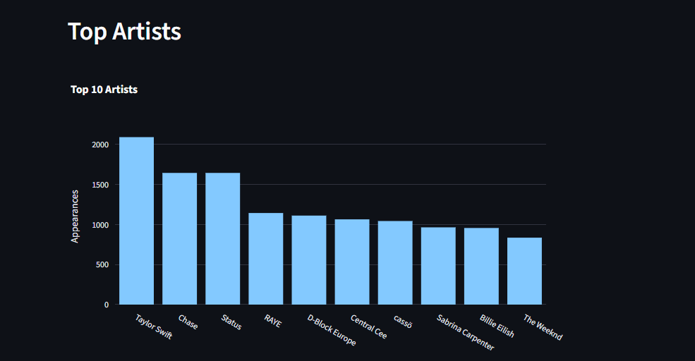
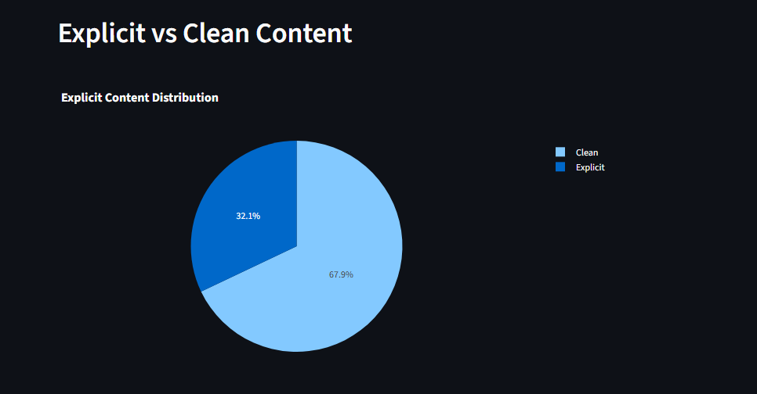
Dashboard Development
Interactive Streamlit dashboard created
Displays KPIs and market insights
Includes artist leaderboard and charts
Helps business decision making

Slide 12
Conclusion
UK music market is highly diverse
Collaborations play major role
Single releases dominate
Dashboard provides actionable insights

Slide 13
Thank You
Questions?

