Slide 1
TEXT-EDITOR
Language: C
Data Structures and Algorithms II
Name: Viraj Dnyandeo Najan
MIS NO : 111903127
Batch : S3
DIV : 2nd

Slide 2
Data Structures Used
GAP BUFFER -> for storing the data / Content of file and
Effective Insertion and Deletion.
TRIE ->for Auto Suggestions

Slide 3
1. GAP BUFFER
Gap Buffer is a data structure used for editing and storing text in an efficient manner that is being currently edited.
similar to an array but a gap is introduced in the array for handling multiple changes at the cursor.

Slide 4
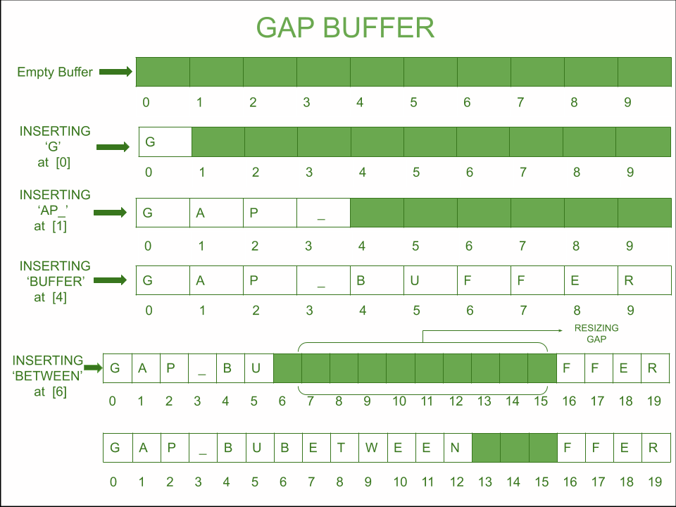
Working
The gap is moved at the location of insertion and deletion.
Time Complexity of insertion and deletion is O(1).
Time Complexity for growing the gap is O(n).

Slide 5
2. TRIE data Structure
TRIE Data Structure also known as the Prefix Tree is remarked as an excellent Data Structure for processing and storing the Strings and is primarily used for word retrieval
In this Text editor it is used for Auto suggetions feature.
Once a tab key is pressed text editor will display all possible word from the given word.

Slide 6
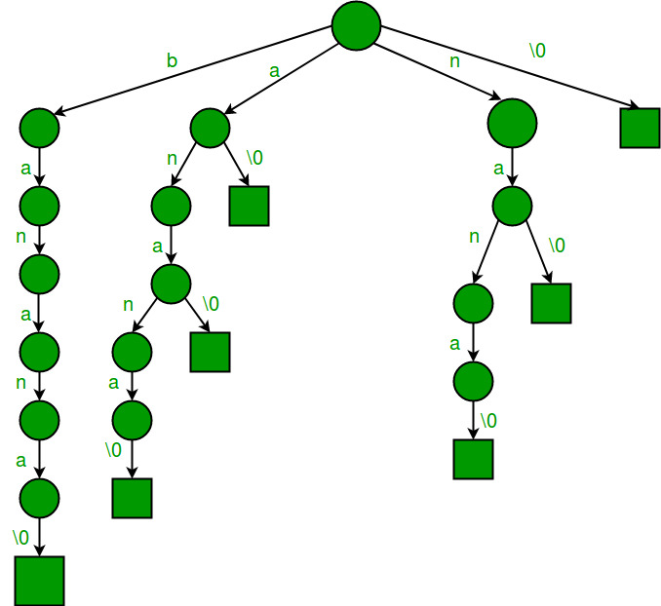
Working
Initially trie is created from a file named auto.txt which contain near about 20k words.
Once a query is given to autocomplete function, it will search if the given query is present or not.
If the given query is not present it will return Zero.
If the given query is present and it is last word then -1 will be return.
If query is not last word then control will enter in suggest function and it will add all the word starting from the given query to a text file name suggest.txt

Slide 7
Functionality Of Text Editor
We can Open , Save and Edit any file
Cursor Movement using arrow key works.
Enter key for newline.
Page-UP and Page Down-Key work .
Backspace and delete key to delete.
Tab key for auto suggetions.
Ctrl+S to save file work.
Home-Key for help and End Key to exit the text editor.

Slide 8
User Interface
Ncurses is used to give User interface to text editor
ncurses (new curses) is a programming library providing an application programming interface (API) that allows the programmer to write text-based user interfaces in a terminal-independent manner.
It is a toolkit for developing "GUI-like" application software that runs under a terminal emulator.

Slide 9
Further Functionality
Following Features can be add Further.
Cut, Copy, Paste.
Find Replace.
Undo Redo.
Grammer Checking.

Slide 10
Thank You

