Slide 1
PROJECT DETAILS
Student Details
Project: Giriraje Food Restaurant Website
Prepared by: vivek & viraj
Class: BCA1 & div-D
Roll No.: 36,42
Web design and presentation project

Slide 2

Giriraje Food Restaurant
A simple food website idea
FOOD · DISCOVERY · GUEST VISIT

Slide 3
GIRIRAJE FOOD RESTAURANT
Target Audience
• Families looking for a comfortable dining experience
• Students and young adults exploring local food
• Visitors who want to discover Giriraje’s menu, service, and restaurant style
A clear website helps every guest decide with confidence.

Slide 4
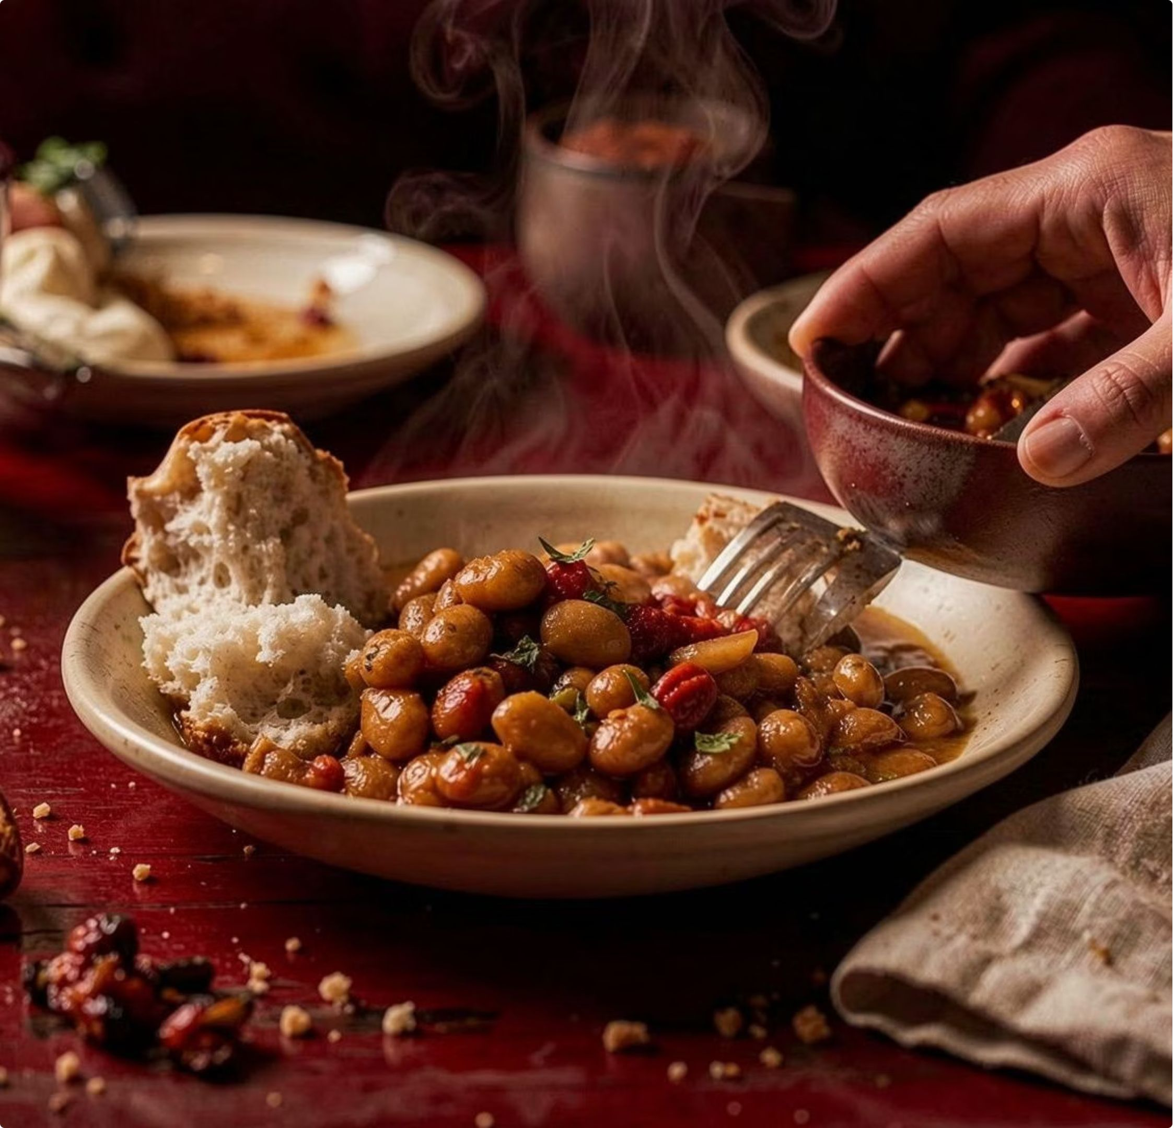
T H E D I G I TA L I D E A
A website
made for food
lovers
The website brings the food,
service, and restaurant style
together in one place.

Slide 5
A B ST RACT
T H E E X P E R I E N C E
From first click to
Show the restaurant’s
style
Help people learn and
decide
Make the next step easy
first meal
The website should make Giriraje easy to understand,
explore, and choose.

Slide 6
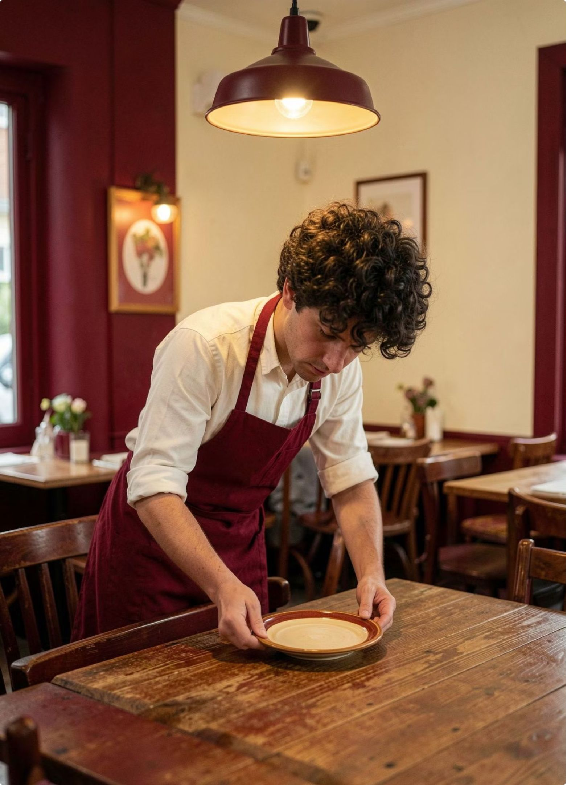
T H E R E STAU RA N T
About Giriraje
Giriraje is explained through three simple ideas: the
restaurant story, the food and service, and the guest
experience before arrival.
01
Restaurant story
02
Food and service
03
First connection

Slide 7
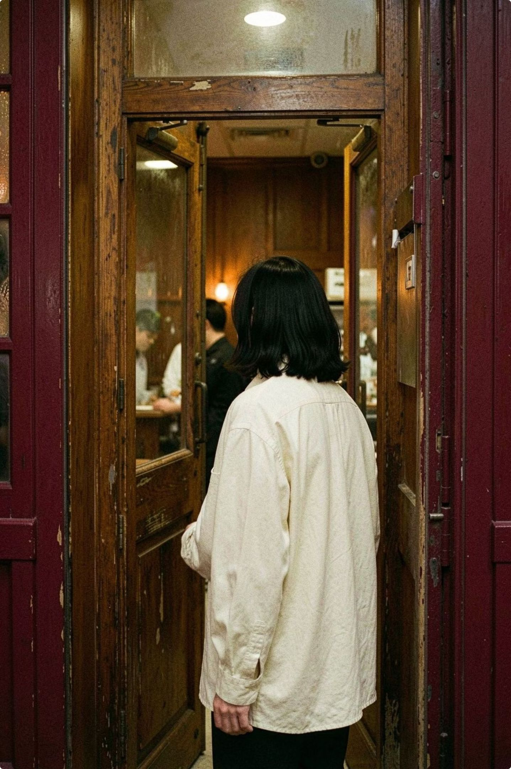
W H AT T H E W E B S I T E E N A B L E S
Services that bring visitors
Explore
See the menu and food.
Understand
Find key information quickly.
Connect
Ask questions, reserve, or contact.
Visit
Move from online interest to a visit.

Slide 8
T H E C O R E F LOW
Service details at a glance
01
02
03
04
Discover
Review
Choose
Connect
Meet Giriraje and its
Understand the food and
Choose how to visit or
Take the next step
food.
service.
ask.
easily.

Slide 9
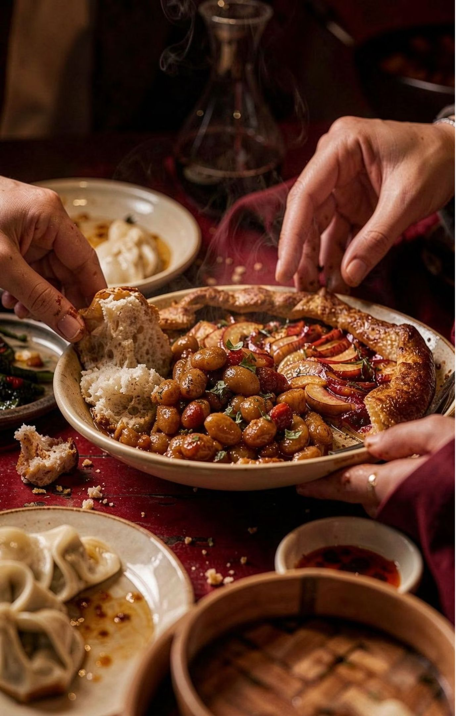
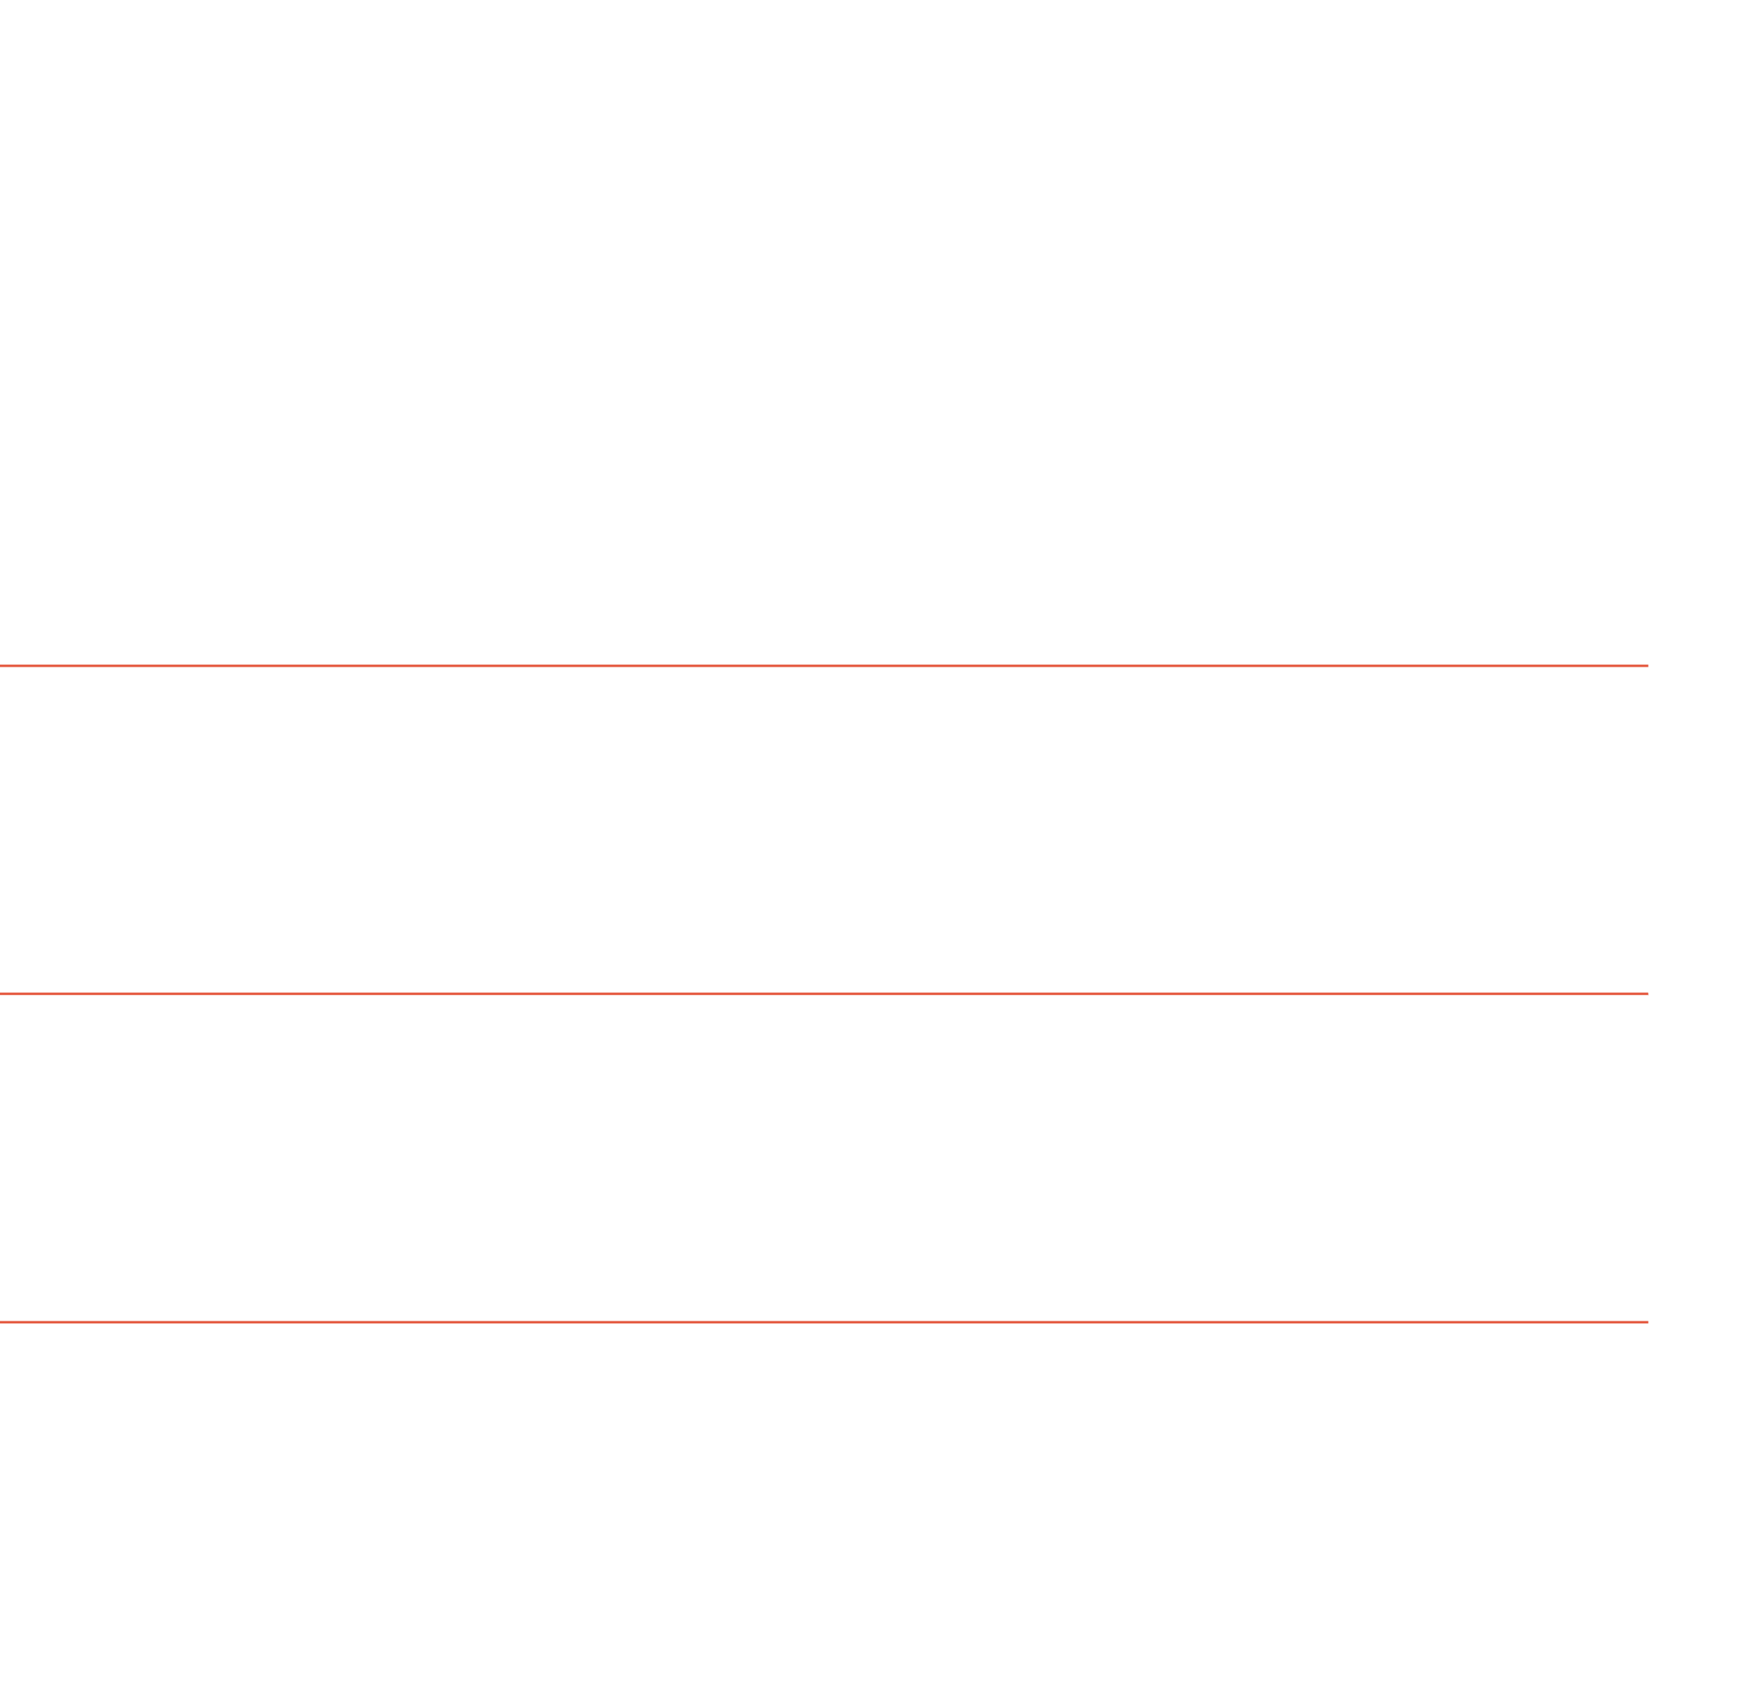
T H E VA LU E O F T H E E X P E R I E N C E
Why Giriraje?
A clear identity
The food style is clear from the first screen.
A useful first impression
People can understand the restaurant before they visit.
Information around needs
Information is arranged around common questions.
A memorable bridge
The website connects online discovery with a restaurant visit.

Slide 10
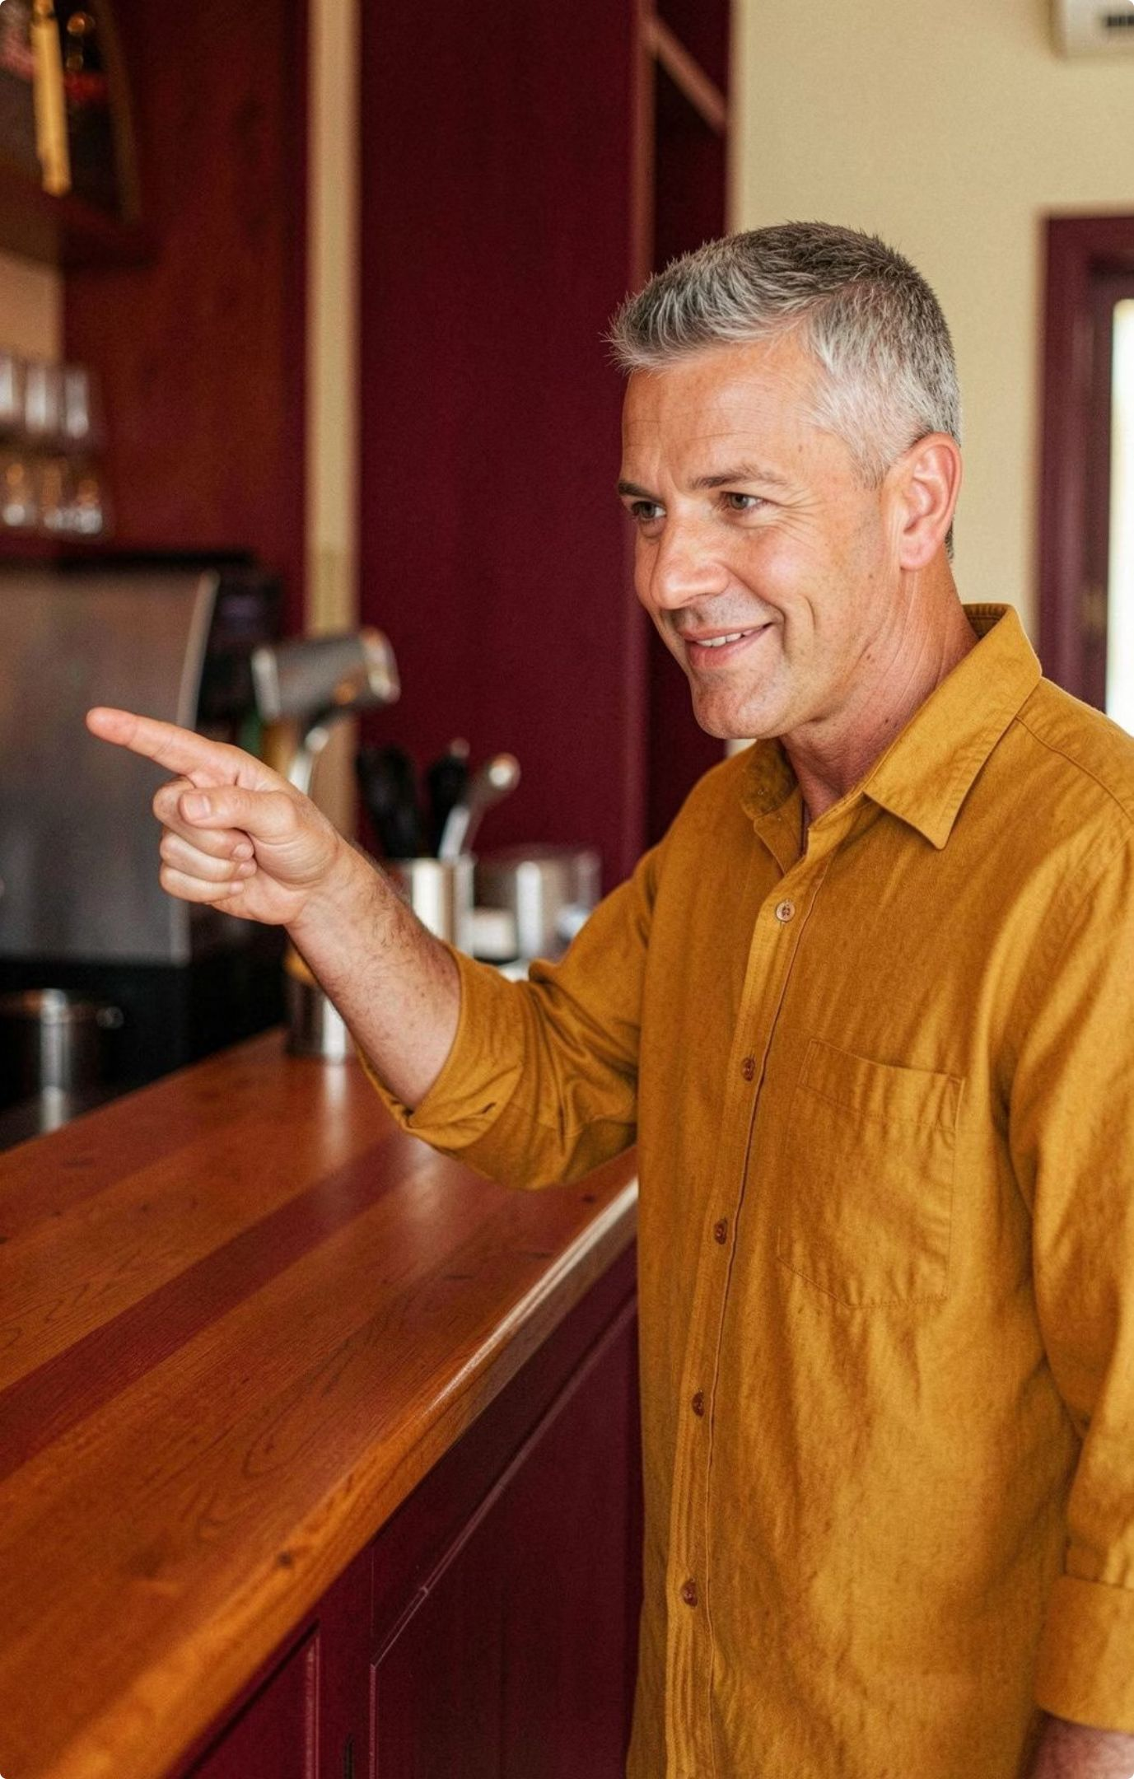
U S E F U L BY D E S I G N
Useful website features
Simple navigation
Food visuals
People can find things easily.
Images show the food and
mood.
One information space
Clear next actions
Service details are in one
Clear buttons show what to do
place.
next.

Slide 11
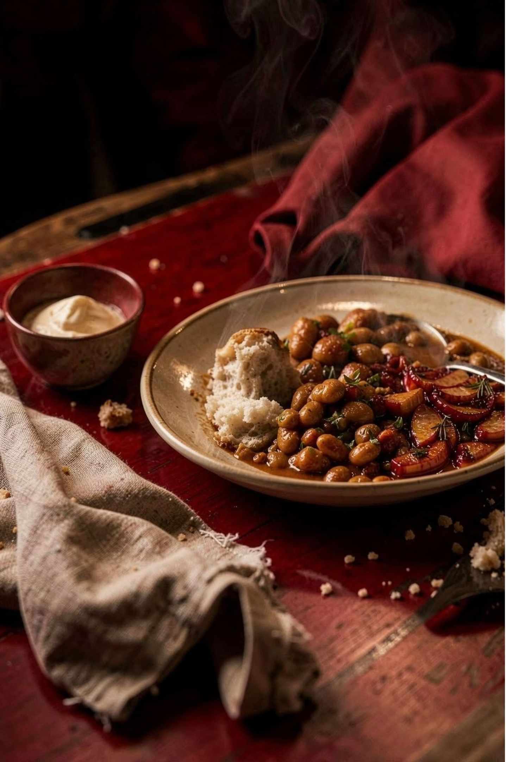
T H E M E N U AS A D EC I S I O N TO O L
The menu should help
people choose
Use good food images, short descriptions, and clear sections.
This helps people understand the food before they visit.
Show
Explain
Organise
Show the food.
Keep text short.

Slide 12
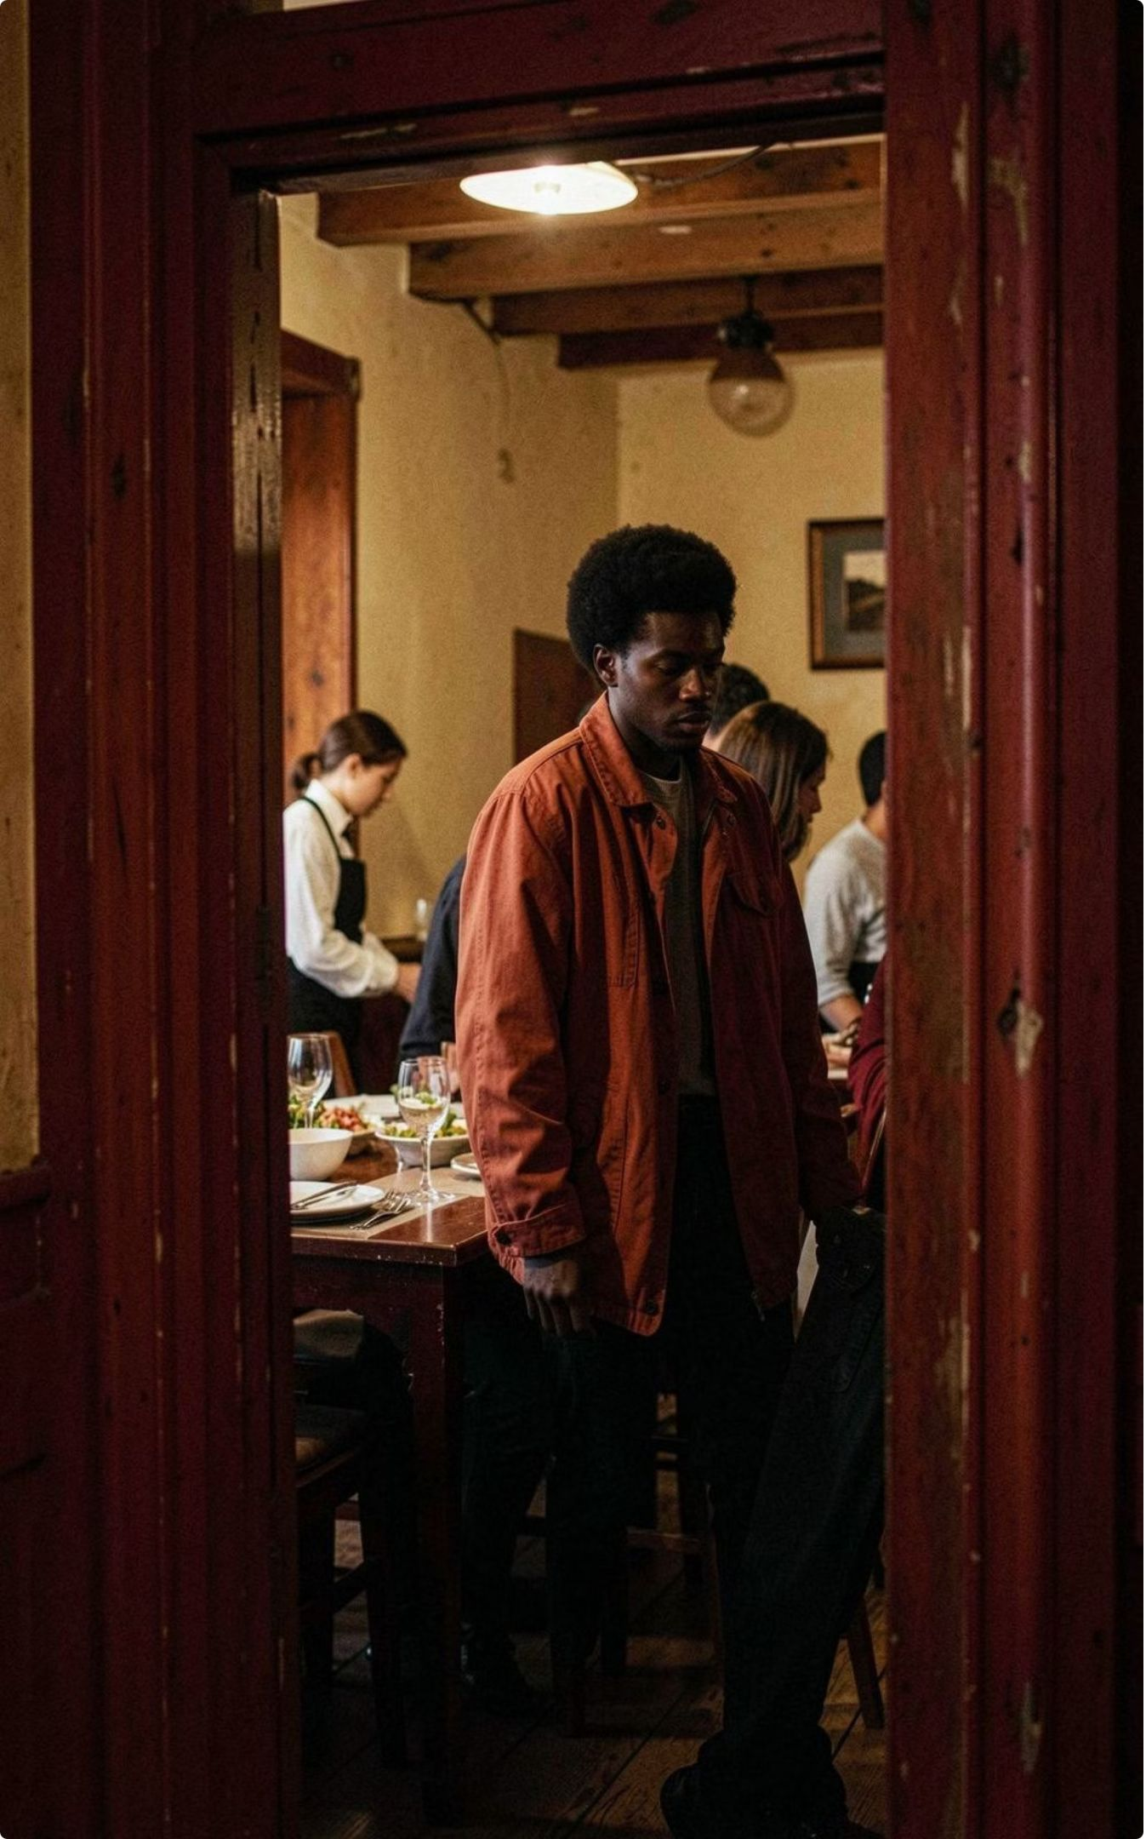
T H E G U E ST J O U R N E Y
A simple guest journey
1. Open the website and recognise Giriraje.
2. Understand what the restaurant offers.
3. Check important details before visiting.
4. Choose what to do next.

Slide 13
THE BIG IDEA
Final Message
Giriraje’s website should feel as welcoming as the restaurant itself.
By bringing together the story, services, menu, and guest journey, the website can turn interest into a visit.
Simple information. Strong identity. Better guest decisions.

Slide 14
THANK YOU
Thank You
Thank you for exploring the Giriraje Food Restaurant website idea.
Questions or suggestions?
Giriraje — good food, warm service, memorable visits.

