Slide 1
TCIE-2 • PERFORM & DEMONSTRATE
MS WORD
MAIL MERGE
Create one invitation. Personalize it for every student.
Group Member :Viraj sakdecha Roll No.: 42
Class: BCA 1ST SEM Divisionn: D
COLLEGE SEMINAR INVITATION • PRACTICAL PRESENTATION
01 / 10

Slide 2
01 | Introduction to Mail Merge
A quick way to create many personalized documents
What is Mail Merge?
Why use it?
A Microsoft Word feature that combines a standard document with a data source to create a separate personalized copy for each recipient.
It saves time, reduces repetitive typing, keeps formatting consistent, and makes bulk letters more personal.
THE PROCESS AT A GLANCE
1
Main document
2
Recipient list
3
Merged letters
Invitation template
Excel student data
One per student
Main document → Data source → Personalized output
02 / 10

Slide 3
02 | Objective of the Practical
What this activity demonstrates
Prepare a standard invitation
Draft a professional college seminar invitation in Word.
01
Build a recipient database
Store at least 10 students’ names, enrollment numbers and email addresses in Excel.
02
Connect the files
Link the Word document to the Excel recipient list.
03
Insert merge fields
Place fields where each student’s personal details should appear.
04
Preview and generate
Check the letters and finish the merge for all recipients.
05
03 / 10

Slide 4
03 | Tools & Features Used
Microsoft Word works with an Excel data source
Microsoft Word
Microsoft Excel
Mail Merge features
• Invitation template
• Mailings tab
• Insert Merge Field
• Preview Results
• Finish & Merge
• Column headings
• One row per student
• Consistent data format
• Unique enrollment numbers
• Save as .xlsx
• Select Recipients
• Edit Recipient List
• Address/field mapping
• Preview each record
• Print or edit merged letters
Before starting
• Keep the Excel file closed while connecting if Word has trouble reading it.
• Use clear headers such as Name, EnrollmentNo and Email.
• Save both files in a known folder so they are easy to find.
04 / 10

Slide 5
04 | Step 1 — Prepare the Excel Recipient List
Create a clean data source with at least 10 student records
Name | EnrollmentNo | Email
Aarav Patel | TCIE2401 | aarav.patel@example.com
Diya Shah | TCIE2402 | diya.shah@example.com
Rohan Mehta | TCIE2403 | rohan.mehta@example.com
Anaya Joshi | TCIE2404 | anaya.joshi@example.com
Kabir Desai | TCIE2405 | kabir.desai@example.com
Important
The sample names and example.com emails are illustrative. Replace them with your approved practical data.
Save the workbook
Save as Student_List.xlsx. Keep the first row for column headings.
Add 5 more records to reach 10 students. Each student must occupy one row.
05 / 10

Slide 6
05 | Step 2 — Draft the Invitation in Word
Create the reusable main document before inserting fields
COLLEGE SEMINAR INVITATION
Suggested details
Seminar title, date, time, venue and organizer.
Date: [Insert date]
Dear «Name»,
You are cordially invited to attend our college seminar. The session will provide an opportunity to learn, exchange ideas and interact with fellow students.
Use placeholders first
Type the basic letter, then replace personal details with Word merge fields.
Enrollment No.: «EnrollmentNo»
Please confirm your participation by email: «Email»
Note: «Name», «EnrollmentNo» and «Email» become real merge fields in Word.
Regards,
Seminar Organizing Committee
06 / 10

Slide 7
06 | Step 3 — Connect & Insert Merge Fields
Use the Mailings tab in Microsoft Word
Open Mailings
Select Recipients
1
2
Choose Start Mail Merge → Letters.
Use an Existing List and choose Student_List.xlsx.
Choose worksheet
Insert fields
3
4
Select the sheet containing the student table; confirm headers.
Place cursor in the letter, then Insert Merge Field → Name / EnrollmentNo / Email.
Tip: Do not manually type the chevrons. Insert fields using Word’s Insert Merge Field command.
07 / 10

Slide 8
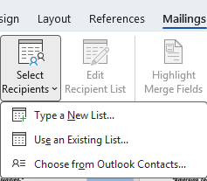
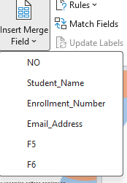
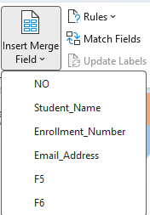
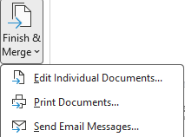
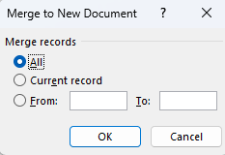
07 | Practical Demonstration Screenshots
Actual Microsoft Word steps: select recipients, insert fields and generate letters
01 SELECT RECIPIENTS
02 INSERT MERGE FIELD
03 CHOOSE A FIELD
04 FINISH & MERGE
05 EDIT INDIVIDUAL DOCUMENTS
Workflow: Mailings → Select Recipients → Insert Merge Field → Finish & Merge → Edit Individual Documents
08 / 10

Slide 9
08 | Step 4 — Preview & Generate Letters
Check every record before finishing the merge
Preview Results
Check the details
Finish & Merge
Use Next Record / Previous Record to inspect different students.
Confirm names, enrollment numbers, email addresses and spacing.
Choose Edit Individual Documents to create all letters in a new document.
EXPECTED OUTPUT
10 student records → 10 personalized invitation letters
Save the merged output as a separate Word document. Recheck page breaks and save your files.
Expected files: Student_List.xlsx • Seminar_Invitation.docx • Merged_Invitations.docx
09 / 10

Slide 10
09 | Conclusion
Mail Merge combines a reusable Word letter with structured Excel data to create personalized documents efficiently.
Time-saving
Consistent
Personalized
Avoid typing the same letter repeatedly.
Keep layout and wording uniform.
Each student receives their own details.
Thank You
Questions & Viva
10 / 10

