Slide 1

“Autonomous Health Insurance Appeal System”
Viraj Jadhao(35515)
Under the Guidance
of
Internal Supervisor (Dr. B. D. Phulpagar)
PES Modern College of Engineering Department of Computer Engineering Savitribai Phule Pune University
25-Feb-2026
25-feb-2026

Slide 2
Outline
Internship Offer Letter
Internship Certificate
Introduction
Problem Statement
Scope
Objectives
System Architecture
Methodology/ Algorithm
Technology Used
Weekly Work Details (In tabular format)
Expected Results
Conclusion
Acknowledgement
List of references
1
4
7
8
9
1
25-feb-2026

Slide 3
Internship Offer Letter
Dept of Comp Engg Radiotherapy Risk Prediction 25-feb-2026

Slide 4


Internship Certificate
Dept of Comp Engg Radiotherapy Risk Prediction 25-feb-2026

Slide 5
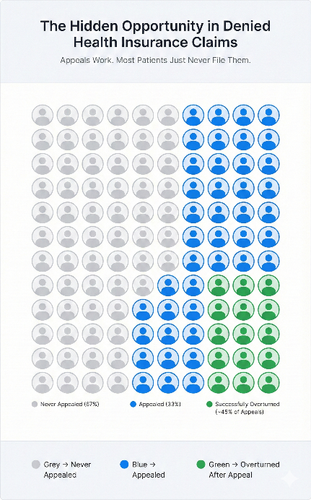
Introduction
AdvocAI is a fully autonomous, end-to-end multi-agent AI system designed to help patients fight wrongfully denied health insurance claims.
Integrates document parsing (OCR), medical evidence retrieval (PubMed), legal statute matching, and professional AI-generated writing into a single automated pipeline.
Requires only two inputs: denial letter PDF + policy PDF — no human intervention after upload.
Deploys a hybrid LLM strategy: Gemini 2.5 Flash (primary) + Ollama Llama 3.2 (offline fallback).
Outputs a complete appeal package: appeal letter PDF, medical evidence dossier, legal brief, and QA scorecard.
25-feb-2026

Slide 6

Problem Statement
Health insurance claim denials constitute a structural challenge within healthcare administration. Although a substantial proportion of appealed denials are overturned, most patients never initiate the process — reflecting systemic barriers rather than lack of eligibility.
Primary Causes of Appeal Failure
Documentation Literacy Deficit: Patients often lack the technical ability to interpret coding errors, policy language, and administrative requirements.
Insufficient Clinical Evidence: Successful appeals require peer-reviewed proof of medical necessity, typically inaccessible to individuals.
Regulatory Complexity: Overlapping federal and state statutes create a legally intricate appeals environment.
Financial Barriers: Professional advocacy and legal support are frequently cost-prohibitive.
Procedural Deadlines: Strict filing timelines discourage or eliminate many potential appeals.
Denials are less a question of medical merit and more a function of systemic complexity. Patients lose coverage due to structural barriers, not clinical ineligibility.
25-feb-2026

Slide 7
Scope
• End-to-End Case Management Dashboard: Secure web interface with guided uploads, real-time status tracking, progress indicators, and in-app document previews.
• Intelligent Document Processing Engine: OCR-based parsing of denial letters and policy PDFs with structured extraction of ICD codes, CPT codes, denial reason codes, and relevant policy clauses.
• Medical & Legal Intelligence Layer: PubMed API integration for peer-reviewed evidence retrieval, combined with automated statute matching against ACA, ERISA, and applicable state mandates.
• Automated Appeal Generation & Validation: Professionally structured appellate letter generation with AI-driven quality checks for citation accuracy, hallucination detection, structural integrity, and compliance scoring.
• Hybrid LLM Orchestration Framework: Adaptive routing across Gemini 2.5 Flash (primary), Ollama Llama 3.2 (fallback), and a stub-based safety layer to ensure resilience and continuity.
• Production-Grade Deployment Architecture: Fault-tolerant FastAPI backend with checkpointing and session persistence, integrated with a scalable web frontend and cloud-ready infrastructure.
25-feb-2026

Slide 8
Objectives
• Automate the End-to-End Appeal Workflow: Design a fully autonomous pipeline that converts denial and policy PDFs into a submission-ready appeal letter, with agents handling parsing, evidence retrieval, legal reasoning, drafting, and validation.
• Ground Appeals in Peer-Reviewed Medical Evidence: Integrate PubMed/NCBI APIs with intelligent query generation to retrieve clinically relevant literature aligned to extracted diagnosis and procedure codes.
• Embed Regulatory Reasoning and Statutory Citation: Implement a legal intelligence layer that identifies and applies federal and state statutes, transforming them into structured, citable arguments.
• Institute AI-Based Quality Adjudication: Deploy an independent Judge Agent that evaluates each appeal for clinical alignment, legal compliance, structural coherence, factual accuracy, and hallucination risk.
• Engineer Production-Grade Resilience: Build a fault-tolerant architecture with checkpoint capability, hybrid LLM fallback routing, and modular agent design to ensure scalability and maintainability.
• Advance AI for Healthcare Equity: Demonstrate that multi-agent AI systems address systemic access barriers, delivering professional-grade appeal documentation to underserved patients.
25-feb-2026

Slide 9
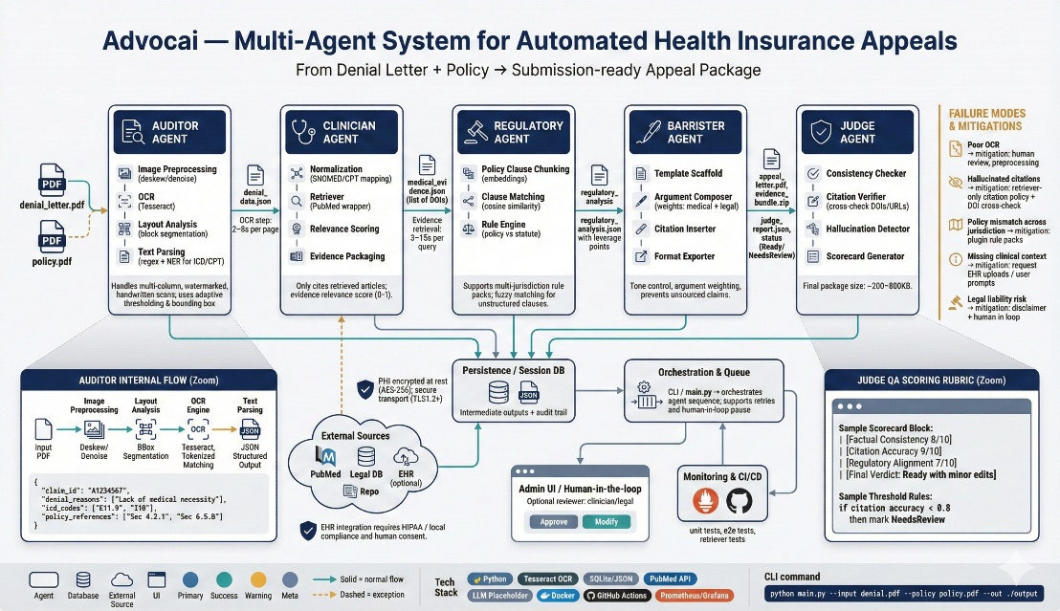
Architectural Diagram
25-feb-2026

Slide 10
Algorithmic Approach
Step 1 — OCR & Denial Parsing (Auditor Agent): Convert denial and policy PDFs into structured text. Extract procedure codes, denial reasons, and relevant policy clauses into JSON.
Step 2 — Evidence Retrieval (Clinician Agent): Generate targeted PubMed queries based on diagnosis and procedure context. Retrieve, verify, and rank peer-reviewed evidence supporting medical necessity.
Step 3 — Legal Reasoning (Regulatory Agent): Match denial characteristics against applicable federal and state statutes. Identify policy–law conflicts and construct structured legal arguments.
Step 4 — Appeal Drafting (Barrister Agent): Synthesize medical evidence and legal reasoning into a formal appeal letter. Ensure all claims are source-backed and professionally formatted.
Step 5 — QA Validation (Judge Agent): Independently evaluate clinical, legal, and structural integrity. Score the appeal and issue an approval or revision recommendation.
25-feb-2026

Slide 11
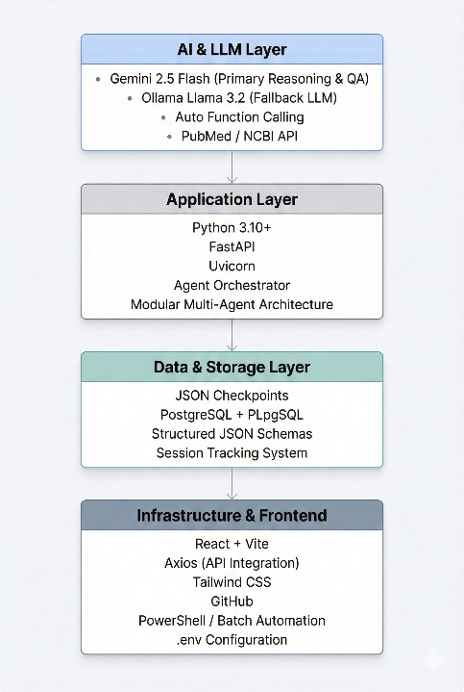
Technology Used
AI & LLMs: Gemini 2.5 Flash (primary reasoning & QA) | Ollama Llama 3.2 (fallback) | Auto Function Calling | PubMed / NCBI API
Backend Stack: Python 3.10+ | FastAPI | Uvicorn | pdfplumber | pytesseract | Pydantic
Frontend: React | Vite | Axios (API integration) | Tailwind CSS | Component-based UI architecture
Data & Storage: JSON checkpoints | PostgreSQL + PLpgSQL | Structured schemas | Session tracking
DevOps & Deployment: GitHub | PowerShell/Batch automation | JS CLI utilities | Modular architecture | .env config
25-feb-2026

Slide 12
Dataset
Primary Inputs • Denial Letter PDFs (ICD, CPT, denial codes, insurer rationale) • Insurance Policy PDFs (coverage clauses, exclusions, plan details)
External Sources • PubMed / NCBI API (peer-reviewed medical evidence) • Federal & State Laws (ACA, ERISA, MHPAEA, state mandates)
Pipeline-Generated Data • DenialObject | EvidenceDossier | LegalBrief | QA Scorecard
Storage & Handling • Structured JSON schemas | Session checkpoints (JSON/PostgreSQL)
Preprocessing • OCR + PDF parsing | Regex code extraction | LLM query generation | Statute matching | Schema validation
25-feb-2026

Slide 13
Conclusion
AdvocAI is a production-aligned, fully engineered multi-agent system — not a prototype. It demonstrates how AI can autonomously handle complex, high-stakes workflows across medicine and law.
Key Takeaways:
• End-to-End Automation: From raw denial PDF to submission-ready appeal — fully autonomous. • Evidence-Based: Every medical claim backed by real-time PubMed literature. • Legally Grounded: Cites ACA, ERISA, MHPAEA, and state mandates. • Self-Validating: Judge Agent scores outputs and blocks unsupported claims. • Production-Ready: Fault-tolerant architecture with LLM fallback and modular design. • AI for Good: Expands access to expert-grade appeal support.
Closing:
AdvocAI integrates medicine, law, and AI into a single intelligent system — built not just to automate, but to equalize access.
25-feb-2026

