Slide 1


ArogyaRakshak
Healthcare Rights Intelligence Platform — B.E. Computer Engineering, PES Modern College of Engineering, Pune | SPPU 2019
Patients upload a hospital bill, prescription, or insurance rejection letter and receive an instant plain-language analysis: whether they have been overcharged, denied coverage unfairly, or are eligible for government schemes they did not know about. Three integrated modules — BillNyay, SchemeSetu, and DawaCheck — share a unified context layer called Kadi. Full support for English, Hindi, and Marathi across all modules.
TEAM LEAD: VIRAJ JADHAO
TEAM OF 5
APPROVED BY GUIDE
DOCUMENT V2 — 12 JULY 2026

Slide 2
Why ArogyaRakshak?
Selected from five candidate FYP ideas — ArogyaRakshak, ClimateX, CivicEye AI, CourtPrep AI, and TenderGuard AI — on three decisive criteria: real end-user reach, public-data-only access, and an existing hackathon build to extend rather than a cold start. The full candidate comparison lives in the project selection dossier; this document is the working technical specification going forward.
Real End-User Reach
Public Data Only
Existing Foundation
Directly addresses financial harm to patients — overbilling, unfair insurance denials, and missed government scheme eligibility — a problem with clear, measurable impact.
All reference data — CGHS rates, PMJAY/MJPJAY scheme rules, NPPA ceiling prices — is publicly available. No proprietary data dependencies or licensing barriers.
BillNyay carries forward a working hackathon build. The team extends and refines rather than starting from zero, reducing timeline risk significantly.

Slide 3

System Architecture — The Kadi Layer
Three modules no longer operate as isolated pipelines. They share one context layer — Kadi (कड़ी, "link" in a chain) — so a single document upload can surface insights across all three modules without the user re-uploading anything. Kadi is not a fourth module; it is infrastructure that all three depend on.
DawaCheck
Any document
Medicine pricing verification
Bill, Prescription, Rejection Letter
Kadi Shared Processing
Shared Extraction Agent
SchemeSetu
Scheme eligibility checks
Unified data extraction
Kadi Shared Case Context
BillNyay
Bill audit and appeal
Common linked context
Any document type triggers the same shared extraction step, lands in Kadi's case context, and from there any of the three modules can read what is already known and write back what they find — that is what "linked, not just co-located" means in practice.

Slide 4
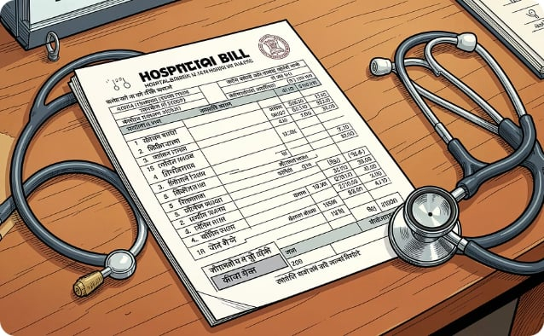
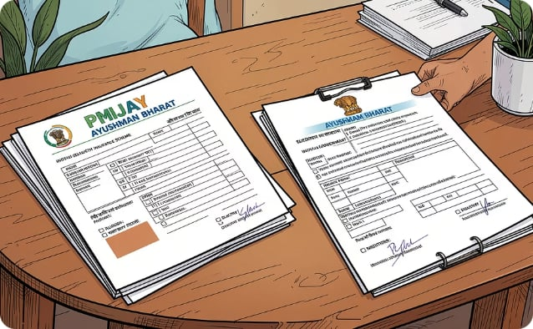
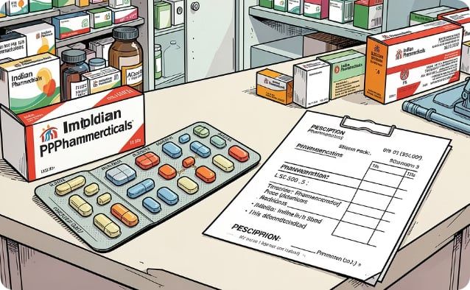
The Three Modules
BillNyay
SchemeSetu
DawaCheck
Formerly BillGuard — renamed for consistency; "Nyay" = justice. Upload a hospital bill → OCR extracts line items → benchmarks against CGHS government rates → flags overcharges. A 5-agent pipeline (Document Auditor → Clinical Reviewer → Regulatory Advisor → Appeal Drafter → QA Judge) drafts an IRDAI-compliant appeal letter as a PDF. Insurance rejection and appeal handling is built into the Appeal Drafter + QA Judge agents — not a separate feature.
User answers a short intake or uploads a bill/prescription → RAG layer over PMJAY (national) and MJPJAY (Maharashtra state) scheme documents → agent reasons through eligibility rules → outputs which scheme(s) apply and a step-by-step claim guide.
Upload a medicine strip photo or prescription → OCR reads drug name and batch → benchmarks MRP against NPPA ceiling prices for Schedule-I formulations (~800–900 price-controlled drugs) → flags overcharging → suggests generic substitutes. Deliberately scoped to Schedule-I only — the one segment with clean, government-published ground-truth prices.

Slide 5
Kadi — Shared Context Layer
Kadi is the connective infrastructure that makes the three modules genuinely interoperate. It comprises three core components: a case and entity data model, a shared extraction agent, and an entity resolution pipeline.
Case & Entity Model
Shared Extraction Agent
cases — One record per patient session; the anchor everything else attaches to
entities — Extracted structured data (medicine, hospital, procedure, amount, category), tagged by type
case_entities — Links entities to the case and the document/module that produced them
One extraction agent normalises any input document (bill, prescription, rejection letter) into a common schema — hospital, diagnosis/procedure, medicines, amount, date, category — rather than each module running its own bespoke parser. Harder to build well than three separate parsers, but it is what lets the three modules speak the same language.
Sits in the same Postgres instance alongside each module's domain tables — a new layer, not a new database.
Auto-Triggering
Once Kadi has enough context, it can proactively fire other modules without a re-upload. A bill mentioning a ₹4L cardiac surgery triggers SchemeSetu eligibility checks in the background — the strongest live-demo moment: one upload, three insights.

Slide 6


Entity Resolution Pipeline
The genuinely hard, genuinely defensible piece of Kadi. Three similarity signals feed a logistic regression that produces one confidence score, determining whether a new entity mention is merged, flagged for user review, or created as a new entity. Blocking happens within a case and by entity type before scoring, keeping it computationally cheap.
New Mention
Confidence Score
Merge / Review / New
The diagram above illustrates the full entity resolution flow — from an incoming entity mention through multi-signal confidence scoring to one of three resolution actions.
String Similarity
Transliteration Matching
Semantic / Cross-Lingual Similarity
Catches surface variants — "Paracetamol 650mg" vs "Paracetamol". Tool: edit distance and token overlap.
Same word, different script — क्रॉसिन ↔ Crocin. Tool: IndicXlit (AI4Bharat), MIT-licensed, supports Hindi + Marathi among 21 Indic languages.
Translated concepts, not transliterations — बुखार ↔ Fever. Tool: IndicSBERT (L3Cube, Pune) via sentence-transformers; outperforms generic multilingual models on Hindi/Marathi/English similarity.
Free win: The medicine entity-resolution work and DawaCheck's "generic substitute" feature both need brand-name ↔ active-ingredient mapping. Build it once, both features benefit.

Slide 7
Multilingual Strategy — English, Hindi & Marathi
Full trilingual support is a cross-cutting requirement across all three modules and Kadi — touching OCR, UI, LLM output generation, and entity resolution independently. Each layer has distinct technical considerations.
OCR on Devanagari Script
Source vs. Generation Distinction
Accuracy on non-Latin scripts is a separate technical risk from English OCR. Requires a dedicated Devanagari test set early in the build cycle, not an afterthought at evaluation time.
Whether PMJAY/MJPJAY/CGHS/NPPA source documents exist natively in Hindi/Marathi determines whether support means ingesting native-language source data (RAG/parsing) or generating output from English sources via LLM — different engineering tasks, scoped per data source.
Terminology QA
Cross-Script Entity Matching
A native/fluent Hindi and Marathi speaker reviews generated appeal letters and scheme explanations for substantive correctness, not just fluency. Legal and regulatory accuracy is non-negotiable.
Handled by Kadi's entity resolution pipeline via IndicXlit + IndicSBERT. Worth keeping distinct in your own mental model from UI/output-language generation — related systems, but separate engineering concerns.

Slide 8

Technology Stack
Layer
Technology
Action Required — Groq Model Swap: The original build used llama3-70b on Groq. Groq deprecated the 70B/8B Llama models on 17 June 2026. Re-point the pipeline to openai/gpt-oss-120b or qwen/qwen3.6-27b. Verify against Groq's live deprecations page before committing, as availability shifts.
Backend
FastAPI
Frontend
Next.js 15
Database
PostgreSQL + pgvector
Vector Search
FAISS
All tools for transliteration and cross-lingual embeddings are open-source and pretrained — no custom training pipeline required, keeping the full entity-resolution version feasible for a 5-person team on an FYP timeline.
LLM Inference
Groq API
Transliteration
IndicXlit (AI4Bharat)
Cross-Lingual Embeddings
IndicSBERT (L3Cube)
Containerisation
Docker Compose

Slide 9
Repository Structure & Team Roles
Monorepo — resolved this session. With Kadi as shared infrastructure that all three modules depend on, three separate repos would mean painful cross-repo dependency management for no real benefit at this team size.
Repository Layout
Team Roles
arogyarakshak/
├─ apps/
│ ├─ web/ # Next.js 15 frontend
│ └─ api/ # FastAPI backend
├─ packages/
│ ├─ kadi/ # shared context layer
│ ├─ billnyay/
│ ├─ schemesetu/
│ └─ dawacheck/
├─ data/ # ingestion scripts + processed data
├─ docs/ # this spec and future docs
└─ docker-compose.yml
01
Pipeline / Orchestration
Multi-agent reasoning across all three modules and Kadi's entity resolution pipeline — the heaviest single role.
02
OCR + Data Layer
Document ingestion, Devanagari OCR validation, RAG ingestion for all reference datasets.
03
Frontend / UX
Next.js interface with trilingual UI across English, Hindi, and Marathi.
04
Infra / Deployment
Docker, database, SSE streaming, and hosting configuration.
05
Data + Legal / Multilingual QA
Government data structuring, IRDAI/scheme rule accuracy, Hindi/Marathi terminology review.

Slide 10

Decisions, Open Items & Next Steps
✅ Resolved This Session
⬜ Open Items — Pending
BillGuard renamed to BillNyay
Cross-module linking architecture designed — Kadi, shared case context, not a fourth module
Entity resolution: full version approved, cross-script included, built on IndicXlit + IndicSBERT
Repo structure: monorepo, structure finalised
Scope, naming, and architecture locked — approved by guide
Confirm whether hackathon BillNyay code can carry into FYP submission directly, or must be framed as new work per department rules
Confirm SPPU Phase-I review date and what "done" looks like by then vs. final submission
Resolve Hindi/Marathi source-vs-generation per data source — determines real workload
Execute the Groq model swap — flagged, not yet confirmed done
Decide synthetic vs. real self-donated test-document dataset for OCR validation
Plan the labelled entity-pair dataset needed to tune entity-resolution confidence thresholds
Explicitly Out of Scope: Non-Schedule-I drug price variance; state schemes beyond Maharashtra; any stored patient data — every module stays bring-your-own-document.

