Slide 1


MedGuard AI
AI-Powered Medical Billing Auditor & Insurance Appeal Engine for India

Slide 2

The Healthcare Financing Crisis in India
India's healthcare financing system suffers from a critical lack of transparency and accessibility at the patient level, resulting in significant financial losses for millions of individuals annually.
50Cr
8M
Insured Population
Annual Denied Claims
Individuals covered by health insurance across India
Insurance claims rejected each year
67%
₹8K-15K
Never Appealed
Average Overcharge
Denied claims that patients don't contest
Per hospital bill excess charges
Key Challenges
Non-standardized and complex hospital billing formats
Limited patient understanding of medical and legal terminology
Lack of accessible interpretation of IRDAI regulations
High cost and effort required to file appeals
Outcome: Patients incur significant financial losses due to lack of actionable tools.

Slide 3









Intelligent System Architecture
Input Layer
Processing Pipeline
Output Layer
PDF bills, scanned images, voice input (Hinglish supported)
Speech-to-text, document parsing, billing analysis, regulatory mapping, multi-agent reasoning
Overcharge report, savings estimate, downloadable appeal letter (PDF)
Core Features
Hinglish Voice Input
Intelligent Bill Parsing
Supports mixed Hindi-English speech, converts natural language into structured data
Layout-aware document understanding, extracts line items, quantities, prices, table structures
CGHS-Based Detection
Confidence Scoring
Compares billed items with CGHS rate benchmarks, detects price inflation, duplicates, non-standard charges
Assigns probability scores based on price deviation, pattern recognition, historical mappings
IRDAI Intelligence
Multi-Agent Engine
Embeds IRDAI circulars into searchable vector database, enables clause-level citation
Clinician, Regulatory, and Legal agents validate medical necessity, map rules, draft appeals

Slide 4
How MedGuard AI Works
01
02
Upload Hospital Bill
Processing (~15 seconds)
PDF, scanned image, or voice input accepted
AI analyzes document and extracts billing data
03
04
Overcharges Highlighted
Savings Estimate Displayed
CGHS-based comparison identifies inflated charges
Total potential recoverable amount shown prominently
05
06
Click "Generate Appeal"
Download Appeal PDF
Multi-agent system creates evidence-backed appeal
Legally formatted document with citations ready to submit
Sample Detection Output
Detected Anomaly
Regulatory Citation
Item: Blood Test
"As per IRDAI Circular 2023/14, Clause 5.2, insurers must adhere to benchmark pricing guidelines for standard medical procedures..."
Charged: ₹840
CGHS Rate: ₹320
Overcharge: ₹520
Confidence: 87%

Slide 5

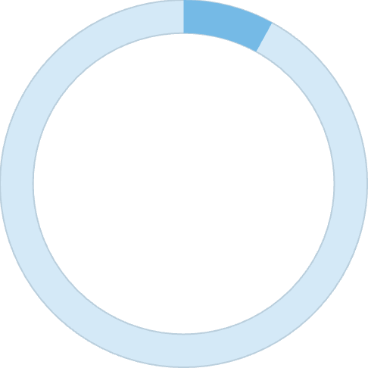

Technology Stack & Business Model
Technology Stack
Layer
Technology
Frontend
Next.js
Backend
FastAPI
Speech Processing
Whisper
Document AI
LayoutLMv3
Vector Database
FAISS / Pinecone
LLM Orchestration
GPT-based models
Deployment
Vercel + HuggingFace
Business Model
Consumer (B2C)
Business (B2B)
Enterprise
₹99 per appeal generation
SaaS for TPAs and insurers
API integration for insurance platforms
Market Opportunity
50Cr
8M
67%
Insured Population
Annual Denied Claims
Unappealed Claims

Slide 6

Transforming Healthcare Financial Protection
Competitive Advantages
India-Focused Solution
End-to-End Pipeline
CGHS + IRDAI integration tailored for Indian healthcare regulations
Complete audit and appeal generation in single platform
Multi-Agent Reasoning
Real Financial Impact
Specialized AI agents for clinical, regulatory, and legal validation
Clear visibility of potential savings and recoverable amounts
Future Scope
Integration with insurer APIs for automated claim filing
Hospital compliance analytics and monitoring
Large-scale fraud detection across healthcare providers
Conclusion
MedGuard AI addresses a critical gap in India's healthcare ecosystem by empowering patients with actionable insights and automated legal support. It transforms a complex, opaque process into a structured, accessible, and data-driven workflow—enabling financial protection at scale.

