Slide 1

Pragati Engineering College
Breast Cancer Prediction
Presented By
Y .Mahendra reddy(20A31A4464)
S.Viraj(20A31A4463)
N.V.S.Narayana(20A31A4452)
Sattar baig(20A31A4459)
Guided By
Mrs.K Lakshmi viveka-Asst.prof& HoD in CSE(AI)

Slide 2
Contents
1.Abstract
2.Introduction
3.Scope
4.Technologies

Slide 3
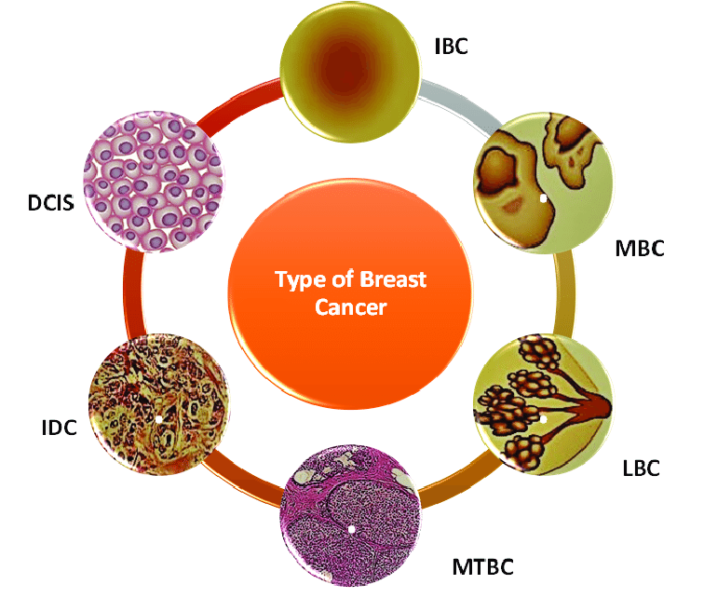
1.Abstract
Breast cancer is one of the most common cancers with a high mortality rate among women. With the early diagnosis of breast cancer survival will increase from 56% to more than 86%. Therefore, an accurate and reliable system is necessary for the early diagnosis of this cancer. The proposed model is the combination of rules and different machine learning techniques. Machine learning models can help physicians to reduce the number of false decisions. They try to exploit patterns and relationships among a large number of cases and predict the outcome of a disease using historical cases stored in datasets.
Types of breast cancer

Slide 4
2.Introduction
The second major cause of women's death is breast cancer (after lung cancer)
Cancer starts when cells begin to grow out
of control
Breast cancer can spread when the cancer cells get into the blood and are carried to other parts of the body
There are many algorithms for classification
and prediction of breast cancer outcomes
The algorithms we can use in this project is SVM , Logistic Regression , Random Forest ,kNN and DecisionTreeClassifier which are among the most influential machine learning algorithms

Slide 5
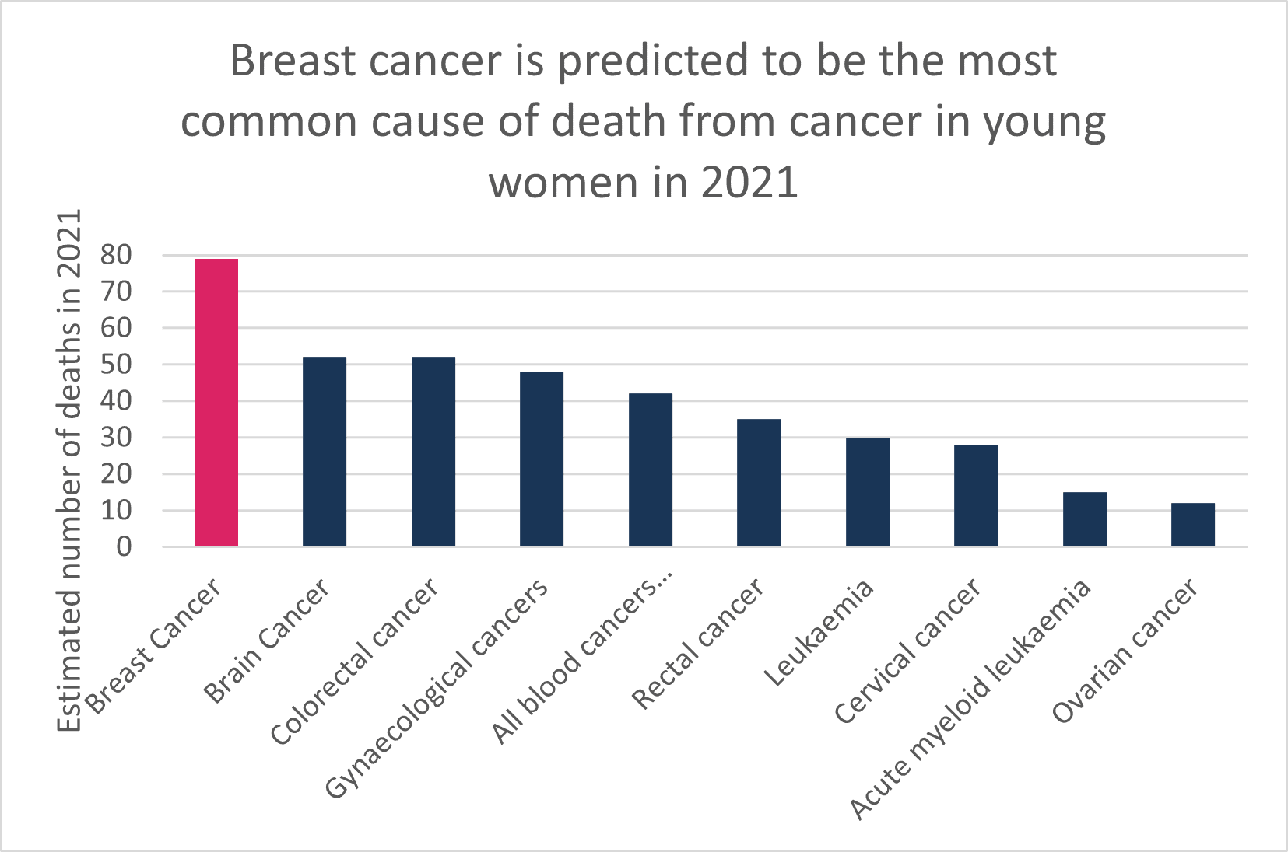
Scope
It has been observed that a good dataset provides better accuracy. Selection of appropriate algorithms with good home dataset will lead to the development of prediction systems. These systems can assist in proper treatment methods for a patient diagnosed with breast cancer. There are many treatments for a patient based on breast cancer stage; data mining and machine learning can be a very good help in deciding the line of treatment to be followed by extracting knowledge from such suitable databases.

Slide 6

Technologies
PYTHON
Numpy
Pandas
Seaborn
matlplotlib
Source
KAGGLE

Slide 7
Thank You

