Slide 1
INTRODUCTION TO ITP
ITP – IT 222
Lecture 1
Sri Lanka Institute of Information Technology
B. Sc. Special Honors in Information Technology
Year 2 – Semester 2

Slide 2
Agenda
Introduction to ITP
Semester Plan
Assessment Details
Project Initiation
Project Charter
Project Progress Details
Guidelines to Succeed the Project

Slide 3
Course Identification
Course Name: Information Technology Project (ITP)
Course Code: IT222
Credit Points: 4
Duration: One Semester

Slide 4
Pre-requisites
IT102, IT200 – Software Technology
IT103 – Database Management Systems I
EC143,EC224 – Data Communications & Computer Networks
IT101 – Introduction to Programming Environments
IT104 – Internet Technology & Applications
IT220 – Software Engineering I
Knowledge acquired through one and half years of completing the Associate Diploma Course in Information Technology

Slide 5
Mode of Delivery
Formal
2 hr Lecture session per week
1 hr Tutorial per week/ Discussions/Presentations
2 hr Lab session per week
Informal
Group discussions among the group members
Members participating in project related work
Meeting lecturer & supervisor (by appointment)…Team Leader should communicate
Meeting your client (by appointment)

Slide 6
Mode of Delivery
Resources and Materials
All the unit resources and materials will be delivered using the courseweb.
Every student must obtain access to the new courseweb and enroll to the ITP unit.
Notices
All notices will be published on the courseweb unit page
Check the unit page regularly

Slide 7
Objectives of ITP
What is ITP?
An important piece of work in your degree program
Involves students in developing, managing and achieving the objectives of an ICT project
A major independent project activity which involves the defining of the project objectives, the preparation of a project documents and showing the various stages of completion of project and develop the product.

Slide 8
Objectives of ITP
Why do you need ITP?
Provides an opportunity to demonstrate your knowledge & skills in a practical ICT application
A benchmark of your ability to solve an industry problem using ICT
Improve team work
Develop various skills
Become outstanding graduate **

Slide 9
Categories of Projects
Industry Based Projects
These projects must have a real client.
If necessary we can issue a formal letter to the client companies.
Projects aligned with competitions
Example : Microsoft Imagine Cup

Slide 10
Categories of Projects
Further in your project you can develop a :
Desktop Application
Web-based Application
But not a Web site
Vehicle Management System
Hotel Management System
Student Management System
Hospital Management System
Designing systems (Fashion/Fabric)

Slide 11
Project Scope
Select a project with the correct scope(size).
The scope must not be too small or too large for a 14 week duration.
The project must have at least 8 significant business functions.

Slide 12
Contribution of the Team Members
You must handle your function from “end-to-end”.
You are in-charge of documenting, designing, coding, testing, integrating, etc. your function.
It should not be the case that one member is only writing documents, the other one just doing the ER and the database, another one only designing the user interfaces etc..

Slide 13
ITP – IT 222
Semester Plan

Slide 14
Lectures
Introduction to Information Technology Project
Introduction to Agile Software Development
Project proposal writing , Plagiarism and Referencing
Project Management
User Interface Design concepts
Software quality & Testing

Slide 15
Practical Sessions
Trello (Agile Project Management Tool)
Git (Version Control Software)
Unit Testing using JUnit
Introduction to SonarQube for code quality

Slide 16
Weekly Plan (Changes May Occur)
Starting Date of the Week | Week | Evaluations | Deadlines
17-July | Week 1 | Project Charter submission | Project Charter
24-July | Week 2
31-July | Week 3 | Iteration 01 - Proposal Discussion | Proposal Document
07-August | Week 4
14-Augustl | Week 5 | Iteration 02 (User interface designing)
21-August | Week 6 | Iteration 02 (User interface designing)
28-August | Week 7
4-Septmber | Week 8
11-Septmber | Week 9 | Prototype Presentation
18-Septmber | Week 10 | Prototype Presentation
25-Septmber | Week 11
2 - October | Week 12 | Practical Exam
9 - October | Week 13 | Iteration 04 (Feedback session) | Final Document
16 - October | Week 14 | Iteration 04 (Feedback session)
Final Presentation – The Week After the Final Examinations

Slide 17
ITP – IT 222
Assessment Details

Slide 18
What are the assessments?
Project Charter (Registration)
Project Proposal
Proposal Document and Discussion
User Interface and Design Evaluation
Prototype Presentation
Online Examination
Final Document
Final Product Demonstration and Viva
Teamwork and Project Progress

Slide 19
Assessments
Iteration 01 (Project Proposal and Requirements) | 5%
Iteration 02 (User interface & design evaluation) | 10%
Prototype Demonstration | 20%
Online Examination | 30%
Iteration 04 (Feedback session) | 5%
Final Document | 5%
Final Product and Demonstration and viva | 25%

Slide 20
Assessments
During an evaluation all members must be present
Some evaluations may held during the lecture and the tutorial sessions
Most evaluations are group activities
Therefore attending all lectures and the tutorial sessions are important
All the members of the group must attend the same lecture and the tutorial session

Slide 21
Assessments
In every assessment the contribution of each member is assessed
A “common mark” is not given for the entire project
Thus to pass the unit every member’s involvement in all project stages and activities are necessary

Slide 22
Steps to start the Project
Form a group (8 Members)
Find a client
Discuss the project with one of the ITP lecturers
Prepare the project charter and get it approved
Submit the approved project charter
Deadline will be during second week of the semester.

Slide 23
ITP – IT 222
Guidelines to Succeed a Project

Slide 24
Why Do Projects Fail?
People begin programming before they understand the problem
A team that begins programming too soon will end up writing good software that solves the wrong problem
The team has an unrealistic idea about how much work is involved.
From far away, most complex problems seem simple to solve
Teams can commit to impossible deadlines by being overly optimistic and not thinking through the work

Slide 25
Why Do Projects Fail?
Defects are injected early but discovered late.
The team does not have a good sense of the overall state of the project.
Everyone assumes that the testers will catch all of the defects that were injected throughout the project

Slide 26
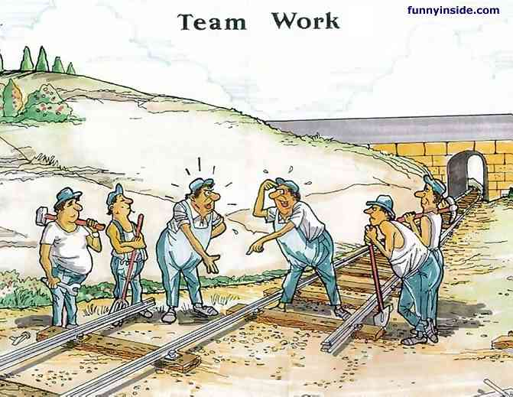

Slide 27
How can we make sure that our projects succeed?
Make sure all decisions are based on openly shared information
Friends and enemies
All project documents, schedules, estimates, plans and other work products should be shared with the entire team, stakeholders, users and anyone else in the organization who wants them.
Major decisions that are made about the project should be well-supported and explained.

Slide 28
How can we make sure that our projects succeed?
Just because a leader/manager has responsibility for a project’s success, it doesn’t mean that he’s more qualified to make decisions than the team members
Introduce software quality from the very beginning of the project
Use good engineering practices
Managers and teams often want to cut important tasks – especially estimation, reviews, requirements gathering and testing.

Slide 29
Contact ITP Lecturers
Lecturer-in-Charge - Ms. Geethanjali Wimalaratne
Ms. Geethanjali Wimalaratne (Metro) - geethanjali.w@sliit.lk
Ms. Tharani Jayakodi (Metro & Malabe) – tharani.j@sliit.lk
Ms. Yashodhya Wijesinghe (Malabe) – yashodhya.w@sliit.lk
Ms. Thilini Yatanwala (Malabe) – thilini.y@sliit.lk
Ms. Kushnara Suriyawansa (Malabe)- kushnara.s@sliit.lk
Ms. Janani Tharmaseelan (Malabe) - janani.t@sliit.lk
Ms. Chamari Silva (Matara) - chamari.s@sliit.lk
** Make sure to email the lecturer prior to place an appointment.

Slide 30

Submissions
Project Charter
Weekday Students
Metro – At the Tutorial ( on week 1 & 2)
Malabe - At the Tutorial ( on week 1 & 2)
Weekend Students
Metro – At the Tutorial ( on week 1 & 2)
Malabe - At the Tutorial ( on week 1 & 2)

Slide 31

Any Questions ???
Notes:
ITP_lec1_2010

