Slide 1

BitCode Tutorials An Online Learning Platform for New Programmers SUBMITTED IN PARTIAL FULFILLMENT OF DIPLOMA IN ADVANCED COMPUTING (PG-DAC) UNDER THE GUIDANCE Of Mr. Jitesh Bafna Presented By
Viraj More 230340120121
Sangram Nipane 230340120132
Aditya Mane 230340120107
Suraj Sawant 230340120209
Sahil Patil 230340120180
Group No 3

Slide 2
Introduction
BitCode Tutorials is an online learning platform that provides various courses on a variety of programming languages. These tutorials are developer documentation based, with the best interpretation of technical jargons into simplified layman terms. The detailed requirements and specifications for the development of BitCode Tutorials website are provided in this document. Document Purpose BitCode Tutorials website aims to create a E-learning programming tutorials website toprovide free, extensive and accurate knowledge to the learners at one single place.

Slide 3
Problem Statement
With the advent in technology and with the perpetual increase in the strength of the students and the number of departments in the educational institutions, it is laborious to exchange the study materials between the students and the faculties.
The main objective of the E-Learning is to help the students get over the traditional methods of learning and make them accustomed to the internet where the notes for their respective subjects are easily available. It provides an automation procedure of studying the notes online. The implementation of this project helps the students. The students can gain access to these notes by searching for the name of the file under their respective department.
This project not only helps to facilitate easier access to notes for the students but also helps cutting down on expenditure for the universities as well. Students and Universities alike spend a considerable amount of money on printing costs which can be prevented.
E-Learning is an inexpensive, efficient and comfortable way for students to easily access notes and an easier alternative to study for exams.

Slide 4
Product Scope
This web application is an online E-learning tutorials website that helps programmers with extensive knowledge of various programming languages, along with plenty of coding examples. Each user can signup to this website and keep a track record of their learning journey.
There are options to subscribe for premium contents of this tutorials website which provides user with exclusive content. A course purchase history is maintained for every subscription made.

Slide 5
Aims & Objectives
Specific goals are: -
To produce a web-based system that allow users to access the content depending upon the courses available which can be free and paid.
To produce a web-based system that allow admins to add the contents in the existing courses and additional information.
To maintain a track for the admin on the respective courses about the purchase ratios. And also keep tract upon the transactions.

Slide 6
Overall Description
This programming tutorials website provides plenty of code snippets to make user familiar with the programming environment and programming syntax. Each code snippet is followed by a in depth explanation.
The content is thoroughly tested and designed in a manner that assures easy understanding to leaners.
An online coding compiler is made available for users with paid subscriptions for immediate hands on.
Admins have right to access all the user profiles and other related informations such as progress tracking, course enrollments, payment transactions, etc. Admins can add new contents within the existing courses and also can add new courses.
The users are provided various courses with specific contents and relative information as per requirements. Users registration is done for the purchase various paid contents and profile is maintained along with the progress tracking.

Slide 7
Operating Environment
Server Side:
Processor: Intel® Xeon® processor 3500 series
HDD: Minimum 500GB Disk Space
RAM: Minimum 4GB
OS: Windows 10, Linux 6
Database: MySQL
Client Side (minimum requirement):
Processor: Intel Dual Core
HDD: Minimum 80GB Disk Space
RAM: Minimum 1GB
OS: Windows 8 and above, Linux

Slide 8
Design and Implementation Constraints:
The application will use ReactJS, Spring Boot API, Ajax, JavaScript, jQuery and CSS as main web technologies.
HTTP and FTP protocols are used as communication protocols. FTP is used to upload the web application in live domain and the client can access it via HTTP protocol.
Several types of validations make this web application a secured one.
Since BitCode Tutorials is a web-based application, internet connection must be established.
BitCode Tutorials will be used on PCs and will function via internet or intranet in any web browser.

Slide 9
Specific Requirement
External Interface Requirements:
User Interfaces:
All the users will see the same page when they enter in this website. This page asks the users a username and a password.
After being authenticated by correct username and password, user will be redirect to their corresponding profile where they can do various activities.
The user interface will be simple and consistence, using terminology commonly understood by intended users of the system. The system will have simple interface, consistence with standard interface, to eliminate need for user training of infrequent users.

Slide 10
Hardware Interfaces:
No extra hardware interfaces are needed.
The system will use the standard hardware and data communication resources.
This includes, but not limited to, general network connection at the server/hosting site, network server and network management tools.

Slide 11
Functional Requirements
Access Website
New users can register to this website for free and start their programming
journey, or simply browse through the website for free content without registration.
Admin Profile
The admin has all the rights to have an access to the entire courses and the
users profile which contains the user profile tracking, progress of the course for all
users. The admin have an access to the payments related detailed information
regarding the courses with respect to all users. Admin have an access to modify the
existing course contents and also to add a new course as per required.

Slide 12
User Profile
Each user has a personalized dashboard that displays user specific information like course purchase history, learning track record, etc.
Various personal details like profile name, password, etc can be updated via this dashboard as well.
Enrollment of the course
The user can enroll the courses which are free as well as paid. Users need to enroll the paid courses by purchasing the course respective to their enrollment amounts.
Progress Tracking
The course or contents enrolled by the specific user is been added to respective profiles with proper progress tracking bar. As the contents are been marked as done it reflects the progress within the profile.
Application Interfaces:
OS: Windows 10, Linux

Slide 13
Web Browser:
The system is a web-based application; clients need a modern web browser such as Mozilla Firebox, Internet Explorer, Opera, and Chrome. The computer must have an Internet connection in order to be able to access the system.
Communications Interfaces:
This system uses communication resources which includes but not limited to, HTTP protocol for communication with the web browser and web server and TCP/IP network protocol with HTTP protocol.
This application will communicate with the database that holds all the booking information. Users can contact with server side through HTTP protocol by means of a function that is called HTTP Service. This function allows the application to use the data retrieved by server to fulfil the request fired by the user.

Slide 14
Non-Functional Requirements
Security
The system’s back-end servers shall only be accessible to authenticated administrators. Sensitive data will be encrypted before being sent over insecure connections like the internet.
Availability
The system should be available at all times, meaning the user can access it using a web browser, only restricted by the downtime of the server on which the system runs. In case of an of a hardware failure or database corruption, a replacement page will be shown. Also, in case of a hardware failure or database corruption, backups of the database should be retrieved from the server and saved by the administrator. Then the service will be restarted. It means 24 X 7 availability.

Slide 15
Reliability
The reliability of the overall program depends on the reliability of the separate components. The main pillar of the reliability of the system is the backup of the database which is continuously maintained and updated to reflect the most recent changes. Thus, the overall stability of the system depends on the stability of container and its underlying operating system.
Maintainability
A commercial database is used for maintaining the database and the application server takes care of the site. In case of a failure, a re-initialization of the program will be done. Also, the software design is being done with modularity in mind so that maintainability can be done efficiently.
Accessibility
The system will be a web-based application it is going to be accessible on the web browser.

Slide 16
Back up
We will take a backup in our system database. In order to enable the administrator and the user to access the data from our system.
Performance
The product shall be based on web and has to be run from a web server. The product shall take initial load time depending on internet connection strength which also depends on the media from which the product is run. The performance shall depend upon hardware components of the client/customer

Slide 17
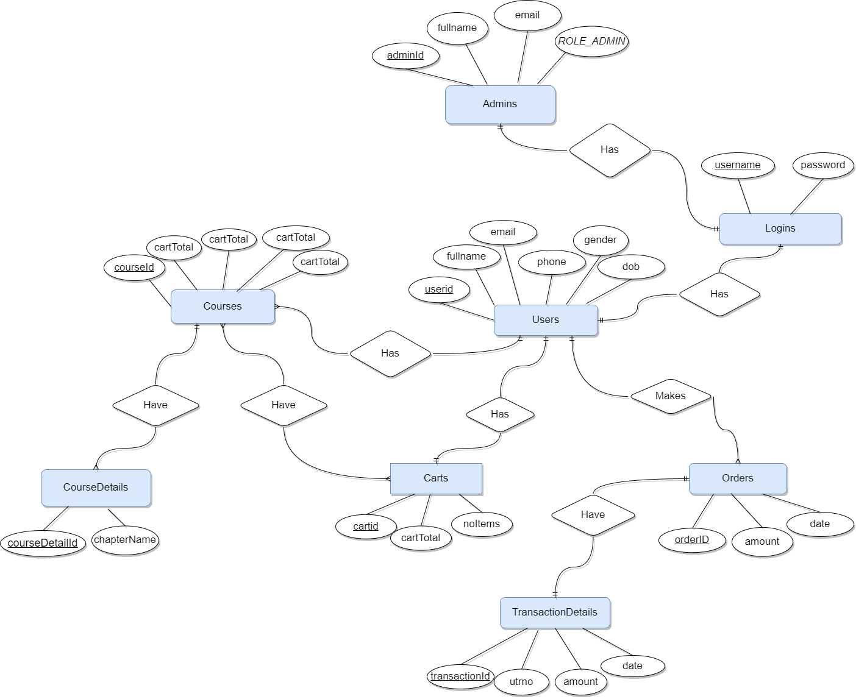
System Design
ER Diagram

Slide 18
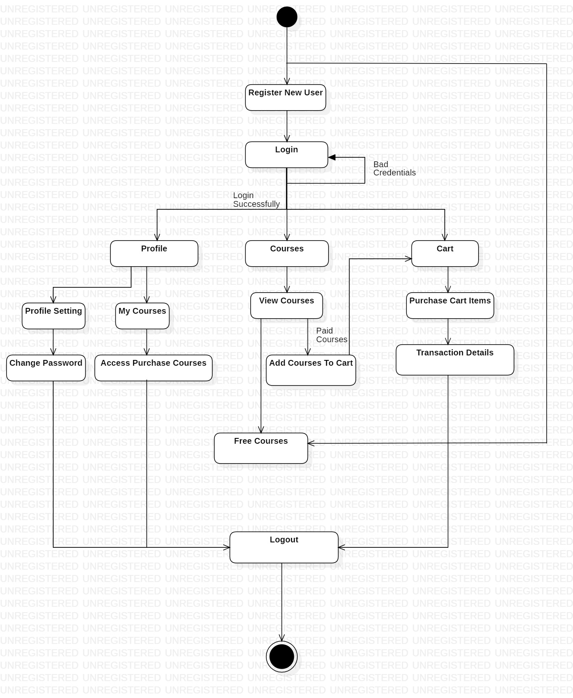
Activity Diagram

Slide 19
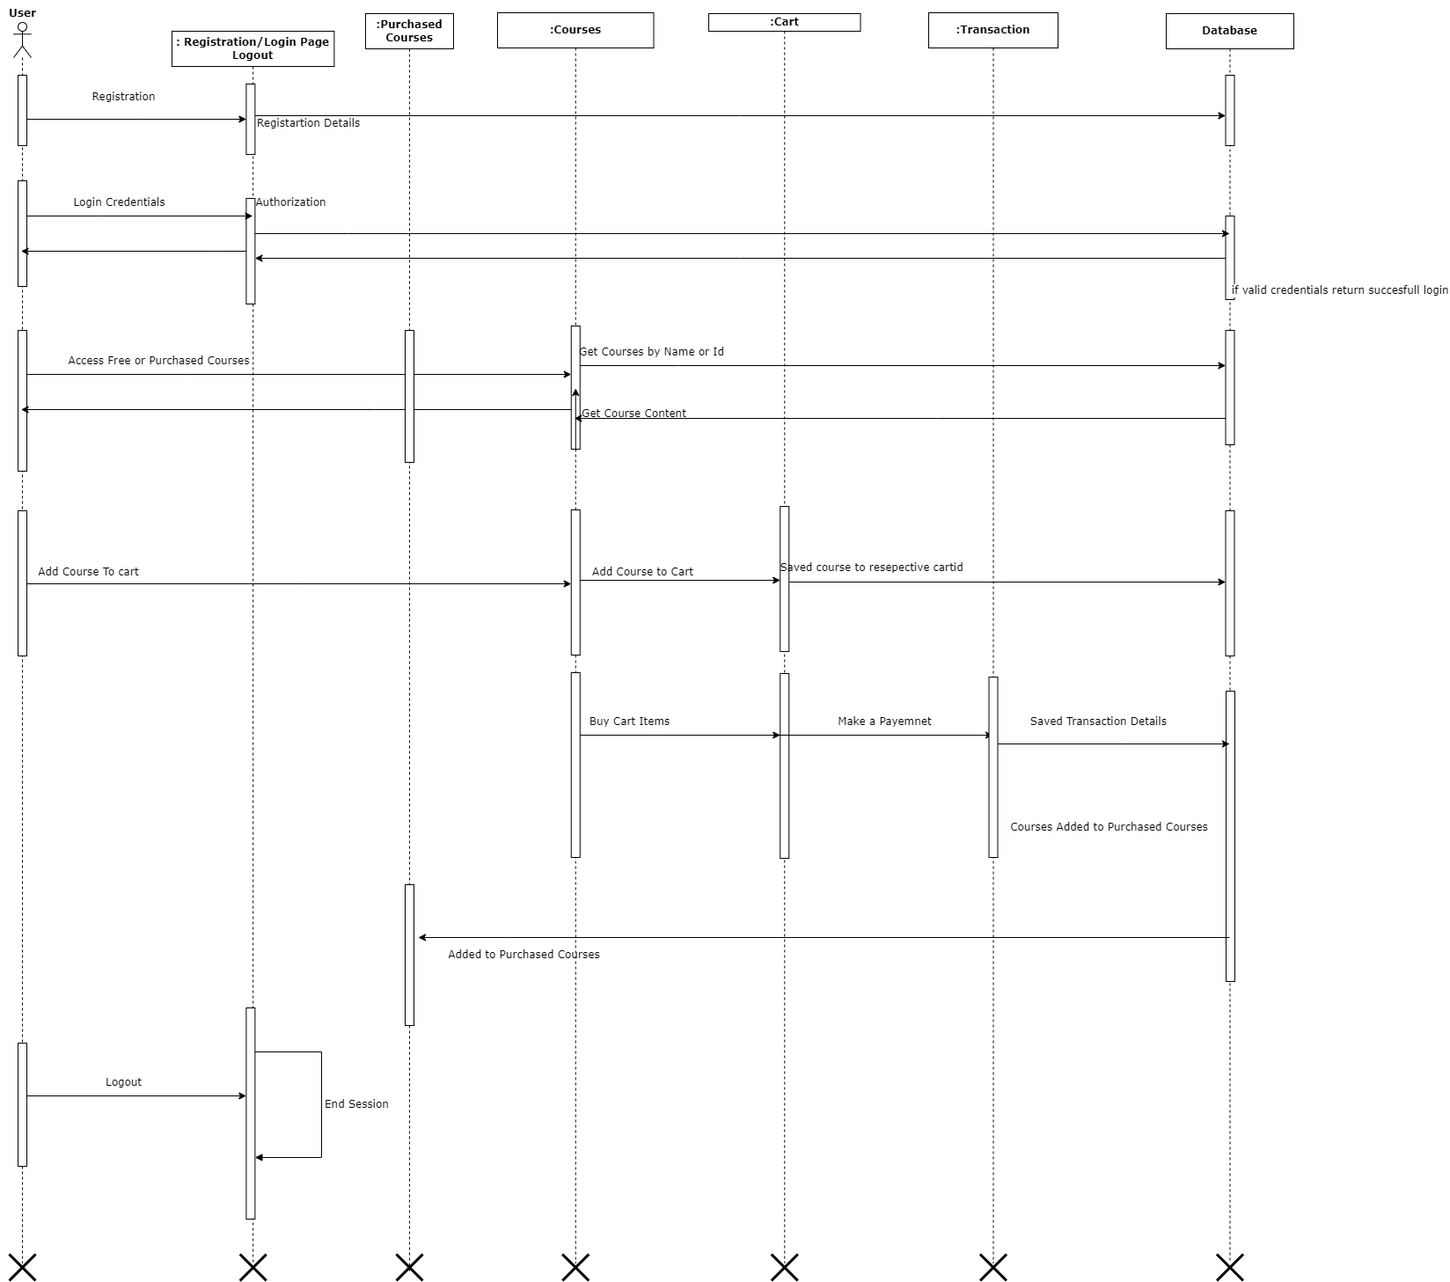
Sequence Diagram

Slide 20
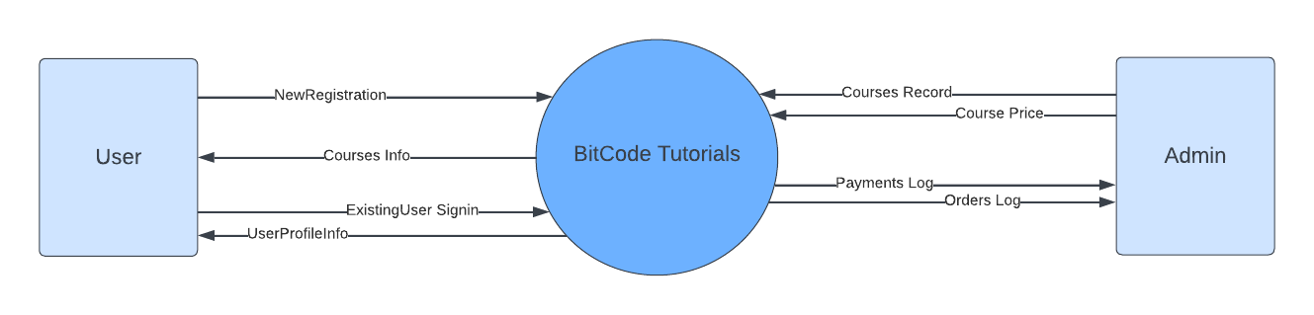
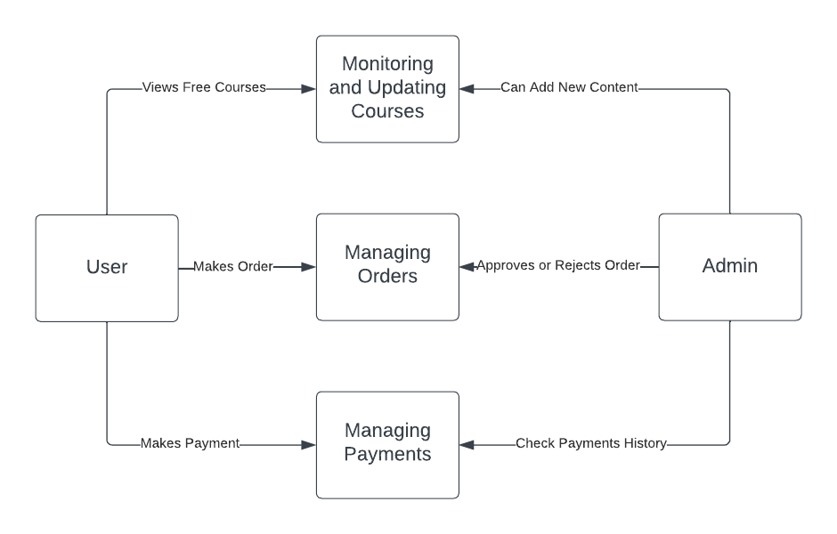
Data Flow Diagram

Slide 21
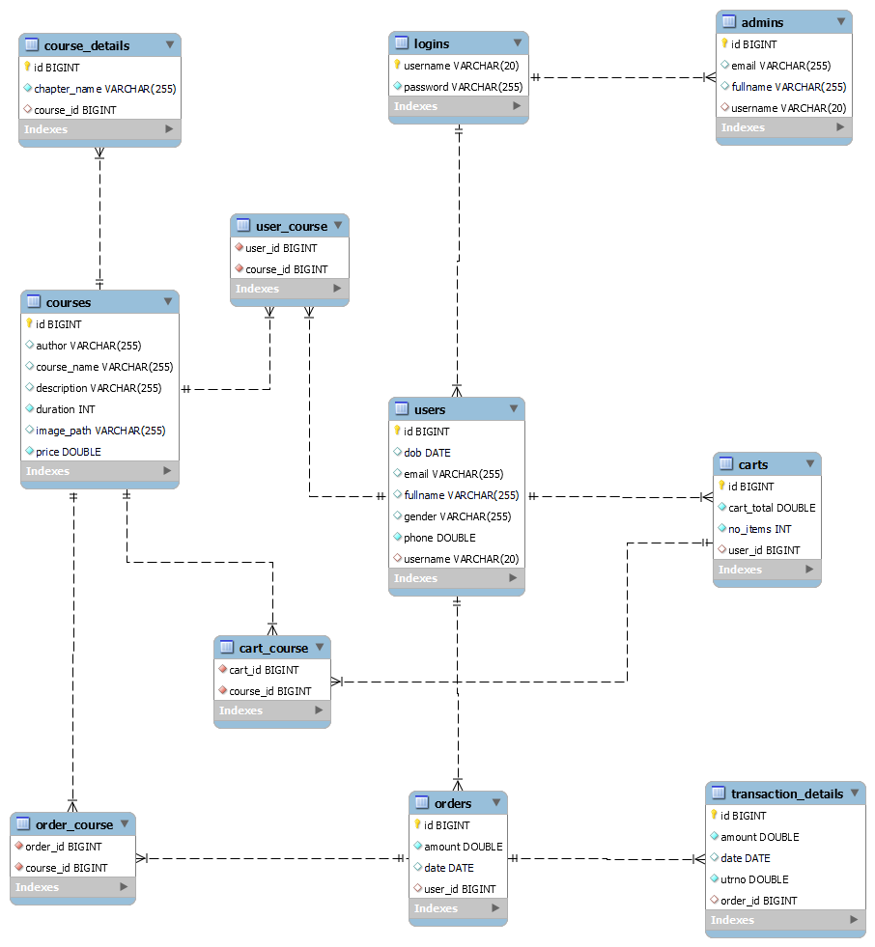
Class Diagram

Slide 22
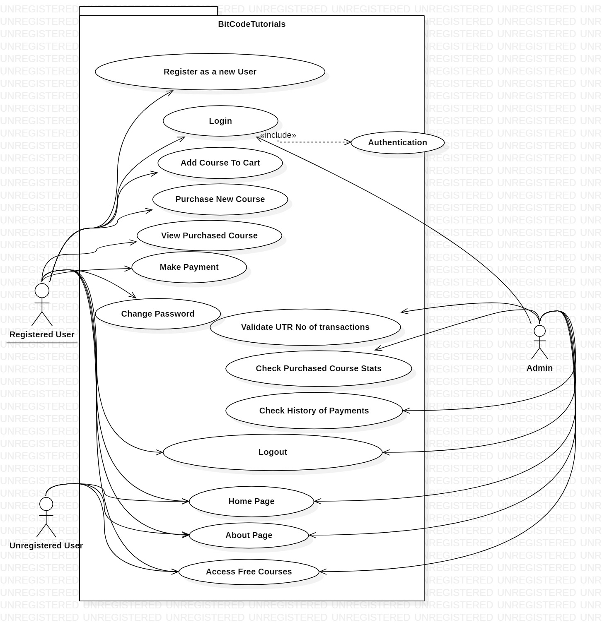
Use Case Diagram

Slide 23
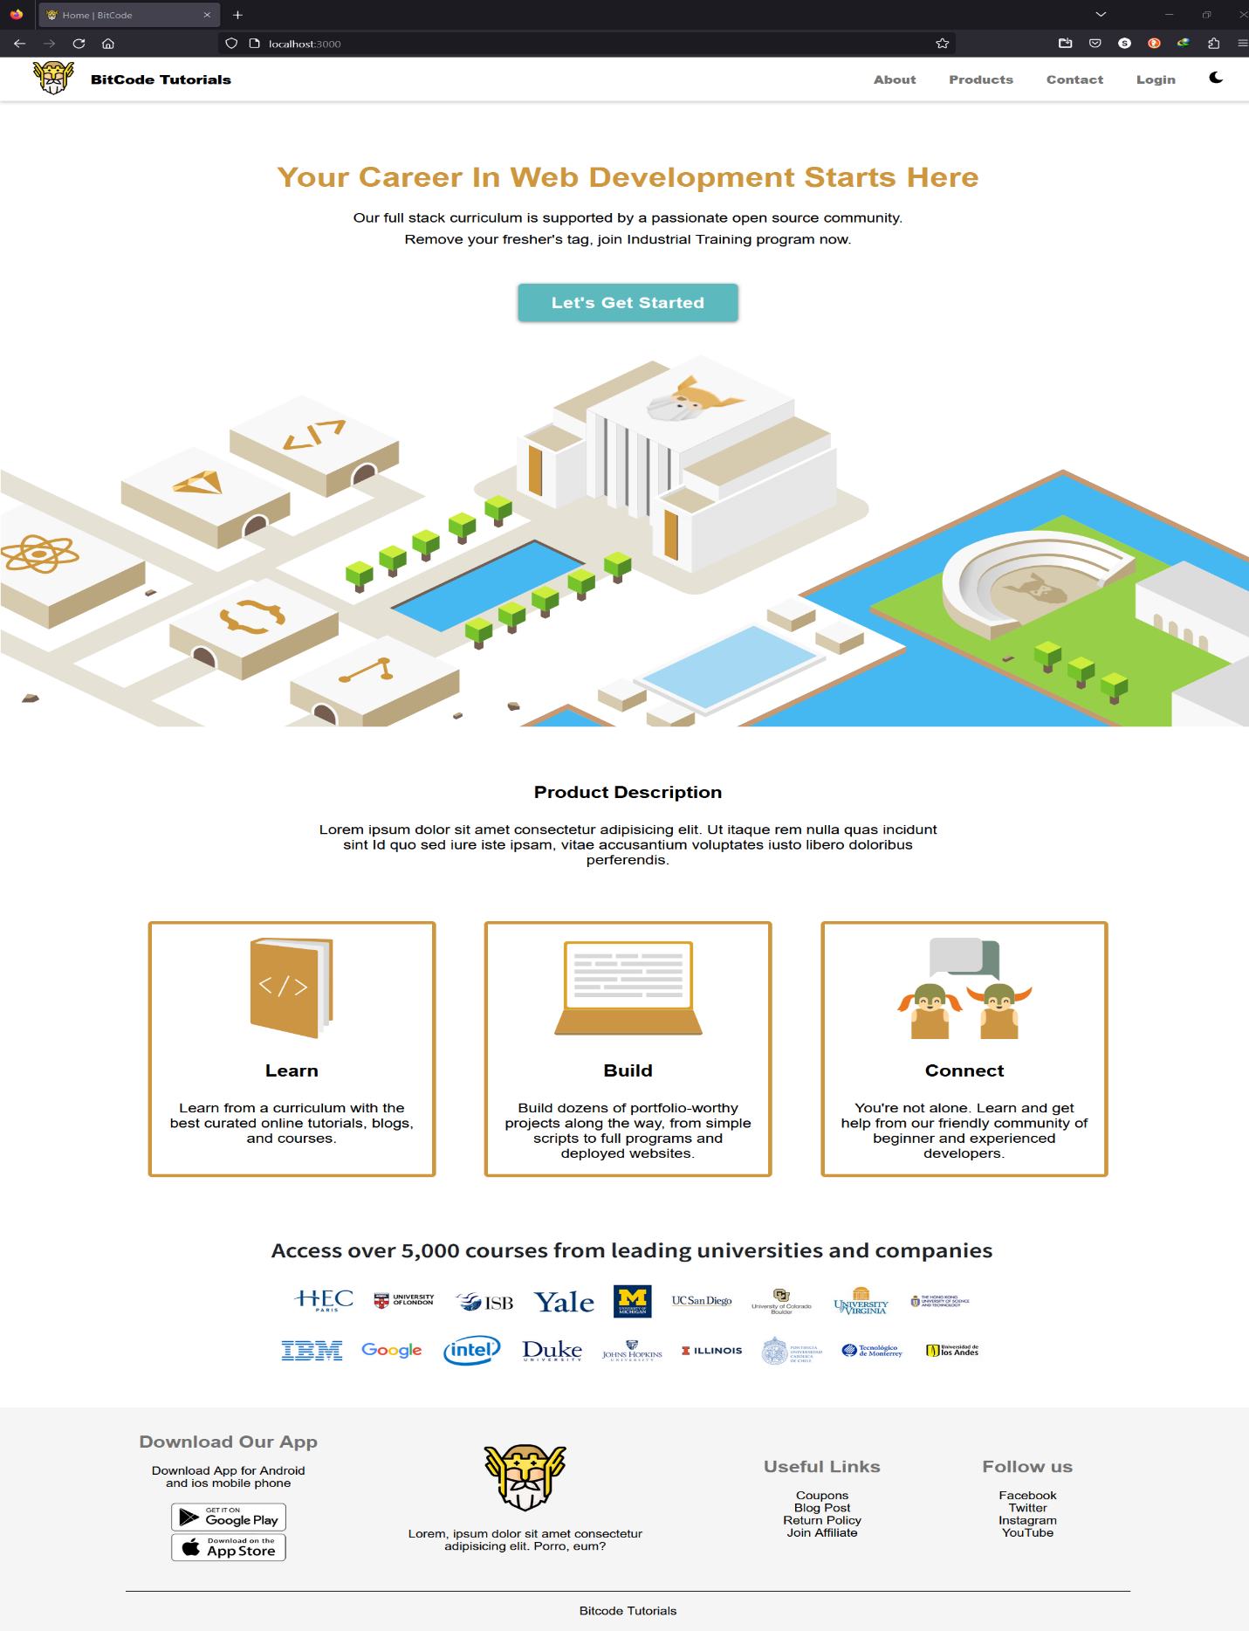
Website UI:
Guest UI

Slide 24
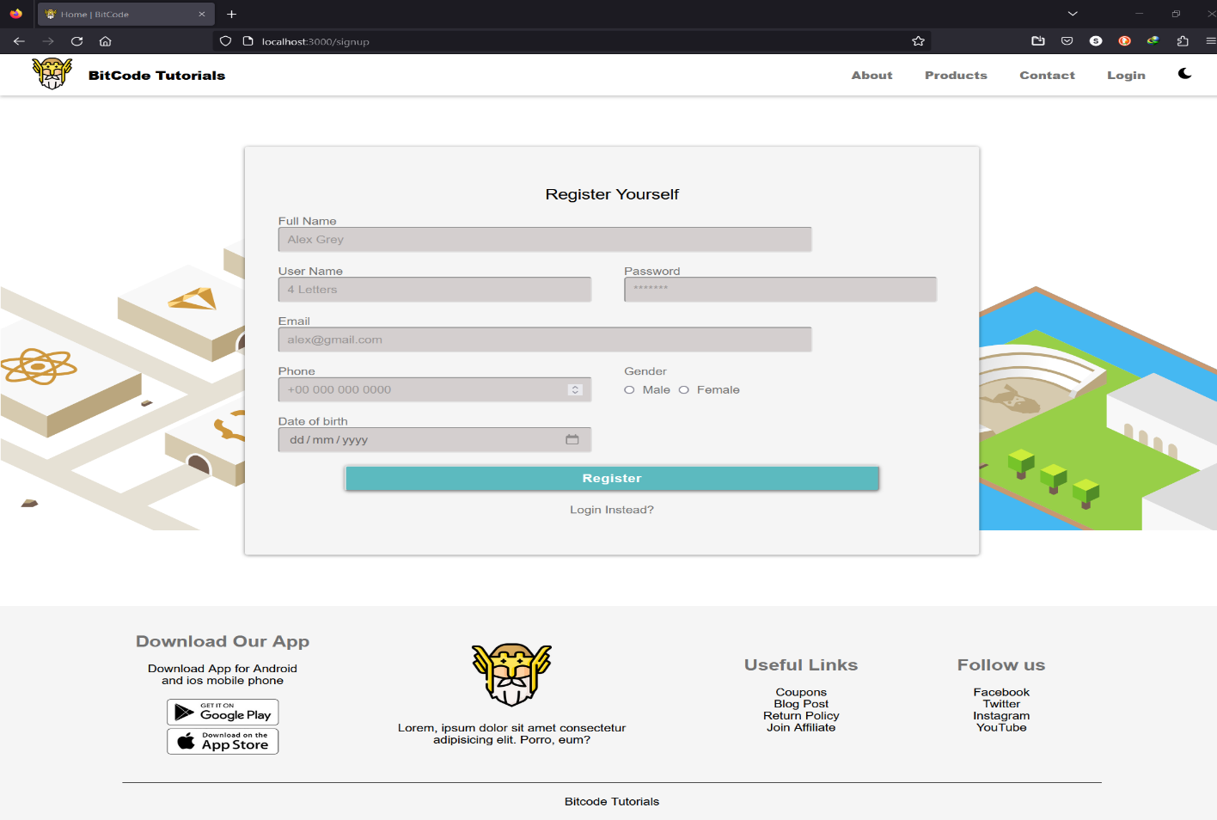

Slide 25
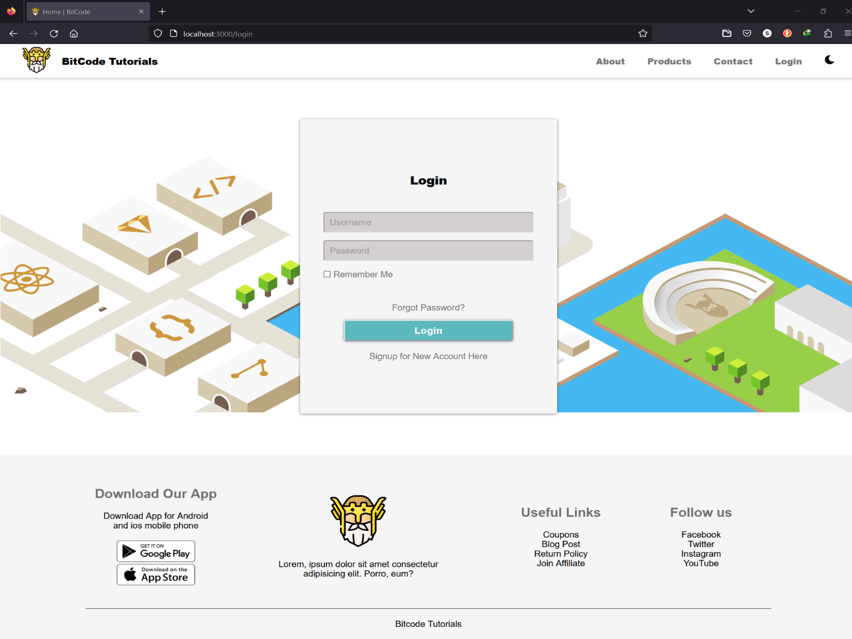

Slide 26
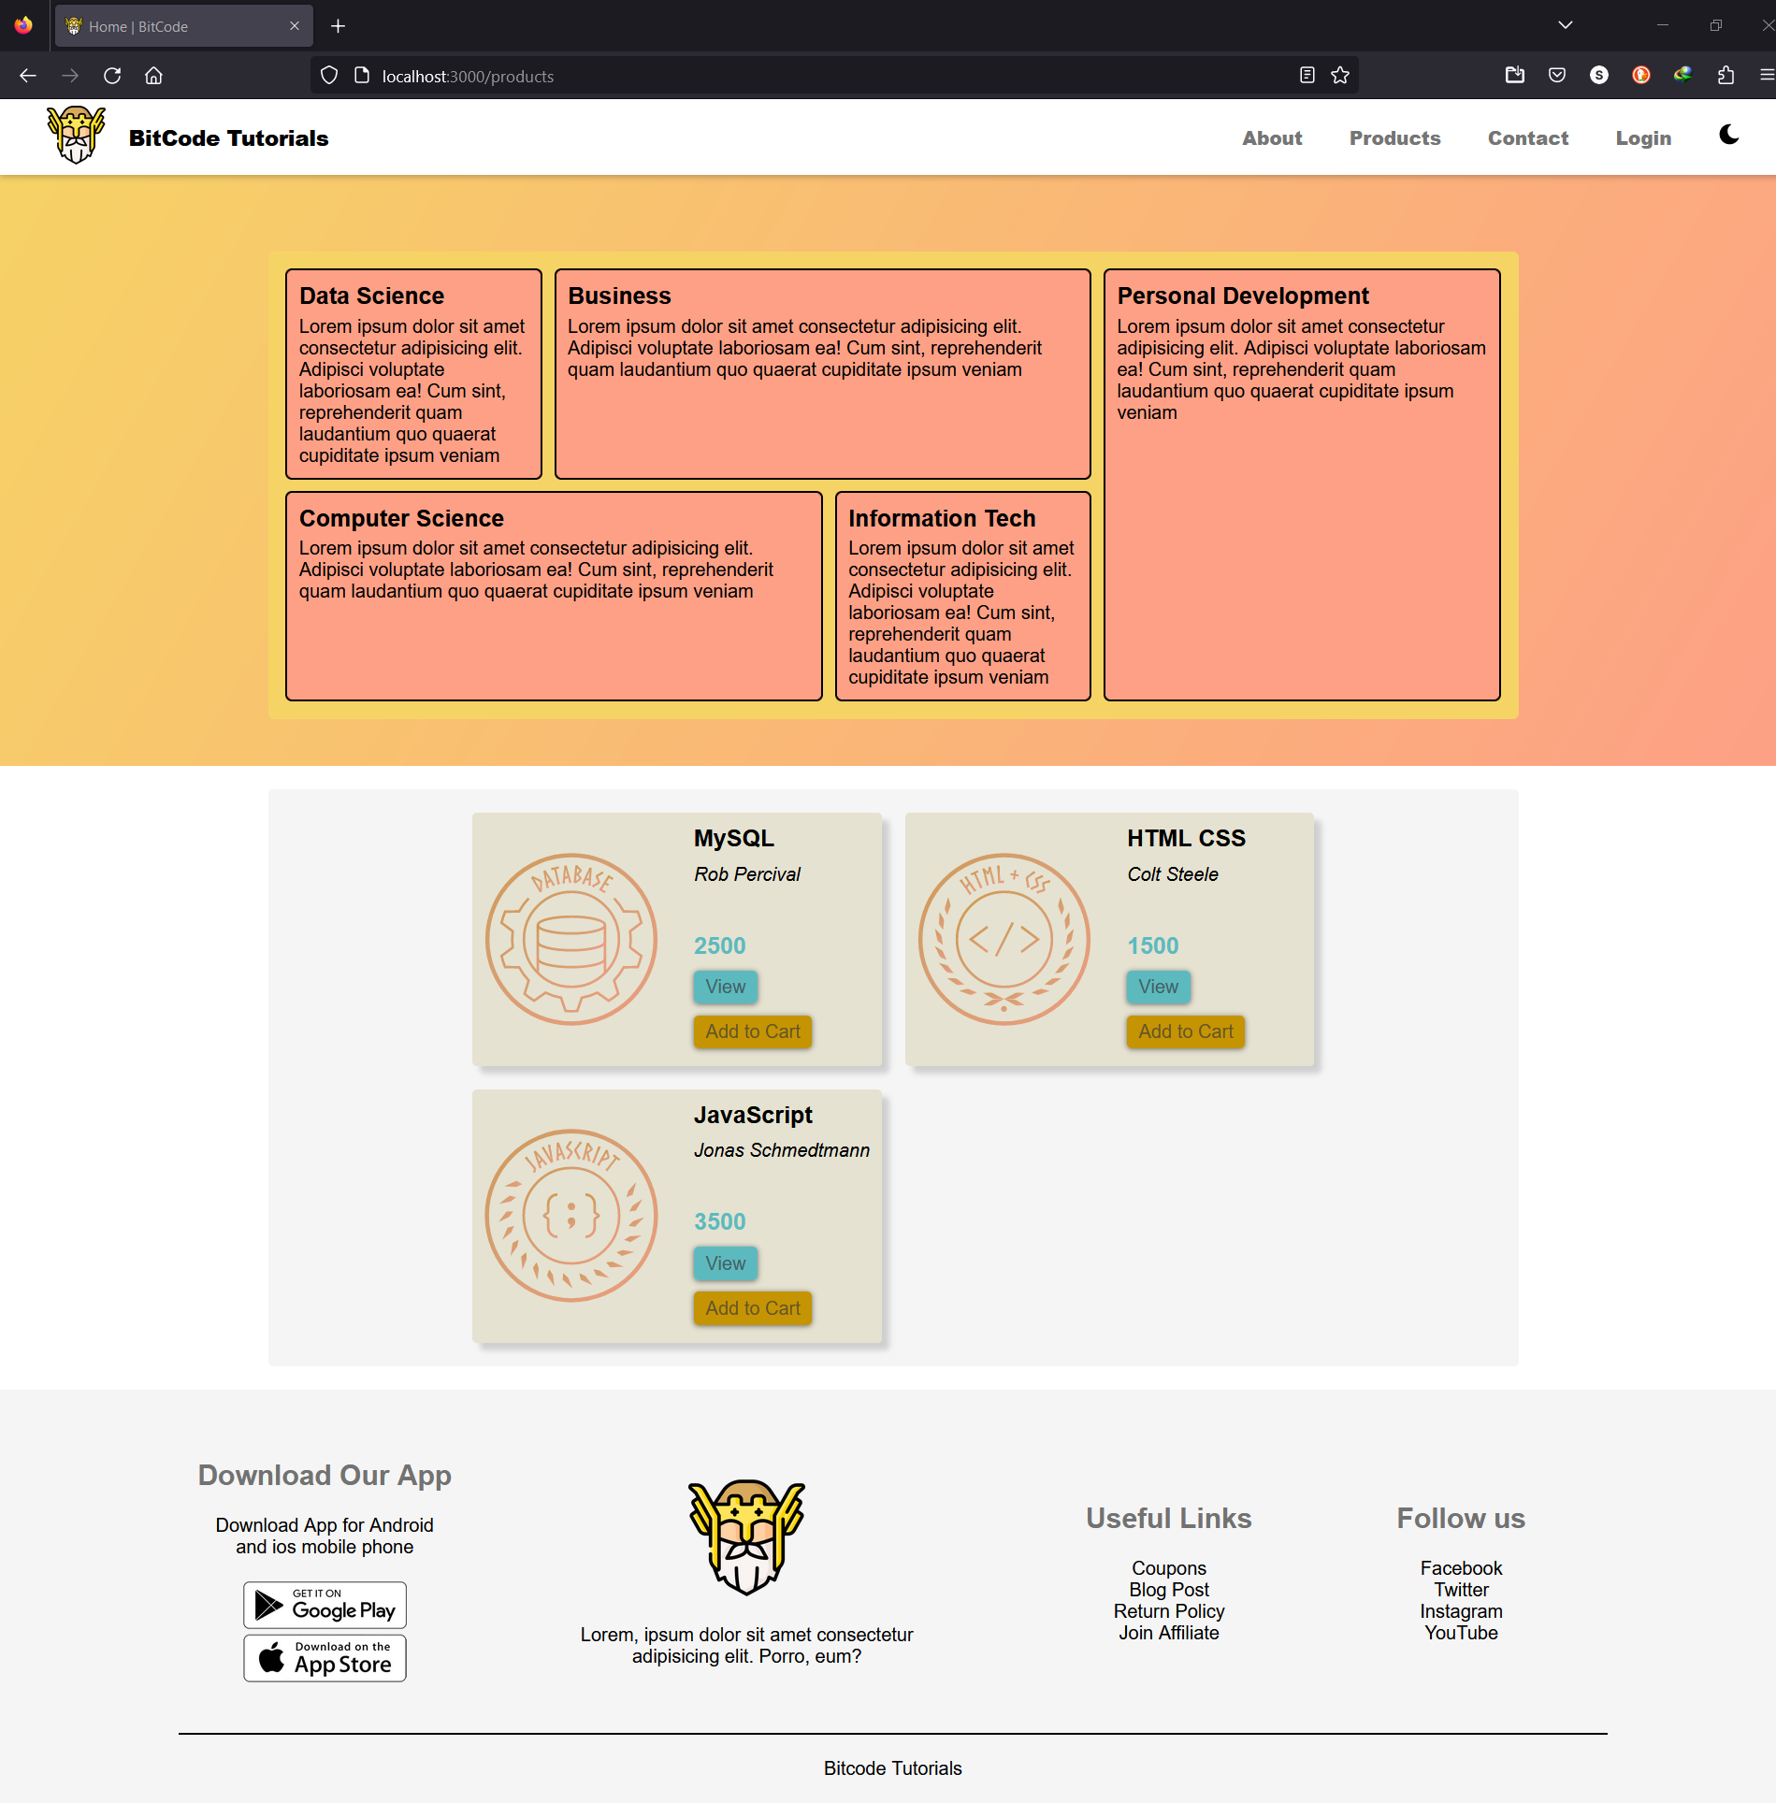

Slide 27
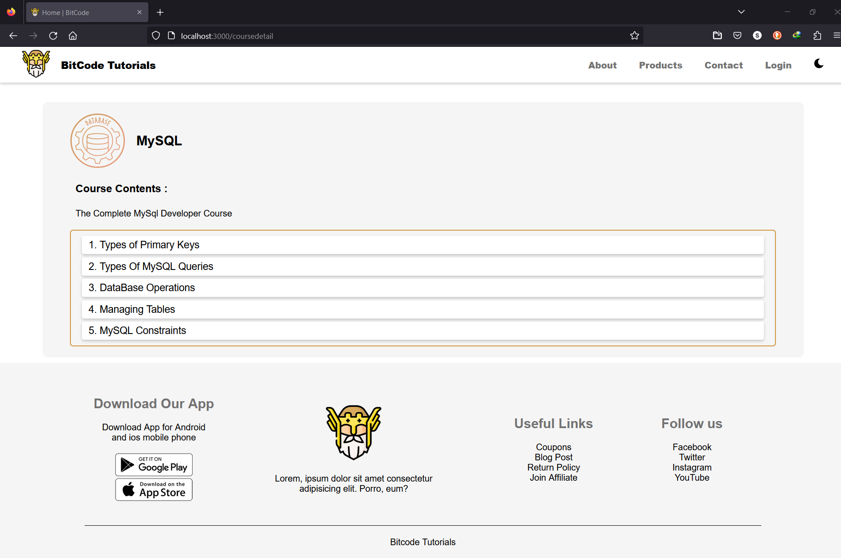

Slide 28
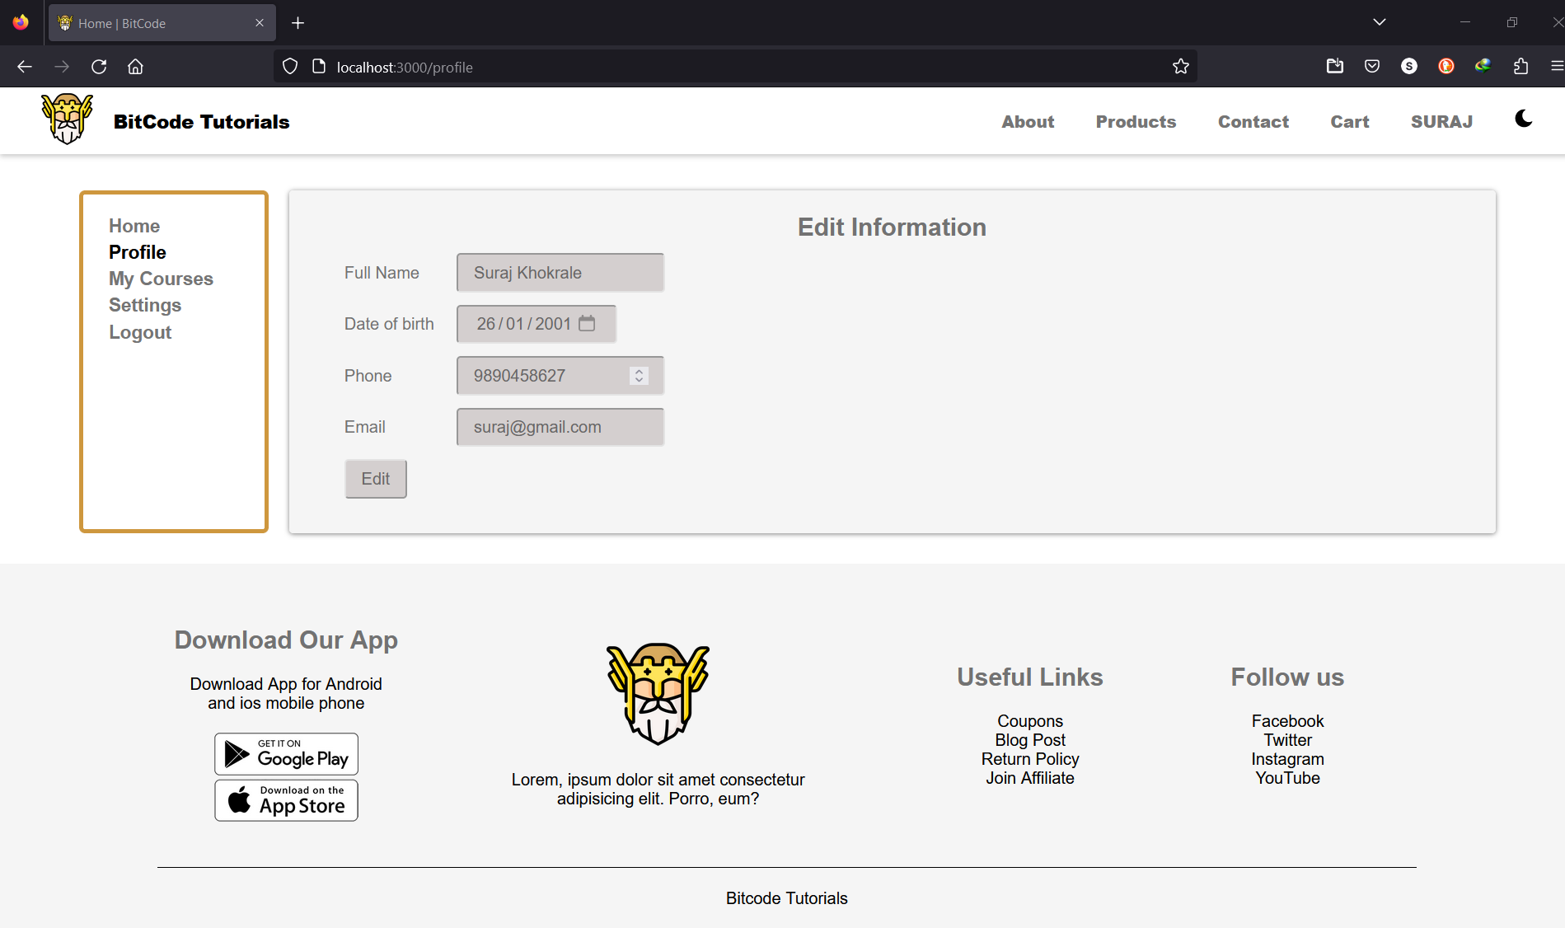
Subscriber UI

Slide 29
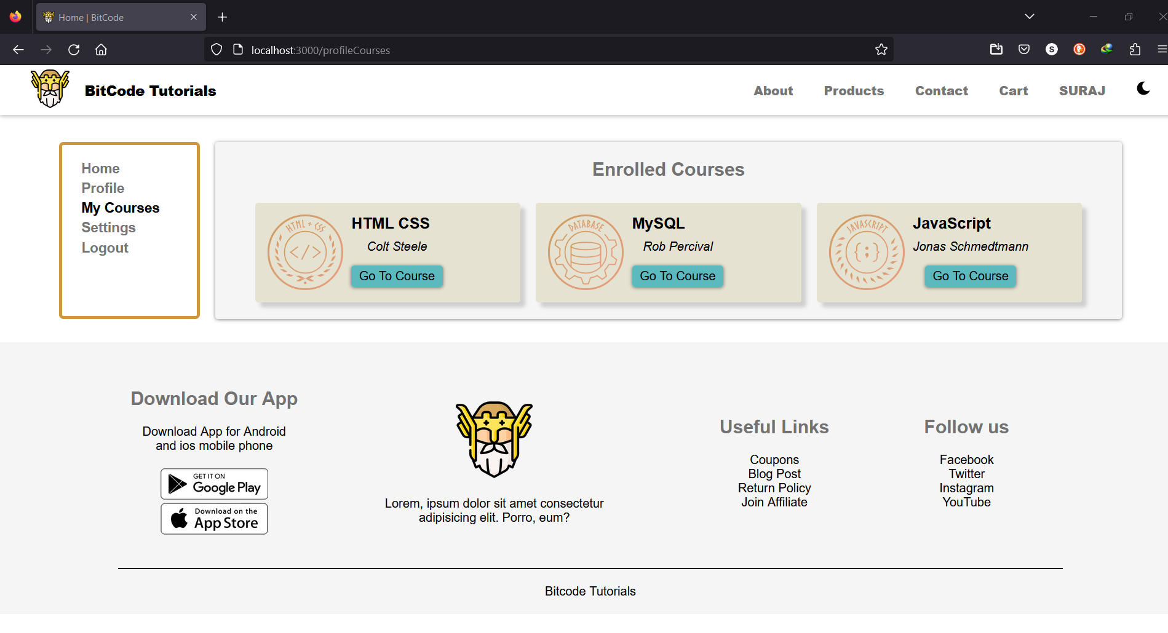

Slide 30
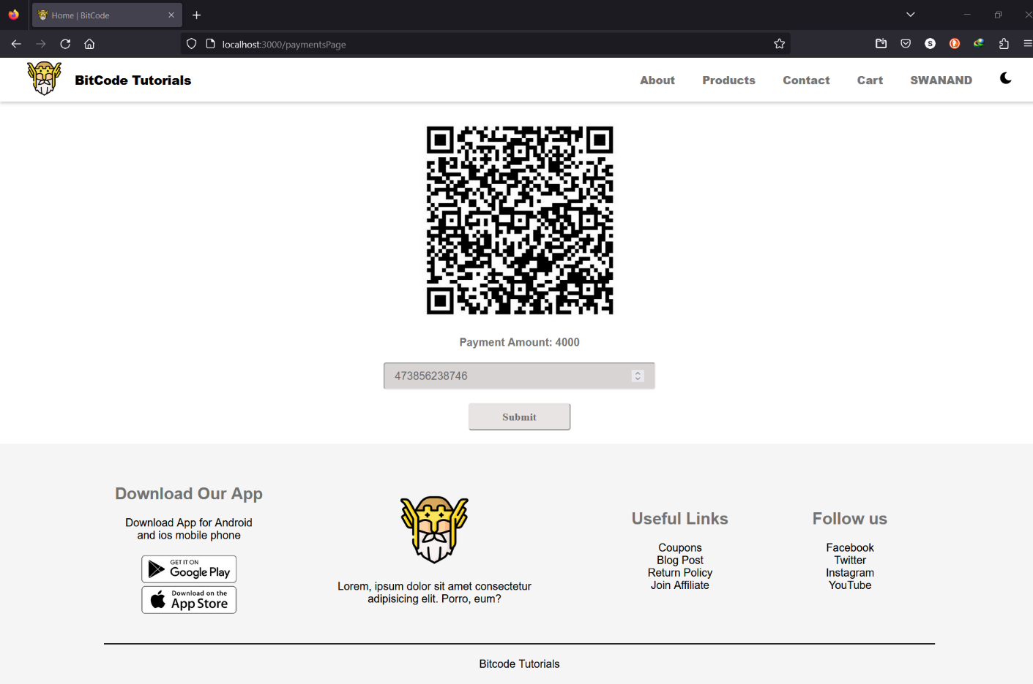

Slide 31
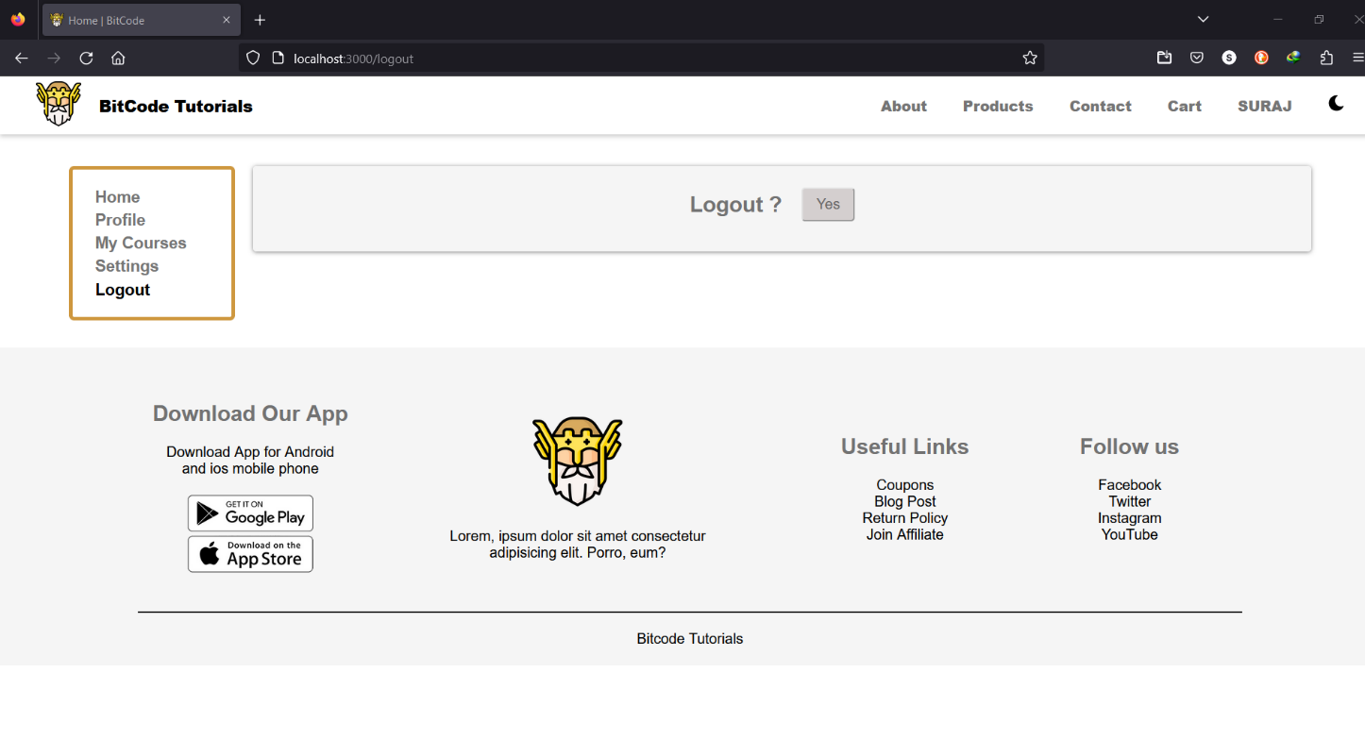

Slide 32
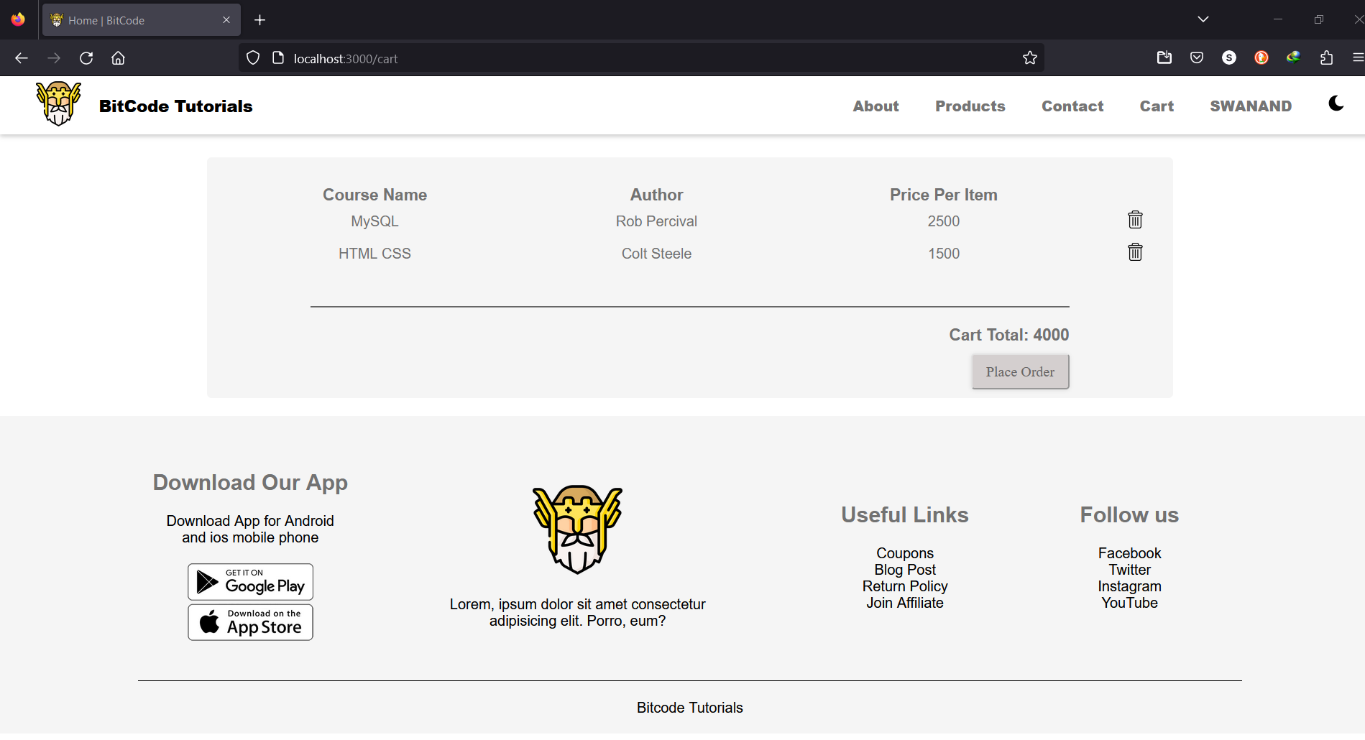

Slide 33
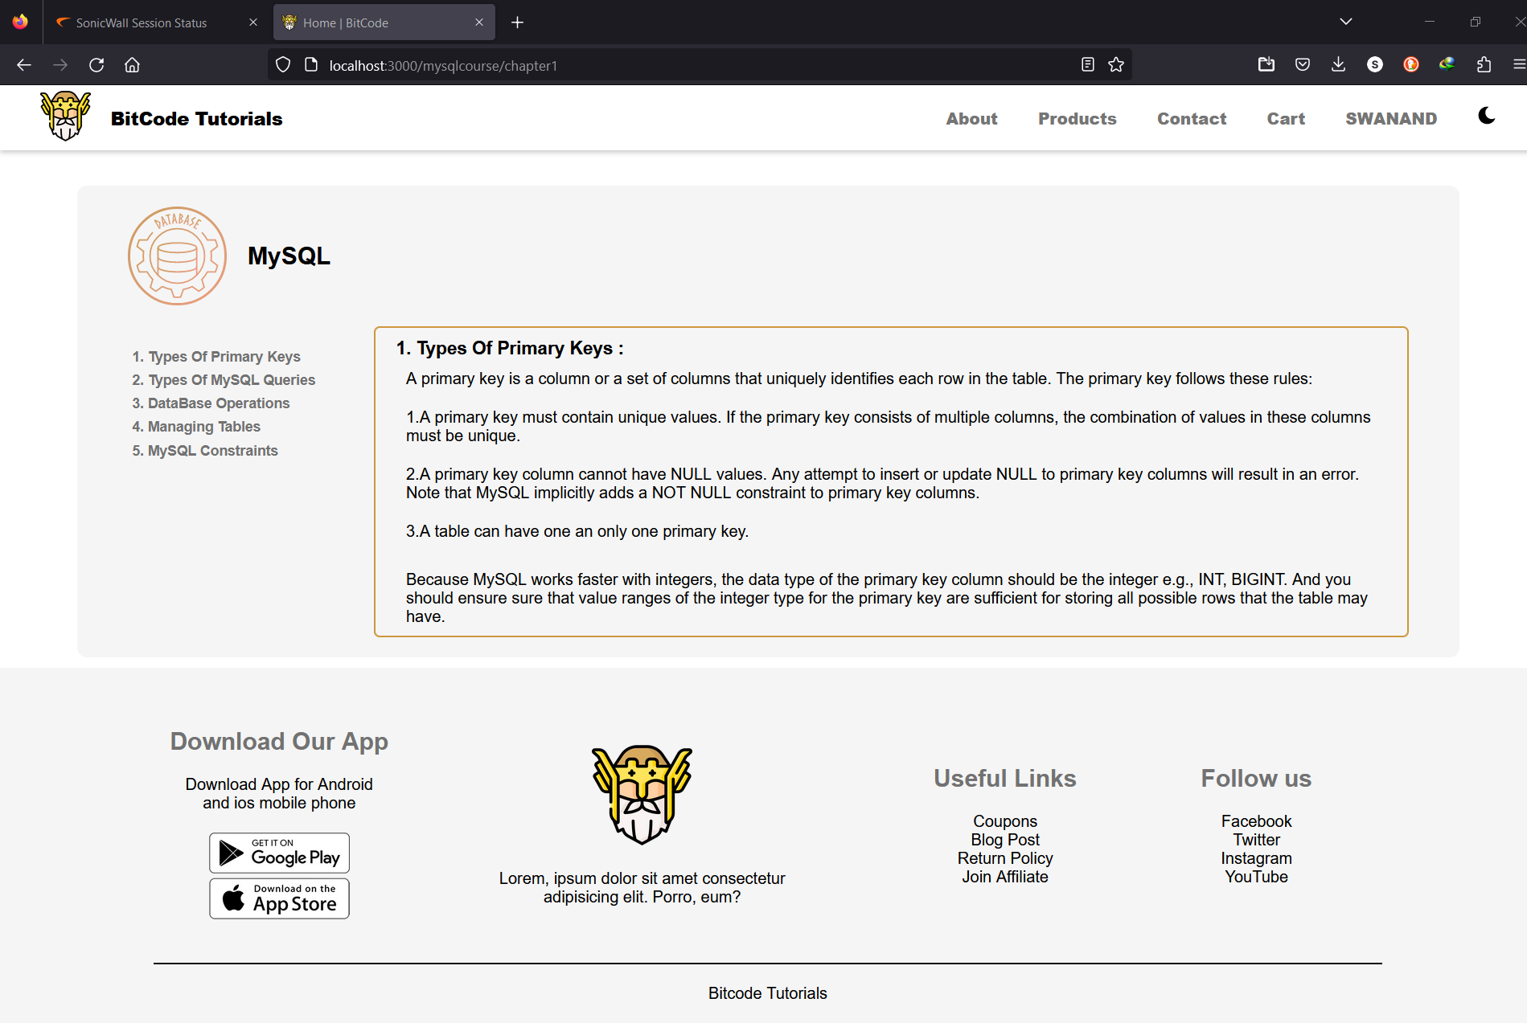

Slide 34
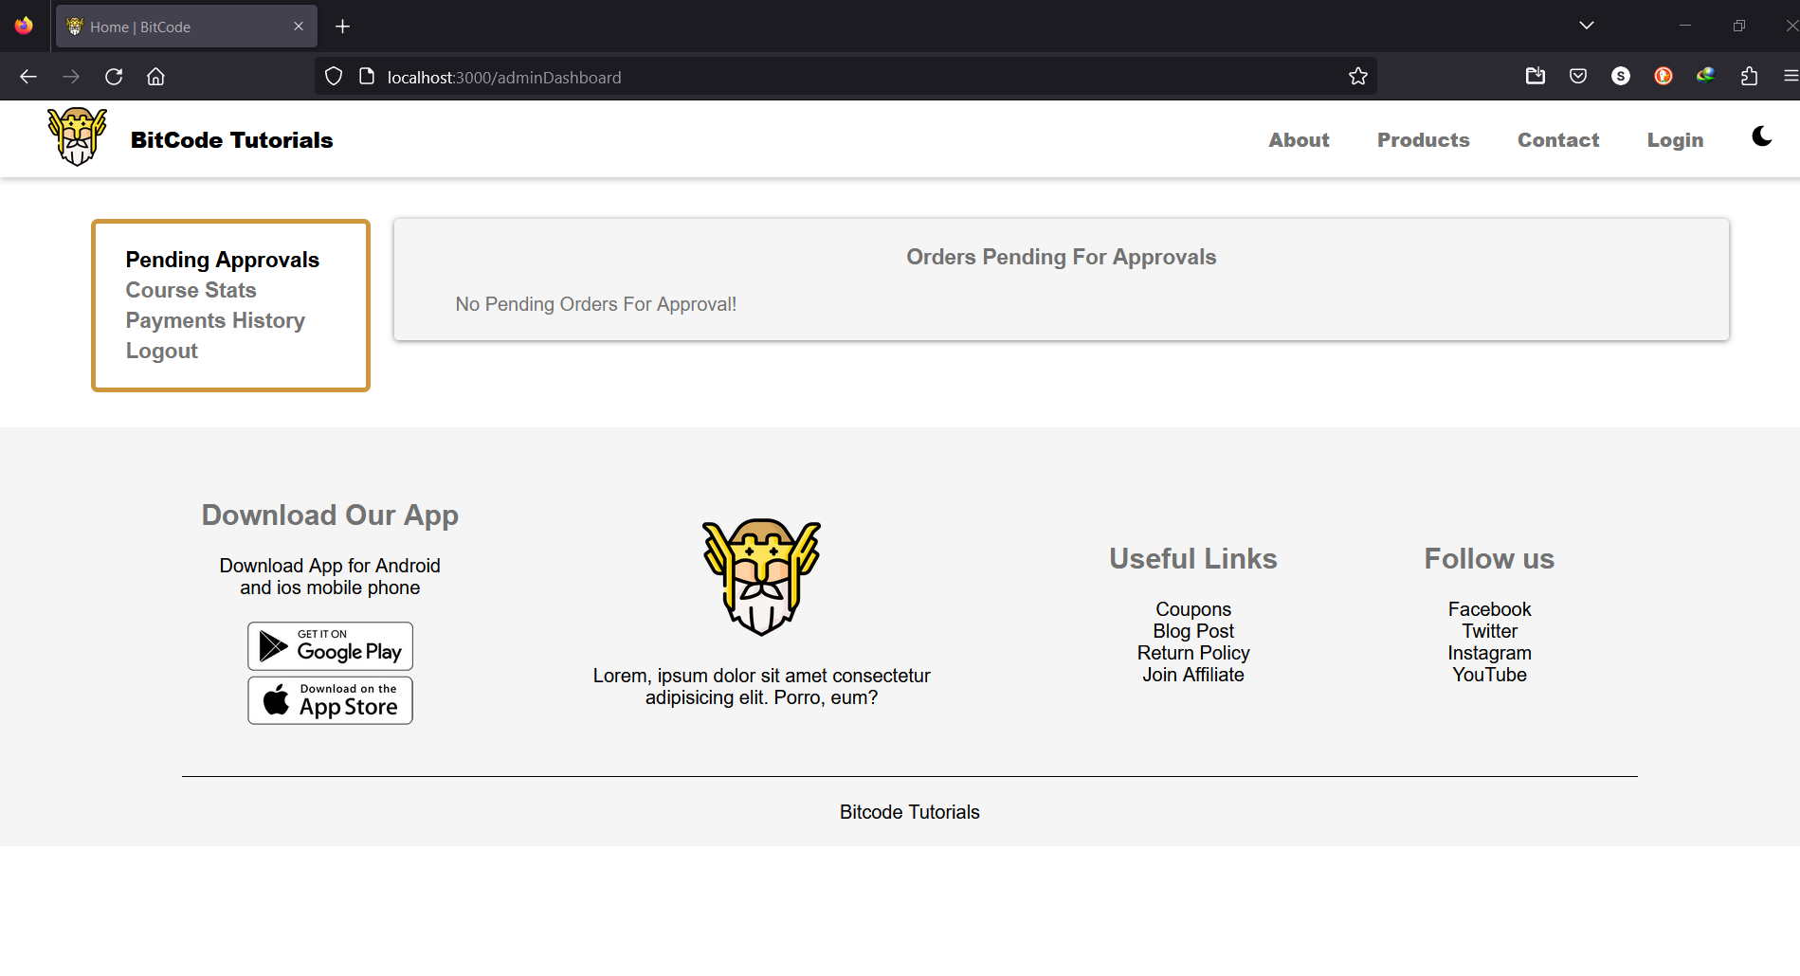
Admin UI

Slide 35
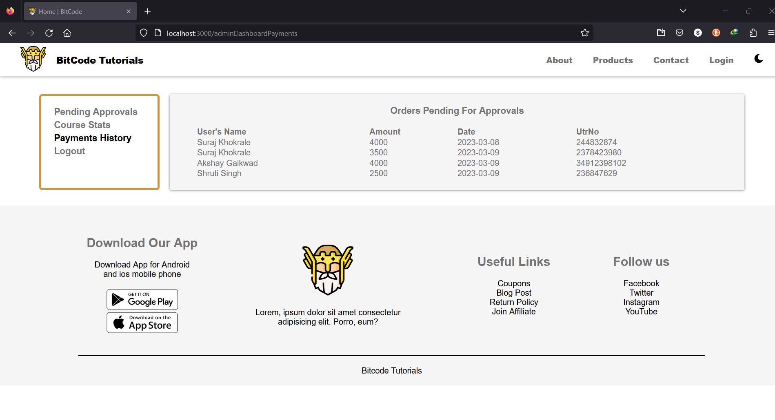

Slide 36


Slide 37
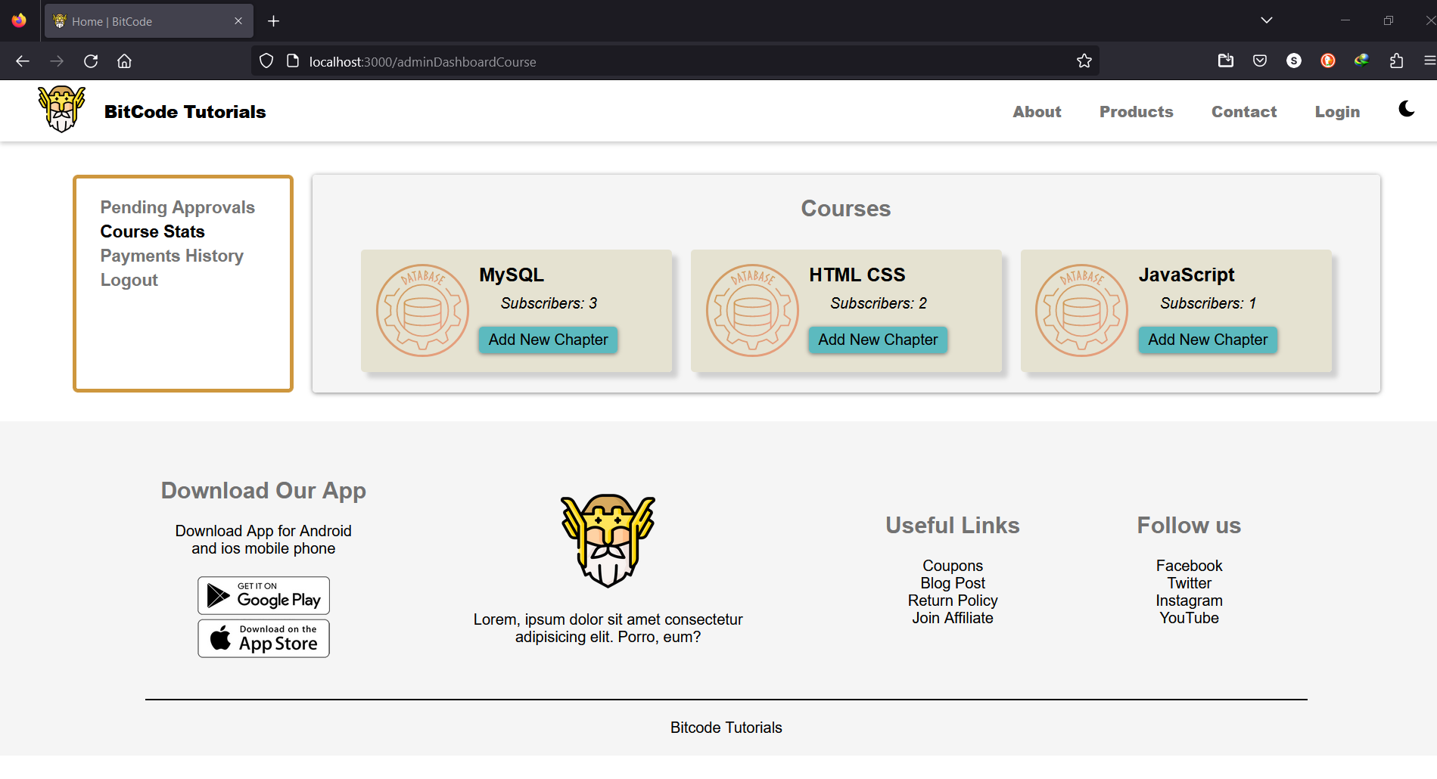

Slide 38
Conclusion
In conclusion, Bitcode tutorial can be an effective tool for students of all ages and backgrounds to enhance their academic performance. The website can provide a variety of resources, such as interactive quizzes, practice problems, and study tips, to cater to different learning styles and preferences. Additionally, it can offer flexibility and convenience for students who may have busy schedules or limited access to traditional learning resources.
For a successful online study tutorial website, it is important to conduct thorough research on the target audience and their specific needs and preferences. The website is user-friendly and accessible, with clear and concise instructions for accessing and using the resources. Regular updates and improvements to the website can also help to keep the content fresh and relevant.
Overall, Bitcode tutorial website is a valuable tool for students seeking to improve their academic performance and achieve their educational goals. By providing accessible and comprehensive resources, the website can help to support students in their learning journey and contribute to their long-term success.

Slide 39
References
https://docs.spring.io/spring-boot/docs
http://www.ijcstjournal.org/volume-7/issue-1/IJCST-V7I1P4.pdf/
https://bootstrapmade.com/mentor-free-education-bootstrap-theme/
https://reactjs.org/docs
https://javaee.github.io/javaee-spec/javadocs/
https://axios-http.com/docs/
https://jwt.io/introduction/
https://www.w3schools.com/

