Slide 1
NLP Toolkit
ETL, Document Summarization, PII detection
and sentiment analysis.
Version 1

Slide 2
NLP Toolkit
Functions
Agenda:
ETL function
Sentiment analysis
Document summarization
PII detection
Notebook link:
All_functions_import_test - Databricks (azuredatabricks.net)

Slide 3
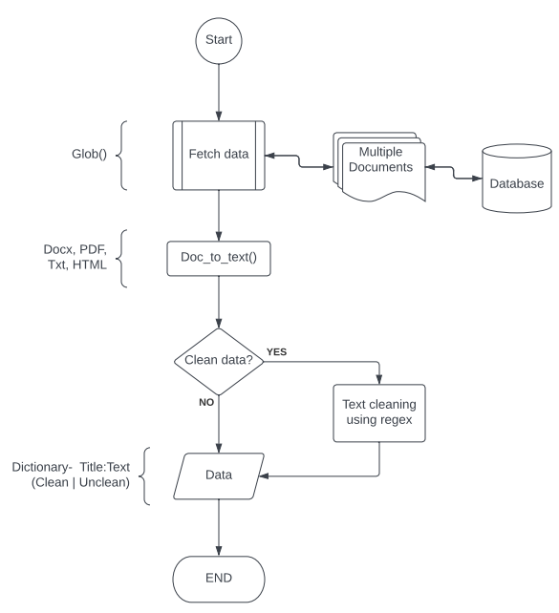
ETL – Docx, pdf, html, txt.
ETL function
ETL process flowchart:
Flowchart.1

Slide 4
Sentiment analysis using pre-trained deep learning models
Function execution
Model: Distilbert-base-uncased-finetuned-sst-2-english
Sample data:
The_Apollo_11_Conspiracy.docx (Size 14.5kb)
James_Webb_Space_Telescope.html (100 kb/ 9200 words approx.)
Execution time:
Sentiment analysis for The_Apollo_11_Conspiracy.docx completed in: 0.32 seconds
Sentiment analysis for James_Webb_Space_Telescope.html completed in: 2.49 seconds

Slide 5
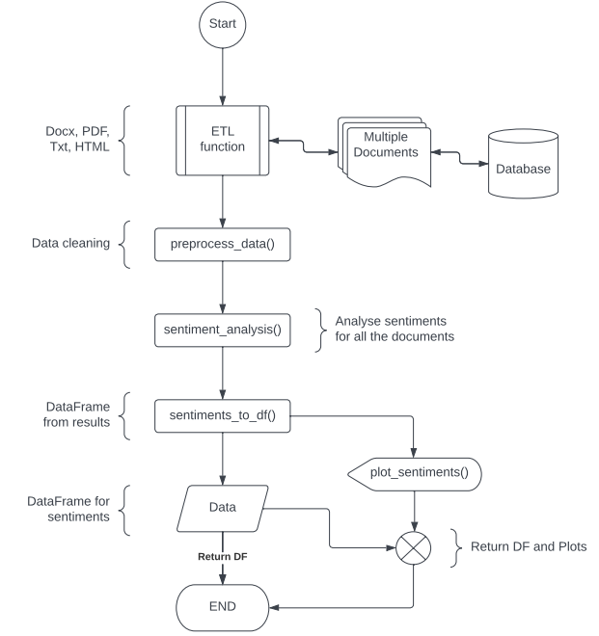
Sentiment analysis using pre-trained deep learning models
Sentiment analysis function
Sentiment analysis
flowchart:
Flowchart.2

Slide 6
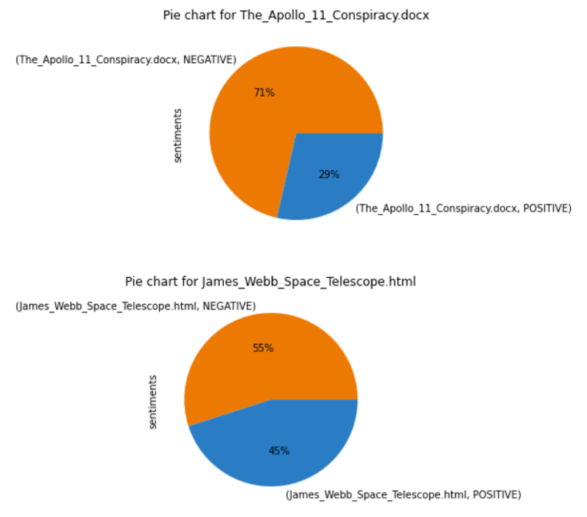
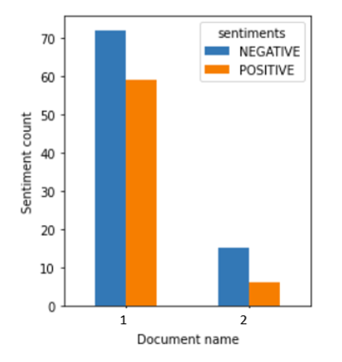
Sentiment analysis using pre-trained deep learning models
Function output
Plots: Distilbert-base-uncased-finetuned-sst-2-english
Figure.1
Figure.2

Slide 7
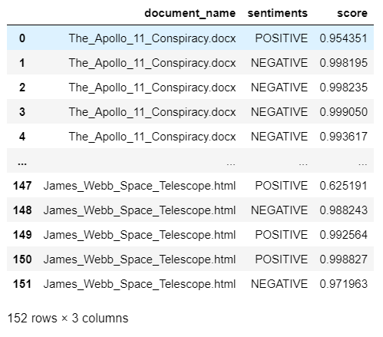
Sentiment analysis using pre-trained deep learning models
Function output
Data frame: Distilbert-base-uncased-finetuned-sst-2-english
Figure 3

Slide 8
Sentiment analysis using pre-trained deep learning models
Function execution
Model: nlptown/bert-base-multilingual-uncased-sentiment
Sample data:
The_Apollo_11_Conspiracy.docx (Size 14.5kb)
James_Webb_Space_Telescope.html (100 kb/ 9200 words approx.)
Execution time:
Sentiment analysis for The_Apollo_11_Conspiracy.docx completed in: 0.56 seconds
Sentiment analysis for James_Webb_Space_Telescope.html completed in: 5.43 seconds

Slide 9
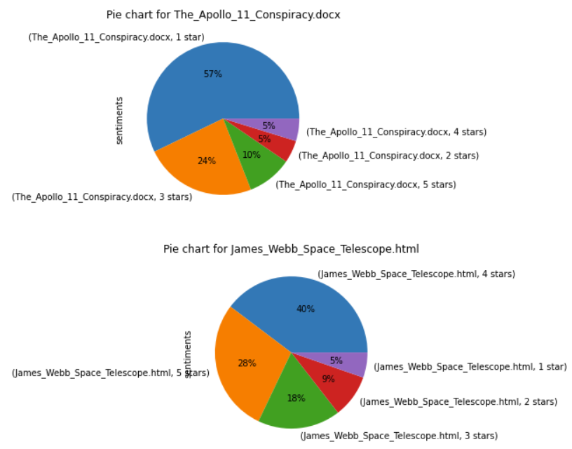
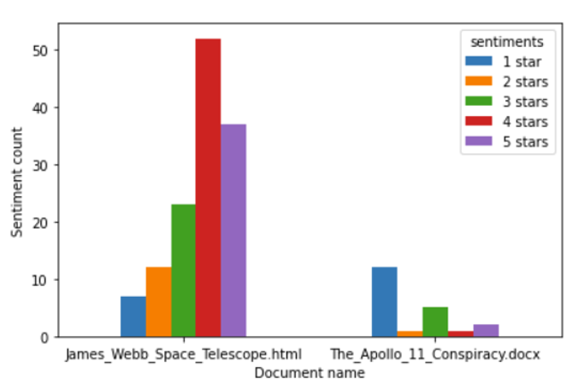
Sentiment analysis using pre-trained deep learning models
Function output
Plots: nlptown/bert-base-multilingual-uncased-sentiment
Figure.4
Figure.5

Slide 10
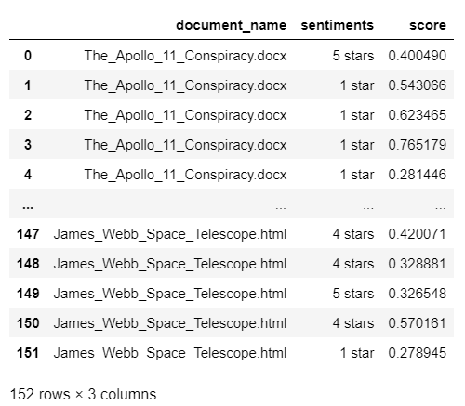
Sentiment analysis using pre-trained deep learning models
Function output
Data frame: Distilbert-base-uncased-finetuned-sst-2-english
Figure 6

Slide 11
Document summarization using pre-trained deep learning models
Function execution
Model: knkarthick/MEETING_SUMMARY
Sample data and execution time:
Summarization for 2021-08-23 Doris Paquin (Spectrum) meeting notes.docx completed in 5.20 seconds
Summarization for ICT-ACR meeting notes 2020-11-12.docx completed in 5.82 seconds
Summarization for 2020-11-16 GSA USAB meeting notes.docx completed in 10.81 seconds
Summarization for ebidm-dsai meeting notes 2022-01-21.docx completed in 9.10 seconds
Summarization for 2022-06-15 Onyx demo from Curtis ONeil.txt completed in 2.96 seconds
Summarization for 2021-10-15 ESD assumptions meeting notes.txt completed in 2.03 seconds

Slide 12
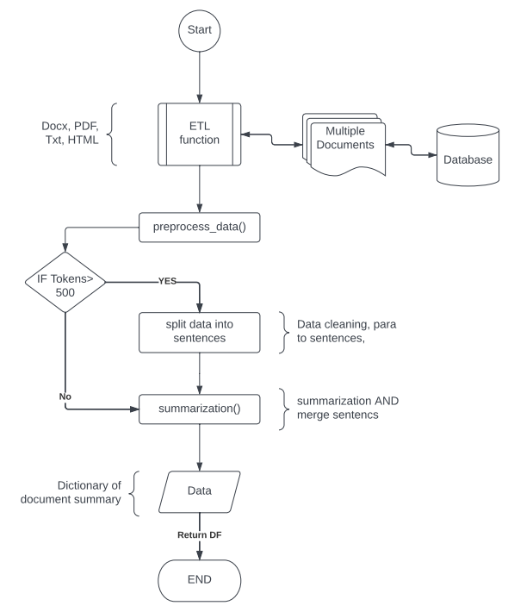
Document summarization using pre-trained deep learning models
Summarization function
Summarization flowchart:
Flowchart.3

Slide 13
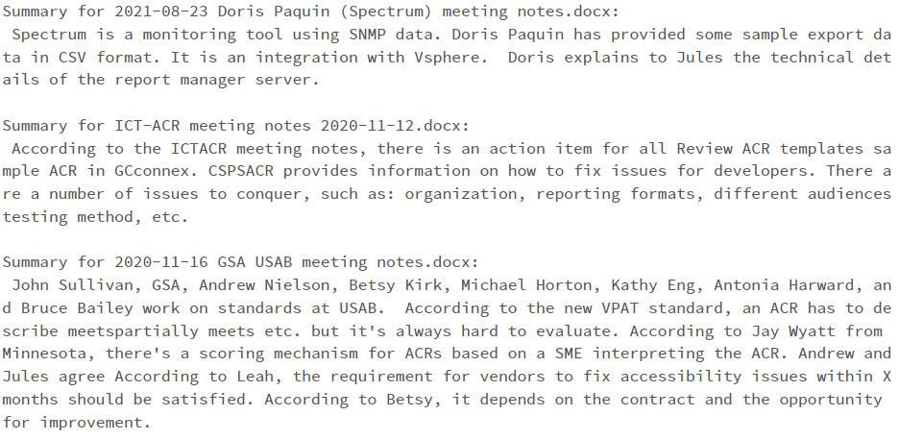
Document summarization using pre-trained deep learning models
Function output
Summarization output: knkarthick/MEETING_SUMMARY
Figure 7

Slide 14
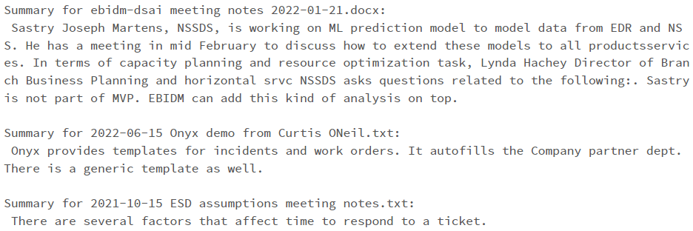
Document summarization using pre-trained deep learning models
Function output
Summarization output: knkarthick/MEETING_SUMMARY
Figure 8

Slide 15
PII detection using Presidio analyzer-AnalyzerEngine
Function execution
API: Presidio analyzer
Sample data and execution time:
PII analysis for ebidm-dsai meeting notes 2022-01-21.docx completed in 0.18 seconds
PII analysis for 2021-08-23 Doris Paquin (Spectrum) meeting notes.docx completed in 0.11 seconds
PII analysis for 2020-11-16 GSA USAB meeting notes.docx completed in 0.18 seconds
PII analysis for 2022-06-15 Onyx demo from Curtis ONeil.txt completed in 0.06 seconds

Slide 16
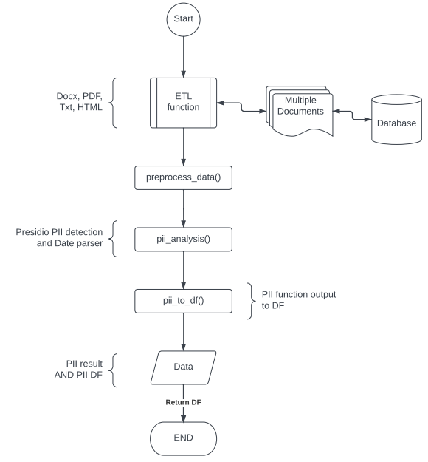
PII detection using Presidio analyzer-AnalyzerEngine
PII detection function
PII detection flowchart:
Flowchart.4

Slide 17
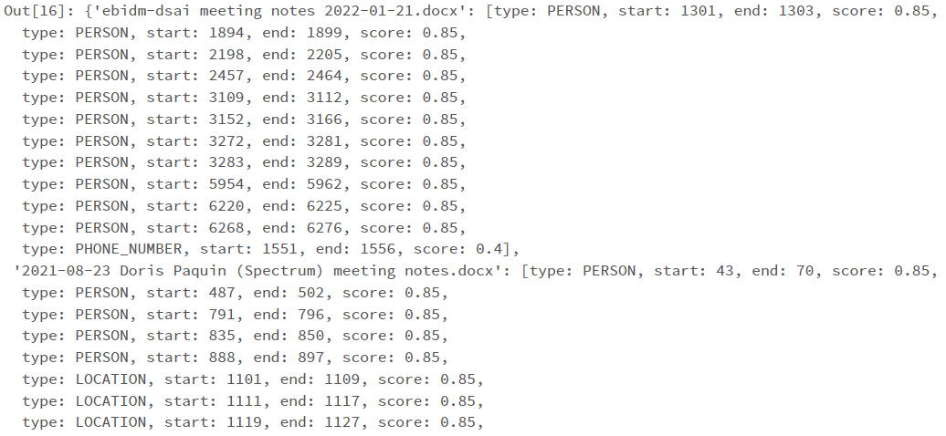
PII detection using Presidio analyzer-AnalyzerEngine
Function output
Presidio analyzer output:
Figure 9

Slide 18
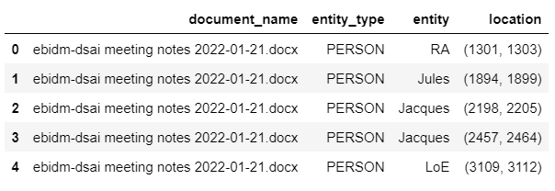
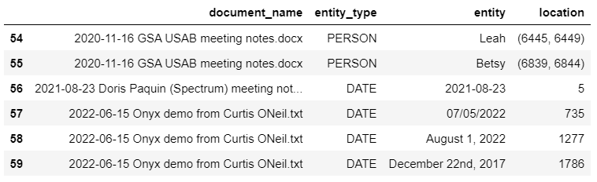
PII detection using Presidio analyzer-AnalyzerEngine
Function output
PII DataFrame:
Figure 10

Slide 19
Thank you

