Slide 1


Team Details
  Team name: The Mitra Team
  Team leader name: Gaurav Giri
  Problem Statement: Media, Content & Digital Experiences. Correct explainer videos are slow and costly to make, and AI video gets facts wrong.
  Team members: Gaurav Giri (leader), Viraj Sawad

Slide 2
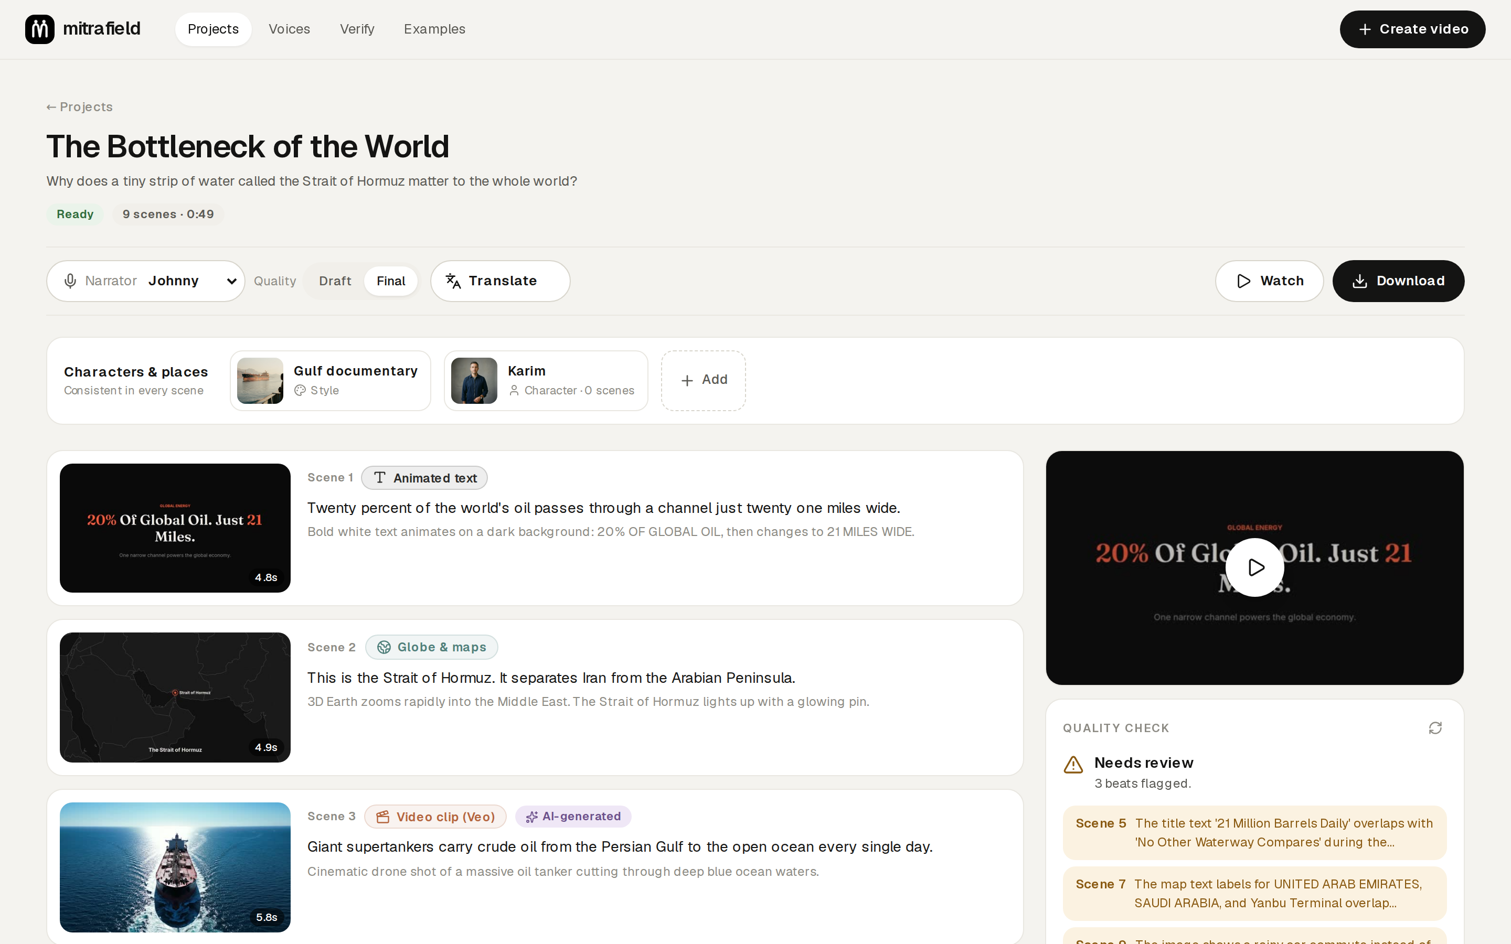
Brief about the idea
Ask a question. Get a correct, narrated explainer video.
MitraField is an AI video studio. An AI director built on Gemini writes the script, chooses the right kind of picture for every scene and renders a finished video with narration, music and subtitles, in minutes.
Real data for facts
Your own voice
9 languages
Problem: a correct explainer takes a studio days; AI video tools are fast but invent numbers, maps and equations; most explainers are English-only.
For: teachers, NGOs, newsrooms and creators across JAPAC.
The studio: approve the storyboard, edit any scene, AI pictures labelled

Slide 3
Opportunities
How is it different from existing ideas?
How will it solve the problem?
USP
• Picks the right kind of picture per scene: real maps, math animation, charts; AI imagery only for mood
• Full narrated explainers of 1 to 6 minutes, not 8-second clips
• Checks its own work: facts, picture and sound
• Minutes instead of days, for about $1 to $3 a video
• Facts drawn from data and code, then fact-checked with Google Search
• One click makes a Hindi, Nepali or Bahasa version with the same visuals
• Correct, not just pretty
• Narrated in your own cloned voice
• An invisible watermark anyone can verify
• You approve the plan first, then change any scene in plain words
Beautiful is easy. Correct is the product.

Slide 4
List of features offered by the solution
1
AI director
2
Eleven kinds of visual
3
Voice cloning
4
One-click translation
Writes the storyboard from a question, notes or PDFs
Real maps, math animation, charts, timelines, Veo clips
Your voice from 15 seconds of speech, in English and Hindi
Nine narration languages; the visuals are reused
5
Edit in plain words
6
Fact and quality checks
7
Ten looks, one cast
8
Invisible watermark
"Simpler", "show it on a map": only that scene re-renders
Google Search grounding; Gemini reviews every scene
The same characters and objects in every shot
Anyone can verify a copy on the Verify page
Also: vertical Shorts, subtitles, a music bed, cost per video, spending caps, and it works on a phone.

Slide 5
Process flow diagram or Use-case diagram
1
2
3
4
5
6
7
Ask
Storyboard
Approve
Narrate
Render
Check
Export
You
Gemini 3.1 Pro
You
Cloned voice / Gemini TTS
Code · Nano Banana · Veo
Gemini + Google Search
ffmpeg · Lyria
Question, notes or PDFs
Script and a picture per scene
Nothing is spent before
Each line timed
Scenes in parallel
Quality and facts
Music, subtitles, watermark
Change one scene
Translate
Ask in plain words
Only that scene re-renders
Update video
Pick a language
New narration, same visuals
Hindi / Nepali version
Every scene is narrated first, so its picture is cut to the exact length of the sentence.

Slide 6
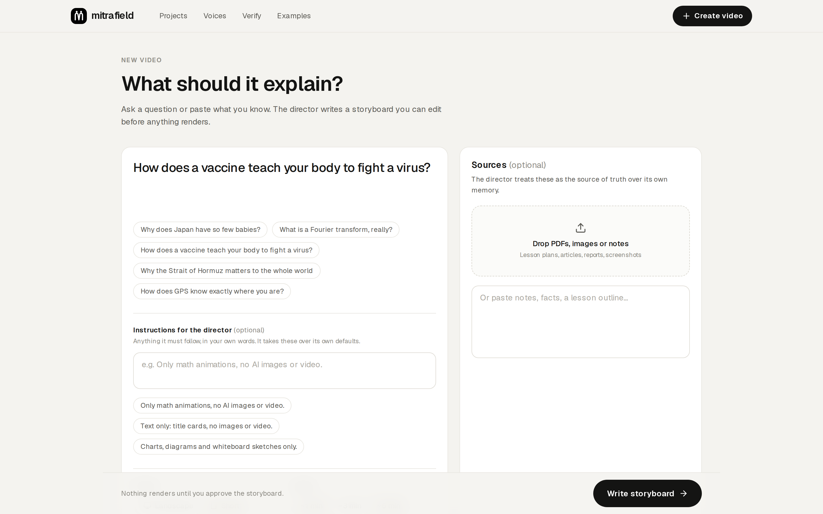
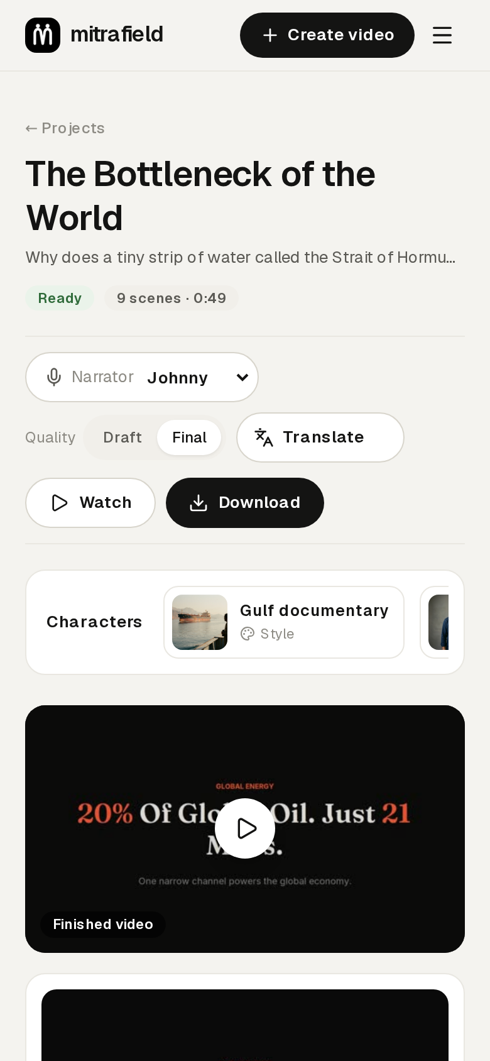
Wireframes/Mock diagrams of the proposed solution (optional)
1. Create: question, sources, instructions, narrator and look. The main action stays in view.
2. Studio: approve the storyboard, edit any scene, render, download or translate.
3. On a phone
Screens from the working prototype, not mock-ups.

Slide 7
Architecture diagram of the proposed solution
Users
Cloud Run · API
Cloud Tasks
Gemini API
Browser or phone
Public, stateless. Passcode and spending caps. Saves projects, queues work. Never renders.
Durable queue: retries, rate limits
Gemini 3.1 Pro · 3.5 Flash · Nano Banana · Veo 3.1 · Gemini TTS · Lyria 3 · Google Search grounding
Firebase Hosting
Cloud Run · worker
Serves the web app from a CDN
Private. Writes, narrates and renders scenes in parallel; checks, assembles, watermarks
Cloud Run GPU (NVIDIA L4)
Cloned voices; off when idle
Firestore · Cloud Storage · Secret Manager
Project state · videos and images · API and watermark keys
Delivery GitHub Actions → keyless sign-in → Cloud Build → Artifact Registry → test copy checked live → released

Slide 8
Technologies to be used in the solution
Google AI
Google Cloud
Open source
Gemini 3.1 Pro
Gemini 3.5 Flash
Cloud Run
Cloud Run GPU (L4)
FastAPI
Next.js
Manim
Nano Banana
Veo 3.1
Cloud Tasks
Firestore
ffmpeg
OmniVoice
Gemini TTS
Lyria 3
Cloud Storage
Secret Manager
Natural Earth
Headless Chrome
Google Search grounding
Firebase Hosting
Cloud Build
OpenCV
SynthID (on generated media)
Artifact Registry
Workload Identity Federation
Cloud Billing budgets
Everything runs on Google Cloud in asia-southeast1 (Singapore); all AI calls go through the Gemini API.

Slide 9
Estimated implementation cost (optional)
$0.80–2.80
model cost per finished video, logged per call
$0
compute when idle: every service scales to zero
42% · 31% · 24%
Veo clips · images · Gemini text (share of spend)
$5 / $25
hard caps per video and per day
Estimates from Google's published Gemini API rates, logged by the app for every call. Cloned-voice GPU time is billed only while narrating (about $1 an hour when on, our estimate).

Slide 10
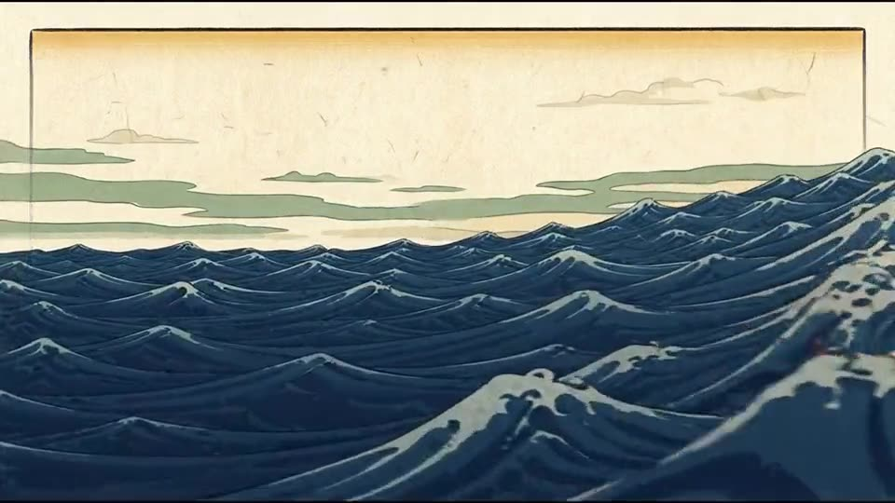

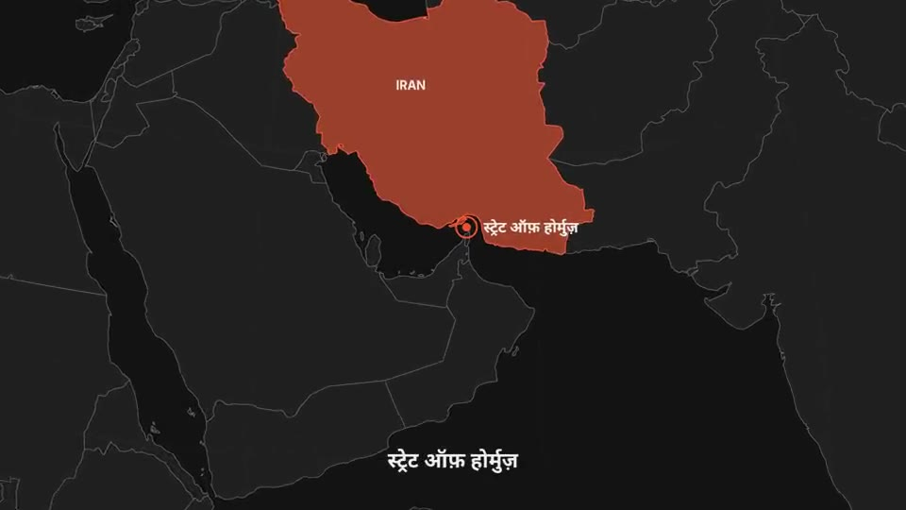
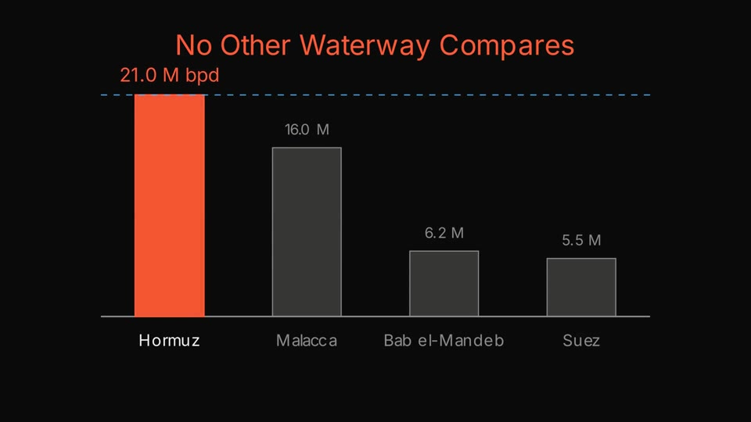
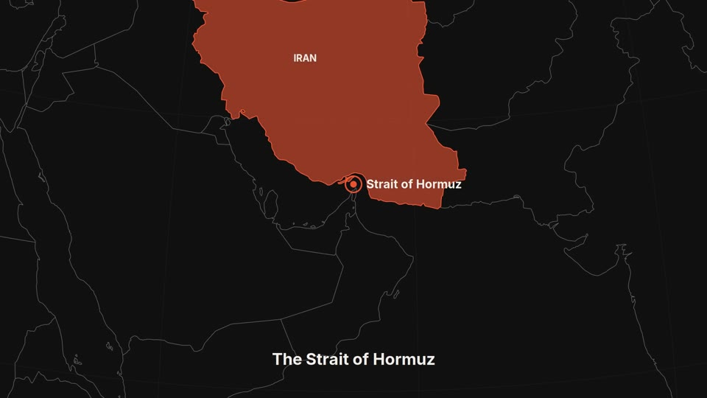

Snapshots of the prototype
Woodblock look · how a tsunami forms
Vertical Short · vaccines, with a presenter
Hindi version · labels redrawn in Devanagari
Math animation, drawn by code
Real map data · the Strait of Hormuz
Veo clip from an on-model first frame

Slide 11
Prototype Performance report/Benchmarking
12
62%
4–9 min
126
finished videos, 116 scenes, 3 languages
of scenes drawn from data and code
to render a one-minute video, unattended
automated tests, run on every change
Measure | Result
Cloned narration (Cloud Run GPU) | 18 to 46 s for the first line after idle (GPU start); 0.7 to 6 s per line when warm
Fact check (Hormuz video) | All 9 checkable claims supported, 12 web sources
Watermark robustness | Read back after re-encoding (crf 34), 480p, 30 to 24 fps and a trimmed start; ~7 s to verify a 46 s video
Release safety | Each release is a test copy first; goes live only after a live check of the database, a model call, the watermark and the voice GPU

Slide 12
Responsible AI and trust
Fact check
AI labels
Invisible watermark
Every claim checked against your sources, then Google Search, with links
Scenes with AI pictures are labelled; Veo and Nano Banana output carries SynthID
In every export; anyone can verify a copy on the Verify page
No deepfakes
Safe with uploads
Spending limits
Requests to fake a real person's words are refused
PDFs and notes are treated as data; model-written code runs in a sandbox
Every call priced and logged; caps of $5 a video and $25 a day
Consent is required before a voice is cloned, and uploaded sources and voice samples are never public.

Slide 13
Additional Details/Future Development (if any)
1
Google Drive
Known limits today
Import sources from Drive and save finished videos to it
A fully flexible video editor
• No user accounts yet; creating needs a shared passcode
• The first cloned-voice line after idle waits for the GPU to start
• Fact checks reduce errors but cannot remove them all; flagged claims are shown
• Heavy cropping or editing can remove the watermark
2
Timeline editing on top of the AI storyboard
3
Sign-in and private workspaces
Firebase Authentication, for schools and teams
4
More languages and voices
Regional voices and subject glossaries
5
Publish straight to YouTube
And to learning platforms

Slide 14
Provide links to your:
GitHub public repository
github.com/VirajSawad1021/MitraField
Demo video (2:08)
github.com/VirajSawad1021/MitraField/blob/main/docs/demo-video/MitraField_Demo.mp4
Final product
mitrafield-api-u6zih6e3hq-as.a.run.app
Browse the examples freely. Creating a video needs the passcode given in our submission form.

Slide 15


