Slide 1

Invoice Assistant
Student Name : Tank Viraj Rupeshbhai
Roll No. : EC034
DDU ID : 21ECUBG069
Guide Name : Mr. Umesh Ghediya
Institute/Company Name : OneOnic Solutions
Internal Supervisor : Dr. NarendraKumar Chauhan
B. Tech. (EC) Semester VIII - Industrial Training
April 2025

Slide 2
Table of Content
Motivation
Project Introduction
Flowchart
Workflow
Project Demonstration
Result & Observation’s
Conclusion

Slide 3
Motivation
Challenges with Manual Invoicing:
Time-consuming and inefficient.
Difficult to retrieve specific invoice details.
Data inconsistency due to manual handling.

Slide 4
Motivation
Why Invoice Assistant?
Eliminates errors with OCR & AI-powered extraction.
Saves time by automating invoice analysis.
Easy access via Telegram bot for real-time processing.
AI-powered query system for quick invoice-related answers.

Slide 5
Project Introduction
Invoice Assistant automates invoice processing using AI & OCR.
Users upload invoices (PDF/Image) via Telegram bot for processing.
Google Gemini AI extracts key details like supplier info, invoice number, and payment details.
Extracted data is structured into JSON format for easy storage & retrieval.
Users can ask queries about invoice details and get real-time AI responses.
The system ensures accuracy, efficiency, and accessibility in invoice management.

Slide 6
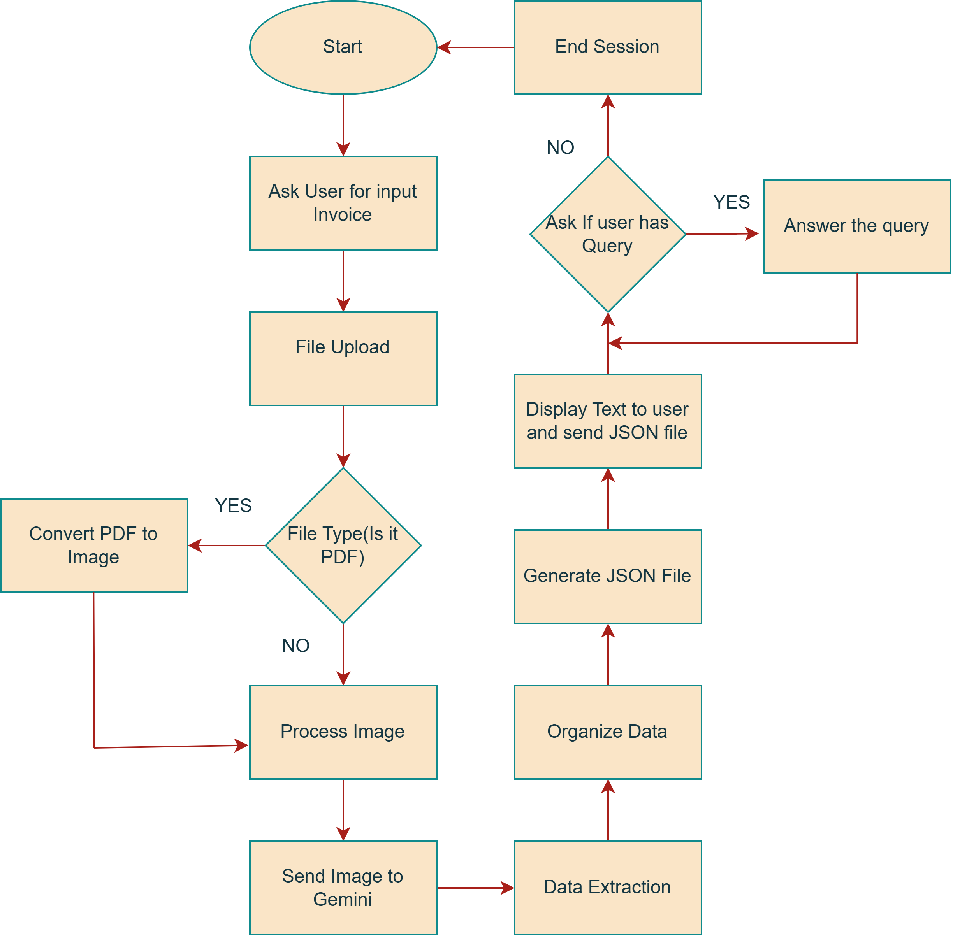
Flowchart

Slide 7
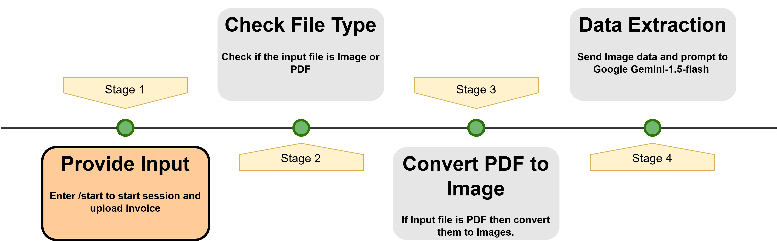
Workflow
The start function responds to the “/start” command by greeting the user and instructing them to upload an invoice file. It runs asynchronously to ensure smooth interaction without delays.

Slide 8
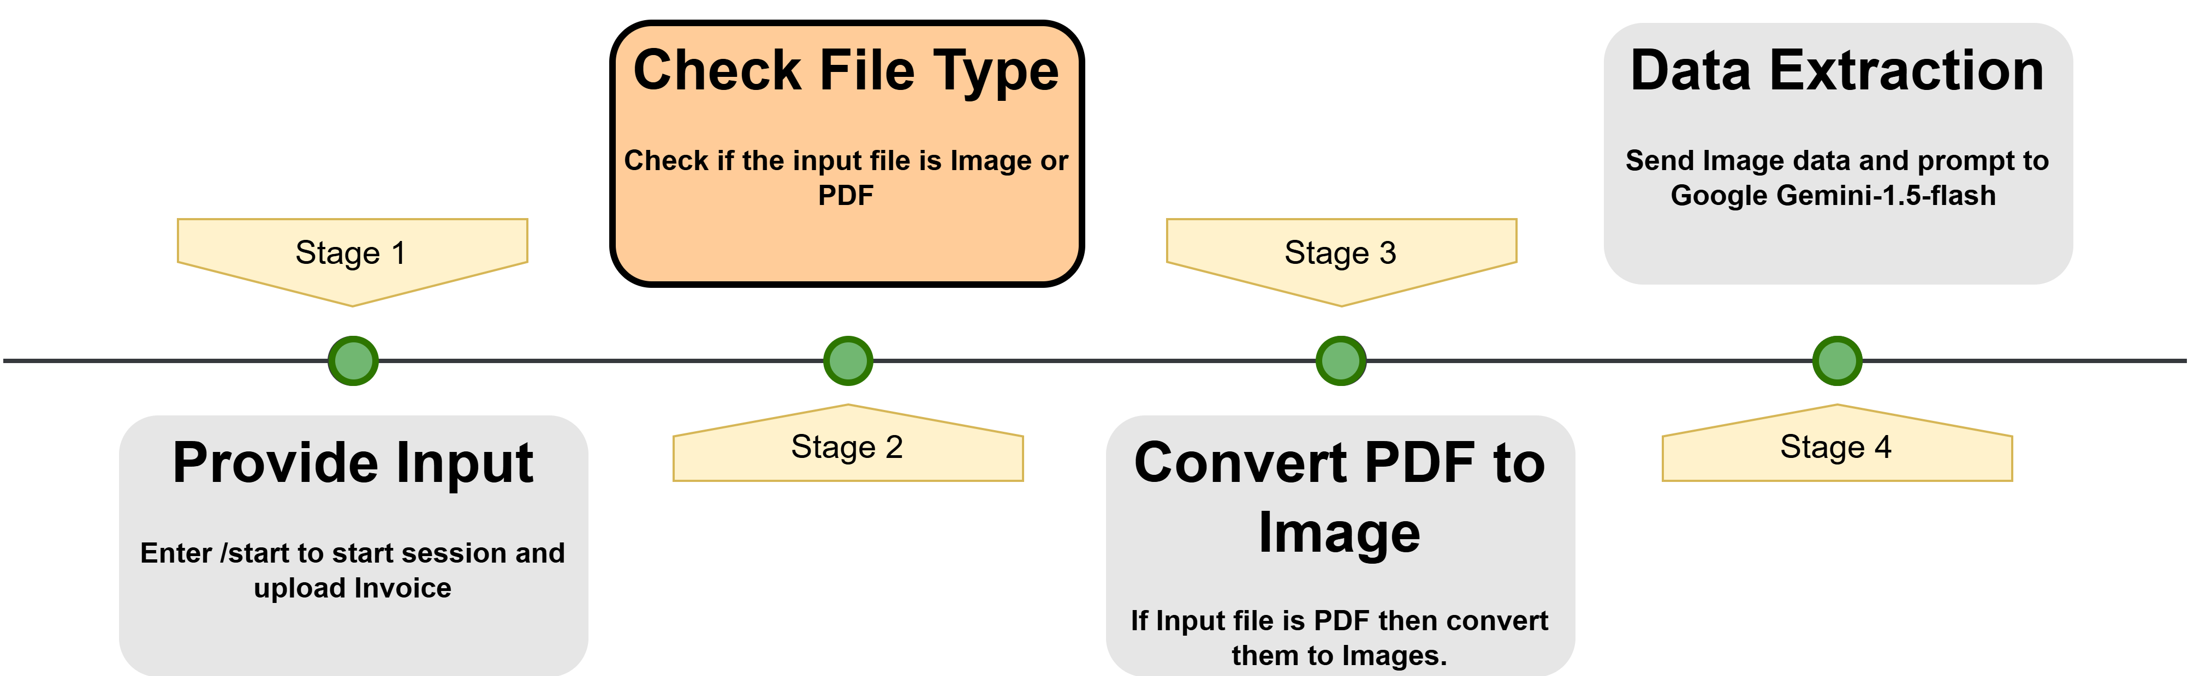
Workflow
Then it manages file uploads from users while handling connection errors. It first checks if the uploaded file is a supported format (PDF or image).

Slide 9
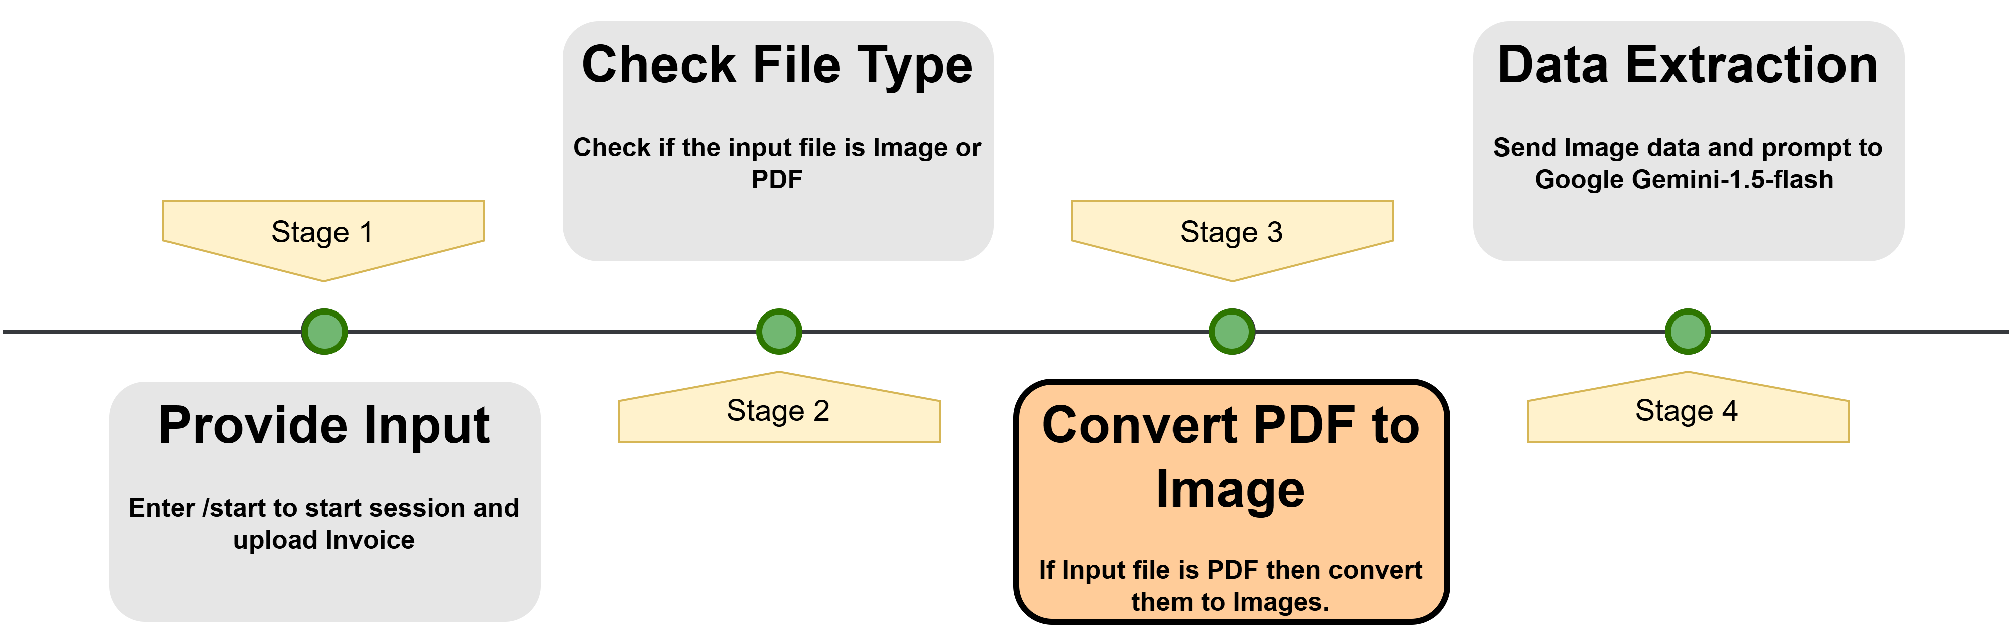
Workflow
If the file is a PDF, it is converted into an image for further processing. Then it creates a user specific directory and downloads the file.

Slide 10
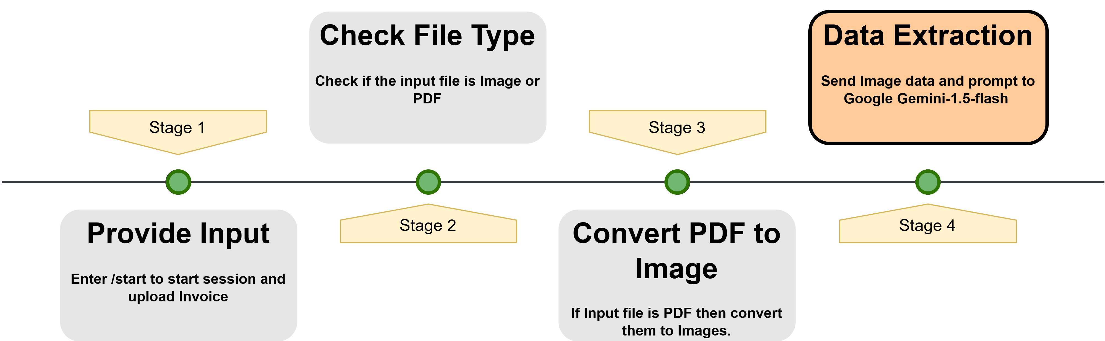
Workflow
For next step now it sends the invoice image to Google Gemini for text extraction and processes the extracted data.

Slide 11
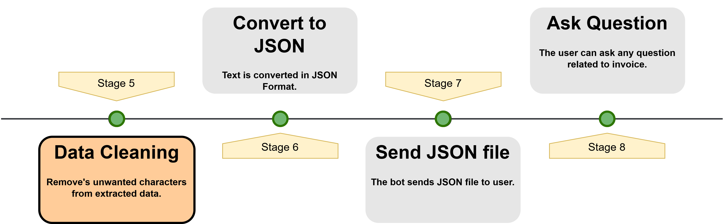
Workflow
The extracted text is cleaned. That is it removes extra characters with might hinder us while converting it to JSON file.

Slide 12
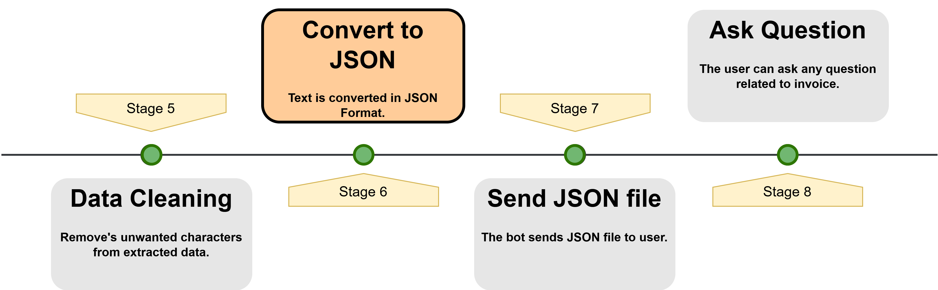
Workflow
The extracted text is cleaned and converted into JSON format. If valid, the data is saved as a JSON file.

Slide 13
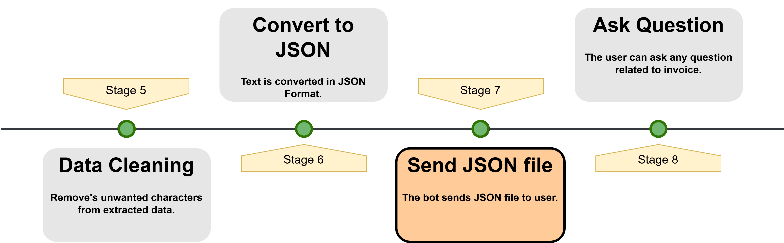
Workflow
The data is saved as a JSON file in the user’s directory and sent to the user. If the response is not valid JSON, the raw text is shared instead.

Slide 14
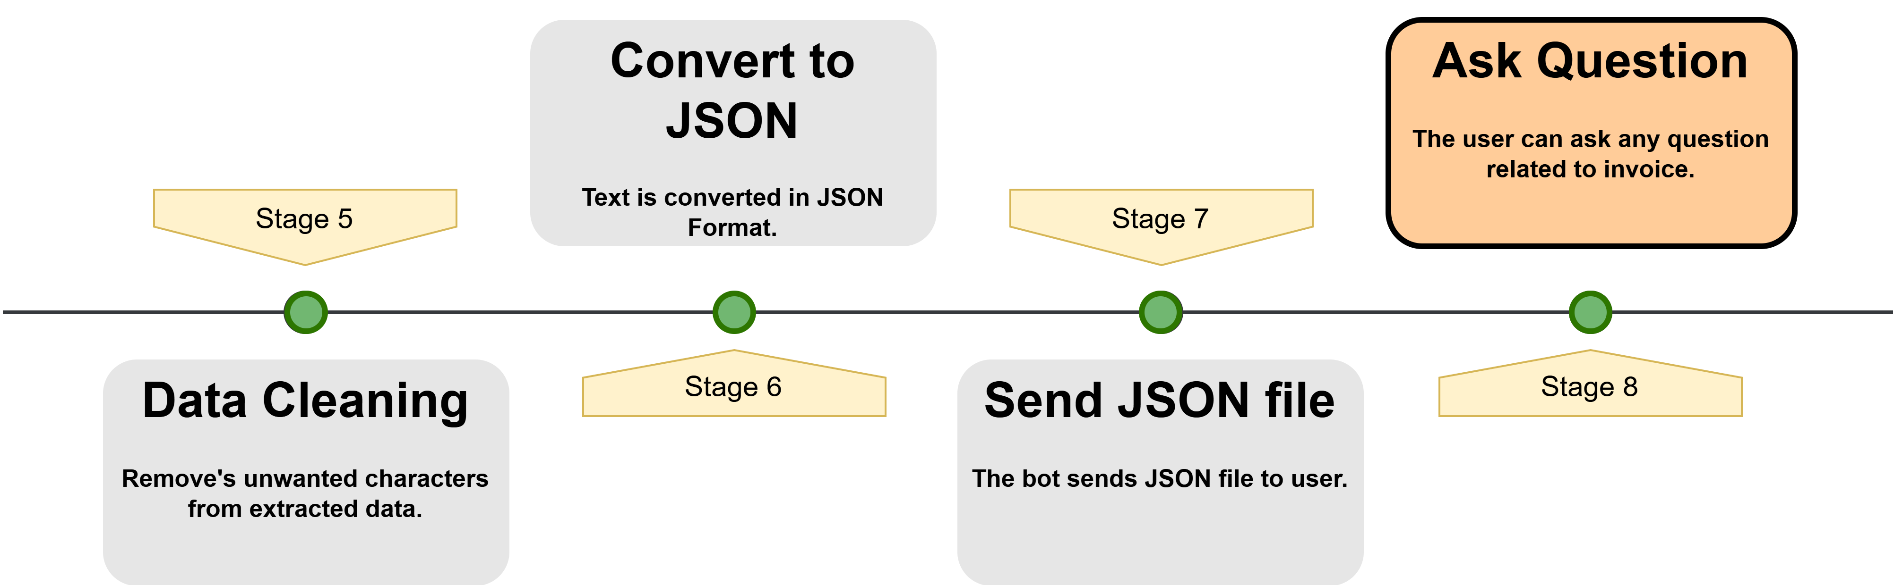
Workflow
Now in next step it allows users to ask questions about their uploaded invoice by using “/ask” command. It first checks if the user has uploaded an invoice; if not, it prompts them to do so.

Slide 15
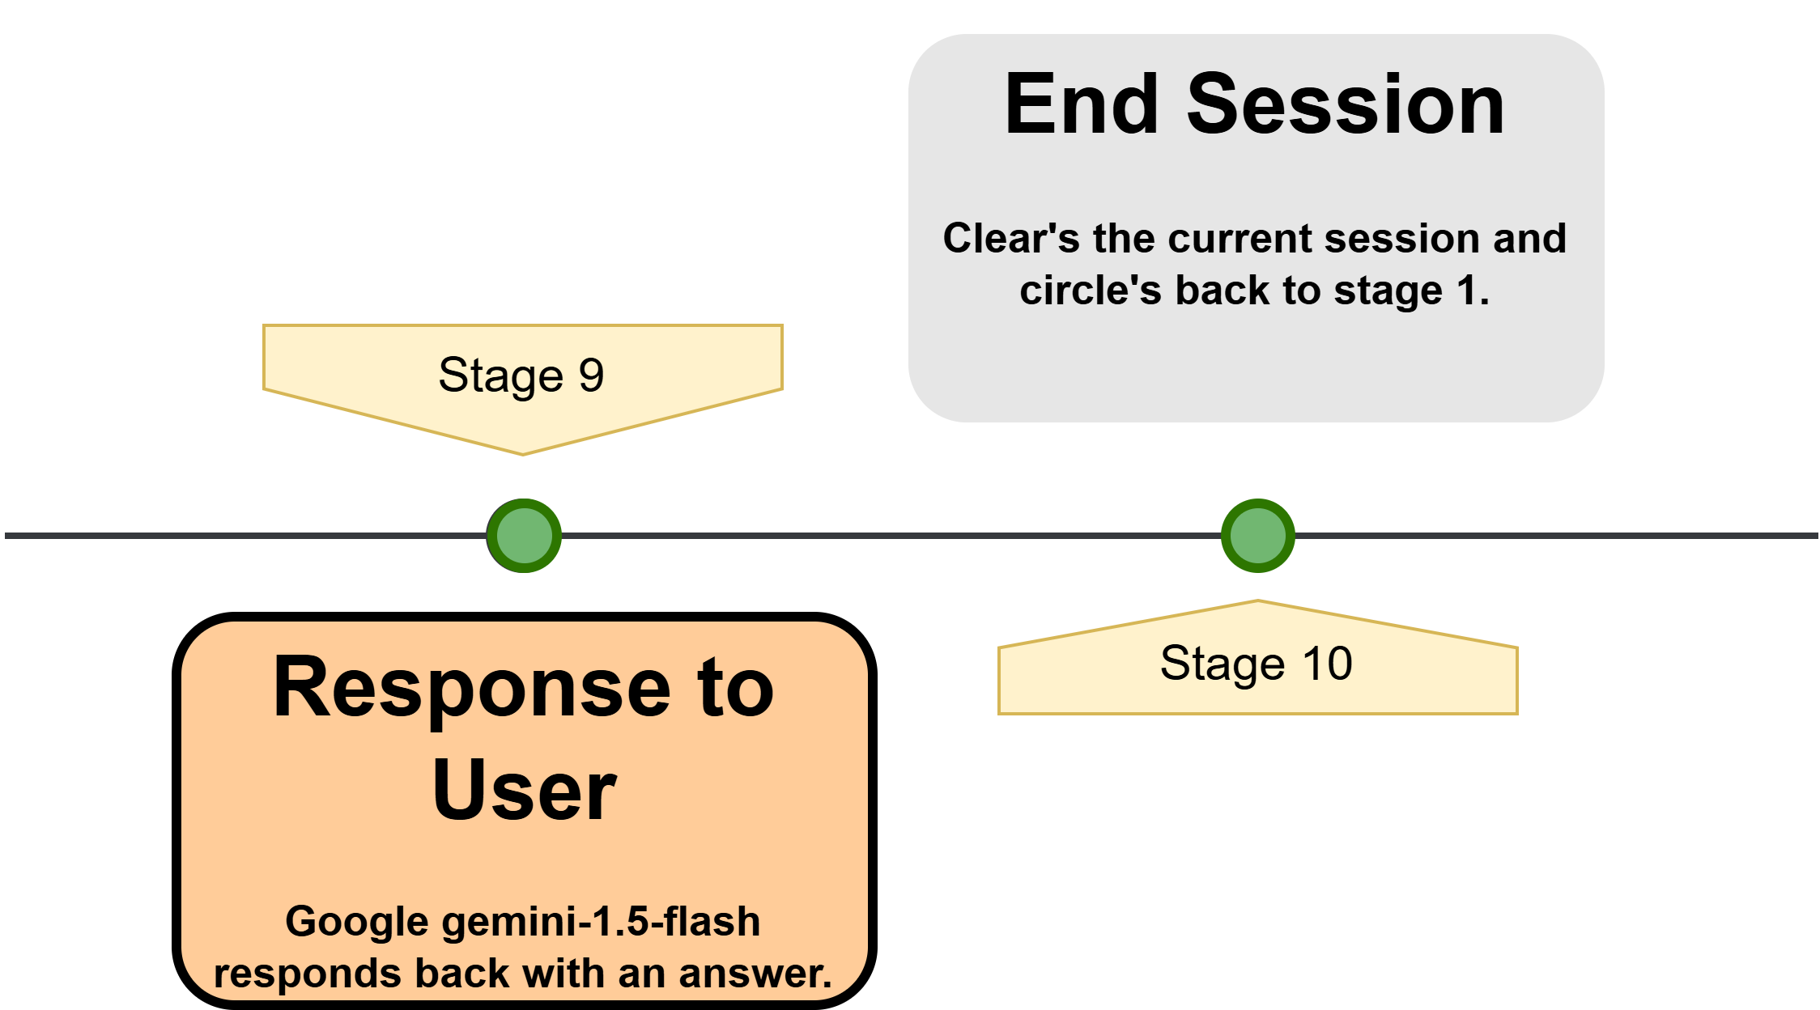
Workflow
The user’s question is formatted into a structured prompt for Google Gemini, which extracts relevant details from the invoice and responds back to user with an answer.

Slide 16
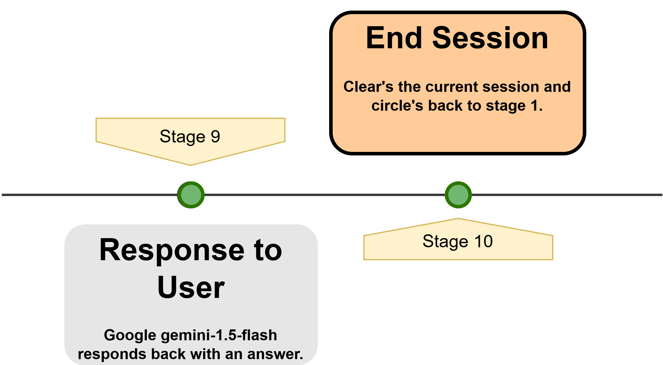
Workflow
Lastly by using “/end” it clears the user’s session by removing their data, ensuring a fresh start for the next interaction. It then sends a message confirming that the session has ended and instructs the user to restart with the “/start” command if they want to process another invoice.

Slide 17
Project Demonstration
How to Use the Invoice Assistant :-
Scan the QR Code to access the Telegram bot.
Start the bot by clicking Start or using the “/start” command.
Upload an invoice in PDF or image format (JPG, PNG, JPEG).
The bot processes the invoice, extracts key details, and organizes them into JSON format.
The extracted details are sent back to the user, and a JSON file is generated.

Slide 18
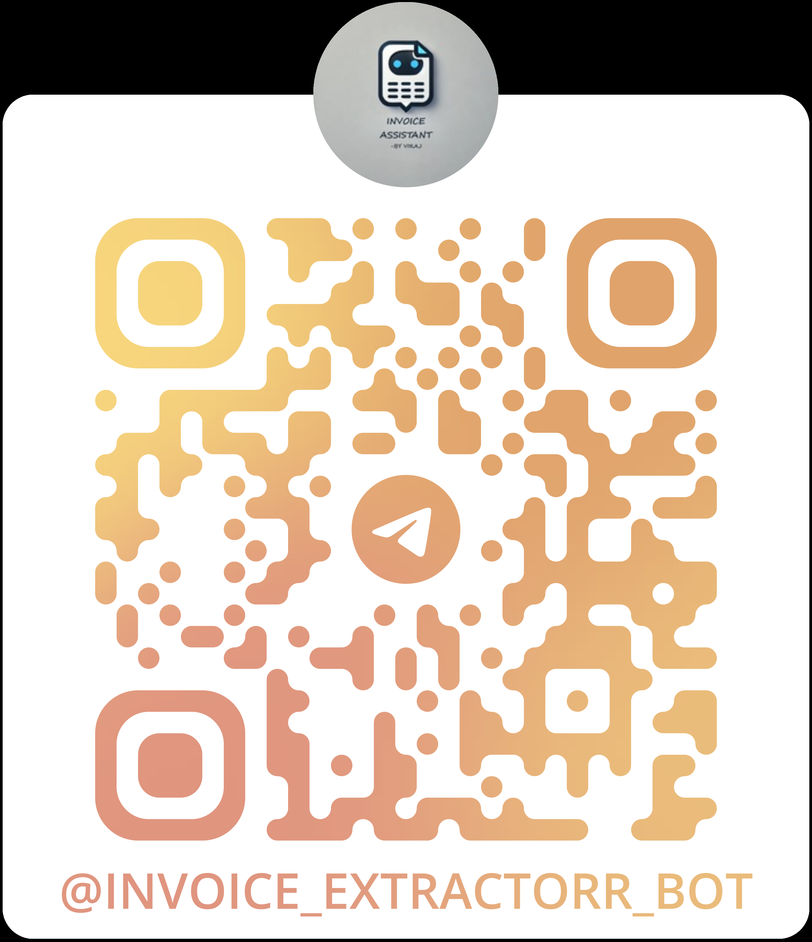
Project Demonstration
The user can ask specific questions about the invoice using “/ask” <question>.
Once done, the user can end the session with “/end”, clearing the current data.

Slide 19
Result & Observation’s
The bot successfully extracts and organizes invoice details into a structured JSON format.
Google Gemini provides accurate results, even for different invoice layouts.
When providing multiple invoices at a time it extracts data from all invoices but answers only to the last invoice uploaded.
Sometimes when there is connection issue we have retry mechanism which ensures smooth operation.

Slide 20
Result & Observation’s
Logging helps in debugging issues and tracking user interactions efficiently.
Some invoices with unclear text or poor image quality may result in incomplete or inaccurate extraction.
In this we can still optimise the input prompts for further accuracy for complex layouts.

Slide 21
Conclusion
The Invoice Assistant automates invoice data extraction from PDFs and images.
Google Gemini processes various invoice formats and provides accurate responses.
Retry mechanisms and logging ensure smooth operation, even during network issues.
The bot runs only while the code is active in VS Code; it stops if the script is terminated.
For continuous deployment, platforms like AWS, Google Cloud, or Microsoft Azure can be used.

Slide 22
Conclusion
Extraction accuracy depends on image quality; blurry or low-resolution invoices may cause errors.
The free tier of Google Gemini has request limits (15 RPM), which may slow down processing for multiple invoices.
Struggles with handwritten invoices or non-standard layouts, requiring better OCR solutions.
Despite limitations, it streamlines invoice management, reduces manual work, and improves efficiency.

Slide 23
Q & A

