Slide 1

Store Finder
Infinity Innovators Interns
Fathima Sahara Ameer
Virajani Dharmathilaka

Slide 2
Content
Problem Statement
Suggested Approach
Aims And Objectives
Methodology And Timeline
Technological Stack

Slide 3
Problem Statement
In an era where everything has been automated, still traditional buyers used to visit onsite on purchasing.
Such a traditional customer does not only waste his time searching from one store to another till he gets what he needs but also creates a risk in today’s pandemic situation.

Slide 4
Suggested Approach
Traditional buyers should be able check the availability of goods before they visit to a store physically, so that they can directly visit to the available store only.

Slide 5
Aim
Creating a web application so that store owners can manage records of stocks and customers can view records of stock availability.

Slide 6
Objectives
Store owners should be able to;
Create a separate account for his store and create records
Edit and delete records accordingly
View user preference suggestions
Customers should be able to;
View stock records by filtering with item name and location
Add user preferences to notify the store owners

Slide 7
Methodology And Timeline

Slide 8
Design database architecture & scope of the project
Learn Python, Flask & PostgreSQL
Complete backend
January 19,20
January 21
(weekend 22,23)
January 24
January 25,26
January 27,28
January 29,30
(weekend)
Learn JavaScript, React & React-Redux
Complete frontend
Bug fixing & Testing

Slide 9






Technological Stack
Front end
Back end
Database
Testing

Slide 10
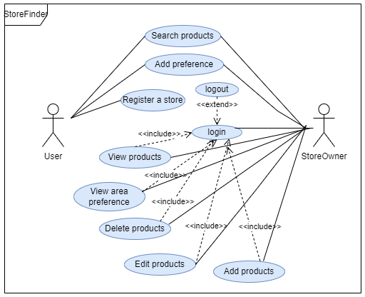
Use Case
Diagram

Slide 11
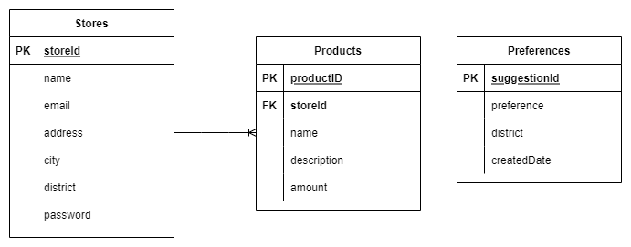
ER Diagram of the database

Slide 12
System Architecture
REST API
Front End
Backend
request
GET/POST/PUT/DELETE
response(JSON)
response
request

Slide 13


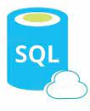






Azure Database for PostgreSQL server
Azure App Services
Single Server
Backend web app
Database
Azure CDN
Storage Blob
Azure Active Directory
Client

Slide 14
Module tests
Modules | Test cases | Expected outcome | Actual Outcome | Status
Store sign up module | Sign up into the system by entering requested fields in the sign up form and validating the each input field to prevent invalid entries by users. | Should not be able to sign up without filling all the fields. | Same as the expected outcome | Pass
 |  | Validating the input fields and give warning at each input fields | Same as the expected outcome | Pass
 |  | Checking whether the email is already registered | Same as the expected outcome | Pass
 |  | Strong password acceptance | Same as the expected outcome | Pass
 |  | Visit the home page after successful registration | Same as the expected outcome | Pass

Slide 15
Store sign up module | Storing the validated inputs provided by the user | Assigning a unique primary key (id) for the each tuple | Same as the expected outcome | Pass
 |  | Storing an encrypted password in the database | Same as the expected outcome | Pass
Store log in module | Login into the system by providing required credentials | Accepting user inputs | Same as the expected outcome | Pass
 |  | Verifying the user credentials with the database | Same as the expected outcome | Pass
 |  | Issuing warning if credentials do not match | Same as the expected outcome | Pass
 |  | Visit the home page after successful login | Same as the expected outcome | Pass

Slide 16
Store product management module | Add products | Should not be able to submit till all the required fields are submitted | Same as the expected outcome | Pass
 |  | Validating all the required fields and give warning | Same as the expected outcome | Pass
 |  | Storing the validated inputs with a reference to the owner store | Same as the expected outcome | Pass
 | Edit product details | Displaying already existing values for each field in the editing form | Same as the expected outcome | Pass

Slide 17
Store product management module | Edit product details | Allow to edit only the allowable values | Same as the expected outcome | Pass
 |  | Give warning for invalid fields | Same as the expected outcome | Pass
 |  | Submitting the edited validated values to the database | Same as the expected outcome | Pass
 |  | After submitting the updates to the database products page should display updated values | Same as the expected outcome | Pass
 | Delete products | Deleting the tuple | Same as the expected outcome | Pass
 |  | Returning the updated products list to the interface | Same as the expected outcome | Pass

Slide 18
 | Check user preferences of the area which the store is located | Displaying the user preferences where the store is located with the date | Same as the expected outcome | Pass
Store account management module | Store account log out | Logout of the account and return to main home page | Same as the expected outcome | Pass
 |  | Should not be able to revisit the pages without logged in status | Same as the expected outcome | Pass
 | Store account delete | Deleting the account details from the database | Same as the expected outcome | Pass
 |  | Deleting all the products that belong to the store | Same as the expected outcome | Pass

Slide 19
User module | Filter and Search | Filter stores with districts and product name | Same as the expected outcome | Pass
 |  | If the exact name is not entered then showing the most likely products | Same as the expected outcome | Pass
 | Add user preferences | Users should be able to enter the preference and select an area | Same as the expected outcome | Pass
 |  | Storing the user preferences to be filtered by area and displayed to the stores of the area | Same as the expected outcome | Pass

Slide 20
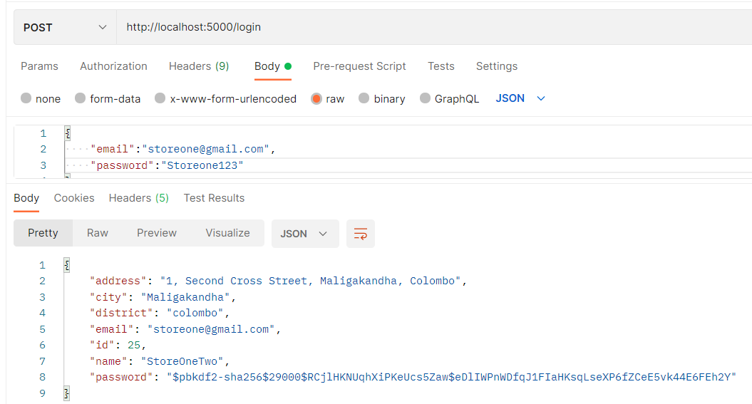
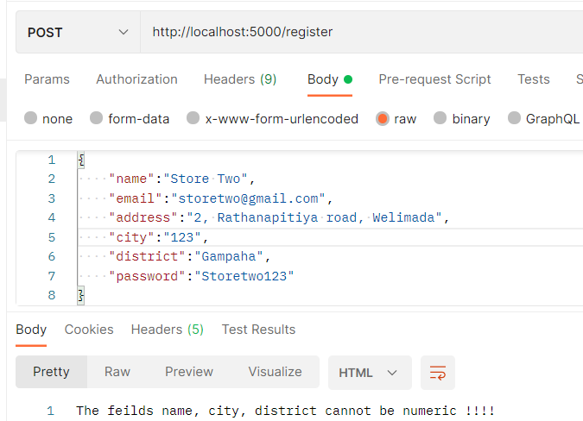
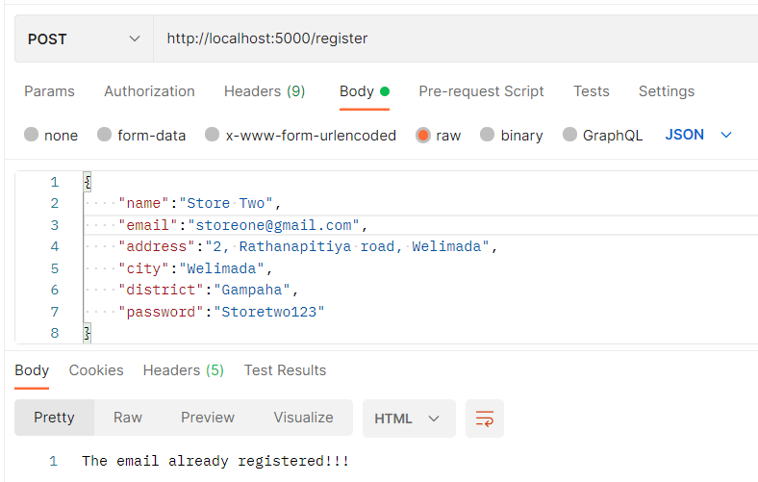
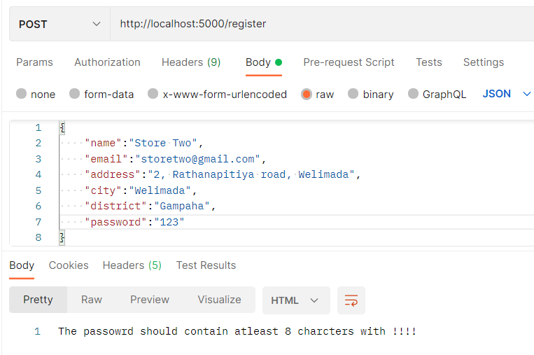
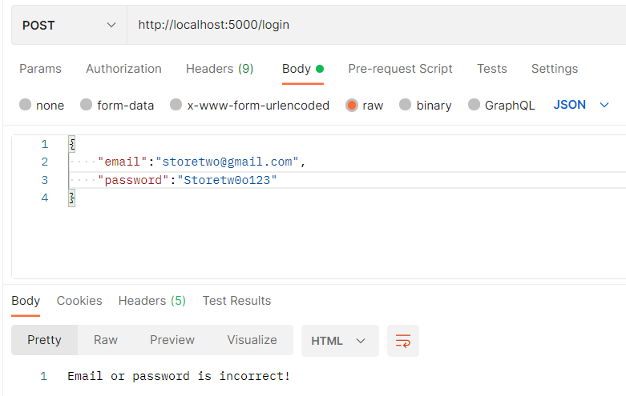
Snap shots of Test Case Testing

Slide 21
Store Finder Demonstration

Slide 22
Thank You!!!

