Slide 1
PRESENTATION TOPICS
INTRODUCTION
POWERSHELL
SALTSTACK

Slide 2

Who am I?
Virajdatt.V.Kohir CSE student at Gogte Institute of Technology
Avid learner
Passionate about cricket

Slide 3

POWERSHELL
Command lets
Allows easier access to otherwise difficult to get information
Autocompletion of commands
Accomplishes mundane task quickly
SCRIPTING in POWERSHELL:-
Get_uptime,Diskusage,Filesize,Dns_check,MySql_Query

Slide 4
Getting started with SaltStack
Installed Ubuntu on Virtualbox
Installed Salt-Master and Salt-Minion on this OS
Install Salt-Minions on all the interested remote m/c
Installed MobaXterm and got connected to Ubuntu through ssh session

Slide 5

SALTSTACK
SaltStack platform or Salt is a Python-based open-source configuration management software and remote execution engine.

Slide 6
SALT is:-
• a configuration management system
• a distributed remote execution system
The core function of Salt:
• enable commands to remote systems to be called in parallel rather than serially

Slide 7
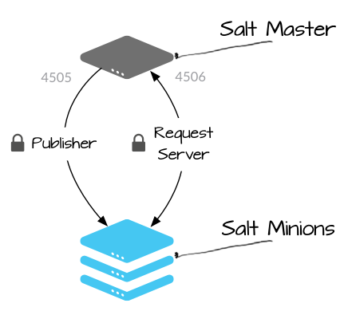
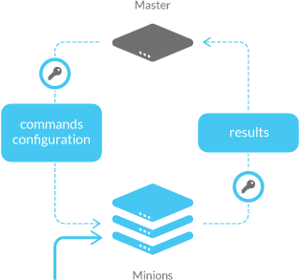
Authentication between salt master & minion

Slide 8
SALTSTACK interfaces : -
GRAINS
PILLARS
SALTSTACK Files : -
init.sls
top.sls

Slide 9

MY FIRST SALTSTACK MODULE

Slide 10
#/etc/salt/disk1/init.sls
disk1:
{ %if grains[‘os’]==’Ubuntu’ % }
cmd.run
- name : df
{ %if grains[‘os’]==’Windows’ % }
cmd.run
name: powershell.exe -Execution Policy Bypass “pthnam to powershell script”
{ % endif % }

Slide 11
#/etc/salt/top.sls
base:
‘*’:
disk1

Slide 12
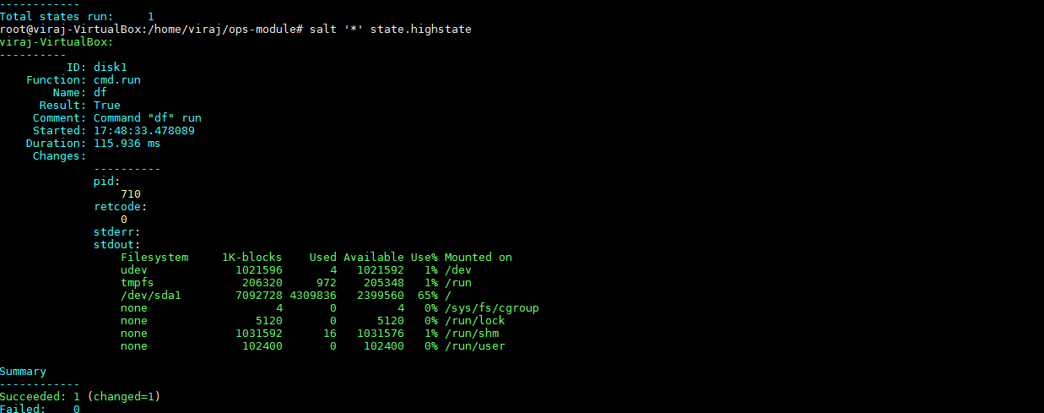
root@viraj-VirtualBox/etc/salt# salt '*' state.highstate

Slide 13
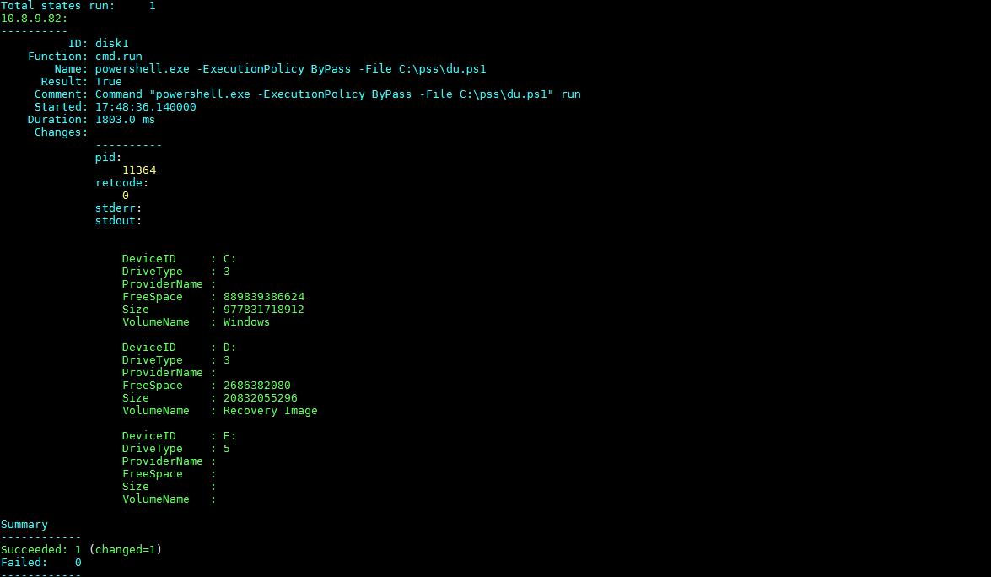

Slide 14
References
https://saltstack.com/
www.powershell.com/Mastering-PowerShell.pdf
www. download.microsoft.com/download/2/1/2/...0ee6.../powershell_langref_v3.pdf
https://www.mysql.com/downloads/
http://downloads.mysql.com/docs/mysql-installation-excerpt-5.1-en.pdf
https://www.youtube.com/watch?v=f5qQDm3ciDg
www.github.com
http://bencane.com/2013/09/03/getting-started-with-saltstack-by-example-automatically-installing-nginx/
http://bencane.com/2013/09/23/remote-command-execution-with-saltstack/

Slide 15


My Time at

Slide 16


