Slide 1
Data Warehouse Architecture and Analytics for Stocks Trader Dataset
Overview of ETL Process, Data Cleaning, and Analytical Insights
M V Virajit

Slide 2
Data Warehouse Architecture - Source Data
Overview of Source Data
CM_MKT_TRAD_GD_ZS.csv: Stocks traded, total value (% of GDP)
CM_MKT_TRNR.csv: Stocks traded, turnover ratio of domestic shares (%)
Other CSV files: Country and indicator data
Data Flow:
CSVs from various sources (Trade, Country, Indicator) are ingested into staging tables.

Slide 3
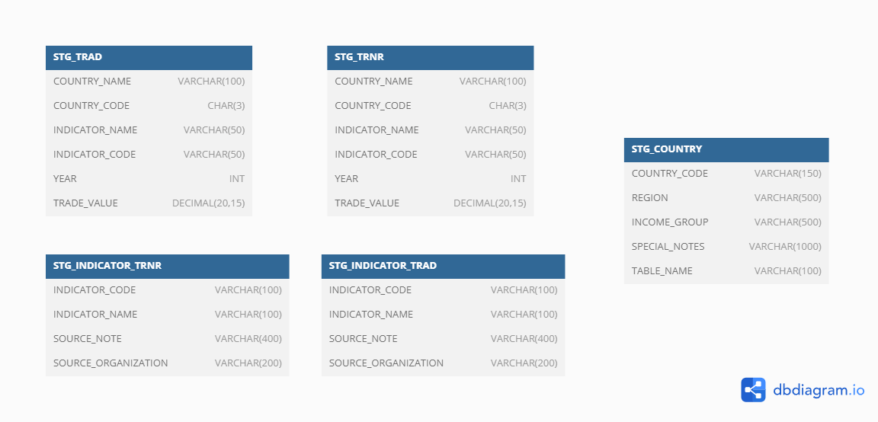

Slide 4
Data Warehouse Architecture - Dimensional & Fact Tables
Dimensional Tables:
DIM_COUNTRY: Contains details about countries like COUNTRY_CODE, COUNTRY_NAME, REGION, INCOME_GROUP.
DIM_INDICATOR: Contains details about the indicator codes and names (INDICATOR_CODE, INDICATOR_NAME).
DIM_YEAR: Contains year and decade information (YEAR, DECADE).
Fact Table:
FACT_TRADE: Contains trade values linked to country, indicator, and year (TRADE_ID, COUNTRY_ID, INDICATOR_ID, YEAR_ID, TRADE_VALUE).

Slide 5
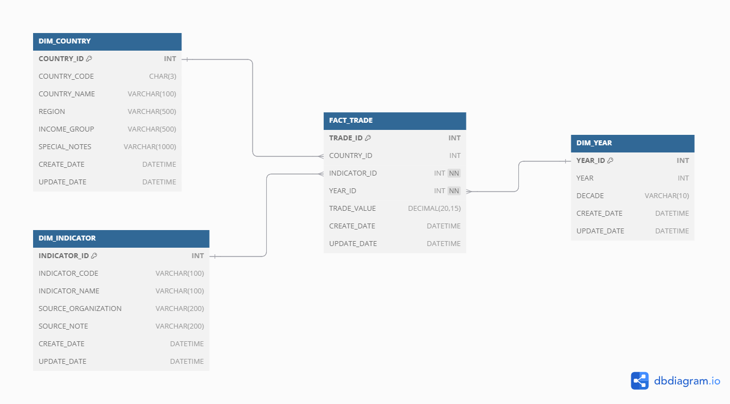

Slide 6
Data Cleaning and Transformation - Data Quality Issues
Missing or Null Values:
Missing TRADE_VALUE, are retained as it is.
The source dataset is retained as it is because no approval was provided to change it.
Formatting Issues:
Ensuring consistent COUNTRY_CODE and YEAR formats.
Removing extra spaces and handling special characters.

Slide 7
Data Transformation - ETL Process in Detail
Source to Staging:
Normalizer Transform: Used to unpivot year columns for both CM_MKT_TRAD_GD_ZS.csv and CM_MKT_TRNR.csv files.
Expression Transformation: Used for conversions (e.g., GCID to YEAR column).
Staging to Dimensional Tables:
Lookup Transformation: To ensure only unique values are added to dimension tables like DIM_COUNTRY, DIM_YEAR, and DIM_INDICATOR.
Update Strategy: Handles insertions, updates, and deletions in the dimension tables based on existing data.

Slide 8
Data Transformation - Aggregation and Lookup
Handling Duplicate Data:
Using Aggregator Transformation to ensure that only unique years and indicators are inserted into DIM_YEAR.
Lookups:
Static Lookup: For DIM_YEAR, DIM_COUNTRY and DIM_INDICATOR to check the existence of country and indicator IDs before processing the fact table.

Slide 9
Data Transformation - Fact Table Processing
Lookup on Dim Tables:
FACT_TRADE links to DIM_COUNTRY, DIM_YEAR, and DIM_INDICATOR through foreign keys to ensure accurate trade data is inserted.
Final Data Processing:
Insertions, updates, and deletions are handled via Update Strategy Transformation.
The final TRADE_VALUE is captured for each country, year, and indicator combination.

Slide 10
Analytics - Trade Value Analysis by Country
Overview:
Visualizing trade values by country using bar graphs.
Graph Description:
Line Chart: Displays total TRADE_VALUE by YEAR for a specific indicator and a specific country.
Insights: Countries with the highest or lowest trade value as a percentage of GDP.

Slide 11
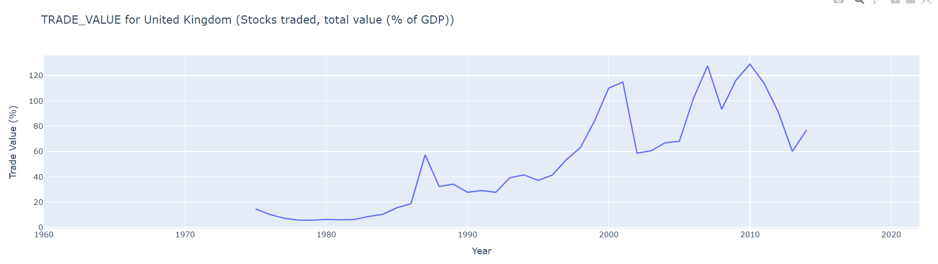
Example – Country: United Kingdom Indicator: CM_MKT_TRAD_GD_ZS

Slide 12
Analytics - Comparison of Trade Value Over Decades
Overview:
Analyzing trade value trends over decades for specific countries.
Graph Description:
Bar Chart: Displays trade value aggregated by decade (e.g., 1970s, 1980s) for the selected country.
Insights: Trade value trends and historical changes in economic indicators.

Slide 13
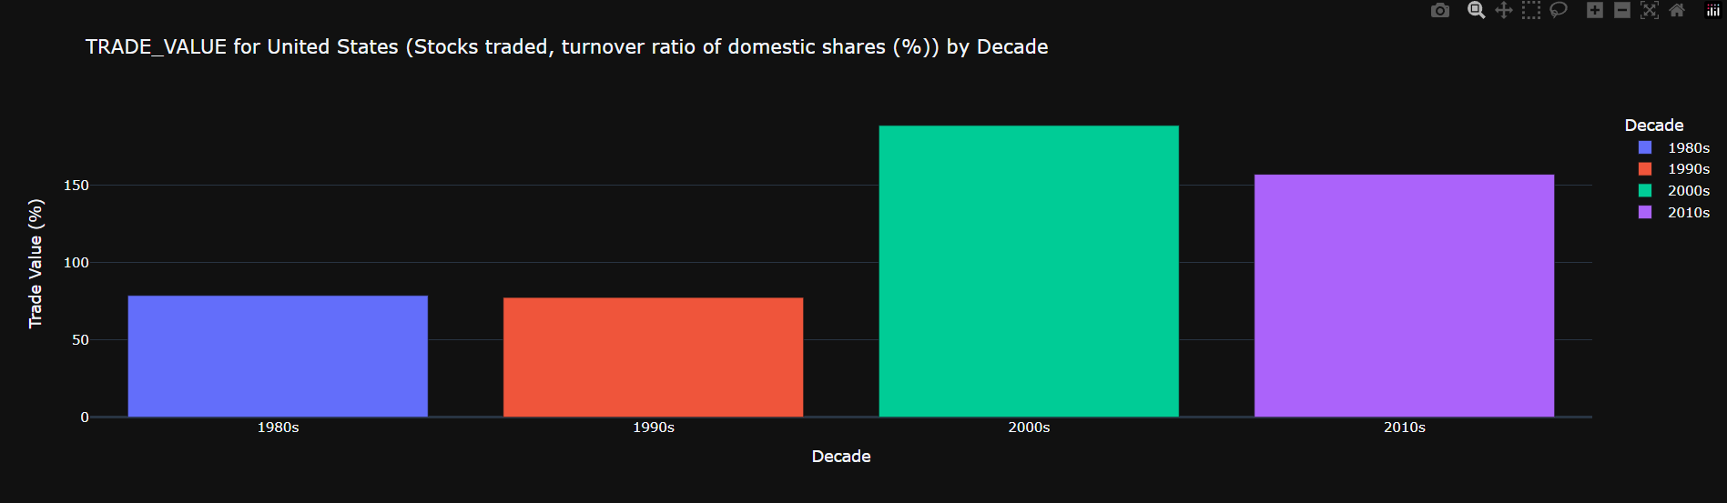
Example – Country: United States Indicator: CM_MKT_TRNR

Slide 14
Analytics - Income Group Analysis for Trade Value
Overview:
Analyzing how trade value varies by INCOME_GROUP over different years.
Graph Description:
Line Chart: Shows the trade value over time for each income group.
Insights: Identifying trends in trade value growth or decline across different income groups.

Slide 15
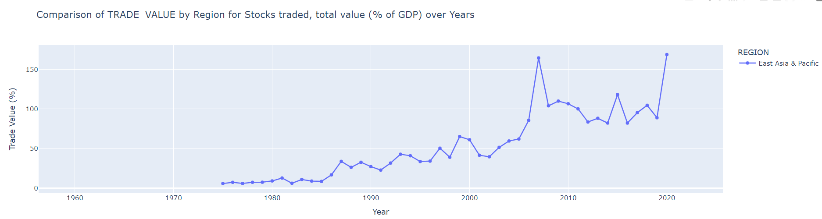
Example – Region: East Asia & Pacific Indicator: CM_MKT_TRAD_GD_ZS

Slide 16
Analytics – Region Analysis for Trade Value
Overview:
Analyzing how trade value varies across Region over different years.
Graph Description:
Line Chart: Shows the trade value over time for each region.
Insights: Identifying trends in trade value growth or decline across different regions.

Slide 17
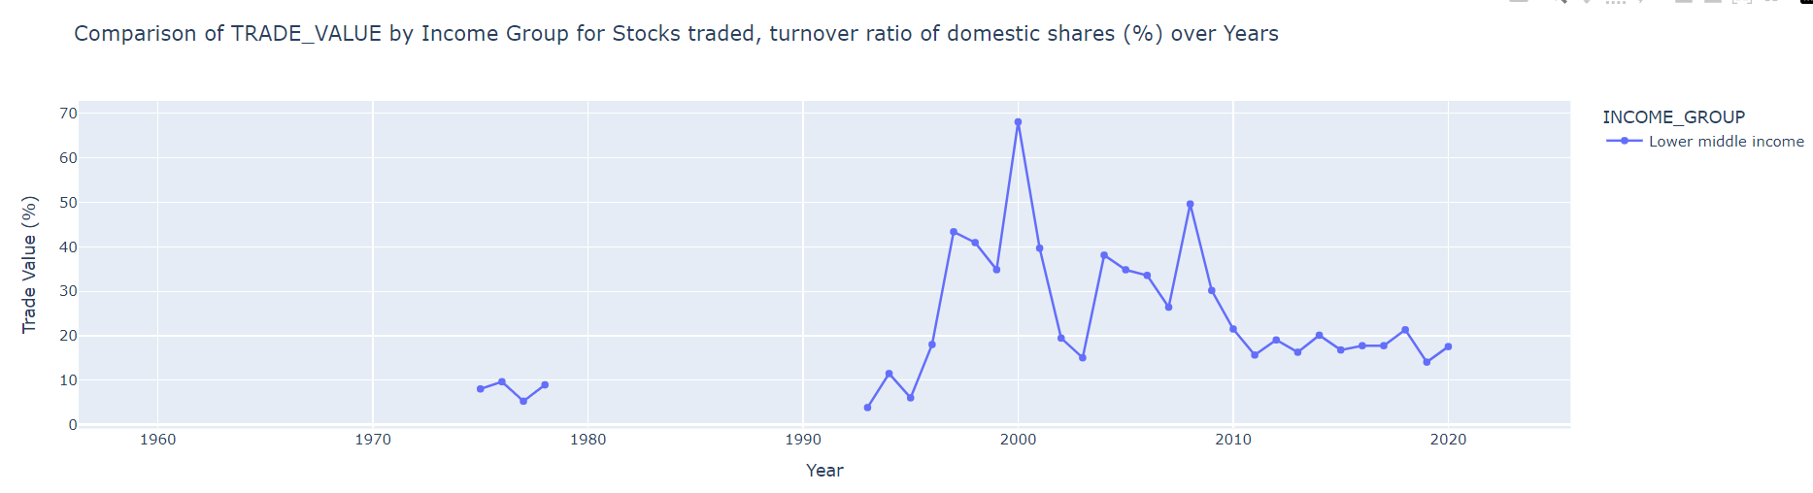
Example – Income Group: Lower middle income Indicator: CM_MKT_TRNR

Slide 18
Key Insights and Conclusions
Countries with the highest trade values show economic growth trends, while those with lower trade values may indicate underdeveloped or stagnated markets.
Over the decades, some countries' trade values as a percentage of GDP have remained stable, while others have fluctuated greatly.
Income groups influence trade value trends, and the analysis reveals potential areas for economic policy intervention.

Slide 19
Future Work & Improvements
Introduce more granular analysis using sub-national data for more detailed insights.
Expand the dataset to include other trade indicators for a comprehensive analysis.
Use machine learning models to predict trade value trends based on historical data.

Slide 20
Thank You!

