Slide 1
Deepfake Detector
THE PROJECT AIMS TO DETECT WHETHER MEDIA IS REAL OR FAKE USING DEEP LEARNING
VIRAJ SAWANT

Slide 2
Deepfakes are synthetic videos or images generated using AI, where a person’s face or voice is swapped or altered. These are often indistinguishable from real media and can be misused for spreading fake news, political manipulation, or cyber fraud. Our project focuses on building a system to automatically detect such manipulated content using deep learning techniques.

Slide 3

METHODOLOGY
Collected dataset containing real and fake samples.
Preprocessed frames: resized, normalized, and converted to grayscale.
Built a CNN model for binary classification.
Split dataset into training and testing sets.
Evaluated using metrics like accuracy and precision.
Ingoude Company

Slide 4
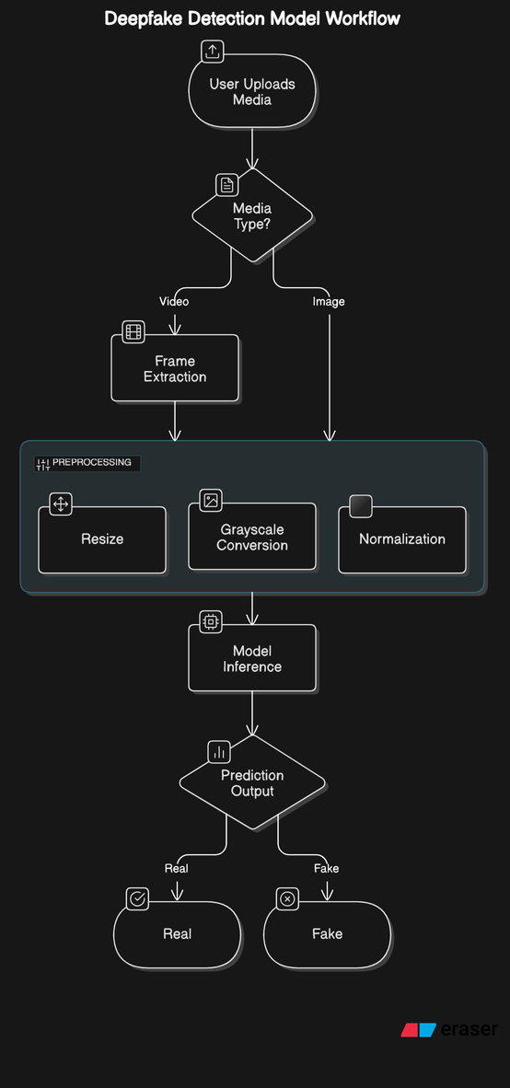
HOW IT WORKS
User uploads a video or image.
Frames are extracted from video (if applicable).
Images are preprocessed before analysis.
CNN model predicts whether the media is real or fake.
Final result is displayed to the user.

Slide 5
TECHNOLOGIES USED
Python for scripting and model development.
OpenCV for image/video processing.
NumPy & Pandas for data handling.
TensorFlow/Keras for building the CNN model.
(Optional) Flask for web interface.
Ingoude Company

Slide 6
CHALLENGES AND DRAWBACKS
Dataset availability and imbalance.
Detecting subtle, high-quality deepfakes.
Processing power limitations for training.
Overfitting due to small dataset size.
Ingoude Company

Slide 7
Thank you!

