Slide 1
Database Management System
A Presentation on
DineEasy – A Restaurant Management System

Slide 2
Overview of the system
DineEasy is a Restaurant Database Management System (RDMS) designed to manage and streamline the day-to-day operations of a restaurant efficiently.
Our System provides functionalities of 3 USER ROLES :
Customer
Staff
MANAGER

Slide 3
Functionalities offered:
Role :
Customer
1. Update user password – to update the login password for the current user.
2. Delete the Account – to delete their account.
3. Place Order and Pay – Choose the restaurant, look into its menu, decide the food item to order, place order and make the payment by entering the card details.
4. View Previous Orders – after logging in, the current user can see his/her previous orders placed
5. View Reservations – view the current reservations for the current user.
6. Make a reservation – make a reservation in the available restaurants for a selected date by choosing the time slot and table number.

Slide 4
Functionalities offered:
Role :
Staff Member
1. Update Staff Account Password – Update the Password for the Staff
2. Delete Staff Account – Delete the Staff account
3. Check Food Items Quantity – check the quantity of food available to serve the customers.
4. Get Restaurant and Manager Information – This will give the information of the restaurant where the staff is working, along with the Manager of the restaurant.

Slide 5
Functionalities offered:
Role :
Manager
1. Update Manager Account Password – Update the Password for the Manager
2. Delete Account – Delete their account
3. Check Food Items Quantity – check the quantity of food available to serve the customers.
4. Update Available Food item quantity – Update the available food quantity according to the restaurant’s requirements.
5. Add a New Food Item to the Menu – Can add a new food item to the Restaurant Menu.
6. Delete a Food Item – Can delete the food item from the restaurant.
7. Get Restaurant and Manager Information – This will give the information of the restaurant where the staff is working, along with the Manager of the restaurant.

Slide 6
Review of Database Design
Our database has the following entities -
Restaurant
Customer
Reservation
Staff Member
Manager
Order
Payment Card
Food Item
Dining Area
User Login
The relationship between them is described in the next slides, in the conceptual and logical design.

Slide 7
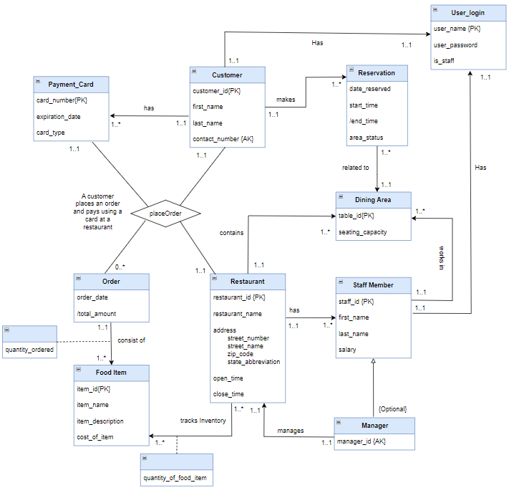
Conceptual Design

Slide 8
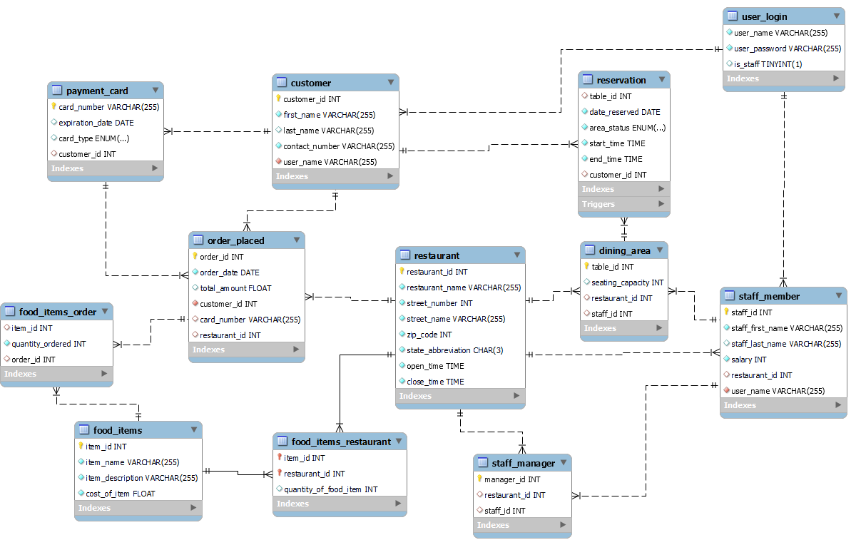
Logical Design

Slide 9
The README.md file has a description of how to use it. Now let us switch to the actual demonstration of our system …

